Slide 1
Project: IEEE P802.15 Working Group for Wireless Personal Area Networks (WPANs)
Submission Title: THz Bridge for Data Center
Date Submitted:
Source: Cai Yunlong, Huawei
Address: Huawei Building, No.3 Xinxi Road, Shangdi, District Haidian, Beijing, 100085, China
E-Mail: <caiyunlong@huawei.com>
Abstract: THz has tens GHz bandwidth, which means big data-rate. The data center is hungry for data-rate. This proposal gives a investigation of data center architecture and its data-exchanging demand. With comparison, THz shows some features than fiber, electrical lines, SiPH and so on. THz will be a good candidate in ultra-high-speed data exchanging.
Purpose: Input for THz scenarios discussion
Notice: This document has been prepared to assist the IEEE P802.15. It is offered as a basis for discussion and is not binding on the contributing individual(s) or organization(s). The material in this document is subject to change in form and content after further study. The contributor(s) reserve(s) the right to add, amend or withdraw material contained herein.
Release: The contributor acknowledges and accepts that this contribution becomes the property of IEEE and may be made publicly available by P802.15.

Slide 2




What’s flowing in Data Center
Google
  Gmail, Searching, Map, Google Doc and Apps, Google Driver, Blogger, APPs
Facebook
  Messaging, Insight and Metrics System(ODS);
Ebay&Taobao
  Users, Goods, Transactions
Cloud Computing，Virtualization, Internet Education, Online video&broadcast；

Slide 3
Data Center, Need for Speed
76 % of data flows remains within the data center between 2011 to 2016*.
In the next 10 years, 10G/40G /100G interfaces will coexist**.
Server & Switch companies begin to merge.
Interconnection between blades/racks is 40Gb/s, CPUs wait for data about half running time in some mobile case.
* Cisco Global Cloud Index: Forecast and Methodology, 2011–2016
** The Internet Data Center Network: Challenges and Solutions

Slide 4
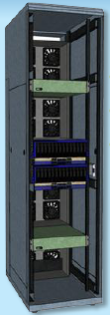
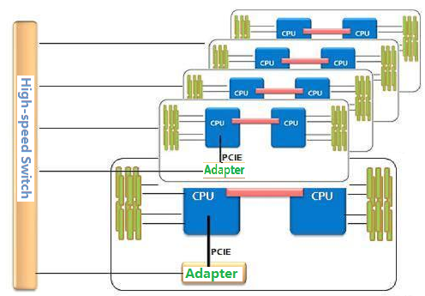
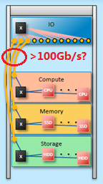
Data center Architecture
THz
Link
?
Pooled computing
Pooled storage
Pooled memory
Data-rate demand
Between CPU&RAM and I/O
Between racks/blades
Between the pooled modules

Slide 5
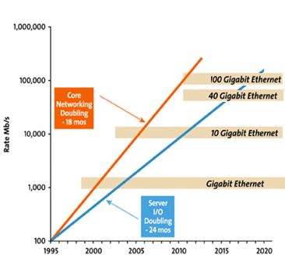
Moore’s Law and Networking
Three Major Problems
  Moore’s Law applies to Transistors, not Speed
  Transistor count is doubling every 2 years
  Transistor speed is only increasing slowly
Number of I/O pins fixed
Only improvement is I/O speed
I/O Speed scales less than Moore
  Larger package sizes offset constraint
  Next step is 25 Gb/s SERDES in 2014
Full-Custom Design Flow Required
  ASIC design flow wastes silicon potential
THz High-speed I/O？
Source: Ethernet Alliance

Slide 6
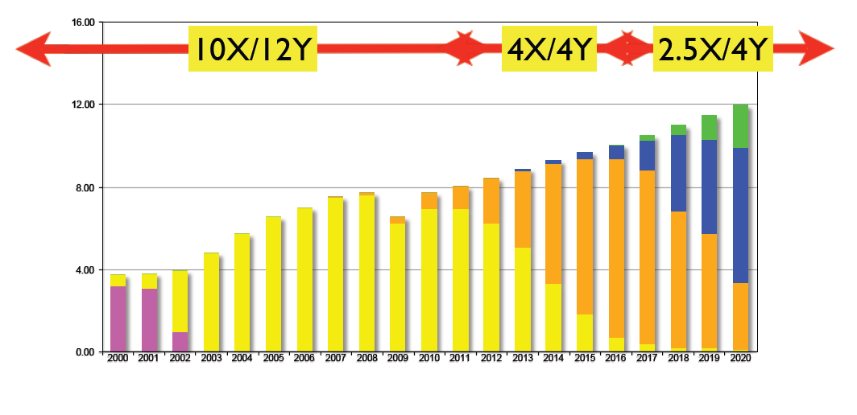
Server 10/40/100Gb/s Adoption Cycle
Best time point
40Gb/s will be the mainstream in the near future,
When the THz solution is ready?
Source: Intel LAN Group

Slide 7
Board2Board Communications
Typical range
  a few cm
    cm range covers chip to chip. DDR4:51.2GB/s, QPI: 96GB/s
  tens of cm better?
Specific propagation conditions
  LOS/NLOS, potentially strong multi paths
Requirements for the antenna alignment
  In the chassis, for redundancy/ disaster recovery, automatically aligning /switched beam is better
BER
  10⁻¹²~10⁻¹⁶
Topology
  Point-to-point

Slide 8
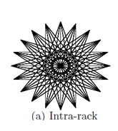
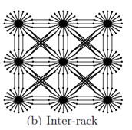
Data Center/Server Farm Wireless Data Distribution
Typical range:
  up to 100 meters
  10m? neighbored blade/rack?
Specific propagation conditions
  LOS, Obstructed-LOS
Requirements for the antenna alignment
  switched beam, spatial separation for frequency reuse
Network is self-organizing, fixed node
BER
  10⁻¹⁵~10⁻¹⁸
Topology
  point to point, star，grid
Courtesy: Ji-Yong Shin and so on

Slide 9
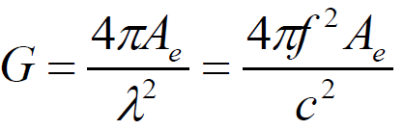
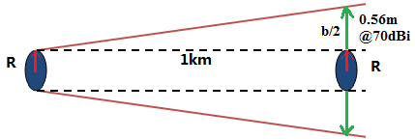
Transmission Range and Antenna
Carrier frequencies: first window, 76GHz,mature?
Antenna gain Vs size:
  R=5mm@300GHz, 30dBi,
  Real horn antenna about 1cm²*4cm, volume?
  How about 50dBi, 70dBi?
  For 70dBi, R=1m, the diameter of
  radiated area, 2(R+b/2)?; b the spreading diameter at 1km
  In “board-to-board” and ”data center” scenarios, the size of port is important
  Antenna type: horn, parabolic, printed?

Slide 10
Size, Weight, Power and Cost
Product of size and capacity
  ant. size-gain-SNR-capacity,
Power <5.5W@100Gb/s
  Finisar optical module, 24W;Cisco CPAK, 5.5W;
  Power dissipation is about1.5 times when data-rate double, i.e., 12.5Gb/s->25Gb/s
Cost is sensitive
  Hardware, cable (THz, no)
  Maintenance, 15% of cost YOY*
  100Gb/s optical module,US$10k
* http://www.siemon.com/us/white_papers/11-02-15-higher-speed-cabling-solutions.asp

Slide 11
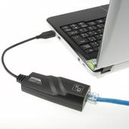
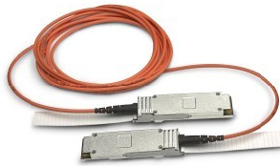
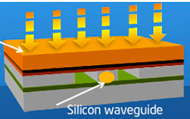
Data Center Communication Protocols
Ethernet
Fibre Channel
InfiniBand
SiPH
THz, new player?

Slide 12
Electrical vs. Optical
Equalization cost vs. conversion cost
  Distance, data-rate, tech. dependent
Heavy Equalization assumed to be expensive
Electrical baseband
  Active (repeated) connector appears to enable 64Gb/s over 1m distance*
    Isolate package/connector reflections / crosstalk from actual long-distance link
  2PAM/4PAM 50Gb/s Backplane Transceiver
Loss_{Optical} ≈ 0.0035dB/m, but PSD@850nm is 18dB higher than electrical channel operating at 290K**.
Electrical has the limit: 25Gb/s,30 inches
** E. Yuceturk, “Comparative study of very short distance electrical and optical interconnects based on channel characteristics” Optics in Computing . Optical Soc. of America. 2003, pp.7-9. Washington, DC, USA Jun. 2003.

Slide 13
High-speed GigE Means High Cost
Issue is cost-performance utility
  40 GigE > 4X Cost of 10 GigE
  100 GigE >>> 10X Cost of 10 GigE
Biggest problem is optics cost
  100 GigE optics are extremely expensive
  Even 40G optics are > 4X 10G Optics
Volume Adoption requires Cheaper Optics/other choice?
  100 GBE is about US$100,000 and there is only several hundred market.
  10 GigE, ~100m; 40 GigE, ~7m

Slide 14
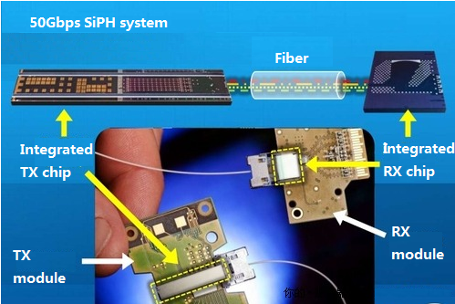
High-speed SiPH System
This Intel SiPH module can support 100Gb/s @100m, which is aimed at data exchanging between RACs。
InP generate the laser, complex and expensive.
Note: SiPH, silicon photonics
The latest speed is 4*25Gb/s

Slide 15
THz and Rivalries comparison
-Based on board2board and data center scenarios
 | Cost | Integration In PCB | Data-rate /Gb/s | Distance
Fiber Channel | High | NO | 10, 14,28,100 | 0.5m~50km, 150m@100G
Electrical | Low | YES | 10,25 | <70cm**(PCB) 100m@10G
Infiniband | High | NO | 40,56 | <15m(copper) 100m(fiber)
SiPH | Middle | YES*** | 100(4×25) | <100m
THz | Low | YES | 40,100,180* | 10m?100m?
* 180Gb/s, BW of THz is 275GHz~320GHz(45GHz), 16 QAM modulation.
** 18inches line + 12inches switch, i.e., 40cm@25Gb/s, IBM backplane solution
*** Integrated Lasers by chip bonding or epi on Si

Slide 16
Conclusion
Data center is hungry for bandwidth, especially between racks/blades.
THz is a good candidate for information exchanging in data center.
  BW, LOS, Size……
  Cost evaluation?
  Power consumption?
  Mature time?

