Slide 1
doc.: IEEE 15-13-0421-00-0led
Project: IEEE P802.15 Working Group for Wireless Personal Area Networks (WPANs)
Submission Title: [Study Issues of Positioning on CamCom Platform]
Date Submitted: [July, 2013]
Source: [Yeong Min Jang, and Ratan Kumar Mondal]
[Kookmin University]
Address [Kookmin University, Seoul, Korea]
Voice:[82-2-910-5068], FAX: [82-2-910-5068], E-Mail:[yjang@kookmin.ac.kr]
Re: []
Abstract: [Study issues of positioning on CamCom platform]
Purpose: [Contribution to IEEE 802.15 IG-LED]
Notice: This document has been prepared to assist the IEEE P802.15. It is offered as a basis for discussion and is not binding on the contributing individual(s) or organization(s). The material in this document is subject to change in form and content after further study. The contributor(s) reserve(s) the right to add, amend or withdraw material contained herein.
Release: The contributor acknowledges and accepts that this contribution becomes the property of IEEE and may be made publicly available by P802.15.
Notes:
doc.: IEEE 802.15-09-0117-00-0007
<month year>

Slide 2
Contents
doc.: IEEE 15-13-0421-00-0led
Goals
Deployment Service Scenario
VLC Positioning Comparison and Opportunities
Development and Challenges
Study Issues
Conclusions

Slide 3
Goals
doc.: IEEE 15-13-0421-00-0led
Need to study easy deployment strategies of VLC system
Need to enhance the VLC based positioning system
Addressing user service oriented developing challenges and study direction
What we need to study for VLC positioning deployment issue

Slide 4
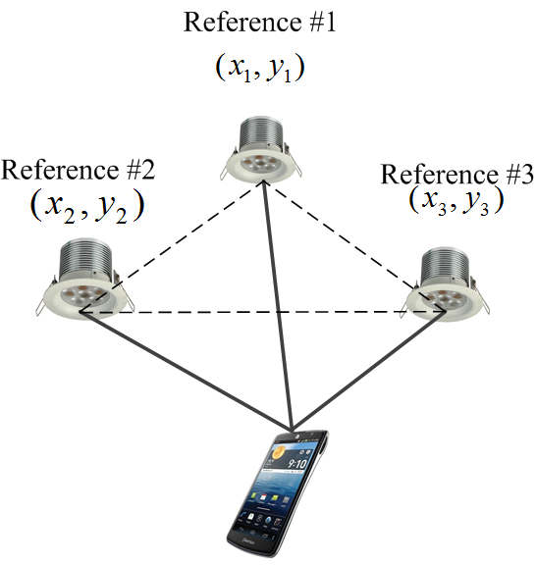
Deployment Service Scenario
doc.: IEEE 15-13-0421-00-0led
Indoor localization- Mobile coordinate estimation by using Smartphone camera in VLC environment
Image sensor (in Smartphone Camera) will be used for receiving LED modulated data
Position estimation techniques-
One-way positioning- suitable scenario for CamCom
Two-way positioning- difficult to deploy in Smartphone platform (have no reliable uplink transmitting option in Smartphone which convenient with the LED based eco-system)
Tentative localization techniques- AOA, TDOA, TOA, RSSI, Cell-ID etc.
Localization by reference lighting system for LBS application

Slide 5
VLC Positioning Comparison and Opportunities
doc.: IEEE 15-13-0421-00-0led
 | TDOA | TOA | RSSI | AOA | Cell-ID
Description | Signal travel time difference between user and LED transmitters | Signal travel time between user and LED transmitters | Estimation of path distance from signal propagation attenuation | Intersection of angular radials from multiple LED transmitters | Networks can identify approximate position of user by knowing the serving cell
Accuracy Potential | High | High | Moderate | High | Low
Synchronization | Yes (Precisely) | Yes(Precisely) | No | No | No
Implementable as one-way positioning | YES | YES | YES | YES | YES
Recommended Optical Implementation | Non-imaging lens with optical concentrator | Non-imaging lens with optical concentrator | Imaging lens with image sensor | Imaging lens with image sensor | Imaging lens with image sensor

Slide 6
Development & Challenges
doc.: IEEE 15-13-0421-00-0led
Handling imaging optics- spatial separation of reference LED light signal
Precise position estimation- Need to use error correction scheme
Line-of-sight interruption problem
Need to provide seamless connectivity by fast link recover
Supporting network and operation:
Cell ID or coordinate system development
Network based localization techniques developing for dynamic estimation
Enhancing cell search procedure in MAC frame operation
Lightwave signal configuration which will be aligned with VLC network operation

Slide 7
Conclusions
doc.: IEEE 15-13-0421-00-0led
Need to standardize VLC positioning in CamCom platform
Need to fixed easy deployment strategies of the current standard of particular application
Need to enhance the position estimation technique based on the Smartphone platform which will pursuit with the LED communication
Study contents should be implementable and Smartphone oriented services

Slide 8
References
doc.: IEEE 15-13-0421-00-0led
“VLC system deployment discussion,” R. Roberts, IEEE P802.15.7 working group for wireless personal area networks, March 2013.
“Technical Issues of Active LED-ID system,” Y. M. Jang, R. K. Mondal, and T. Nguyen, IEEE P802.15.7 working group for wireless personal area networks, November 2012.

