Slide 1
Project: IEEE P802.15 Working Group for Wireless Personal Area Networks (WPANs)
Submission Title: [Establishing a Study Group for a Spectrum Resource Utilization (SRU) through Radio Resource Measurement and Management for WPANs]
Date Submitted: [July 12, 2013]
Source: [Shoichi Kitazawa] Company [ATR]
Address [2-2-2, Hikaridai, Seika, Kyoto, Japan]
Voice:[+81-774-95-1511], FAX: [ ], E-Mail:[kitazawa@atr.jp]
Re: []
Abstract: [This document proposes establishment of the Study group for Spectrum Resource Utilization.]
Purpose: [Information to SC WNG]
Notice: This document has been prepared to assist the IEEE P802.15. It is offered as a basis for discussion and is not binding on the contributing individual(s) or organization(s). The material in this document is subject to change in form and content after further study. The contributor(s) reserve(s) the right to add, amend or withdraw material contained herein.
Release: The contributor acknowledges and accepts that this contribution becomes the property of IEEE and may be made publicly available by P802.15.

Slide 2
Establishing a Study Group for a Spectrum Resource Utilization (SRU) through Radio Resource Measurement and Management for WPANs
Shoichi Kitazawa
ATR
Chair IEEE 802.15 IG SRU

Slide 3
Contributors

Slide 4
Outline
Goal
Background
Review of IG SRU activity
Scope and Objectives
Use case
Timeline

Slide 5
Goal for SG SRU
The focus of the Study Group is to draft a PAR and 5C for achieving more efficient utilization of spectrum resources through mechanisms of Radio Resource Measurement and Management for WPANs, primarily targeting applications using 802.15.4.
Of particular interest are applications typical of those found in Hospital/Medical/Healthcare, Industrial Automation, and Infrastructure Monitoring.

Slide 6
Background
Heavy interference has been occurred due to various wireless systems are operating in the unlicensed band.
In order for these wireless systems to operate in better quality, more efficient Spectrum Resource Utilization needs to be considered.

Slide 7
Overview of IG-SRU
The IG SRU (Spectrum Resources Usage in WPANs) started in November 2010.
  The IG was established based on “A Proposal Toward Better Use of Spectrum Resources in future WPAN (15-10-0739-01)” in September 2010.
Objectives
  To explorer advanced technologies for improving the efficiency of spectrum usage in ISM and unlicensed band
  To summarize informative ideas to judge to establish SG
Discussion topics
  Measurements and simulations of congestion situation in 2.4GHz
  System and mechanism proposals
Achievements (deliverables) of IG SRU so far
  IG SRU Technical Document (15-12-184r1) has been released

Slide 8
Overview of IG-SRU
History
  Ten F2F and three teleconference meetings were held.
  Average number of attendee is 10.
Year | Month | Venue | Agenda | Closing Report | Minutes | Number of participant
2010 | November | Dallas | 15-10-0839-01 | 15-10-0924-01 | 15-10-0934-00 | 10
2011 | March | Singapore | 15-11-0159-01 | 15-11-0298-00 | 15-11-0440-00 | 8
 | July | San Francisco | 15-11-0456-00 | 15-11-0552-00 | 15-11-755-00 | 11
 | November | Atlanta | 15-11-0757-01 | 15-11-0830-00 | 15-12-0106-00 | 13
2012 | March | Waikoloa | 15-12-0107-00 | 15-12-0191-00 | 15-12-0197-00 | 4
 | July | San Diego | 15-12-0326-01 | 15-12-0425-00 | 15-12-0440-00 | 11
 | November | San Antonio | 15-12-0595-01 | 15-12-0628-01 | 15-12-0659-01 | 9
2013 | January | Vancouver | 15-12-0681-02 | 15-13-0078-00 | 15-13-0093-00 | 10
 | March | Orlando | 15-13-105-01 | 15-13-0225-00 | 15-13-0305-00 | 12
 | May | Waikoloa | 15-13-260-01 | 15-13-0318-00 | 15-13-0344-00 | 9

Slide 9
Scope and Objectives
Scope
  SG-SRU focuses on mechanisms of Radio Resource Measurement and Management (RRMM) for WPANs.
    Primary target may be on 802.15.4
Objectives
  A common RRMM mechanisms for WPANs will be established for achieving efficient spectrum resource utilization.

Slide 10
Conceptual Model for RRMM

Slide 11
Use Case Examples
Three major use cases have been in consideration
  Hospital/Medical/Healthcare
  Industrial Automation
  Infrastructure Monitoring

Slide 12
Use case: Hospital
Various wireless systems are deployed in medical environments.
Requirement
  Self-organizing wireless system
  Spectrum sensing of whole band for searching vacant radio resources
  Radio resource assignment and network topology management
A Use Case of Self-Organizing Wireless Network for Medical System(15-13-0306r0)

Slide 13
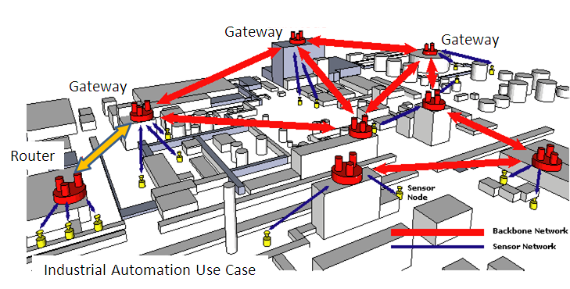
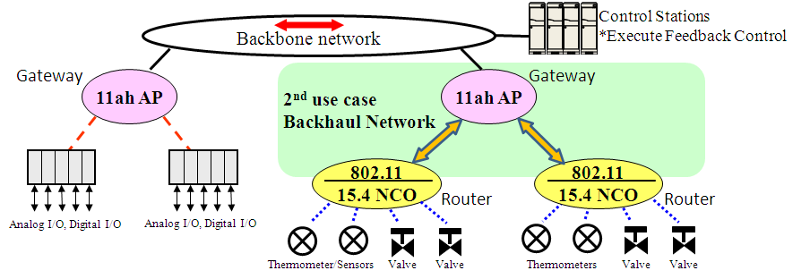
Use case: Industrial Automation

Slide 14
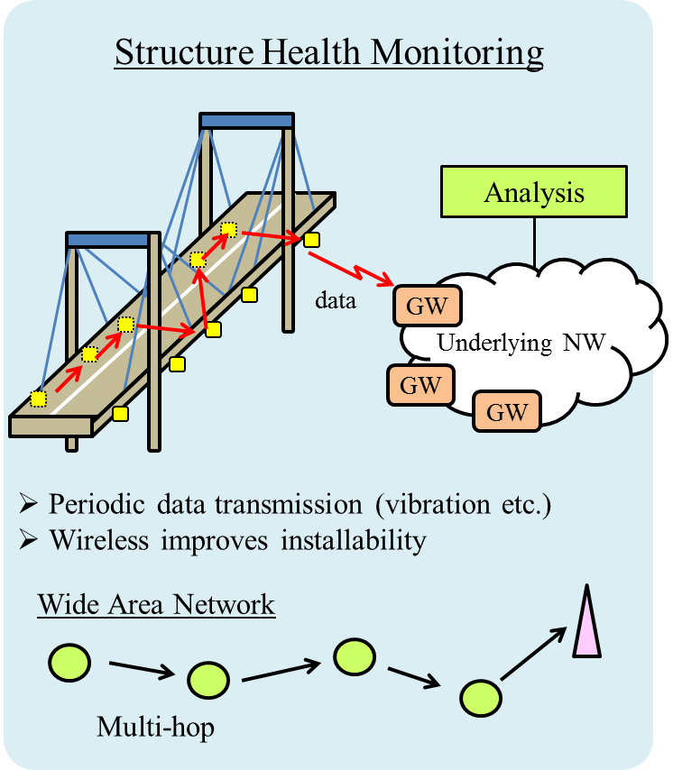
Use case: Infrastructure monitoring
Application Server
Status Management
network condition
(maximum data rate, …)
desired QoS
(data rate, delay, ...)
Radio Resource
Management Entity
Optimization Function
measurement result
(interference, battery, …)
communication parameters
(interval, topology, ...)
Wireless Node
Radio Resource
Measurement
Configuration
Modification
Proposal of radio resource management architecture(15-13-0285r1)

Slide 15
Related Issues on 802.11 Standards
802.11k Radio Resource Management
802.11v Wireless Network Management
(Bold items may be important for RRMM)
Channel load
Noise histogram
Beacon
Frame
STA statics
LCI(Location Configuration Information)
Transmit stream/category measurement
BSS Max idle period management
BSS transition management
Channel usage
Collocated interference reporting
Diagnostic reporting
Directed multicast service (DMS)
Event reporting
Flexible multicast service (FMS)
Location services
Multicast diagnostic reporting
Multiple BSSID capability
Proxy ARP
QoS traffic capability
SSID list
Triggered STA statistics
TIM broadcast
Timing measurement
Traffic filtering service
U-APSD Coexistence
WNM-Notification
WNM-Sleep mode

Slide 16
Proposed Timeline
Year |  | 2013 |  |  |  |  |  | 2014
Month |  | 1 | 3 | 5 | 7 | 9 | 11 | 1 | 3 | 5 | 7 | 9 | 11
Preparatory phase (IG)
Technical presentation & Use cases
SG Work Items | PAR development
 | Use Cases
 | Title
 | Scope & Purpose
 | 5C analyses
 | Interaction with other TG/WG (to identify relationship )
 | Submission to WG
Standard development phase (TG) |  |  |  |  |  |  |  |  |  | Ad Hoc
Target dates:
  PAR submission to NesCom in March 2014
  SASB approval in June 2014

Slide 17
References
Proposal of radio resource management architecture(15-13-0285r1)
A Use Case of Self-Organizing Wireless Network for Medical System(15-13-306-0)
IG SRU Working Draft RRMM-usecases and 5C(15-13-0294r1)
IG SRU Usecase requirements table(15-13-0293r1)

