Slide 1
Project: IEEE P802.15 Working Group for Wireless Personal Area Networks (WPANs)
Submission Title: [Medical Body Area Network Systems European Update]
Date Submitted: [11 July 2013]
Source: [Dave Evans] Company [Philips]
Address [101 Cambridge Science Park, Milton Road, Cambridge, CB4 0FY, UK]
Voice:[+44 1293 886490], FAX: [Add FAX number], E-Mail:[david.evans@philips.com]
Re: [If this is a proposed revision, cite the original document.]
[If this is a response to a Call for Contributions, cite the name and date of the Call for Contributions to which this document responds, as well as the relevant item number in the Call for Contributions.]
[Note: Contributions that are not responsive to this section of the template, and contributions which do
not address the topic under which they are submitted, may be refused or consigned to the “General Contributions” area.]
Abstract: [Reviews MBANS, MBANS in USA and summarises the MBANS situation in Europe]
Purpose: [To inform WG 802.15 on the MBANS regulatory and standards status in Europe.]
Notice: This document has been prepared to assist the IEEE P802.15. It is offered as a basis for discussion and is not binding on the contributing individual(s) or organization(s). The material in this document is subject to change in form and content after further study. The contributor(s) reserve(s) the right to add, amend or withdraw material contained herein.
Release: The contributor acknowledges and accepts that this contribution becomes the property of IEEE and may be made publicly available by P802.15.

Slide 2
Medical Body Area Network Systems
European Update
Geneva
July 2013

Slide 3
Content
MBANS
MBANS in USA
European Regulatory Status
European Standard Status
Conclusions

Slide 4
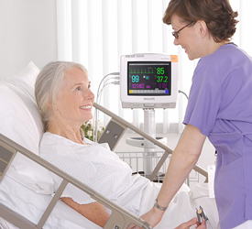
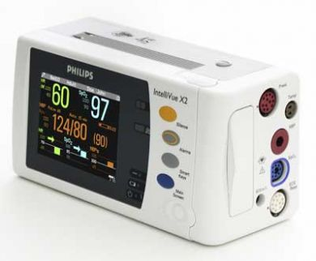
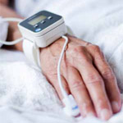
MBANS – Ubiquitous patient monitoring
Ubiquitous monitoring aims to monitor patients everywhere in the hospital
  Vital sign monitoring, freedom of movement for patients
  Improves recognition and response to changes in a patient’s condition
  Enables immediate and seamless integration of patient data into EMR and Clinical Decision Support Systems
  Contributes to reduce costs of healthcare
  Provides an opportunity to bridge the gap between professional and home healthcare solutions

Slide 5

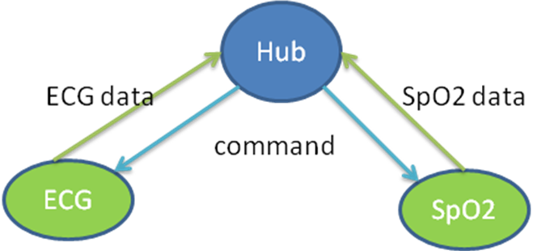
MBANS – Ubiquitous patient monitoring
Patients wear multiple MBANS sensors
  Electrocardiogram (ECG)
  Oxygen saturation (SpO2)
  Blood Pressure
  Respiration
  Temperature
MBANS sensors communicate with MBANS hub devices via short range (body area) wireless link
Hub device communicates with hospital infrastructure (e.g. Wi-Fi)

Slide 6




MBANS in USA
Philips, GE-Healthcare and AFTRCC collaborated and presented a joint proposal to the US FCC for sharing frequency spectrum
FCC published MBAN service rules in September 2012
Work on certification aspects is progressing
IEEE published 802.15.4j in February 2013
Amendment specifies MBAN use in 2360 to 2400 MHz USA band

Slide 7
MBANS European Regulatory Status
CEPT/ECC WG System Engineering (SE) commenced an MBANS compatibility studies with systems in various frequency bands (2011)
  Considered bands from 2300 to 2500 MHz
SE24 (SRDs) completes report on compatibility studies (April 2013)
  MBANS compatible with Services in 2483.5–2500 MHz band
  No support to use of the 2360–2400 MHz band - preference of specific administrations for future use of the 2300–2400 MHz band for IMT/4G
  Public consultation of this ECC Report 201 ends on 17 July
CEPT/ECC WG Frequency Management agreed to develop regulations for MBANS in Europe
  To be included in ECC Rec 70-03 for SRDs

Slide 8
MBANS European Regulatory Status
MBAN USA
30 MHz for in-hospital
10 MHz for home and ambulance
MBANS Europe
16.5 MHz for in-hospital and in-home (proposed)
2300 MHz
2400 MHz
2483.5 MHz
2500 MHz
ISM band
Amateur radio
Aeronautical Telemetry Systems
Europe: 4G/LTE
etc.
Wi-Fi
Bluetooth
ZigBee
Microwave ovens
etc
SAP/SAB video links
Medical Implants
Galileo
etc.

Slide 9
MBANS European Standard Status
  MBANS and all LP-AMI devices shall co-exist in the band 2483.5–2500 MHz on the basis of equal access to the band
ETSI ERM-TG30 (Medical devices) has been requested by ECC WG FM to address the coexistence of MBANS and LP-AMI in the band 2483.5–2500 MHz
  The coexistence issue will be solved by industry
  Discussions have begun between MBANS and implant manufacturers to solve the issues and come to a band sharing solution
ETSI starts the development of a Harmonized Standard for MBANS in support of the EU regulatory requirement

Slide 10
Conclusion
European MBANS frequency band allocated
MBANS SRD regulations are being defined
Coexistence discussions are on-going between the SRDs in the band
ETSI harmonized standard development started

