Slide 1
Project: IEEE P802.15 Working Group for Wireless Personal Area Networks (WPANs)
Submission Title: Performance evaluation for LG’s proposal
Date Submitted: July 7th, 2013
Source: Suhwook Kim, Jinyoung Chun, Han Gyu Cho (LG Electronics)
Address: Seocho R&D Campus, 19, Yangjae-daero 11gil, Seocho-gu, Seoul , Korea
Voice: +82-2-6912-6589, E-Mail: suhwook.kim@lge.com
Re: Proposal for PFD
Abstract: Technical proposal of PAC procedure
Purpose: Proposal for discussion
Notice: This document has been prepared to assist the IEEE P802.15. It is offered as a basis for discussion and is not binding on the contributing individual(s) or organization(s). The material in this document is subject to change in form and content after further study. The contributor(s) reserve(s) the right to add, amend or withdraw material contained herein.
Release: The contributor acknowledges and accepts that this contribution becomes the property of IEEE and may be made publicly available by P802.15.

Slide 2
Outline
Discovery simulation
System evaluation
  Simulation parameters
  Simulation results
  Analysis
Conclusion

Slide 3
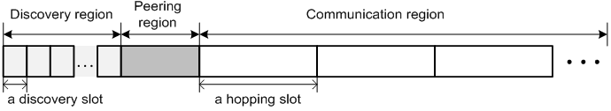

Discovery simulation
PAC structure (13-394r0)
Discovery simulation condition
  Pre-peering discovery
  Communication region has random length, random channel

Slide 4
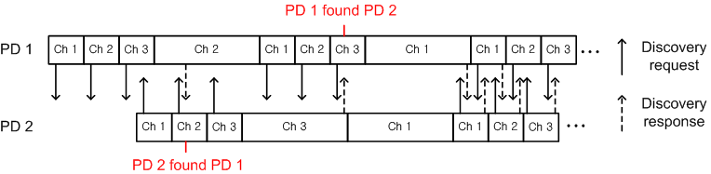
Discovery simulation
Discovery procedure
  Discovery region
    Fixed length
    PD broadcasts Discovery request frame
  Communication region
    Random length (Unit: Hopping slot)
    PD waits for Discovery request frame
  PD responses using Discovery response frame when it receives Discovery request frame

Slide 5
System evaluation
Simulation parameters (based on TGD)
  3 non-overlapped channels
  Hopping slot length: 100 msec
  Discovery slot length: 33 msec (100 msec / 3 channel)
  Communication region: 100, 200, 300 msec (random)
  PD deployment: Uniform random drop
  0~400 msec random turn-on
  CSMA/CA
  Using IEEE 802.11 PHY
    6Mbps transmission rate (BPSK, 1/2 coding rate)
    Discovery frame size: 45 bytes (Including PHY/MAC header)
    Discovery frame transmission time: 45 bytes *8bit / 6Mbps = 60 usec

Slide 6
System evaluation
Channel model (based on TGD)
  Frequency band: 2.4 GHz
  Tx power: 20 dBm
Simulation assumption*
  Receiver sensitivity is -90 dBm
    Pathloss is too high in 2.4 GHz band
    Tx range is only 30 meters for -76 dBm
    30 meter isn’t sufficient for performance evaluation
  Tx range is 50 meters
    SNR at 50 meter is zero
    PER at SNR 0 is under 10% (DCN13-0058)
  Neighbor PDs of device k
    Located within 50 meter from device k
* These assumption are not part of proposal, just for performance evaluation

Slide 7
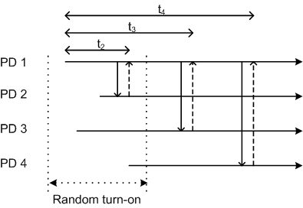
Discovery simulation
Random variables for performance evaluation
  Discovering time: Time from turn-on to receiving the first Discovery response frame from each neighbor PD
  Discovery complete time: Time from turn-on to receiving Discovery response frames from whole neighbor PDs
Mathematic definition
  Discovering time of device k
    t_{i} (i≠k, i: device index)
  Discovery complete time of device k
    Max (t_{i}) (i≠k, i: device index)

Slide 8
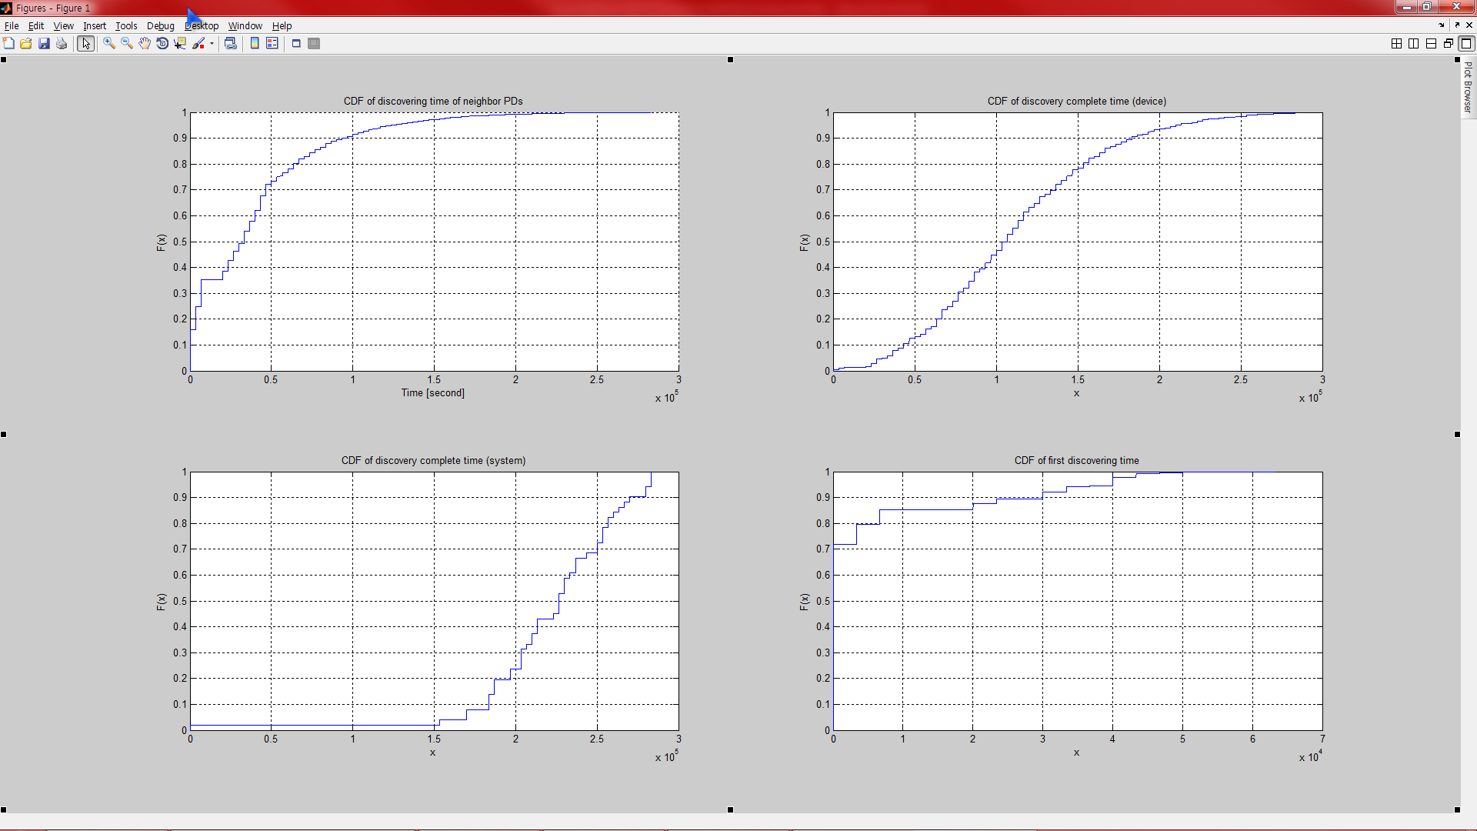
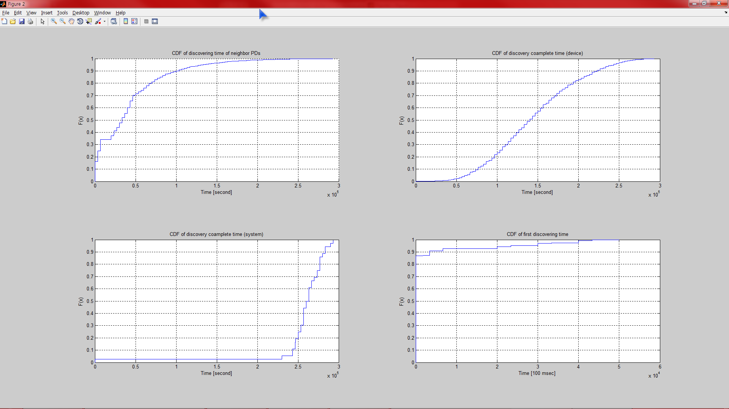
Simulation results
Discovering time(20, 40 devices in [100m 100m])
  Average number of neighbor PDs: 9.2, 18.8 (similar as 500, 1000 devices in [500m 500m])
  CDF of t_{i}
  A PD can find averagely 70% of its neighbor PDs at 0.5 second from turn-on in both cases
20 devices
Mean value: 380 msec
40 devices
Mean value: 420 msec

Slide 9
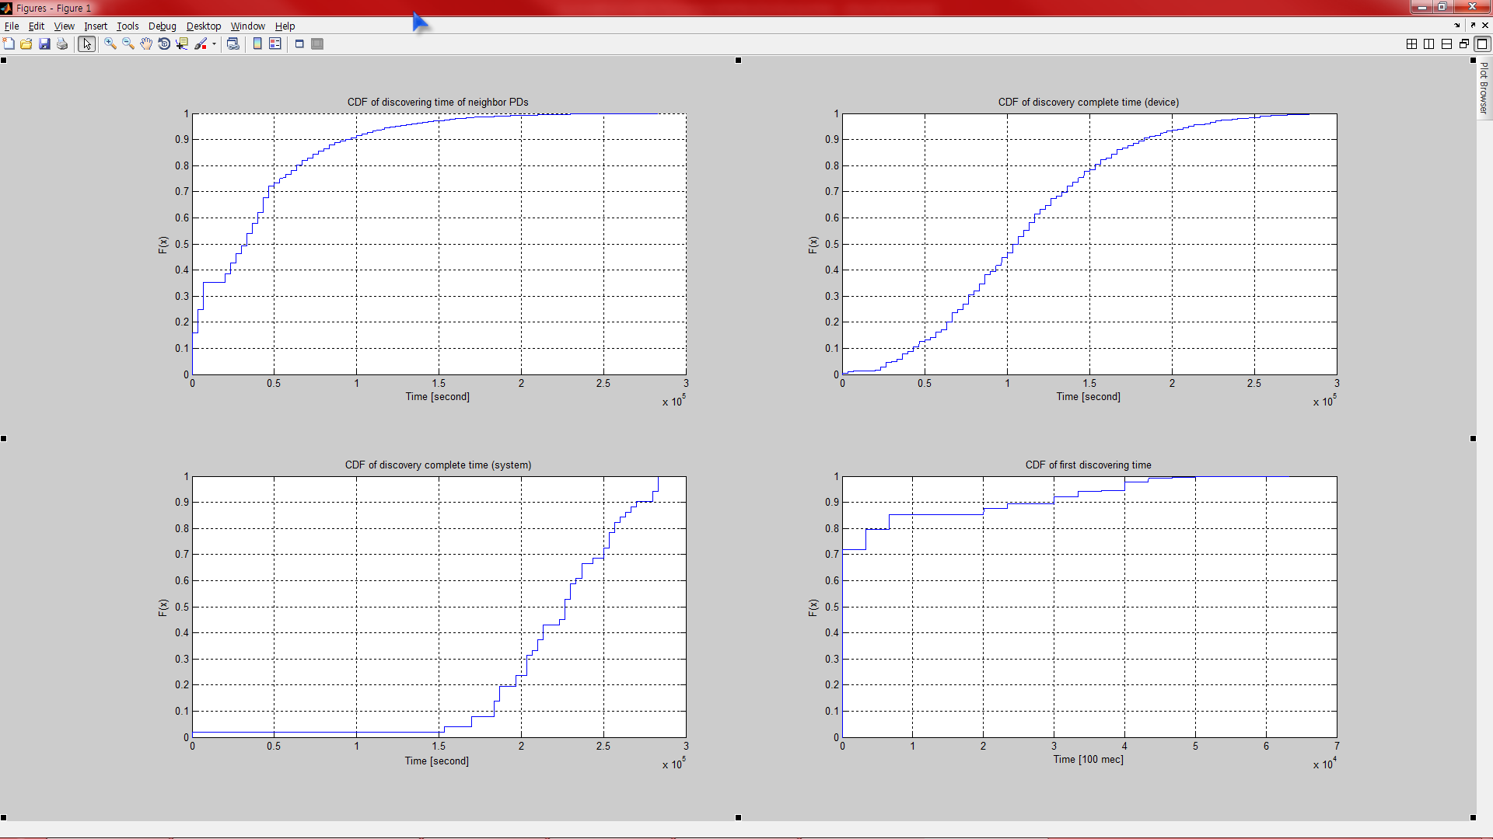
Simulation results
Discovery complete time(20, 40 devices in [100m 100m])
  CDF of Max(t_{i})
  Averagely, 45% of PDs can find its whole neighbor PDs at 1 second from turn-on in 20 devices case (20 % for 40 devices case)
20 devices
Mean value: 1.06 sec
40 devices
Mean value: 1.45 sec

Slide 10
Analysis
20, 40, 60, 100, 200 devices in [100m 100m]
Mean of discovering time varies in 300 ~ 700 msec
Mean of discovery complete time varies in 1 ~ 2 seconds
When the device density increases, discovery time also increases but not linearly
Mean value | 20 devices | 40 devices | 60 devices | 100 devices | 200 devices
Discovering time | 380 msec | 420 msec | 448 msec | 508 msec | 644 msec
Discovery complete time | 1.06 sec | 1.45 sec | 1.71 sec | 2.10 sec | 2.49 sec
# of neighbor PDs | 9.2 | 18.8 | 28.5 | 47.8 | 96.2

Slide 11
Conclusion
We proposes channel hopping system with performance evaluation
By our discovery mechanism, a PD can find its whole neighbor PDs in certain time
More evaluation results will be submitted next meeting
  Resolving random turn-on offset
  Different hopping slot length
  Post-peering discovery

Slide 12
Appendix
Results form other topologies
Mean value | 100 devices in [500m 500m] | 80 devices in [200m 200m] | 100 devices in [50m 50m]
Discovering time | 397 msec | 396 msec | 721 msec
Discovery complete time | 667 msec | 1.21 sec | 2.55 sec
# of neighbor PDs | 2.85 | 12.4 | 96.5

Slide 13
Appendix
Results form other deployment (hopping slot time)
  20 devices in [100m 100m]
Mean value | 100 msec | 50 msec
Discovering time | 380 msec | 226 msec
Discovery complete time | 1.06 sec | 587 msec

