Slide 1
Project: IEEE P802.15 Working Group for Wireless Personal Area Networks (WPANs)
Submission Title: Performance evaluation for LG’s proposal
Date Submitted: July 7th, 2013
Source: Suhwook Kim, Jinyoung Chun, Han Gyu Cho (LG Electronics)
Address: LG R&D Complex 533, Hogye-1dong, Dongan-gu, Anyang-shi, Kyungki-do, Korea
Voice: +82-31-450-1901, FAX: +82-31-450-4049, E-Mail: suhwook.kim@lge.com
Re: Proposal for PFD
Abstract: Technical proposal of PAC procedure
Purpose: Proposal for discussion
Notice: This document has been prepared to assist the IEEE P802.15. It is offered as a basis for discussion and is not binding on the contributing individual(s) or organization(s). The material in this document is subject to change in form and content after further study. The contributor(s) reserve(s) the right to add, amend or withdraw material contained herein.
Release: The contributor acknowledges and accepts that this contribution becomes the property of IEEE and may be made publicly available by P802.15.

Slide 2
Outline
Discovery simulation
System evaluation
  Simulation parameters
  Simulation results
  Analysis
Conclusion

Slide 3
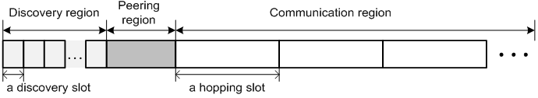

Discovery simulation
PAC structure
Discovery simulation condition
  Pre-peering discovery
  Communication region has random length, random channel

Slide 4
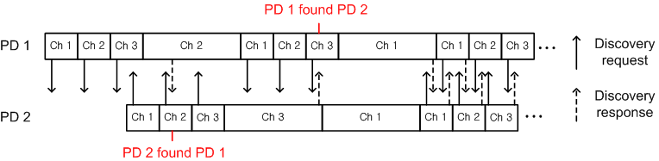
Discovery simulation
Discovery procedure
  Discovery region
    Fixed length
    PD broadcasts Discovery request frame
  Communication region
    Random length (Unit: Hopping slot)
    PD waits for Discovery request frame
  PD responses using Discovery response frame when it receives Discovery request frame

Slide 5
System evaluation
Simulation parameters (based on TGD)
  3 non-overlapped channels
  Hopping slot length: 100 msec
  Discovery slot length: 33 msec (100 msec / 3 channel)
  Communication region: 100, 200, 300 msec (random)
  PD deployment: 100 PDs in 500 x 500 m² (Uniform random drop)
  Simulation time: 5 seconds, 20 iterations
  CSMA/CA
  Using IEEE 802.11 PHY
    6Mbps transmission rate (BPSK, 1/2 coding rate)
    Discovery frame size: 45 bytes (Including PHY/MAC header)
    Discovery frame transmission time: 45 bytes *8bit / 6Mbps = 60 usec

Slide 6
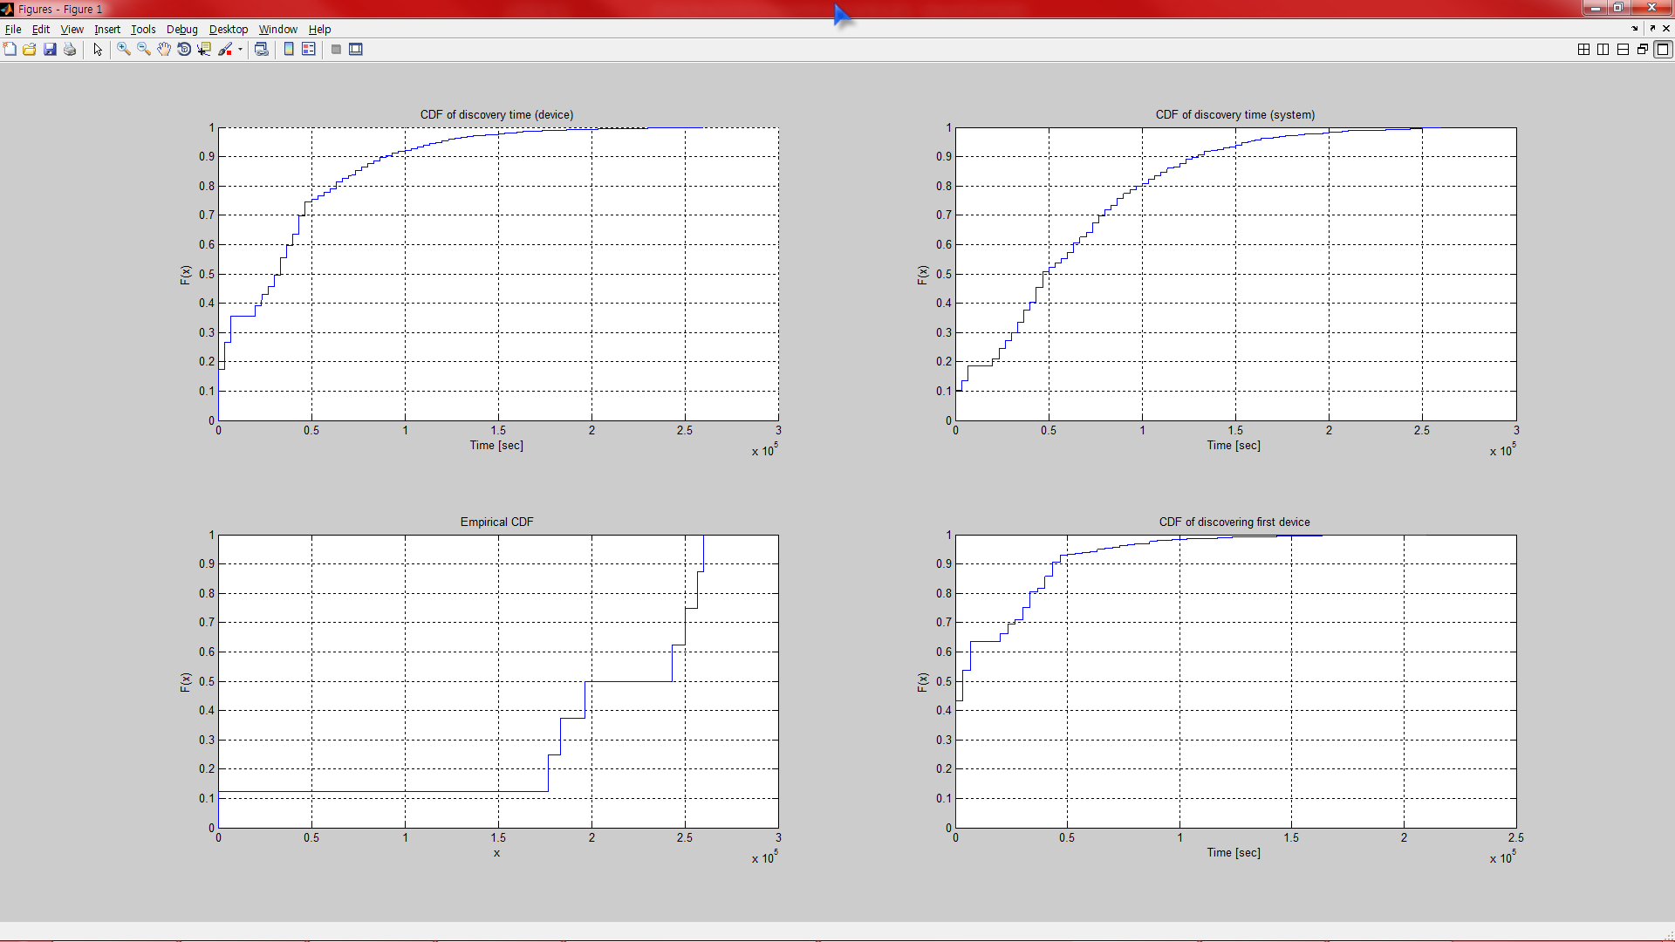
System evaluation
Simulation results
  Average time for 100% discovering: 1.96 sec (view of device)

Slide 7
System evaluation
Simulation results
  Average time for whole device completing discovery

Slide 8
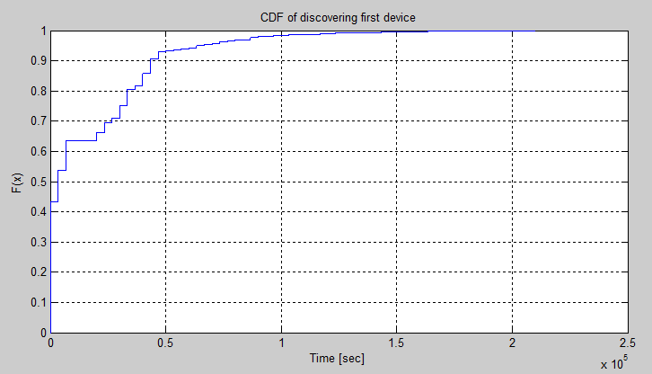
System evaluation
Simulation results
  Average time for first discovering: 0.172 sec

Slide 9
Conclusion
We proposes channel hopping system with performance evaluation
By proposed discovery mechanism, a PD can find every neighbor PDs in few seconds

