Slide 1
Project: IEEE P802.15 Working Group for Wireless Personal Area Networks (WPANs)
Submission Title: [Technical Proposal for IEEE 802.15.8]
Date Submitted: [May 6th, 2013]
Source: [Jeongseok Yu, Woongsoo Na, Hyoungchul Bae, Taejin Kim, Yunseong Lee, Juho Lee, Zeynep Vatandas, Sungrae Cho, and Junbeom Hur]
Company [Chung-Ang University, Korea]
E-Mail:[jsyu@uclab.re.kr, wsna@uclab.re.kr, hcbae@uclab.re.kr, tjkim@uclab.re.kr, yslee@uclab.re.kr, jhlee@uclab.re.kr, zvatandas@uclab.re.kr, srcho@cau.ac.kr, jbhur@cau.ac.kr]
Re: [This is the original document]
Abstract: [Technical Proposal for IEEE 802.15.8]
Purpose: []
Notice: This document has been prepared to assist the IEEE P802.15. It is offered as a basis for discussion and is not binding on the contributing individual(s) or organization(s). The material in this document is subject to change in form and content after further study. The contributor(s) reserve(s) the right to add, amend or withdraw material contained herein.
Release: The contributor acknowledges and accepts that this contribution becomes the property of IEEE and may be made publicly available by P802.15.

Slide 2
Technical Proposal for IEEE 802.15.8
Jeongseok Yu, Woongsoo Na, Hyoungchul Bae, Taejin Kim, Yunseong Lee, Juho Lee, Zeynep Vatandas, Sungrae Cho, and Junbeom Hur
Chung-Ang University

Slide 3
Contributions of the Proposal
Multicast/Broadcast Protocol for PAC
  Multicast Group Management Technique
  Reliable Multicast Protocol
  Directional Antenna based Multicast Protocol
Multi-hop Operation for PAC
  Multi-hop Unicast Transmission without Heavy Loaded Routing Table.
Security Mechanism for PAC
  Infrastructure based Security Mechanism
  Infrastructureless based Security Mechanism

Slide 4
Why Multi-hop/Multicast/Security Mechanism?
FlashLinQ
PAC
GPS/Base-station is required for synchronization.
It does not support Multi-hop
GPS /Base-station is not necessary for synchronization
It supports Multi-hop
Bluetooth
1-to-1 Data Communication
Communication Range is limited 10m
It does not support Multi-hop
Multicast/broadcast technique can be available
1:1, 1:N, N:N communication.
Multi-hop transmission can extend transmission range
Wi-Fi
Direct
Group Owner (AP) and Client (Terminal) make
a group.
Multiple clients is associated per one group
owner (1:N).
1-to-1 data communication (Group owner and
client)
The data communication between clients is
impossible.
Communication Range is limited 100m.
It does not support Multi-hop.
Fully Distributed (There is no role for AP or terminal)
Data communication among PDs is available
Low energy consumption
Multi-hop transmission can extend transmission range
Compare with FlashLinQ, Bluetooth, and Wi-Fi Direct, PAC has a several merits including multi-hop support.

Slide 5
Contents (1/2)
Multicast Group Management
  Finding/Joining Multicast Group
  Device Group ID Creation
  Multicast Group Notification Frame (MGNF)
    How to reduce MGNF traffic
    Redundant MGNF Transmission
    UMA-based MGNF Transmission
  Creation and Management of Routing Table
  Leaving Multicast Group
  Mobility Support for Multicast
  Merging Multicast Groups
Multicast/Unicast Routing
  Multicast/Unicast Data Transmission
    Prevention Loopback Problem

Slide 6
Contents (2/2)
Reliability
  Reliability Support
  Reliable Multicast
Multicast Protocol using Directional Antenna
Security Mechanism
  Security Modes
  Security Parameters
  Flow Chart for Authentication
  Infrastructureless Architecture
  Key Derivation
  Authentication
  Authorization
  One-Way Authentication

Slide 7
Multicast Group Management

Slide 8
Multicast Group Management
In order to multicast, each PD has same multicast group.
In this parts, we describes the multicast group management technique as the following:
  Finding/Joining/Leaving Multicast Group
  Group ID Creation
  Routing Table Creation/Management

Slide 9
Finding/Joining Multicast Group (1/12)
A multicast group consists of two or more PDs with the same application type ID, application specific ID, application specific group ID, and device group ID.
A multicast group can be formed only if two or more PDs can recognize themselves.
Before a PD joins a multicast group, it has to find the multicast group within K-hop coverage.
  If the PD cannot find the group, then it finds the group periodically.
  In order to find a multicast group, a PD broadcasts an Advertisement Command Frame (ACF) after random timer T_{j} where the maximum TTL is set to K. Range of T_{j} is [0, T_{jmax} ].

Slide 10
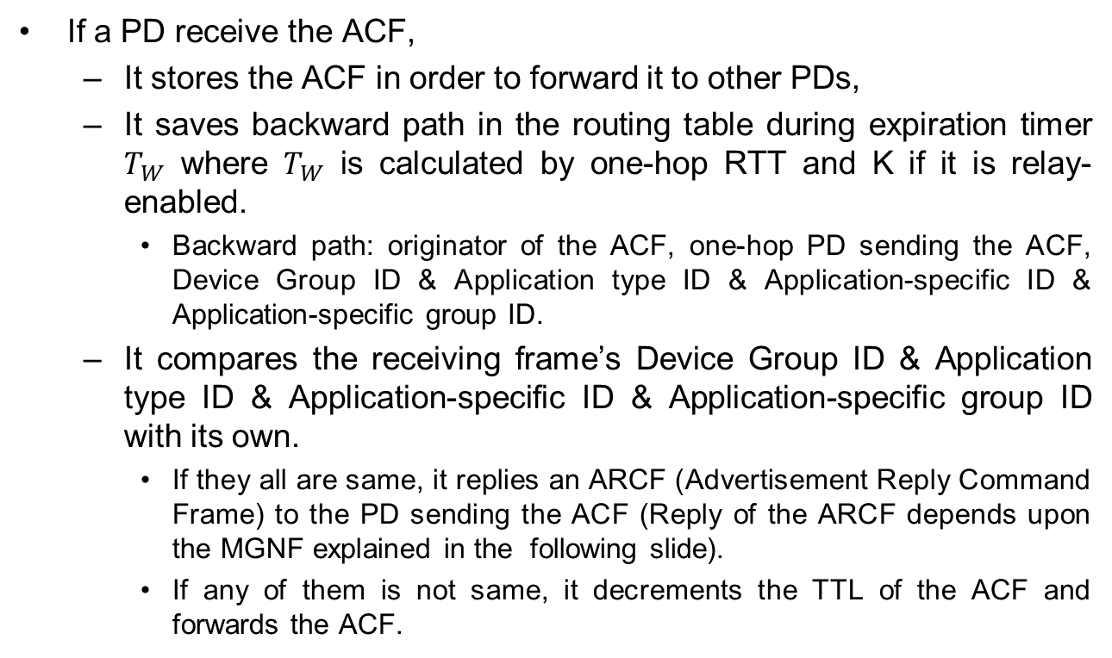
Finding/Joining Multicast Group (2/12)
If a PD receive the ACF,
  It stores the ACF in order to forward it to other PDs,
  It saves backward path in the routing table during expiration timer $T_{W}$ where $T_{W}$ is calculated by one-hop RTTand K if it is relay-enabled.
    Backward path: originator of the ACF, one-hop PD sending the ACF, Device Group ID & Application type ID & Application-specific ID & Application-specific group ID.
  It compares the receiving frame’s Device Group ID & Application type ID & Application-specific ID & Application-specific group ID with its own.
    If they all are same, it replies an ARCF (Advertisement Reply Command Frame) to the PD sending the ACF (Reply of the ARCF depends upon the MGNF explained in the following slide).
    If any of them is not same, it decrements the TTL of the ACF and forwards the ACF.

Slide 11
Finding/Joining Multicast Group (3/12)
In order to limit the duplicate ARCF, PDs replying the ARCF multicast a Multicast Group Notification Frame (MGNF) after random time. (MGNF is explained detail in later section)
Then, the PD multicasting the MGNF replies source PD with an ARCF by using backward path.
A PD receiving both ACF and MGNF does not reply an ARCF.
A PD receiving the ARCF whose destination is not itself saves the route information of
      ID of the source PD sending the ARCF, ID of the one-hop PD sending the ARCF, Device Group ID, Application type ID, Application-specific ID, Application-specific group ID.
      Then, this PD is referred to as “FORWARDING PD.”
A PD receiving the ARCF whose destination is itself saves the route information same as FORWARDING PD.
  Then, this PD is referred to as “JOINED MULTICAST GROUP MEMBER.”

Slide 12
Finding/Joining Multicast Group (4/12)
Assume the following topology.
  There is a multicast group consisting PDs B, D, F, and G.
G
: Member PD
F
: Candidate PD
1-hop
1-hop
: Non-member PD
D
B
E
C
1-hop
1-hop
1-hop
A
1-hop

Slide 13
Finding/Joining Multicast Group (5/12)
If PD A want to join the multicast group, it broadcasts an ACF (assume K=4 hops).
G
: Member PD
F
: Candidate PD
: Non-member PD
D
B
E
C
A
: Adv Command Frame

Slide 14
Finding/Joining Multicast Group (6/12)
PD C is not in the multicast group. Therefore, it saves the route information and forwards to the others (e.g., F and E).
PD D already received the ACF and PD F now receives the ACF.
Then, there will be a duplicate ARCF from both of D and F to A.
In order to limit the duplicate ARCF, PD D multicasts a MGNF notifying that D will send an ARCF instead of F.
G
: Member PD
F
: Candidate PD
: Non-member PD
D
B
E
E
C
C
A
: Adv Command Frame
: Multicast Group Notification Frame

Slide 15
Finding/Joining Multicast Group (7/12)
E forwards the ACF to B and G.
D replies with ARCF to A.
D may send KEKs(key encryption keys) to A after authentication for secure multicast if needed.
D may send rekeying messages to update an existing group key for backward secrecy.
F does not transmit an ARCF to A.
G
: Member PD
F
: Candidate PD
D
B
: Non-member PD
E
C
A
: Adv Command Frame
: Adv Reply Command Frame

Slide 16
Finding/Joining Multicast Group (8/12)
When PD A receives the ARCF, A joins D’s multicast group.
Also, PD B receives the ACF from PD E.
Then, B multicasts a MGNF to limit a duplicate ARCF from G.
G
: Member PD
F
: Non-member PD
D
B
E
C
A
: Adv Command Frame
: Adv Reply Command Frame
: Multicast Group Notification Frame

Slide 17
Finding/Joining Multicast Group (9/12)
PD B replies with an ARCF to A through E.
B may send KEKs(key encryption keys) to A after authentication for secure multicast if needed.
B may send rekeying messages to update an existing group key for backward secrecy.
G does not transmit an ARCF to A since the PD G already received the MGNF from B.
G
: Member PD
F
: Non-member PD
D
B
E
C
A
: Adv Command Frame
: Adv Reply Command Frame

Slide 18
Finding/Joining Multicast Group (10/12)
E forwards the ARCF to PD C.
G
: Member PD
F
: Non-member PD
D
B
E
C
A
: Adv Command Frame
: Adv Reply Command Frame

Slide 19
Finding/Joining Multicast Group (11/12)
C forwards the ARCF to PD A.
G
: Member PD
F
: Non-member PD
D
B
E
C
A
: Adv Command Frame
: Adv Reply Command Frame

Slide 20
Finding/Joining Multicast Group (12/12)
PD A is aware of route between PD A and PD B.
Now, PD A joins PD B’s multicast group.
Although group of B and G are not aware of group of D and F currently, multicasting service still works by simply forwarding multicast data frames.
G
: Member PD
F
: Non-member PD
D
B
E
C
A
: Adv Command Frame
: Adv Reply Command Frame

Slide 21
Flow Chart - Join Scenario
PD 1
Group1
PD 2
Group1
PD 3
Group Join Request (Send ACF)
Group Join Request (Send ACF)
Send MGNF (Type = 0)
Group Join Reply (Send ARCF)
Group Join Complete

Slide 22
Device Group ID Creation (1/5)
A multicast group is determined by application type ID, application specific ID, and application specific group ID.
Therefore, it is inefficient if transmitting all IDs in a frame and managing routing table.

Slide 23
Device Group ID Creation (2/5)
Therefore, we propose a device group ID creation scheme.
  Device group ID should be unique and distributed by a PD sending the first ARCF in the group.
  The PD manages/updates group keys for secure and dynamic multicast group communications after authentication procedures described in security section.
  The PD generates device group ID based on its unicast ID.
  Since a PD’s unicast ID is unique, prefix concatenated by PD’s unicast ID is also unique.
Prefix | Unicast ID

Slide 24
Device Group ID Creation (3/5)
When two or more multicast groups are merged, the device group ID should be same.
: Member PD
: Merger PD
Group ID: 5
E
D
A recognizes that
two device
group IDs exist
in networks
A
C
B
Group ID: 8
: Multicast Group Notification Frame

Slide 25
Device Group ID Creation (4/5)
The PD recognizing the existence of two or more multicast groups randomly determines the device group ID for those groups.
: Member PD
: Merger PD
Group ID: 5
E
D
A determines that
device group
ID is 8
A
C
B
Group ID: 8
: Multicast Group Notification Frame

Slide 26
Device Group ID Creation (5/5)
Then, the PD sends MGNF (notification type = 3 and TTL = ) to the group that does not have the selected group ID to update multicast group ID.
A may send rekeying messages to update an existing group key for backward secrecy.
: Member PD
Group ID: 5 ➔8
: Merger PD
E
D
A sends
MGNF to D and E
to change
device group ID
A
C
B
Group ID: 8
: Multicast Group Notification Frame

Slide 27
Multicast Group Notification Frame (MGNF) (1/6)
The purposes of MGNF are
  Limiting duplicate ARCF,
  Management of routing table,
  Notifying leaving multicast group,
  Device group ID creation,
  Request for unicast routing,
  Reply for unicast routing,
  Mobility support, and
  Local repair,
  Notification of removed routing entry.
  for relay-enabled PDs.
The MGNF has following eight notification types for above purposes.
Notification Type
0 → Limiting duplicate ARCF
1 → Management of routing table
2 → Notifying leaving multicast
3 → Device group ID creation
4 → Request for unicast routing
5 → Reply for unicast routing
  6 → Mobility support
  7 → Local repair
  8 → Notification of removed routing entry

Slide 28
Multicast Group Notification Frame (2/6)
Limiting duplicate ARCF (Notification Type=0)
  a PD receiving an ACF multicasts MGNF with notification type set to 0 with random timer T_{j}. Range of T_{j} is [0, T_{jmax} ]
  Although missing MGNF can increase duplicate ARCF, MGNFs are not retransmitted to avoid flooding.
  In this case, payload of MGNF contains source of the ACF.

Slide 29
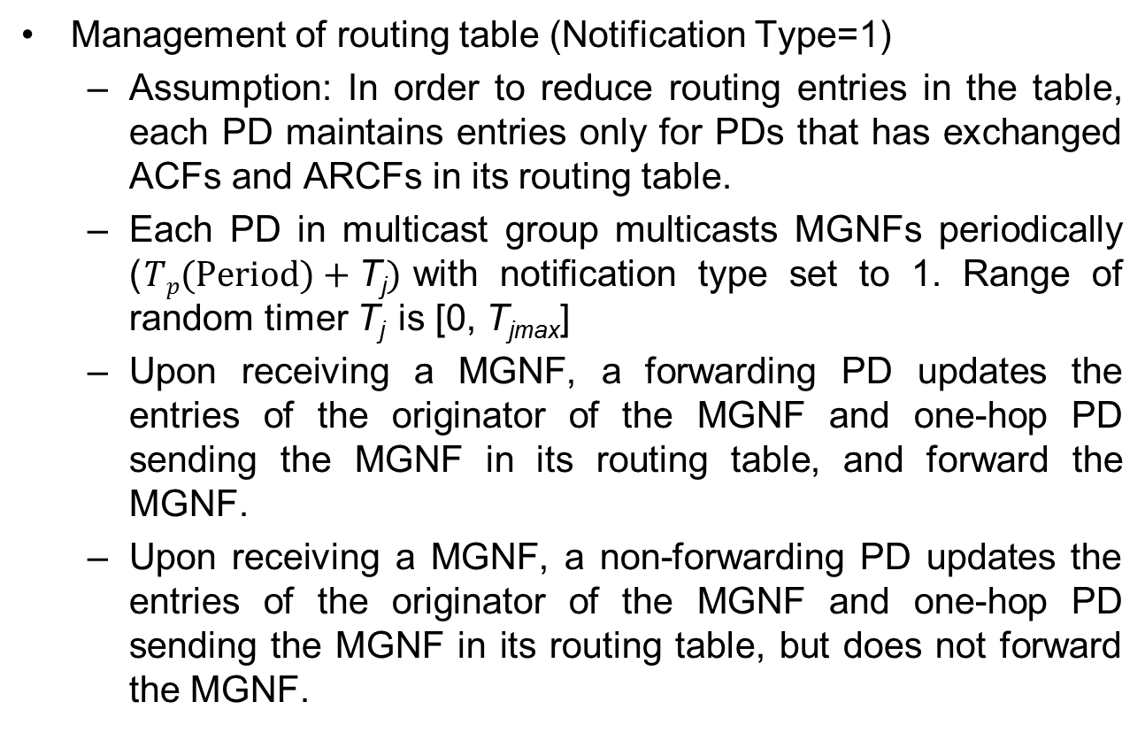
Multicast Group Notification Frame (3/6)
Management of routing table (Notification Type=1)
  Assumption: In order to reduce routing entries in the table, each PD maintains entries only for PDs that has exchanged ACFs and ARCFs in its routing table.
  Each PD in multicast group multicasts MGNFs periodically ($Tp(Period)+\text{T}\text{j})$with notification type set to 1. Range of random timer T_{j}is [0, T_{jmax}]
  Upon receiving a MGNF, a forwarding PD updates the entries of the originator of the MGNF and one-hop PD sending the MGNF in its routing table, and forward the MGNF.
  Upon receiving a MGNF, a non-forwarding PD updates the entries of the originator of the MGNF and one-hop PD sending the MGNF in its routing table, but does not forward the MGNF.

Slide 30
Multicast Group Notification Frame (4/6)
We assume PDs A, D, E, G, and I are same multicast group.
<If every PD has member
destinations in the table>
<Proposed technique can reduce the routing table size>
Dst | …
A | …
E | …
G | …
I | …
Dst | …
A | …
D | …
E | …
G | …
I | …
Dst | …
A | …
D | …
G | …
I | …
Dst | …
A | …
Dst | …
A | …
D | …
E | …
G | …
I | …
Dst | …
G | …
I | …
D
D
Dst | …
E | …
G | …
Dst | …
A | …
D | …
E
E
C
C
B
Dst | …
A | …
D | …
E | …
G | …
I | …
B
16
40
A
Dst | …
E | …
I | …
A
Dst | …
D | …
E | …
G | …
I | …
Dst | …
E | …
G | …
Dst | …
D | …
H
H
Dst | …
A | …
D | …
E | …
I | …
F
F
Dst | …
A | …
D | …
E | …
G | …
I | …
G
G
Dst | …
A | …
D | …
E | …
G | …
Dst | …
E | …
Dst | …
E | …
I
I
A ←→ D, E ←→ G, G ←→ I

Slide 31
Multicast Group Notification Frame (5/6)
Detection and Routing Table Update for link breakage
  Suppose the link between A and B is broken.
  E does not receive MGNF from A.
  E is aware that the link is broken because A’s MGNF does not arrive before E’s routing table Expiration timer is expired.
  E then removes entry of A from E’s routing table.
D
E does not
forward MGNF
since E is not a
forwarding PD
E
C
B
A
H
Although I does not
update its routing
table for A, I’s multicast
data frame can be
transmitted to group members
F
I
G

Slide 32
Multicast Group Notification Frame (6/6)
  Device group ID creation
    Explained in the previous section
Notifying leaving multicast group
  Will be explained in later section
Request for unicast routing
  Will be explained in later section
Reply for unicast routing
  Will be explained in later section
Mobility support
  Will be explained in later section
Local repair
  Will be explained in later section
  Notification of removed routing entry
  Will be explained in later section

Slide 33
Classification of MGNF types
Duplicate response to the MGNF may cause traffic implosion, so we divided nodes into two types
  ACK-enabled MGNF transmission (Notification type = 2, 3, 4, 5, 8)
    A source node transmitting a MGNF has to receive ACK frame.
  ACK-disabled MGNF transmission (Notification type = 0, 1, 6, 7)
    ACK frame is not required since MGNF with type 0, 1, 6, 7 does not need to be reliably transmitted.
    Without those, multicast group management can still work OK.

Slide 34
How to reduce MGNF traffic
When a PD belongs to multiple multicast groups, it multicasts MGNF multiple times.
In order to resolve the above problem, a PD may set Destination Address field of MGNF as United Multicast Address (UMA).
The UMA unifies multiple different groups into a single one.
The UMA can reduce the MGNF traffic as the following slides.

Slide 35
Redundant MGNF Transmission (1/3)
Suppose A, B, C, and D are in group 2 while B, C, and E are in group 1.
B and C are in both groups 1 and 2 simultaneously.
B starts to multicast its MGNF for Group 1 to C and D (forwarding to E).
After C and D verify device group ID field in PD B’s MGNF, PDs C and D recognize that the MGNF belongs to group 1.
A
E
B
D
C
: Group1 Member PD
: Multicast Group Notification Frame
: Group2 Member PD
: Group1 and 2 Member PD
<PD B’s Group 1 MGNF>
Destination Address | Src Address | Originator Address | Notification Type | ……
Group 1 | B | B | 1 | ……

Slide 36
Redundant MGNF Transmission (2/3)
Then, D forwards the MGNF from B to E.
After PD E verifies device group ID in B’s MGNF, E recognizes that the MGNF belongs to group 1.
A
E
B
D
C
: Group1 Member PD
: Multicast Group Notification Frame
: Group2 Member PD
: Group1 and 2 Member PD
<PD B’s Group 1 MGNF>
Destination Address | Src Address | Originator Address | Notification Type | ……
Group 1 | D | B | 1 | ……

Slide 37
Redundant MGNF Transmission (3/3)
B starts to transmit its MGNF for Group 2 to PD A, C, and D.
Then A, C, and D verify their device group ID in PD B’s MGNF, they recognize that the MGNF belongs to group 2.
Total 3 transmissions for MGNF (B transmitted MGNF twice).
A
E
B
D
C
: Group1 Member PD
: Multicast Group Notification Frame
: Group2 Member PD
: Group1 and 2 Member PD
<PD B’s Group 2 MGNF>
Destination Address | Src Address | Originator Address | Notification Type | ……
Group 2 | B | B | 1 | ……

Slide 38
UMA-based MGNF Transmission (1/3)
<A’s Routing Table>
B starts to transmit its MGNF whose destination address field set to UMA for Groups 1 and 2 to A, C, and D.
Then A, C, and D verify the device group ID field in PD B’s MGNF, they recognize that the MGNF belongs to UMA.
Destination address | … | Device Group ID | …
B | … | 2 | …
A
E
B
D
C
<D’s Routing Table>
Destination address | … | Device Group ID | …
B | … | 2 | …
B | … | 1 | …
E | … | 1 | …
<C’s Routing Table>
Destination address | … | Device Group ID | …
B | … | 1 | …
B | … | 2 | …
: Group1 Member PD
<B’s MGNF>
: Group2 Member PD
Destination Address | Src Address | Originator Address | Notification Type | ……
UMA | B | B | 1 | ……
: Group1 and 2 Member PD

Slide 39
UMA-based MGNF Transmission (2/3)
If a PD finds
  Received MGNF’s destination address is equal to UMA,
  Two or more device group IDs that have the same value (forwarding PD for that group ID), and
  Those device group ID have the same destination address with the originator of the received MGNF,
  Then, the PD forwards the received MGNF.
<A’s Routing Table>
Destination address | … | Device Group ID | …
B | … | 2 | …
A
E
B
D
C
<D’s Routing Table>
Destination address | … | Device Group ID | …
B | … | 2 | …
B | … | 1 | …
E | … | 1 | …
<C’s Routing Table>
Destination address | … | Device Group ID | …
B | … | 1 | …
B | … | 2 | …
: Group1 Member PD
<B’s MGNF>
: Group2 Member PD
Destination Address | Src Address | Originator Address | Notification Type | ……
UMA | B | B | 1 | ……
: Group1 and 2 Member PD

Slide 40
UMA-based MGNF Transmission (3/3)
<E’s Routing Table>
E receives the MGNF from D.
E does not forward the MGNF.
Total 2 transmissions for MGNF (B transmitted MGNF just once).
Although reduction seems to be not much, this can really reduce the MGNF traffic if you have bigger network size.
Destination address | … | Device Group ID | …
B | … | 1 | …
A
E
B
D
C
: Group1 Member PD
<PD B’s MGNF>
: Group2 Member PD
Destination Address | Src Address | Originator Address | Notification Type | ……
UMA | B | B | 1 | ……
: Group1 and 2 Member PD

Slide 41
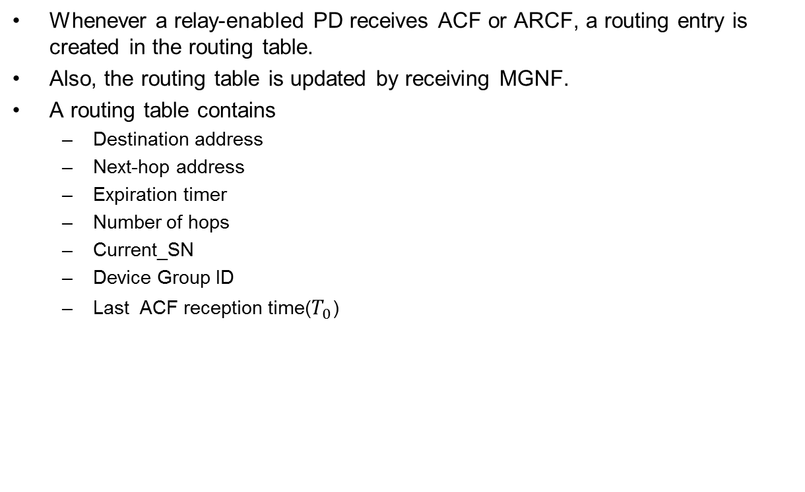
Creation and Management of Routing Table (1/10)
Whenever a relay-enabled PD receives ACF or ARCF, a routing entry is created in the routing table.
Also, the routing table is updated by receiving MGNF.
A routing table contains
  Destination address
  Next-hop address
  Expiration timer
  Number of hops
  Current_SN
  Device Group ID
  Last ACF reception time($T_{0}$)

Slide 42
Creation and Management of Routing Table (2/10)
B
If A wants to join a multicast group, it broadcasts an ACF (assume K=4 hop).
The initial routing table for A is as the following table (Note that originator of ACF has to save the ACF Tx time).
When C receives the ACF, it creates the routing entry of A in its routing table.
Device Group ID
E
Application type ID
C
...
A
D
: Adv Command Frame
PD A’s Routing Table
Destination address | Next-hop address | Expiration timer | Number of hops | T₀ | …
- | - | - | - | ACF Tx Time | …

Slide 43
Creation and Management of Routing Table (3/10)
B
Since C is not in the multicast group, C forwards the ACF to the others (e.g., D and E).
When D and E receive the ACF, they create the routing entry of A in their routing table.
Device Group ID
Application type ID
E
...
Device Group ID
C
Application type ID
A
D
...
: Adv Command Frame
PD A’s Routing Table
Destination address | Next-hop address | Expiration timer | Number of hops | T₀ | …
- | - | - | - | ACF Tx Time | …

Slide 44
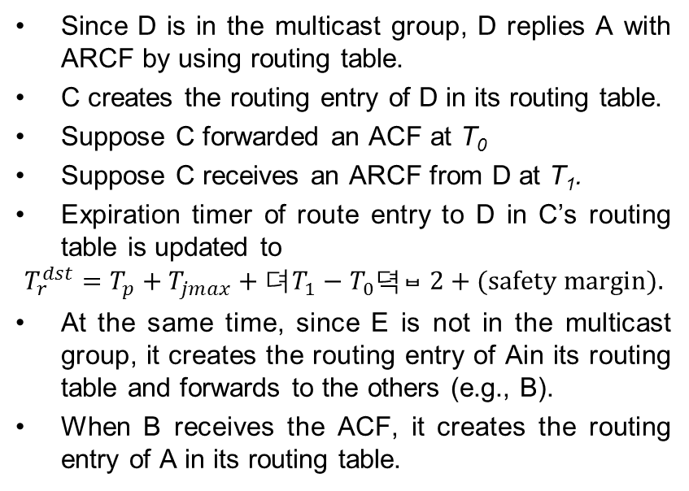
Creation and Management of Routing Table (4/10)
Since D is in the multicast group, D replies A with ARCF by using routing table.
C creates the routing entry of D in its routing table.
Suppose C forwarded an ACF at T₀
Suppose C receives an ARCF from D at T₁.
Expiration timer of route entry to D in C’s routing table is updated to
$$T_{r}^{dst}=T_{p}+T_{jmax}+{\left(T_{1}−T_{0}\right)}/{2+\text{(}\text{safety} \text{margin}).}$$
At the same time, since E is not in the multicast group, it creates the routing entry of Ain its routing table and forwards to the others (e.g., B).
When B receives the ACF, it creates the routing entry of A in its routing table.
B
Device Group ID
Application type ID
E
...
C
Destination address : A
A
D
Next-hop address : C
Hops : 1
...
: Adv Command Frame
: Adv Reply Command Frame
PD A’s Routing Table
Destination address | Next-hop address | Expiration timer | Number of hops | T₀ | …
- | - | - | - | ACF Tx Time | …

Slide 45
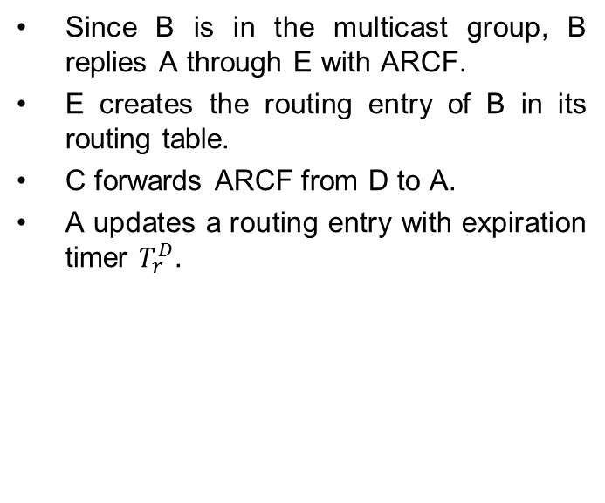
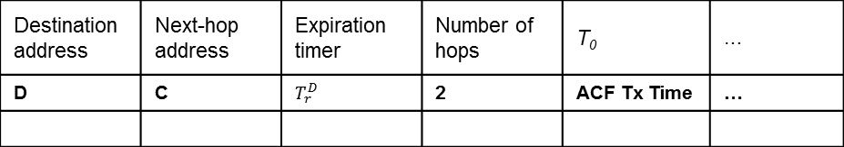
Creation and Management of Routing Table (5/10)
B
Since B is in the multicast group, B replies A through E with ARCF.
E creates the routing entry of B in its routing table.
C forwards ARCF from D to A.
A updates a routing entry with expiration timer $T_{r}^{D}$.
Destination address : A
Destination address : A
E
Next-hop address : A
Next-hop address : E
Hops : 2
C
Hops : 1
...
...
A
D
: Adv Reply Command Frame
PD A’s Routing Table
Destination address | Next-hop address | Expiration timer | Number of hops | T₀ | …
D | C | $$T_{r}^{D}$$ | 2 | ACF Tx Time | …

Slide 46
Creation and Management of Routing Table (6/10)
B
E forwards the ARCF received from B to C.
C creates the routing entry of B in its routing table.
E
Destination address : A
C
Next-hop address : C
Hops : 2
A
D
...
: Adv Reply Command Frame
PD A’s Routing Table
Destination address | Next-hop address | Expiration timer | Number of hops | T₀ | …
D | C | $$T_{r}^{D}$$ | 2 | ACF Tx Time | …

Slide 47

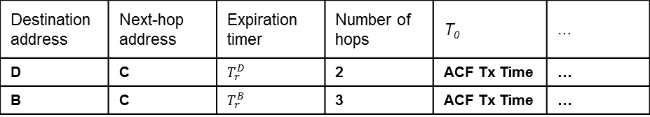
Creation and Management of Routing Table (7/10)
B
PD C forwards the ARCF received from E to A.
A creates a routing entry with expiration timer $T_{r}^{B}$.
Destination address : A
E
Next-hop address : A
Hops : 3
C
...
A
D
: Adv Reply Command Frame
PD A’s Routing Table
Destination address | Next-hop address | Expiration timer | Number of hops | T₀ | …
D | C | $$T_{r}^{D}$$ | 2 | ACF Tx Time | …
B | C | $$T_{r}^{B}$$ | 3 | ACF Tx Time | …

Slide 48
Creation and Management of Routing Table (8/10)
B
Finally, A is aware of route to B and D.
E
C
A
D
PD A’s Routing Table
Destination address | Next-hop address | Expiration timer | Number of hops | T₀ | …
D | C | $$T_{r}^{D}$$ | 2 | ACF Tx Time | …
B | C | $$T_{r}^{B}$$ | 3 | ACF Tx Time | …

Slide 49
Creation and Management of Routing Table (9/10)
Start
Received MGNF (Type = 1)
no
yes
Source ID is in Routing Entry
no
yes
Updates routing Entry
and sets the TMGNF
based on RSSI
End

Slide 50
Flow Chart - Update Routing Entry
PD 1
PD 2
PD 3
Send MGNF (Type 8)
Reply ACK
Link Break
Group Join Request (Send ACF)
Group Join Request (Send ACF)
Send MGNF (Type = 0)
Group Join Reply (Send ARCF)
Group Join Complete

Slide 51
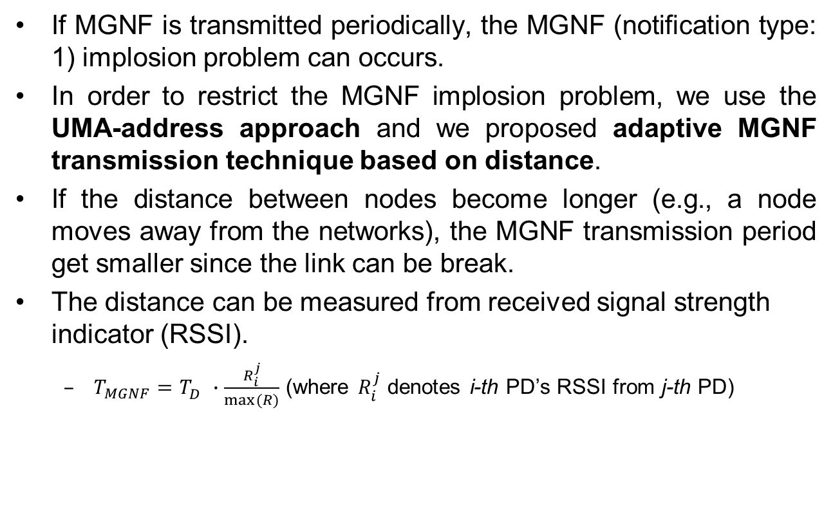
Creation and Management of Routing Table (10/10)
If MGNF is transmitted periodically, the MGNF (notification type: 1) implosion problem can occurs.
In order to restrict the MGNF implosion problem, we use the UMA-address approach and we proposed adaptive MGNF transmission technique based on distance.
If the distance between nodes become longer (e.g., a node moves away from the networks), the MGNF transmission period get smaller since the link can be break.
The distance can be measured from received signal strength indicator (RSSI).
  $T_{MGNF}=T_{D}^{}∙\frac{R_{i}^{j}}{max⁡(R)}$ (where $R_{i}^{j}$ denotes i-th PD’s RSSI from j-th PD)

Slide 52
Reducing # of Routing Entries (1/6)
In the Final proposal (New feature)
  When a PD is full of routing entries due to memory constraints, it chooses to remove an entry with the lowest hop count from it in its routing table.
  Then, it transmits a MGNF (Notification type : 8) to the chosen PD (the removed entry) and sets timer.
  When the chosen PD receives the MGNF (Notification type : 8), it deletes the entry of the sender PD from its routing table, and tries to connect another member of the multicast group by sending an ACF.
  If a PD receives the ACF, it replies with ARCF and creates a new link.

Slide 53
Reducing # of Routing Entries (2/6)
When S wants to break the link to B, S transmits MGNF (Notification type : 8)
to B and sets a timer.
A
B
S
D
S’s Routing Table
A’s Routing Table
B’s Routing Table
C
Destination address | …
A | …
B
C
D
Destination address | …
S | …
Destination address | …
S | …
: MGNF (Type 8)
: ACF
: ARCF

Slide 54
Reducing # of Routing Entries (3/6)
When B receives the MGNF (Notification type : 8), it breaks the link.
A
B
S
D
S’s Routing Table
A’s Routing Table
B’s Routing Table
C
Destination address | …
A | …
B
C
D
Destination address | …
S | …
Destination address | …
S | …
: MGNF (Type 8)
: ACF
: ARCF

Slide 55
Reducing # of Routing Entries (4/6)
Then, B transmits ACF.
S ignores B’s ACF because of PD S’s
timer is not expired.
A
B
S
D
S’s Routing Table
A’s Routing Table
B’s Routing Table
C
Destination address | …
A | …
C
D
Destination address | …
S | …
Destination address | …
: MGNF (Type 8)
: ACF
: ARCF

Slide 56
Reducing # of Routing Entries (5/6)
A receives the ACF and transmits MGNF (type 0) and ARCF to B.
A
B
S
D
S’s Routing Table
A’s Routing Table
B’s Routing Table
C
Destination address | …
A | …
C
D
Destination address | …
S | …
Destination address | …
: MGNF (Type 8)
: ACF
: ARCF

Slide 57
Reducing # of Routing Entries (6/6)
Then, A and B create a new link.
A
B
S
D
S’s Routing Table
A’s Routing Table
B’s Routing Table
C
Destination address | …
A | …
C
D
Destination address | …
S | …
B
Destination address | …
A | …
: MGNF (Type 8)
: ACF
: ARCF

Slide 58
Leaving Multicast Group (1/5)
There are several reasons for a PD to leave from the network: (1) by its intention, (2) by mobility, (3) by limited resources.
If a PD wants to leave from a multicast group, it multicasts (within K-hop) a MGNF with notification type set to 2. A recipient of MGNF may send rekeying messages to valid group members for forward secrecy.
  Upon receiving the MGNF, a forwarding PD deletes the entry of the originator of the MGNF, and forward the MGNF.
  Upon receiving the MGNF, a non-forwarding PD deletes the entry of the originator of the MGNF, but does not forward the MGNF.

Slide 59
Leaving Multicast Group (2/5)
If PD C wants to leave from a multicast group, it multicasts a MGNF with notification type set to 2.
<PD D’s Routing Table>
Destination Address | ……
A | ……
C | ……
<PD C’s Routing Table>
D
Destination Address | ……
D | ……
<PD A’s Routing Table>
B
Destination Address | ……
D | ……
A
C
<PD B’s Routing Table>
Destination Address | ……
A | ……
C | ……
D | ……
: Multicast Group Notification Frame

Slide 60
Leaving Multicast Group (3/5)
  B receives the MGNF from C and deletes the entry of the originator of the MGNF, and forward the MGNF.
<PD D’s Routing Table>
Destination Address | ……
A | ……
C | ……
<PD C’s Routing Table>
D
Destination Address | ……
D | ……
<PD A’s Routing Table>
B
Destination Address | ……
D | ……
A
C
<PD B’s Routing Table>
Destination Address | ……
A | ……
C | ……
D | ……
: Multicast Group Notification Frame

Slide 61
Leaving Multicast Group (4/5)
PD D receives the MGNF and it deletes the entry of the originator of the MGNF.
<PD D’s Routing Table>
Destination Address | ……
A | ……
C | ……
<PD C’s Routing Table>
D
Destination Address | ……
D | ……
<PD A’s Routing Table>
B
Destination Address | ……
D | ……
A
C
<PD B’s Routing Table>
Destination Address | ……
A | ……
D | ……
: Multicast Group Notification Frame

Slide 62
Leaving Multicast Group (5/5)
Finally, PD C leaves the multicast group.
<PD D’s Routing Table>
Destination Address | ……
A | ……
D
<PD A’s Routing Table>
B
Destination Address | ……
D | ……
A
C
<PD B’s Routing Table>
Destination Address | ……
A | ……
D | ……
: Multicast Group Notification Frame

Slide 63
Flow Chart - Leave Scenario
PD 1
PD 2
PD 3
Group Leave Request
(Send MGNF (Type = 0))
Reply ACK
Forward MGNF (Type = 0)
Group Join Reply (Send ARCF)
Link Break
PD 1 Leave The Group

Slide 64
Mobility Support for Multicast (1/4)
Previously, B was 2-hop away from A.
If B moves within the one-hop coverage of A, both of A and B are aware of each other within the one-hop by MGNF’s TTL and update their routing table.
Then, A or B sends a MGNF (notification type = 6) to C.
When C receives that MGNF, C is aware that A and B become closer.
  If C is a multicast group member, it does not do anything.
  If C is a forwarding PD, it deletes routing entries whose destination field is A and B.
A
Move
C
B
A
B
Multicast Group Notification Frame

Slide 65
Mobility Support for Multicast (2/4)
Since expiration timer is proportional to the number of hops from the impaired PD, the closest multicast group member detects link breakage.
A PD starts local repair if it detects link breakage between multicast group members (due to expiration timer).
Then, the PD multicasts MGNF (notification type = 7) .
If PDs receiving the MGNF create routing entry of originator of the MGNF during T_{w} .
Then the PD performing local repair broadcasts an ACF within K-hop coverage.
Local
Repair
Start
Local
Repair
Start
Link
Break
Link
Break
PD
Disappear
Advertisement Command Frame

Slide 66
Mobility Support for Multicast (3/4)
If a PD receiving the ACF then It compares the receiving frame’s Device Group ID & Application type ID & Application-specific ID & Application-specific group ID with its own.
  If they all are same, it finds entry the originator of the ACF in its routing table. And it found the entry then check the expiration timer.
  If the expiration timer is less than T_{m} then replies an ARCF to the PD sending the ACF. (T_{m} is threshold time to decide reply)
  In other case, the PD receiving the ACF does not reply.
  If any of them is not same, it decrements the TTL of the ACF and forwards the ACF.
Local repair &
merging groups.

Slide 67
Mobility Support for Multicast (4/4)
Find/join procedure by using ACFs and ARCFs can help merging disjoint groups.
  If a PD in a group receives a ACF from different disjoint group with the same Device Group ID & Application type ID & Application-specific ID & Application-specific group ID, it can initiate merging process.
  The PD then replies to the ACF originator with ARCF.
  Then, these two disjoint groups are merged by Device ID Creation Scheme.
Local repair by using ACFs and ARCFs also can help merging disjoint groups.
  Each group member performs local repair periodically during T_{L} (long duty cycle) in order to merge disjoint groups.

Slide 68
Flow Chart - Local Repair
PD 1
PD 2
PD 3
PD 2 Disappear
Link is Broken
PD 1 detects the link broken
(due to MGNF (Type = 1))
Send MGNF (notification type = 7) .
Send ACF
Reply ARCF
New Link is established

Slide 69
Multicast/Unicast
With Multi-hop Support

Slide 70
Multicast Data Transmission(1/6)
If a PD receives a multicast data frame, it has to decide forwarding the frame or not.
The PD receiving the multicast data frame compares the source address of the data frame and next-hop address entries of its routing table.
PD checks the next hop addresses in its routing table. If it finds
  one or more next-hop entries which not overlapped with the source address of the received frame and
  those next-hop entries have same device group ID with the received frame.
  Then, the PD forwards the incoming data frame to other PDs.
Otherwise, the PD do not forward the incoming frame.

Slide 71
Multicast Data Transmission(2/6)
For the multicast data transmission, we have to know the following information from multicast data frame:
  Destination address
  Source address
  Originator address
  Sequence number
  Time To Live(TTL)
This information should be included in all multicast data frames.
Therefore, the header in multicast data frames should contain the followings.
Destination address | Source address | Originator address | Sequence number | Time To Live(TTL) | Payload

Slide 72
Multicast Data Transmission(3/6)
H
B
We assume that :
  A, B, F, and G are in a same group ID of 1.
  A, D and H are in a same group ID of 2.
  A has routing information of B, D, and G.
  B has routing information of A and F.
  D has routing information of A and H.
E
D
C
F
A
G
PD A’s Routing Table
Destination address | Next-hop address | … | Device Group ID | Application type ID | Application-specific ID | Application-specific group ID
B | C | … | 1 | 3 | 2 | 5
D | C | … | 5 | 2 | 7 | 5
G | G | … | 1 | 3 | 2 | 5

Slide 73
Multicast Data Transmission(4/6)
H
B
A multicasts data frame to group 1.(Device Group ID: 1, Application type ID: 3, Application-specific ID: 2, Application-specific group ID: 5).
C receiving the data frame compares the source address of the data frame and next-hop address entries in its routing table which has same group IDs from the received data frame.
C finds any routing entry matching with the source address of the received frame and it searches another routing entry that has same multicast group with different next-hop address fields. Since C found, it will forward the data.
E
D
C
F
Destination
Address :
A
Source Address : C
Originator Address : A
G
...
Searching same
multicast group with
different next-hop
address
PD C’s Routing Table
Multicast Data Frame
C receiving
a data frame
from A
Destination address | Next-hop address | … | Device Group ID | Application type ID | Application-specific ID | Application-specific group ID
A | A | … | 1 | 3 | 2 | 5
B | E | … | 1 | 3 | 2 | 5

Slide 74
Multicast Data Transmission(5/6)
H
B
C forwards the data.
E receiving the data frame checks the condition weather forward or not.
E will forward data frame.
E
D
C
F
Destination
Address
A
Source Address : E
Originator Address : A
E receiving
a data frame
from C
G
...
PD E’s Routing Table
Multicast Data Frame
Searching same
multicast group with
different next-hop
address
Searching same
multicast group with
different next-hop
address
Destination address | Next-hop address | … | Device Group ID | Application type ID | Application-specific ID | Application-specific group ID
A | C | … | 1 | 3 | 2 | 5
B | B | … | 1 | 3 | 2 | 5
F | F | … | 1 | 3 | 2 | 5

Slide 75
Multicast Data Transmission(6/6)
H
B
Destination
Address
E forwards the data.
B and F do not forward the multicast data frame because B and F don’t have next-hop address in their routing table except E.
E
Source Address : E
D
C
F
Originator Address : A
Destination
Address
...
A
Source Address : E
Originator Address : A
G
...
Multicast Data Frame
B receiving
a data frame
from C but has not to
forward
PD B’s Routing Table
Destination address | Next-hop address | … | Device Group ID | Application type ID | Application-specific ID | Application-specific group ID
A | E | … | 1 | 3 | 2 | 5
F | E | … | 1 | 3 | 2 | 5

Slide 76
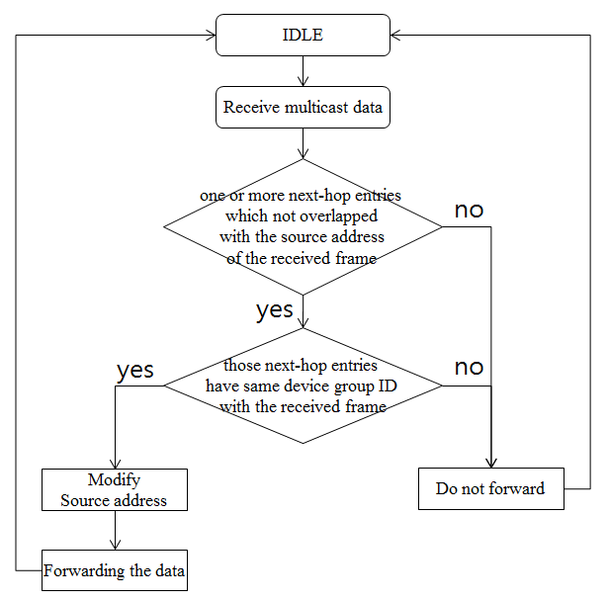
Flow Chart – Multicast Data Transmission

Slide 77
Unicast Data Transmission(1/5)
When a PD wants to unicast data frame, the PD finds routing entry of destination address in its routing table.
If the PD finds routing entry of destination address, the PD starts to unicast immediately.
If the PD does not find routing entry of destination address, the PD multicasts a MGNF (Notification type : 4) to group.
When the other PD receives the MGNF,
  It saves a backward route information in routing table during T_{w}
  It starts to find a routing entry of destination address in its routing table
If a PD receiving MGNG finds routing entry of destination address , the PD unicasts a MGNF (Notification type : 5) to the PD which wants to unicast.

Slide 78
Unicast Data Transmission(2/5)
H
B
A wants to unicast to F within same multicast group ID of 1, but A does not have routing information of F in A’s routing table.
Then, A multicasts a MGNF (Notification type : 4) to group 1.
When C receives the MGNF,
  It saves a backward route information in routing table during T_{w}
  It starts to find a routing entry of F in its routing table.
E
D
Notification type : 4
C
F
Destination Address : F
Notification type : 4
A
...
Destination Address : F
...
G
A does not have
F’s routing
information
: Multicast Group Notification Frame
PD A’s Routing Table
Destination address | Next-hop address | … | Device Group ID | Application type ID | Application-specific ID | Application-specific group ID
B | C | … | 1 | 3 | 2 | 5
D | C | … | 5 | 2 | 7 | 5
G | G | … | 1 | 3 | 2 | 5

Slide 79
Unicast Data Transmission(3/5)
H
B
Since C did not find the routing entry, C forwards the MGNF.
When E receives the MGNF,
  It saves a backward route information in a routing table during T_{w}
  It starts to find a routing entry of F in its routing table.
E
D
C
Notification type : 4
F
A
Destination Address : F
...
G
PD E’s Routing Table
: Multicast Group Notification Frame
Destination address | Next-hop address | … | Device Group ID | Application type ID | Application-specific ID | Application-specific group ID
F | E | … | 1 | 3 | 2 | 5
E has a routing
information

Slide 80
Unicast Data Transmission(4/5)
H
B
Since E finds routing information of F, E unicasts a MGNF (notification type=5) to A.
C creates routing entry of F in its routing table.
E
D
C
F
Notification type : 5
A
Destination Address : A
...
G
PD C’s Routing Table
: Multicast Group Notification Frame
Destination address | Next-hop address | … | Device Group ID | Application type ID | Application-specific ID | Application-specific group ID
F | E | … | 1 | 3 | 2 | 5
C saves a routing
Information of F

Slide 81
Unicast Data Transmission(5/5)
H
B
C forwards the MGNF to A.
When A receives the MGNF, it creates a routing entry of F in its routing table.
Now, A can unicast data to F.
E
D
C
F
Notification type : 5
A
Destination Address : A
G
...
: Multicast Group Notification Frame
PD A’s Routing Table
Destination address | Next-hop address | … | Device Group ID | Application type ID | Application-specific ID | Application-specific group ID
F | E | … | 1 | 3 | 2 | 5
A creates a
routing Information
of F

Slide 82
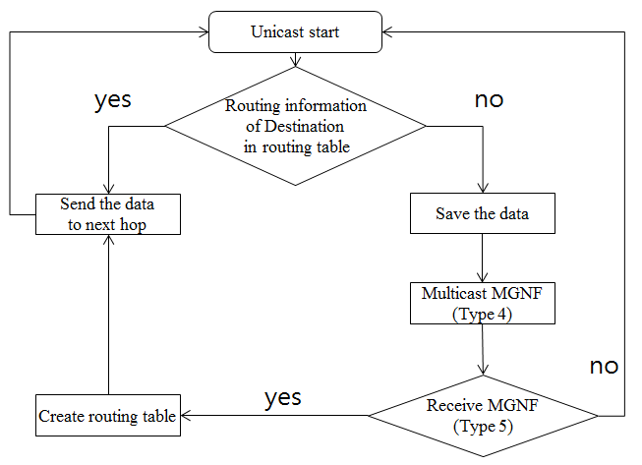
Flow Chart – Unicast Data Transmission

Slide 83
Prevention Loopback Problem (1/3)
PD prevents multicast/broadcast loopback problem by using SN (Sequence Number) of data frames.
A starts multicast/
broadcast with
K=4 and SN=1
C
E
A
B

Slide 84
Prevention Loopback Problem (2/3)
When a PD forwards data with SN = n, the PD sets current_SN field in its routing table to n.
C
E
B sets current _SN=1,
decreases K, and
forwards frame.
A
B

Slide 85
Prevention Loopback Problem (3/3)
If the receiving frame’s SN is not greater than the current_SN , the PD discards the frame.
C also sets
current_SN=1,
decreases K, and
forwards frame.
C
E
A
B receives data
with SN = 1 from C,
it discards frame and
does not forward.
B

Slide 86
Reliable Multicasting

Slide 87
Reliability Support (1/2)
For 1-hop reliable multicast, the role of a transmitting PD is to complete successful transmission of its multicast data frame to its 1-hop multicast members in its routing table.
For multi-hop reliable multicast, the role of a transmitting PD is to complete successful transmission of its multicast data frame to its multicast members in its routing table within K-hop coverage.

Slide 88
Reliability Support (2/2)
Timeout Mechanism
  To avoid ACK implosion, transmitters send the ACK at random time.
  Randomized timer for ACK transmission to substantially reduce the possibility of contentions.
  If an ACK does not arrive within retransmission timeout, the transmitter retransmits the multicast data frame until R (a maximum retransmit limit) times.
For reliable unicast, the role of a transmitting PD is to complete successful transmission of its unicast data frame to its destination.
Every receiving PD along the route from the source to destination shall send ACK to the transmitter in the unicast routing.
The reliable unicast shall using immediate ACK or n-block ACK mechanism.

Slide 89
Selective Group ACK technique for reliable multicast (1/12)
In the pre-proposal
  We proposed bitmap based implicit ACK mechanism for reliable multicast.
  If we use the implicit ACK mechanism, the transmitted frame becomes larger due to bitmap size (considering significant # of one-hop neighbours).
  We propose a new reliable broadcast technique in order to resolve the above scenario.
In the final proposal
  We propose a selective group ACK technique for reliable multicast to know whether the nodes receive multicast data frame fully or not.
  When sender PD sends a multicast data frame, it chooses the groups to acknowledge the frame in the multicast group.

Slide 90
Selective Group ACK technique for reliable multicast (2/12)
  To avoid the feedback implosion problem, a sender forms groups of nodes in its routing table.
  Then, the sender transmits multicast data frame including the information of the group which sends their Block ACK.
  When the nodes in the group receive all multicast data frames successfully, they transmit Block ACK to the sender by notifying that they received all frames successfully.
  If they did not receive any data frame or they did not receive it, they do not transmit Block ACK to the sender.

Slide 91
Selective Group ACK technique for reliable multicast (3/12)
Sender S chooses the groups.
In this example, the number of nodes in a group is 3.
A,B,C are in group1, D,E,F are in group2 and G,H,I are in group3.
S transmits multicast data frame F1 notifying that group1 is responsible for the acknowledgement.
I
A
B
H
S
C
G
D
F
E
: Multicast Data Frame
: Timer Based Block ACK
*The order of frames to be transmitted is F1, F2, and F3.

Slide 92
Selective Group ACK technique for reliable multicast (4/12)
A, B, and C transmit Block ACK (actually a single ACK in this case) to S for F1 because these nodes are in group 1.
I
A
B
H
S
C
G
D
F
E
: Multicast Data Frame
: Timer Based Block ACK

Slide 93
Selective Group ACK technique for reliable multicast (5/12)
S transmits multicast data frame F2 notifying group 2 needs to send the Block ACK.
I
A
B
H
S
C
G
D
F
E
: Multicast Data Frame
: Timer Based Block ACK

Slide 94
Selective Group ACK technique for reliable multicast (6/12)
D, E, and F transmit Block ACK for F1, F2 (Frame1, Frame2) to S.
I
A
B
H
S
C
G
D
F
E
: Multicast Data Frame
: Timer Based Block ACK

Slide 95
Selective Group ACK technique for reliable multicast (7/12)
S transmits multicast data frame F3 notifying group 3 needs to send the Block ACK.
I
A
B
H
S
C
G
D
F
E
: Multicast Data Frame
: Timer Based Block ACK

Slide 96
Selective Group ACK technique for reliable multicast (8/12)
G, H, and I transmit Block ACK for F1, F2, F3 to S.
I
A
B
H
S
C
G
D
F
E
: Multicast Data Frame
: Timer Based Block ACK

Slide 97
Selective Group ACK technique for reliable multicast (9/12)
Since all groups are acknowledged, S checks any unacknowledged groups and frames.
S did not receive ACK for F2 and F3 from A,B, and C and ACK for F3 from D, E, and F.
If the timer is expired, S sends Request ACK to the groups in order to check the reliability for group 1 and 2.
I
A
B
H
S
C
G
D
F
E
: Multicast Data Frame
: Timer Based Block ACK
: Request Block ACK

Slide 98
Selective Group ACK technique for reliable multicast (10/12)
If A, B, and C receive the Request ACK, they transmit the Block ACK (for frames F2 and F3) to S.
I
A
B
H
S
C
G
D
F
E
: Multicast Data Frame
: Timer Based Block ACK
: Request Block ACK

Slide 99
Selective Group ACK technique for reliable multicast (11/12)
Similarly sender S transmit the Request Block ACK to PD F, E, and D.
I
A
B
H
S
C
G
D
F
E
: Multicast Data Frame
: Timer Based Block ACK
: Request Block ACK

Slide 100
Selective Group ACK technique for reliable multicast (12/12)
If D, E, and F receive the Request ACK, they transmit the Block ACK (for frame F3) to S.
I
A
B
H
S
C
G
D
F
E
: Multicast Data Frame
: Timer Based Block ACK
: Request Block ACK

Slide 101
Flow Chart – Block ACK Mechanism
Block ACK Group1
Block ACK Group2
PD 1
PD 2
PD 3
PD 4
PD 5
Send Multicast Data #1
Send ACK
Send ACK
Send Multicast Data #2
Send ACK
Send ACK
Retransmit Multicast Data #1
Send ACK

Slide 102
Reliable Multicast (13/18)
In order to satisfy full reliability, each PD has to receive ACK frame from its routing entry PDs.
In our proposed multicast technique,
each PD has to forward multicast data
although, duplicated frame received.
It will take a long time and cause
traffic congestion.
In the following figure, although PD
A, B, C, D, and E is in one-hop range
from S, total transmission is 5.
A
B
S
E
C
D
: Multicast Data Frame
: ACK

Slide 103
Pre-ACK (1/6)
In order to satisfy full reliability, each PD has to receive ACK frame from all nodes in its routing table.
Suppose S has entry for A, A has entry for B, B has entry for C, C has entry for D, and D has entry for E.
Although A, B, C, D, and E is in one-hop range from S, total transmissions is 5
It will take a long time and cause
traffic congestion.
A
B
S
E
C
D
: Multicast Data Frame
: ACK

Slide 104
Pre-ACK (2/6)
Pre-ACK
  If a PD overhearing a data sent by sender does not have the sender in its routing table, the PD sends pre-ACK to the PDs in the routing table.
  Pre-ACK includes
    Originator Address of Data
    Sequence Number of Data
    Address of Receiver
  If a PD receives pre-ACK, it creates an ACK table.
  If all receivers in the ACK table are acknowledged, the PD doesn’t forward the data.

Slide 105
Pre-ACK (3/6)
Assume that the topology.
S multicasts data frame.
It needs ACK of A for reliability.
And B, C, D overhear the data
then they create an ACK table for
overheard data and set timer for
forwarding.
S | O
B | X
A | X
C | X
A
B
A | X
D | X
S
E
C
B | X
D | X
C | X
E | X
D
: Multicast Data Frame

Slide 106
Pre-ACK (4/6)
A sends ACK to S because
it has routing entry of S.
B, C, D send pre-ACK to PDs
in its routing table.
When a PD receives pre-
ACK, it checks the sender
in ACK table.
If all PDs of routing
entry successfully receive
the frame, it does not forward a frame.
S | O
B | O
A | O
C | X
A
B
A | O
D | O
S
E
C
B | O
D | O
C | O
E | X
D
: ACK
: Pre-ACK

Slide 107
Pre-ACK (5/6)
If some entries are left to forward frame,
it forwards the frame in order to satisfy reliability
(Retransmission Concept)
In this example, B and E forward
the data because their ACK table
are not fully checked.
S | O
B | O
A | O
C | X
A
B
A | O
D | O
S
E
C
B | O
D | O
C | O
E | X
D
: Multicast Data Frame

Slide 108
Pre-ACK (6/6)
When a PD receives the forwarded
data, it sends ACK to the sender.
If whole ACK table is checked,
reliable multicast of the data
is finished.
S | O
B | O
A | O
C | O
A
B
A | O
D | O
S
E
C
B | O
D | O
C | O
E | O
D
: ACK

Slide 109
Multicasting using Directional Antenna

Slide 110
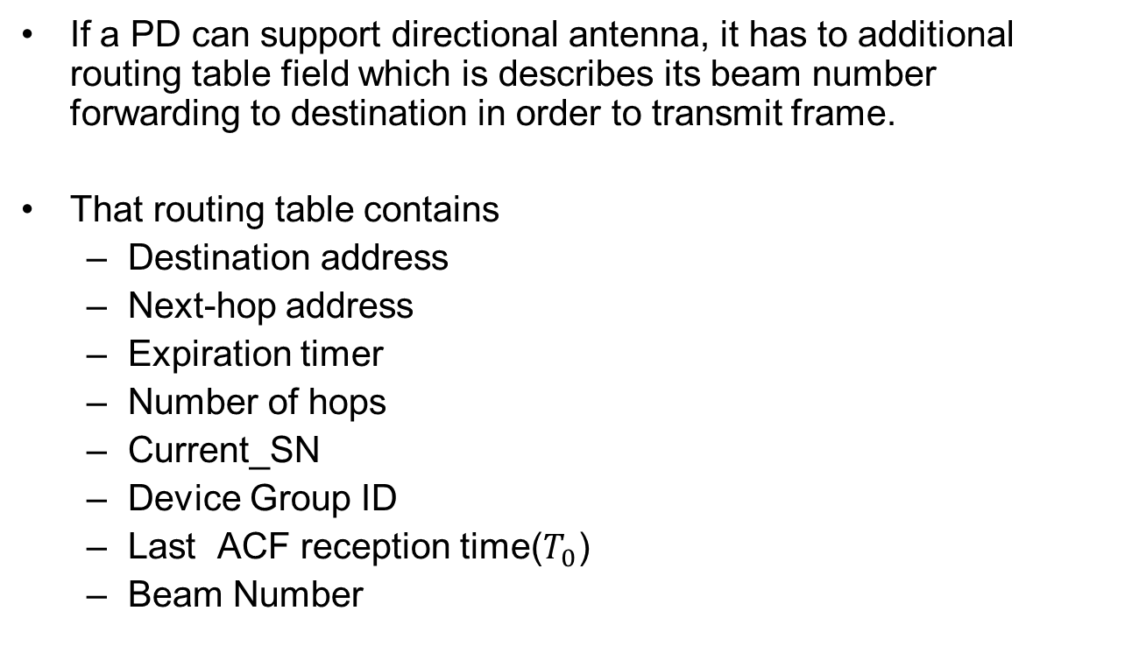
Directional Antenna Support (1/8)
If a PD can support directional antenna, it has to additional routing table field which is describes its beam number forwarding to destination in order to transmit frame.
That routing table contains
  Destination address
  Next-hop address
  Expiration timer
  Number of hops
  Current_SN
  Device Group ID
  Last ACF reception time($T_{0}$)
  Beam Number

Slide 111
Directional Antenna Support (2/8)
If each PD wants to join a multicast group, it performs find/join procedure by using all of beams.
During finding/joining procedure, PDs receiving a ACF check the SNR per beams and saves the specific beam with the highest SNR measured in order to find communication beam.
  If non-multicast group member receives the ACF forwards the ACF by using all of beams.
  If multicast group member receives the ACF, it replies ARCF by using saved specific beam with the highest SNR measured to the originator of the ACF.
When PDs receiving ARCF, it saves the specific beam with the highest SNR measured into its routing table and forwards the ARCF by using backward path.
After updated routing table, all of frames except to broadcast frame can be transmitted directionally.

Slide 112
Directional Antenna Support (3/8)
This example shows finding/joining multicast group when we employ directional antenna.
If PD A wants to join a multicast group, it broadcasts ACF by using all of beams.
: Candidate PD
F
: Non-member PD
D
B
E
2
C
1
A
3
4
: Adv Command Frame
Slide 112

Slide 113
Directional Antenna Support (4/8)
Then PDs D and C receive the ACF.
Since D is a multicast group member, it replies ARCF by using beam 3. Then, A finds the beam with the highest SNR measured and updates its routing table.
C is a non multicast group member then forwards ACF by using all of beams.
: Candidate PD
F
1
: Non-member PD
D
2
4
2
B
3
3
E
2
1
C
1
3
4
A
<PD A’s Routing Table>
4
: Adv Command Frame
Destination Address | Beam Number | ……
D | 1 | ……
: Adv Reply Command Frame
Slide 113

Slide 114
Directional Antenna Support (5/8)
Since F is a multicast group member, it replies ARCF by using beam 4. Then, C receives ARCF and updates its routing table.
Also, E forwards its ACF by using all of beams.
2
: Candidate PD
1
F
3
: Non-member PD
4
D
2
2
3
B
3
1
E
1
C
4
4
A
: Adv Command Frame
: Adv Reply Command Frame
Slide 114

Slide 115
Directional Antenna Support (6/8)
When A receives ARCF from C, it updates its routing table.
Also, B replies ARCF by using beam 1. Then, E receives ARCF and updates its routing table.
<PD A’s Routing Table>
Destination Address | Beam Number | ……
D | 1 | ……
F | 3 | ……
: Candidate PD
F
: Non-member PD
2
D
2
3
2
3
1
B
3
1
E
2
C
4
1
4
4
1
A
3
4
: Adv Command Frame
: Adv Reply Command Frame
Slide 115

Slide 116
Directional Antenna Support (7/8)
Also, E forwards ARCF by using beam 1. Then, C receives ARCF and updates its routing table.
: Candidate PD
F
: Non-member PD
D
2
2
3
B
3
1
E
2
1
C
4
4
1
A
3
4
: Adv Command Frame
: Adv Reply Command Frame
Slide 116

Slide 117
Directional Antenna Support (8/8)
C forwards ARCF by using beam 1.
Then, A receives ARCF and updates its routing table.
<PD A’s Routing Table>
Destination Address | Beam Number | ……
D | 1 | ……
F | 3 | ……
C | 3 | ……
: Candidate PD
F
: Non-member PD
D
2
B
3
E
2
1
C
1
3
4
A
4
: Adv Command Frame
: Adv Reply Command Frame
Slide 117

Slide 118
Performance Evaluation
To evaluate our multicast technique for PAC, we use the OPNET simulator under the one-hop scenario and multi-hop scenario.
Each scenario includes background unicast data transmissions for realistic scenario.
With i7 quad core CPU and 32G memory, each simulation scenario took more than about 10-hour time.

Slide 119
MAC Parameters Used in Simulations
Parameter | Value
ACF Frame Size | 32.75 bytes
MPDU | 512 bytes
MGNF Size | 48.5 bytes
Data Type | Multicast/Unicast
Number of Groups | 1~5
Topology Size | 500m x 500m, depends on max hops
PHY | BPSK (1/2)
Simulation Time | 100 seconds
Number of Channels | 1
Tx Power | DCN-0568
Communication Range | DCN-0568
# of Nodes | 100

Slide 120
MAC Parameters Used in Simulations
Parameter | Value
Data arrival Rate | Full Buffer, 512Bytes/sec, 256Bytes/sec, 1024Bytes/sec, 5120Bytes/sec
Mobility | Static Mobility
Drop | 2-stage Drop
Data Rate | 10Mbps
Multi-hop | Supported
 | Multicast | Unicast
RTS/CTS | Disable | Enable
NAV | Disable | Enable
ACK/NACK | Enable | Enable
CSMA/CA | Exponential increase of CW | Exponential increase of CW
Carrier Sensing | Enable | Enable
CWmin | 2⁴ | 2⁴
CWmax | 2¹⁰ | 2¹⁰
Retry Limit | 7 | 7

Slide 121
Performance Metric
Areal sum goodput (bps/km²): Total number of packets received by all PDs during 1second, expressed as bits per second per square-meter.
Data packet reception efficiency (ratio): The total number of successfully received packet to the total number of transmitted packet including retransmission procedure.
Jain’s fairness index: Jain’s index for number of packets received by PDs.
Average group joining time: The time duration between ACF transmission time and ARCF reception time for one PD.

Slide 122
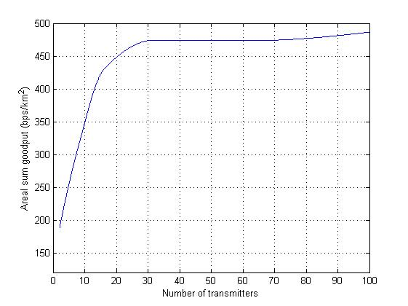
1-Hop Scenario
(100PDs, Full buffer, 1Group, Multicast)
Areal sum goodput
Maximum saturated goodput point (470 bps/km²)
Goodput increases as the
number of transmitters increases
(since they generate more traffic)
When the number of transmitters
is 32, goodput reaches is saturated

Slide 123
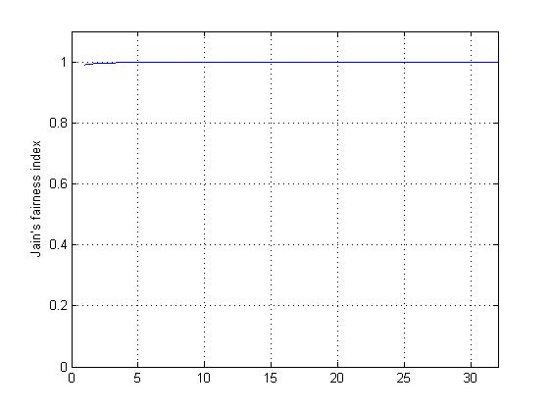
1-Hop Scenario
(100PDs, Full buffer, 1Group, Multicast)
Jain’s fairness index
All of transmitters have almost same chance to transmit
Since all of PDs in a one-hop
range of transmitters, all nodes
have same opportunity of send
data.

Slide 124
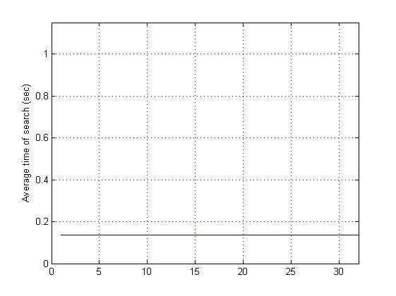
1-Hop Scenario
(100PDs, Full buffer, 1Group, Multicast)
Average Group Joining Time
A PD finds a group and join within 0.2 seconds
Since all of PDs within one-hop
coverage, group joining delay
is relatively small.

Slide 125
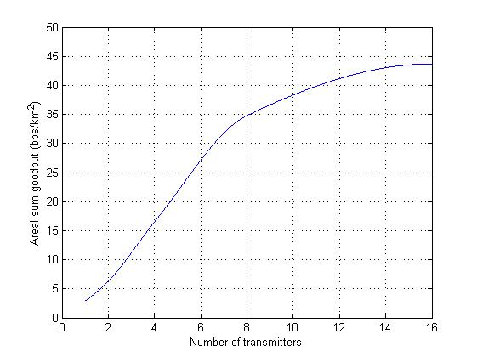
Multi-Hop Scenario
(100PDs, 512Bytes/sec, 1Group, Multicast)
Areal sum goodput
Goodput increases as the
number of transmitters increases
(since they generate more traffic)

Slide 126
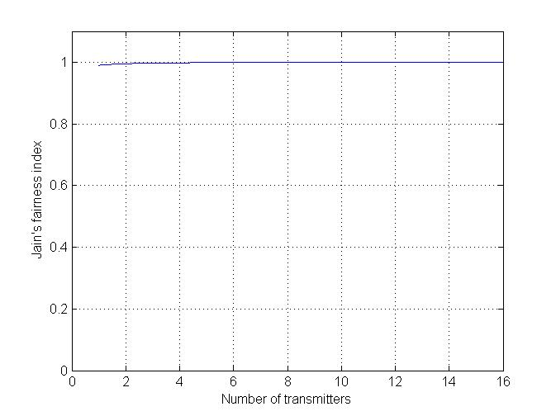
Multi-Hop Scenario
(100PDs, 512Bytes/sec, 1Group, Multicast)
Jain’s fairness index
All of transmitters have almost same chance to transmit

Slide 127
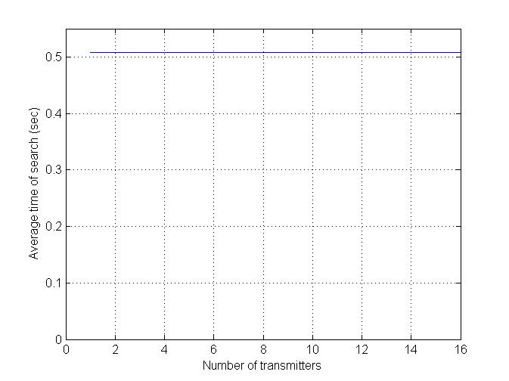
Multi-Hop Scenario
(100PDs, 512Bytes/sec, 1Group, Multicast)
Average Group Joining Time
Since PDs distributed within
multi-hop coverage, it makes
some delay in order to group
joining.

Slide 128
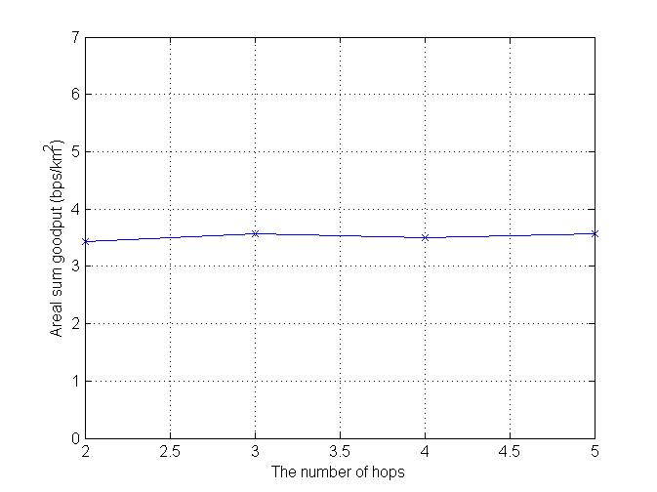
Multi-Hop Scenario
(100PDs, 512Bytes/sec, 1Group, Multicast)
Areal sum goodput (X-axis: The number of Hops)
The goodput is independs on
the number of hops.

Slide 129
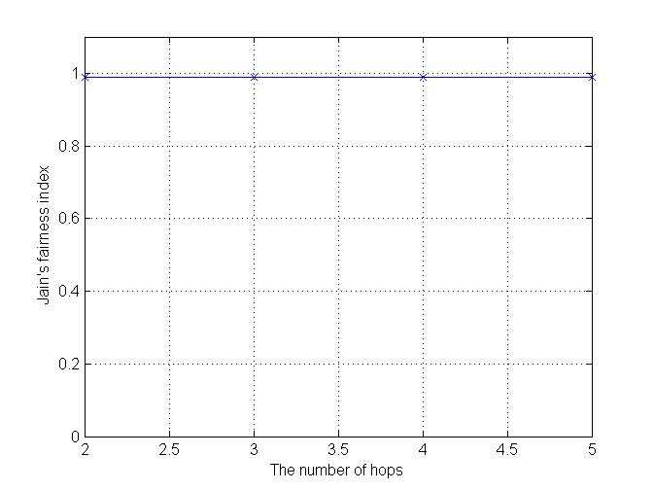
Multi-Hop Scenario
(100PDs, 512Bytes/sec, 1Group, Multicast)
Jain’s fairness index (X-axis: The number of Hops)
The result is similar with
previous scenario.
All of PDs have same
chance to transmit a data frame.

Slide 130
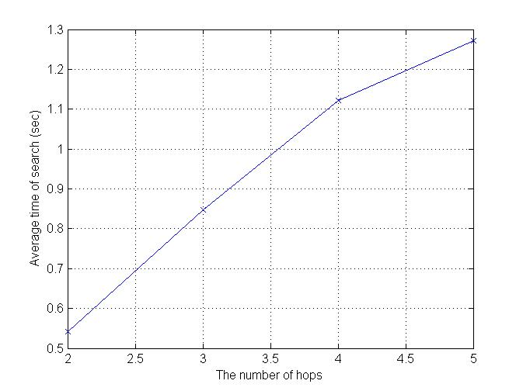
Multi-Hop Scenario
(100PDs, 512Bytes/sec, 1Group, Multicast)
Average Group Joining Time (X-axis: The number of Hops)
The average group joining time
increases as the number of hops
increases due to forward delay.
Most of PDs finds a group
with in a 1.5 seconds even if
a PD is far away from group member.

Slide 131
Realistic Scenario
Realistic Scenario
  Number of PDs: 100
  Traffic Generation: 512Bytes/sec
  Transmitter: 2~8 (half of them generate multicast data and others generate unicast data)
  The number of Groups per PD: 3

Slide 132
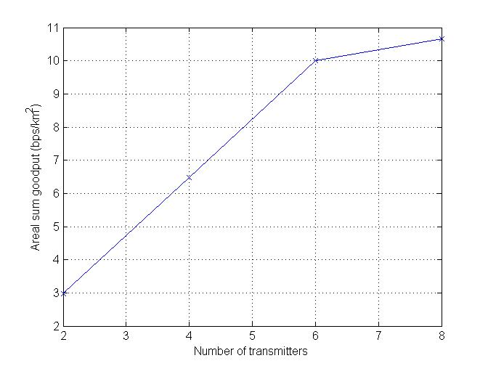
Realistic Scenario - Goodput
In the realistic scenario,
result is similar to previous scenario.
goodput increases as the
number of transmitters increases
(since they generate more traffic)
<Single-Hop Scenario>

Slide 133
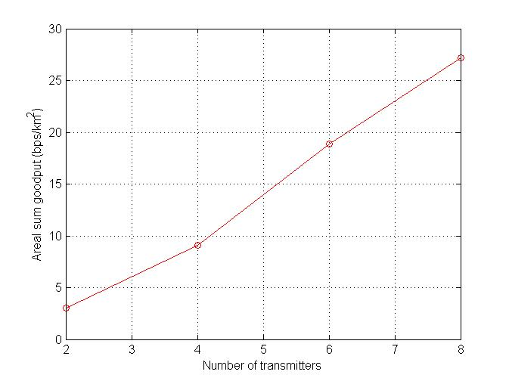
Realistic Scenario - Goodput
In the multi-hop scenario, the
result also similar with previous
simulation result.
<Multi-Hop Scenario>

Slide 134
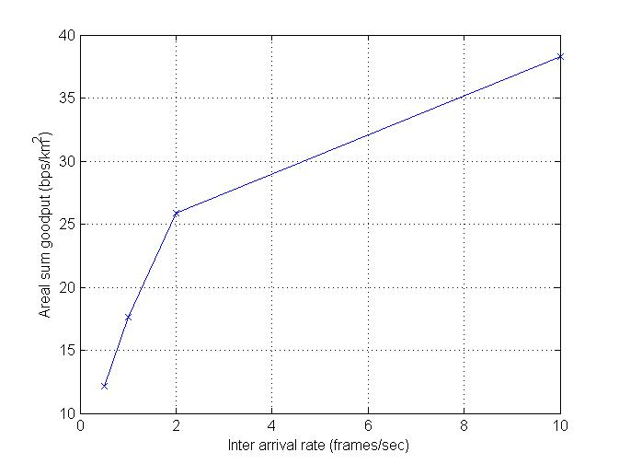
Realistic Scenario – Goodput (x-axis: inter arrival rate)
# of Transmitters: 8
As we expected the goodput increases
as the inter arrival rate increases.
→ Since high inter arrival rate generates
more traffic loads.
<Single-Hop Scenario>

Slide 135
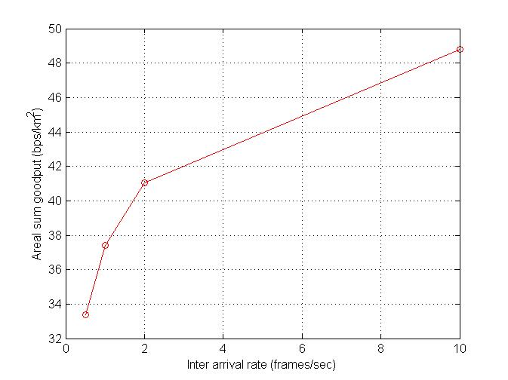
Realistic Scenario – Goodput (x-axis: inter arrival rate)
# of Transmitters: 8
→ Similar to single-hop scenario,
the goodput increases with the
inter arrival rate.
<Multi-Hop Scenario>

Slide 136
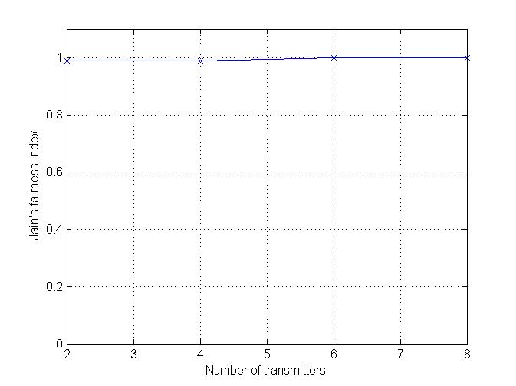
Realistic Scenario – Jain’s Fairness Index
→ Fairness also similar to previous
scenario.
<Single-Hop Scenario>

Slide 137
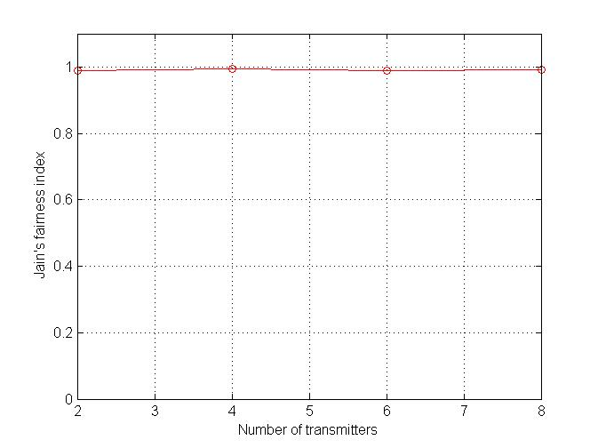
Realistic Scenario – Jain’s Fairness Index
→ Fairness also similar to previous
scenario.
<Multi-Hop Scenario>

Slide 138
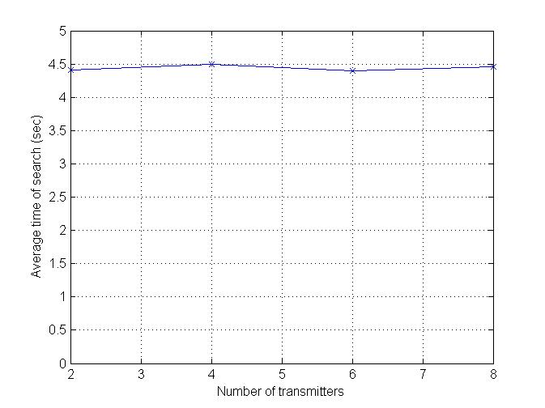
Realistic Scenario – Average Group Joining Time
→ The group joining time is 4.5 seconds,
<Single-Hop Scenario>

Slide 139
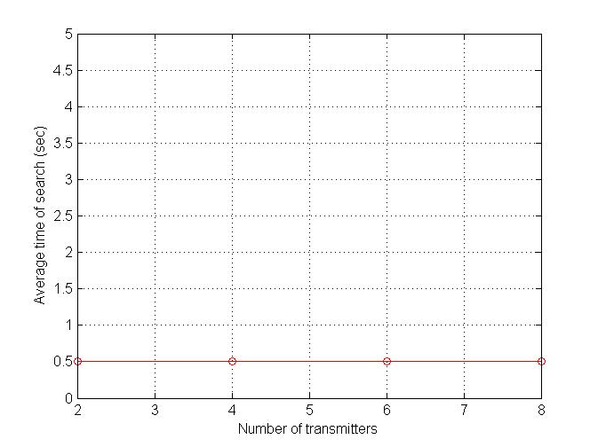
Realistic Scenario – Average Group Joining Time
<Multi-Hop Scenario>

Slide 140
Security Mechanism for PAC

Slide 141
Authentication
Process of verifying ‘who’ is at the other end of the link
Performed for devices (PAC_ADDR)
Achieved by authentication procedure based on the stored authentication key (AUTH_KEY) or by peering (entering a PIN)
Slide 141

Slide 142
Authorization
Process of deciding if device X is allowed to have access to service Y
Trusted devices (authenticated) are allowed to services
Untrusted or unknown devices may require authorization based on interaction before access to services is granted
Authorization always includes authentication
Technically, key would be derived or given (established) to the authorized user
Slide 142

Slide 143
Authorization
Device trust levels
Trusted device | The device has been previously authenticated, An AUTH_KEY is stored The device is marked as “trusted” in the device DB
Untrusted device | The device has been previously authenticated An AUTH_KEY is stored But the device is not marked as “trusted” in the device DB
Unknown device | No security information is available for this device This is also an untrusted device
Slide 143

Slide 144
Security Modes
Security mode 1 (non-secure)
  When a PAC device is in security mode 1, it shall never initiate any security procedure
Slide 144

Slide 145
Security Modes
Security mode 2 (service level enforced security)
  When a PAC device is in security mode 2, it shall not initiate any security procedure before a channel establishment request has been received or a channel establishment procedure has been initiated by itself
  Whether a security procedure is initiated or not depends on the security requirements of the requested channel or service
  Security mode 1 can be considered as a special case of security mode 2 where no service has registered any security requirements
Slide 145

Slide 146
Security Modes
Security mode 2 (cont.)
  A PAC device in security mode 2 should classify the security requirements of its services using the following attributes
Authentication required | - Before connecting to the application, the remote device must be authenticated
Authorization required | - Access is only granted automatically to trusted PAC devices, or untrusted devices after an authorization procedure - Always requires authentication to verify that the device is the right one
Encryption required | - The link must be changed to encrypted mode, before access to the service is possible

Slide 147
Security Modes
Security mode 3 (link level enforced security)
  When a PAC device is in security mode 3, it shall initiate security procedures before the channel is established

Slide 148
Security Parameters
Entity | Size
PAC_ADDR | xxx bits
AUTH_KEY | $≥$160 bits
ENC_KEY | $≥$128 bits
GENC_KEY | $≥$128 bits
RAND | $≥$128 bits
PAC_ADDR: PAC device address (unique for each device)
AUTH_KEY: used for authentication purposes
ENC_KEY: encryption key (for secure unicast)
GENC_KEY: group encryption key
RAND: frequently changing random or pseudo-random number made by the PAC device itself

Slide 149
Flow Chart for Authentication
Authentication start
Already authenticated
yes
no
Link key (AUTH_KEY) available
yes
no
no
Peering allowed
yes
fail
Peering
ok
Authentication fail
Authentication OK

Slide 150
Flow Chart for Authorization
Authorization start
Trusted
yes
no
Link key (AUTH_KEY) available
yes
Creation of trust allowed?
no
no
yes
fail
Authentication succeed?
Create trust
yes
Authorization fail
Authorization OK
Slide 150

Slide 151

Infrastructureless Architecture
No coordinator or AAA (authentication, authorization, accountability) server
Using PIN (symmetric), or certificate (asymmetric) issued by the trusted third party
  Cf) Bluetooth pairing
Slide 151

Slide 152
Key Derivation
Device A
Device B
PIN
PIN
During
peering
PRF
PRF
Authentication
AUTH_KEY_{AB}
AUTH_KEY_{AB}
PRF
PRF
Encryption
ENC_KEY
ENC_KEY
Slide 152

Slide 153


Infrastructure Architecture
AAA (authentication, authorization, accountability) server
(Dynamic) Coordinator
  Intermittent connection to the AAA server
Using master key (symmetric) issued by the AAA server, or certificate issued by the AAA server
  Cf) IEEE 802.1x, Kerberos protocol
coordinator
AAA server
2G/3G/LTE
Authentication &
communication
flow
Communication
flow
Server for some services (e.g., advertising)
Slide 153

Slide 154

PD A
Coordinator B
AS
(Re)association
Association
EAP Start(Msg Header)
EAP Transfer(EAP Payload)
EAP authentication
MSK
EAP Transfer(EAP Success)
Access Accept(PMK)
MSK, PMK
PMK
PMK
AUTH_KEY
AUTH_KEY
SA-ENC-Challenge
SA-ENC-Request
3-way handshake
SA-ENC-Response
Key Request
ENC_KEY delivery
Key Reply(ENC_KEY)
ENC_KEY
ENC_KEY
Group key delivery
Group key delivery delay

Slide 155
EAP Authentication
Extensible Authentication Protocol (EAP)
  De facto authentication protocol for infrastructure architecture (interact with AAA server)
    IEEE 802.16, 802.11, …
  Fulfill the criteria: mutual authentication, protection against the man-in-the-middle attack
  EAP-PSK, EAP-AKA, EAP-PEAP, …
  Yields the512-bit master secret key (MSK)
    Then the other key encryption keys (KEK) and HMAC/CMAC keys are derived from the MSK
Slide 155

Slide 156
Authentication Key Generation
PD A and AS derive MSK, and then PMK
PD A and coordinator B derive AUTH_KEY from PMK
Then, PD A and coordinator B derive
  A shared KEK
  HMAC/CMAC key from the AUTH_KEY

Slide 157
SA-ENC 3-Way Handshake
Provides the following security guarantees:
  Full mutual authentication
  PD A is alive and that A possesses the AUTH_KEY
  Coordinator B is alive
  The coordinator B is guaranteed that SA-ENC-Update is sent by the PD A and is fresh
Slide 157

Slide 158
ENC_KEY Distribution
After a successful authorization, the PD A dynamically requests parameters for SA(security association) including ENC_KEY
  KEY_Request
  KEY_Reply
Slide 158

Slide 159
Group Key Distribution
In a network environment where the secure multicast and broadcast service (MBS) is supported, additional group key (GENC_KEY) generation and delivery process is performed optionally after ENC_KEY distribution procedure
Update on every membership change
  Backward security
  Forward security
Slide 159

Slide 160
Thank you

Slide 161
Finding/Joining Multicast Group (9/12)
S | X
B | X
A | X
C | X
A
B
A | X
D | X
S
E
C
B | X
D | X
C | X
E | X
D
: Multicast Data Frame
: ACK
: Pre-ACK

Slide 162
Expected Questions List
중간중간에 Relay-disable PD (Routing Table이 없음)가 존재할 시 제안한 프로토콜이 잘 동작할 것인가?
  Relay-disable PD는 원래 Routing Table이 없고, 이 PD와 연결된 다른 PD들간에 Routing Table 정보를 가지고 있기 때문에 문제없이 잘 동작 할 수 있음.
  애초 그룹 생성시, ACF와 ARCF 교환 과정에서 Relay-disable PD들은 라우팅 정보를 생성하지 않음.

