Slide 1
Project: IEEE P802.15 Working Group for Wireless Personal Area Networks (WPANs)
Submission Title: A Feasible and Efficient Channel Access Scheme for PAC Networks
Date Submitted: July x, 2013
Source: Sunggeun Jin (Daegu University), Byung-Jae Kwak (ETRI), Kapseok Chang (ETRI),
Moon-Sik (ETRI)
Address: ETRI, Daejeon, Korea
Voice
E-Mail: sgjin@daegu.ac.kr, {bjkwak, kschang, moonsiklee}@etri.re.kr
Re: [A new technical proposal providing a feasible and efficient contention based channel access policy ]
Abstract: [We provide a new contention based channel access policy for the 802.15.8 PAC networks.]
Purpose: [Providing a technical proposal of a new channel access policy]
Notice: This document has been prepared to assist the IEEE P802.15. It is offered as a basis for discussion and is not binding on the contributing individual(s) or organization(s). The material in this document is subject to change in form and content after further study. The contributor(s) reserve(s) the right to add, amend or withdraw material contained herein.
Release: The contributor acknowledges and accepts that this contribution becomes the property of IEEE and July be made publicly available by P802.15.

Slide 2
A Feasible and Efficient Channel Access Scheme in the PAC networks
July 2013
Sunggeun Jin (Daegu Univ.), Byung-Jae Kwak (ETRI),
Kapseok Chang (ETRI), Moon-Sik Lee (ETRI)

Slide 3
Introduction
Motivation:
  Most PAC networks are expected to be deployed in unlicensed bands.
  The PAC networks should coexist with existing networks in unlicensed bands.
  Simple, efficient, and scalable centralized resource allocation scheme is not feasible in unlicensed bands
    Simple: little book keeping
    Efficient: high performance, small overhead
    Scalable: large number of devices
PAC PAR requirements
  Support a large number of PAC devices
  Fully distributed coordination

Slide 4
Assumptions
Synchronous operation
  The time is divided into slots. All times are measured in multiples of the slot.
  All devices are synchronized in time domain in slot level
  All devices are synchronized in frequency domain
Independent of super frame structure
  The access scheme is independent of the underlying or the lack of super-frame structure
Use Slotted CSMA/CA as a fundamental channel access scheme

Slide 5
Synchronous Operation
Devices overhear PAC frames
Use distributed synchronization algorithm to achieve timing and frequency synchronization [1]

Slide 6
Slotted CSMA/CA
CSMA/CA
  It is the most successful channel access policy for unlicensed frequency bands
  Proven to work in distributed wireless networks
Slotted CSMA/CA
  Channel accesses are tried in units of time slots
  It can be exploited with timing synchronization.
  Slotted CSMA/CA eases the design of network management schemes without centralized coordination.

Slide 7
Typical Random Access using CSMA/CA
A random number is selected between 0 and CW-1 (CW: Contention Window)
The chosen number decreases every idle time slots
A frame is transmitted when the number reaches 0
If the transmission experiences a collision, the CW is increased by factor 2 (BEB: Binary Exponential Backoff)
If the transmission succeeds, the CW is reduced to the minimum CW

Slide 8
Improvements to Typical Random Access
Each device should estimate the number of active neighboring devices in the network
CW should be adaptively managed reflecting the number of active devices
Improved backoff scheme: BEB is not scalable
How?
  The number of collisions is a good indicator of the number of active devices
  The devices attempting to access channel needs to detect collisions incurred by simultaneous frame transmissions
  Use EIED as backoff algorithm [2]

Slide 9
Collision Detection
Two approaches: tone based & sequence based [3]
Tone based
  Use one dedicated OFDM symbol for tones
  Simple collision detection
Sequence based
  Collision detection capability is embedded in the preamble
  More reliable collision detection

Slide 10


Collision Detection with Tones
Sending tone
Tx
Rx
Receiving tone
Tone Tx
Tone Rx
What is “tone”
  Energy transmission occupying an OFDM sub-channel.
  It does not have any information regarding phase and amplitude.
A sender transmits a frame including a random tones
A receiver detects the tones in the received frame

Slide 11


Collision Detection with Tones
Tx
Monitoring
Tx
Collision detection procedure
  Devices select and transmit two random tones, each from upper- and lower-half of the sub-carriers
  A monitoring device overhears a frame and detects a collision when it detects more than one tones in each sub-carrier blocks
  Requires frequency synchronization

Slide 12
Collision Detection with Sequences
STF
LTF
1st Collision
Detection
2nd Collision
Detection
Collision detection procedure
  Devices select random root ZC to generate STF and LTF, and the preamble is built with STF and LTF
  A monitoring device overhears a frame. The last period of STF is used for 1st collision detection. If collision is not detected in STF, the last period of LTF is used for 2nd collision detection

Slide 13
Proposed Slotted CSMA/CA
Proposed CSMA/CA Mechanism
  Each device overhears the frames in the air
  Each device increase its contention window if it detects a collision
  Each device decrease its contention window when it does not detect a collision for a given time period (T)
  A device transmits a frame and does not receives an ACK, the device assumes its frame was involved in a collision and increases it contention window
  The increase and decrease of the contention window follows EIED backoff alg.
Features of the proposed CSMA/CA
  Adaptive: The contention window in each device is adjusted dynamically, reflecting the channel condition in a distributed manner
  No “lucky” or “unlucky” devices: The contention window is updated based on the network events, not based on each device’s own experience
  Fairness: In the steady state, all devices have the same contention window size on the average
  Efficiency: The EIED backoff algorithm guarantees efficient medium access [2]

Slide 14
Evaluations
Evaluation scenarios
  Every two devices are paired
  All devices are always ready to transmit traffic (full buffer)
Evaluation parameters
  Slotted CSMA/CA is employed
  One slot time = 8 us
  SIFS = 1 slot time * 2
  PIFS = SIFS + 1 slot time
  DIFS = PIFS + 1 slot time
  Frame structures are assumed to be the same as those of the 802.11
  Frame lengths are multiples of slot time (zero padding if necessary)
Note: The exact parameters are TBD.

Slide 15
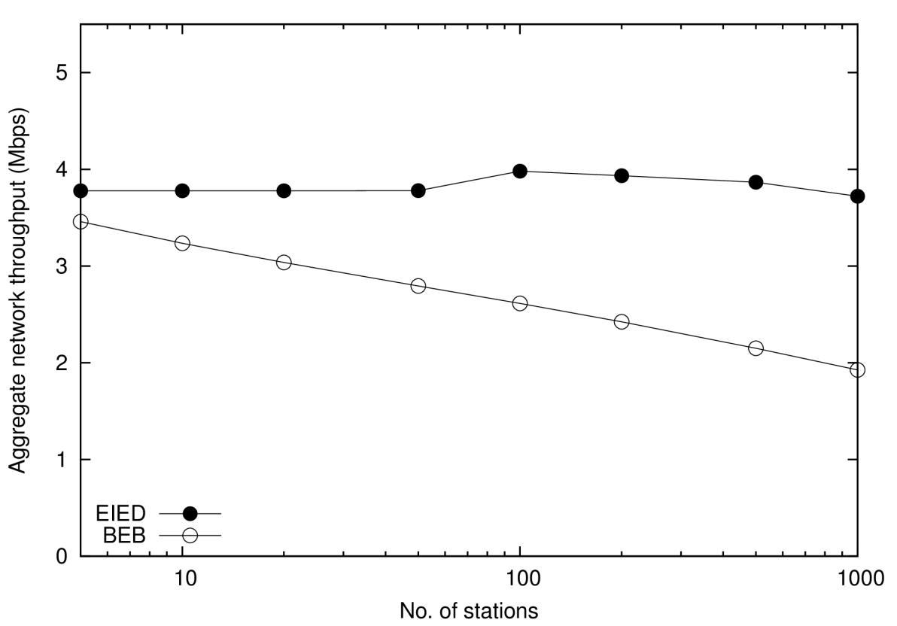
Simulation Results
Proposed random access is scalable
  Easily supports 1000 PDs
  The throughput remains constant for a wide range of # PDs
Proposed random access is highly efficient
  Outperforms BEB for low load
  Almost twice the throughput of BEB when network is crowded
Proposed random access is simple
T = 10 ms
Data rate = 5.5 Mbps
EEID factor = 1.4 (for both up and down)
Payload = 1024 bytes
CW_{min} = 16
CW_{max} = 16 * 1024

Slide 16
Not Covered in the Simulation
Hidden/Exposed terminal problem
  PAC is expected to have significant hidden/exposed terminal problems
Find tuning of the parameters
  T, CW_{min}, CW_{max}, EIED factor for CW increase, EIED factor for CW decrease, etc
Wireless Channel
A variety of traffic models

Slide 17
Text Proposal

Slide 18
References
[1] Jung-Hyun Kim, Jihyung Kim, Kwangjae Lim, Dong Seung Kwon, “Distributed Frequency Synchronization for Global Synchronization in Wireless Mesh Networks,” World Academy of Science and Technology, vol. 70, 2012, pp. 1080-1084.
[2] Nah-Oak Song, Byung-Jae Kwak, Jabin Song, L. E. Miller, “Enhancement of IEEE 802.11 Distributed Coordination Function with Exponential Increase Exponential Decrease Backoff Algorithm,” Proceedings of IEEE 57th Vehicular Technology Conference (VTC 2003-Spring), vol. 4, pp. 2775−2778, Jeju, Korea, April 22−25, 2003.
[3] IEEE 802.15-13-0373-0x-0008, “ETRI Technical PHY proposal for IEEE 802.15 TG8 PAC Standard” July 2013.

