Slide 1
Project: IEEE P802.15 Working Group for Wireless Personal Area Networks (WPANs)
Submission Title: [ NICT PHY Proposal, Part B ]
Date Submitted: [ July 6th, 2013 ]
Source: [ Marco Hernandez, Huan-Bang Li, Igor Dotlić, Ryu Miura ]
Company: [ NICT ]
Address: [ 3-4 Hikarino-oka, Yokosuka, 239-0847, Japan ]
Voice:[+81 46-847-5439] Fax: [+81 46-847-5431] E-Mail:[]
Re: [In response to call for technical proposals to TG8]
Abstract: [ ]
Purpose: [Material for discussion in 802.15.8 TG]
Notice: This document has been prepared to assist the IEEE P802.15. It is offered as a basis for discussion and is not binding on the contributing individual(s) or organization(s). The material in this document is subject to change in form and content after further study. The contributor(s) reserve(s) the right to add, amend or withdraw material contained herein.
Release: The contributor acknowledges and accepts that this contribution becomes the property of IEEE and may be made publicly available by P802.15.

Slide 2
Outline
General PHY description (Part A)
Physical Channels
Data Formatting
Modulation Parameters
Multiple Antenna Procedures
PHY Layer Procedures (Part B)
  discovery, random access
Optional FSK modulation

Slide 3
Common mode Discovery
Peer aware communication networks are aimed to operate without central control:
  Hence, transmission for initial discovery or re-discovery among peers is asynchronous.
Thus, a preamble sequence is required for time and frame synchronization at start up or when re-synchronization is required for discovery or communication.

Slide 4
Common mode Discovery
We propose to use a discovery preamble (DP) based on a ZC sequence and a discovery resource block (DRB) from a modified (DTF-S) OFDM signal.
  The DP and DRB formed the Discovery Signal (DS).
Moreover, we propose to use one channel (from the proposed channelization for sub-GHz, 2.4 GHz and 5.7 GHz bands) for only discovery of devices.
  PAC devices can either transmit or receive the DS in this unique channel asynchronously.
Such unique channel for discovery is named Shared Discovery Channel (SDCH).

Slide 5
Common mode Discovery
The discovery signal (DS) sent over a discovery shared channel (DSCH):
The DS consists of a preamble sequence plus a DRB formed by N_{fs} frequency slots and N_{ts} time slots.
Once synchronized, a receiver knows the location of the discovery resource block (DRS) to scan for possible peers or to pick time-frequency slots to transmit its DS.

Slide 6
Proposed ZC sequence for timing synchronization
The proposed ZC sequence for initial synchronization during discovery (or communication mode) is a ZC sequence with the following parameters:
  Sequence length N = 63, relative prime r = 62 and q = 0.

Slide 7
Proposed ZC sequence for timing synchronization
Such ZC sequence is mapped onto 62 sub-carriers
  The first subcarrier and the DC subcarrier are empty.
  Of course, several repetitions may be transmitted.

Slide 8
DRB
For discovery, the proposed PHY can be reused with some simplifications.
The discovery process is energy intensive. In order to minimize power consumption, in case of DTF-Spread OFDM, the M-point FFT is bypassed (this is not required for OFDM) and only one subcarrier of the N-point IFFT is used per user.
  The PAPR is set to the minimum.
  Across the frequency domain, users are orthogonal (OFDMA)

Slide 9

DRB
For discovery, the nth symbol transmitted over the kth subcarrier is given by
  $x_{n}\left[l,k\right]=\frac{1}{N}X_{n}\left[k\right]\text{exp}(j2πlk/N)$
  for l=-L+1,,…,0,1,…,N-1 and L the CP

Slide 10
DRB structure
Contiguous subcarriers are orthogonal.
The DS is transmitted with a predefined duty-cycle (see NICT MAC pre-proposal).

Slide 11
DRB structure
From upper layers, terminals pick time-frequency slots in the DRB to transmit the DS.
A set of 126 symbols are transmitted per time slot:
  such frame contains information about a given peer (peer ID, service ID, application ID, etc.) and which channel is used for association (different from the SDCH).
The number of frequency slots N_{fs} =1024 (IFFT size) and the number of time slots N_{ts} is chosen as 20.
Consequently, the DRB can support up to N_{fs}xN_{ts}=20,480 users for discovery per Group.

Slide 12
DRB structure
The discovery data is formatted as illustrated
Append 57 bits for user ID, device ID, Group ID, etc.
Append 6 bits from CRC-6-ITU error detection code
Append 63 bits from shorten BCH(126,63) code

Slide 13
Discovery algorithm parameters
Devices are in three possible states:
  RDM –receiving discovery mode,
  TDM –transmitting discovery mode,
  Sleep -idle.
  Also, devices are equipped with clear channel assessment (CCA).

Slide 14
Discovery Algorithm
  1) At start up or after idle or after command, a device enters into receiving discovery mode (RDM) and listens for a DS.
    Synchronization subsystem detects the preamble (and hence the position of the DRB in time) and detection subsystem scans the DRB for DRB usage and detection of peer ID, service ID, etc. Go to Sleep mode.
  2) After command, a device enters into transmitting discovery mode (TDM)
    Device chooses a free time-frequency slot to transmit its DS over the next DRB transmission. Go to Sleep mode.
  Of course, there are intermediate steps like time-out for DRB scanning, miss detection, etc. Here, we present the core algorithm only.

Slide 15
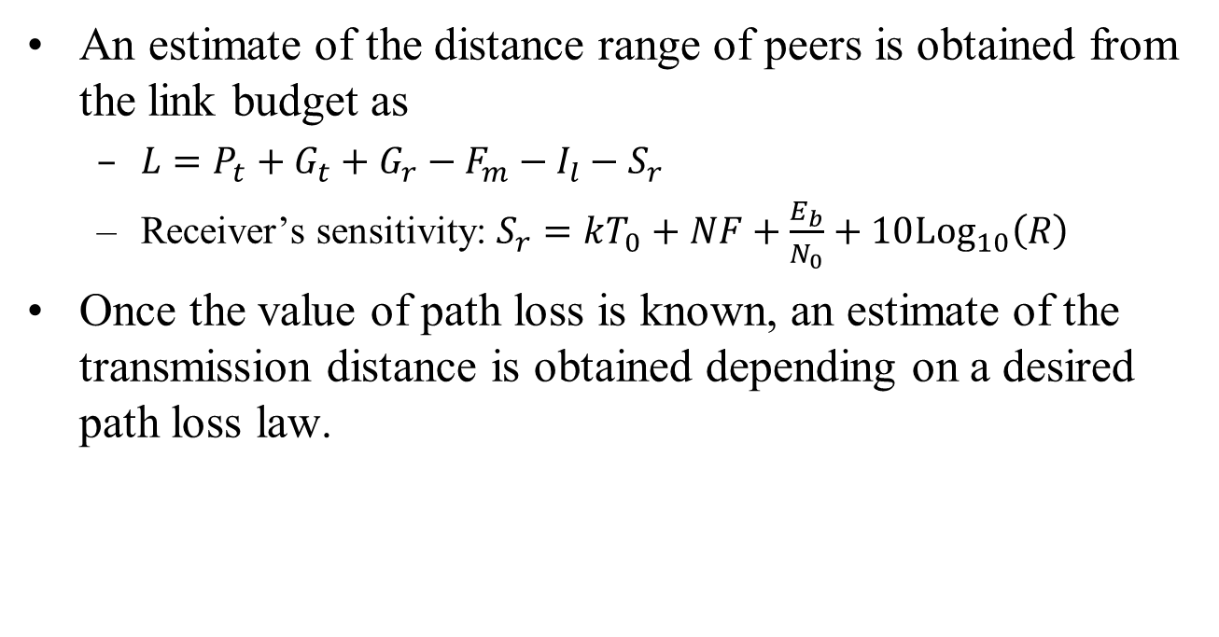
Discovery range
An estimate of the distance range of peers is obtained from the link budget as
  $L=P_{t}+G_{t}+G_{r}−F_{m}−I_{l}−S_{r}$
  Receiver’s sensitivity: $S_{r}=kT_{0}+NF+\frac{E_{b}}{N_{0}}+10{\text{Log}}_{10}\left(R\right)$
Once the value of path loss is known, an estimate of the transmission distance is obtained depending on a desired path loss law.

Slide 16
Discovery range
Path loss parameters
  920 MHz band, option C.
  The maximum transmit power at the input antenna: Pt = 250 mW.
  Antenna gains are assumed as Gt = Gr = 0 dBi.
  The fade margin: Fm = 6 dB.
  Receiver’s implementation losses: Il = 3 dB.
  Receiver’s noise figure: NF = 6 dB.
  Through simulations: E_{b}/N₀ = 8 dB for BER= 10⁻⁷ (BPSK).
  Data rate: 1 Mbps, 250 kbps.
The maximum allowed path losses are:
  L₁ = 114:97 dB for 1 Mbps
  L₂ = 120:98 dB for 250 kbps

Slide 17
Discovery range
Using the ITU outdoor path loss model with h_{b}=h_{m}=1.5 m, distances are:
  900 m for 1 Mbps
  1200 m for 250 kbps.
Using the indoor path loss model with n = 3.27 and 2 block walls, distances are:
  60 m for 1 Mbps
  80 m for 250 kbps.

Slide 18
Discovery-Association
Notice that the first terminal to start a discovery session, will set the discovery signal duty cycling for other terminals to follow, no matter if it stops transmitting afterwards. There is not central control.
Also, such terminal will set the channel for association (communication link) named Association Channel (ACH). Although, it may change afterwards.
For association, intended devices that want to establish a communication link, request that through a random access preamble transmitted in the ACH.

Slide 19
Association Preambles
The random access association preambles are named Random Access Preambles (RAPs).
Such RAPs are formed with ZC sequences as well.
Hence, a pool of orthogonal RAPs is formed
  in order to reduce interference from competing terminals for random access.
A unique RAP is assigned to every device in a Group.
Such unique RAP is used for fine synchronization and control messages (how a communication link is granted).

Slide 20
RAP structure
The RAP signal is illustrated as
  GI is guard interval
  In MAC lingo, it is known as beacon.

Slide 21
RAPs
Set of orthogonal preambles
Maximum round-trip time
  T_{seq} must allow round-trip estimation at the largest expected distance.
  d=500 m (1 km round-trip)

Slide 22
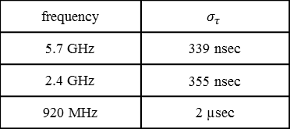
RAPs
The RMS delay spread is estimated as
frequency | $$σ_{τ}$$
5.7 GHz | 339 nsec
2.4 GHz | 355 nsec
920 MHz | 2 µsec

Slide 23
RAPs
Coverage performance can be estimated from the link budget
It is possible to show
  E_{p} is the required preamble energy to meet a PFA of 10⁻³
Parameters
  d=500m, f_{c}=2.4 GHz, P_{t}=1 W, G_{t}=G_{r}=5 dBi, NF=5 dB, kT₀=-204 dB, the path loss model in clause 2.2.6 of the channel model document, through simulations E_{p}/N₀=18 dB.
  T_{seq}=0.433 msec

Slide 24
RAPs
CP and GI lengths
Thus, T_{seq} is upper bounded by
From (1) and (2) T_{seq}=0.4 msec satisfies both inequalities
  Inter-carrier spacing
  Granularity increment
  Sampling time
  Preamble sequence length

Slide 25
RAPs
Conclusion: a set of orthogonal preamble sequences of length 1024 can be generated from ZC sequences for random access, which satisfy maximum round-trip time and coverage performance for a maximum distance of 500m.

Slide 26
Random access procedure
Once initial synchronization and decoding of discovery RB are achieved by Terminal 2 over Terminal 1:
  Terminal 2 requests association by a random access procedure based on an orthogonal RAP.

Slide 27
Random access procedure
The process is initiated and control by upper layers.
1) Terminal 2 sends RAP over the ACH.
  It is randomly selected from a pool of orthogonal ZC sequences.
  It contains finer frequency granularity for Terminal 1 to acquire fine time and frequency synchronization of Terminal 2, plus information about the resources needed to transmit in 3).

Slide 28
Random access procedure
2) Terminal 1 replies with RA response message.
  It contains timing information (round-trip delay), RAP-ID, RB grant to transmit in 3), Group identifier, etc.

Slide 29
Random access procedure
3) Scheduling request
  It contains scheduling request information for transmission.
  If this message is successfully detected in Terminal 1, still contention remains unsolved for other terminals. A quick resolution is needed.

Slide 30
Random access procedure
4) Contention resolution
  Terminal 1 echoes Terminal 2 ID contained in 3)
  Terminal 2 detects its ID and sends ACK (RA terminated) a communication link is scheduled and established.
  Terminal 2 detects another ID (RA terminated, starts a new one)
  Terminal 2 fails to detect ID (RA terminated, starts a new one)

Slide 31
Optional FSK PHY
An optional and very low power PHY based on CP-2FSK modulation is contemplated for the sub-GHz band.
No support for MIMO technologies, i.e., layer mapper and precoding are not necessary.
The proposed channel encoder, bit interleaver and scrambler are used as well. The modulation mapper is CP-2FSK.

Slide 32
Optional FSK PHY
CP-2FSK modulation
  V is amplitude, S(t)=sin(2πf_{c}t) is the modulating-carrier signal, f_{c} is the carrier frequency, is the peak frequency deviation, β=1 is the modulation index, T_{sym} is the symbol time and φ₀ is the initial phase of the modulating-carrier signal
The information bearing signal is
  g_{m} is information bit, p(t) is a Gaussian pulse shape of bandwidth-symbol duration product of 0.8

Slide 33
End
Thanks for your attention

