Slide 1
Project: IEEE P802.15 Working Group for Wireless Personal Area Networks (WPANs)
Submission Title: [ NICT PHY Proposal, Part A ]
Date Submitted: [ July 6th, 2013 ]
Source: [ Marco Hernandez, Huan-Bang Li, Igor Dotlić, Ryu Miura ]
Company: [ NICT ]
Address: [ 3-4 Hikarino-oka, Yokosuka, 239-0847, Japan ]
Voice:[+81 46-847-5439] Fax: [+81 46-847-5431] E-Mail:[]
Re: [In response to call for technical proposals to TG8]
Abstract: [ ]
Purpose: [Material for discussion in 802.15.8 TG]
Notice: This document has been prepared to assist the IEEE P802.15. It is offered as a basis for discussion and is not binding on the contributing individual(s) or organization(s). The material in this document is subject to change in form and content after further study. The contributor(s) reserve(s) the right to add, amend or withdraw material contained herein.
Release: The contributor acknowledges and accepts that this contribution becomes the property of IEEE and may be made publicly available by P802.15.

Slide 2
Outline
General PHY description (Part A)
Physical Channels
Data Formatting
Modulation Parameters
Multiple Antenna Procedures
PHY Layer Procedures (Part B)
  discovery, random access
Optional FSK modulation

Slide 3
Common mode PHY Description

Slide 4
Physical Channels
Frequency bands of operation are:
  Sub-GHz, 2.4 GHz and 5.7 GHz bands.
Those are selected because they do not require operation license. Hence, implementers only comply with local regulations. Moreover, those bands cover all PAC applications in terms of mobility and operational distance.

Slide 5
Proposed frequency band allocations
Channelization of 5.7 GHz band
  Such frequency band ranges from 5.725 GHz to 5.875 GHz, which is divided into 14 channels of 10 MHz. By regulation, the maximum transmit power at the input antenna is 1 W. The central frequencies are given by
  f_{c} = 5735 MHz + 10n for n = 0, 1, ..., 13
Channelization of 2.4 GHz band
  Such frequency band ranges from 2.4 GHz to 2.5 GHz, which is divided into 9 channels of 10 MHz. By regulation, the maximum transmit power at the input antenna is 1 W. The central frequencies are given by
  f_{c} = 2410 MHz + 10n for n = 0, 1, ..., 8

Slide 6
Physical Channels
Channelization of 920 MHz band (Japan)
  Such frequency band ranges from 915.9 MHz to 929.7 MHz. However, this frequency band is divided according to the maximum power at the input antenna and maximum bandwidth allowed by regulations.
  Option 1: frequency band ranges from 915.9 MHz to 928.1 MHz and divided into 61 basic channels of 200 kHz. The bandwidth rule tolerance: 200 n kHz, where n=1,2,3,4,5. Therefore, the maximum bandwidth is 1 MHz.
  Option 2: The frequency band ranges from 928.1 MHz to 929.7 MHz and divided by 16 basic channels of 100 kHz. The bandwidth tolerance: 100 n kHz, where n=1,2,3,4,5. Therefore, the maximum bandwidth is 500 kHz.

Slide 7
Physical Channels
The basic channelization by regulations in Japan is summarized in the following table:
  ¹bandwidth rule tolerance: 200 n kHz, where n=1,2,3,4,5.
  ²bandwidth rule tolerance: 100 n kHz, where n=1,2,3,4,5.

Slide 8
Physical Channels
Proposed channelization

Slide 9
Data Formatting
The physical layer protocol data unit (PPDU) is formed by concatenating synchronization header (SHR), Discovery header (DIS), physical layer header (PHR) and physical layer service data unit (PSDU)
Reference signals for demodulation/equalization are embedded in the PSDU

Slide 10
PSDU construction
The MAC protocol data unit (MPDU) is passed to the PHY
Such data is encoded by QC-LDPC codes.
QC-LDPC codes allows performance close to turbo codes, besides that encoder/decoder enable high throughput and low implementation complexity (efficient implementation in parallel architectures).
Quasi-cyclic LDPC codes are systematic, linear codes satisfying

Slide 11
FEC
Codeword , k information bits, n-k parity bits.
Parity check matrix
QC-LDPC codes are defined by a prototype matrix
H is constructed from H_{p} by replacing each entry [H_{p}]_{i,j} with either a cyclic shift matrix P_{c}, identity or null matrices of size ZxZ (final size of H is M_{p}ZxN_{p}Z).
If [H_{p}]_{i,j}=0 , replace it by I_{ZxZ}=P₀
If [H_{p}]_{i,j}=“-”, replace it by 0_{ZxZ}
If [H_{p}]_{i,j}=c , replace it by P_{c}

Slide 12
FEC
The cyclic-permutation matrix P_{c} is obtained by cyclically shifting the columns of P₀=I_{ZxZ} to the right c times.
Example:

Slide 13
FEC
QC-LDPC parameters
k= number of information bits, n=number of coded bits,
n-k=number of parity bits.

Slide 14
FEC
H_{p} for n=648, Z=27, R=1/2.
0 | - | - | - | 0 | 0 | - | - | 0 | - | - | 0 | 1 | 0 | - | - | - | - | - | - | - | - | - | -
22 | 0 | - | - | 17 | - | 0 | 0 | 12 | - | - | - | - | 0 | 0 | - | - | - | - | - | - | - | - | -
6 | - | 0 | - | 10 | - | - | - | 24 | - | 0 | - | - | - | 0 | 0 | - | - | - | - | - | - | - | -
2 | - | - | 0 | 20 | - | - | - | 25 | 0 | - | - | - | - | - | 0 | 0 | - | - | - | - | - | - | -
23 | - | - | - | 3 | - | - | - | 0 | - | 9 | 11 | - | - | - | - | 0 | 0 | - | - | - | - | - | -
24 | - | 23 | 1 | 17 | - | 3 | - | 10 | - | - | - | - | - | - | - | - | 0 | 0 | - | - | - | - | -
25 | - | - | - | 8 | - | - | - | 7 | 18 | - | - | 0 | - | - | - | - | - | 0 | 0 | - | - | - | -
13 | 24 | - | - | 0 | - | 8 | - | 6 | - | - | - | - | - | - | - | - | - | - | 0 | 0 | - | - | -
7 | 20 | - | 16 | 22 | 10 | - | - | 23 | - | - | - | - | - | - | - | - | - | - | - | 0 | 0 | - | -
11 | - | - | - | 19 | - | - | - | 13 | - | 3 | 17 | - | - | - | - | - | - | - | - | - | 0 | 0 | -
25 | - | 8 | - | 23 | 18 | - | 14 | 9 | - | - | - | - | - | - | - | - | - | - | - | - | - | 0 | 0
3 | - | - | - | 16 | - | - | 2 | 25 | 5 | - | - | 1 | - | - | - | - | - | - | - | - | - | - | 0

Slide 15
FEC
H_{p} for n=648, Z=27, R=2/3
25 | 26 | 14 | - | 20 | - | 2 | - | 4 | - | - | 8 | - | 16 | - | 18 | 1 | 0 | - | - | - | - | - | -
10 | 9 | 15 | 11 | - | 0 | - | 1 | - | - | 18 | - | 8 | - | 10 | - | - | 0 | 0 | - | - | - | - | -
16 | 2 | 20 | 26 | 21 | - | 6 | - | 1 | 26 | - | 7 | - | - | - | - | - | - | 0 | 0 | - | - | - | -
10 | 13 | 5 | 0 | - | 3 | - | 7 | - | - | 26 | - | - | 13 | - | 16 | - | - | - | 0 | 0 | - | - | -
23 | 14 | 24 | - | 12 | - | 19 | - | 17 | - | - | - | 20 | - | 21 | - | 0 | - | - | - | 0 | 0 | - | -
6 | 22 | 9 | 20 | - | 25 | - | 17 | - | 8 | - | 14 | - | 18 | - | - | - | - | - | - | - | 0 | 0 | -
14 | 23 | 21 | 11 | 20 | - | 24 | - | 18 | - | 19 | - | - | - | - | 22 | - | - | - | - | - | - | 0 | 0
17 | 11 | 11 | 20 | - | 21 | - | 26 | - | 3 | - | - | 18 | - | 26 | - | 1 | - | - | - | - | - | - | 0

Slide 16
FEC
H_{p} for n=648, Z=27, R=3/4
16 | 17 | 22 | 24 | 9 | 3 | 14 | - | 4 | 2 | 7 | - | 26 | - | 2 | - | 21 | - | 1 | 0 | - | - | - | -
25 | 12 | 12 | 3 | 3 | 26 | 6 | 21 | - | 15 | 22 | - | 15 | - | 4 | - | - | 16 | - | 0 | 0 | - | - | -
25 | 18 | 26 | 16 | 22 | 23 | 9 | - | 0 | - | 4 | - | 4 | - | 8 | 23 | 11 | - | - | - | 0 | 0 | - | -
9 | 7 | 0 | 1 | 17 | - | - | 7 | 3 | - | 3 | 23 | - | 16 | - | - | 21 | - | 0 | - | - | 0 | 0 | -
24 | 5 | 26 | 7 | 1 | - | - | 15 | 24 | 15 | - | 8 | - | 13 | - | 13 | - | 11 | - | - | - | - | 0 | 0
2 | 2 | 19 | 14 | 24 | 1 | 15 | 19 | - | 21 | - | 2 | - | 24 | - | 3 | - | 2 | 1 | - | - | - | - | 0

Slide 17
FEC
H_{p} for n=648, Z=27, R=5/6
17 | 13 | 8 | 21 | 9 | 3 | 18 | 12 | 10 | 0 | 4 | 15 | 19 | 2 | 5 | 10 | 26 | 19 | 13 | 13 | 1 | 0 | - | -
3 | 12 | 11 | 14 | 11 | 25 | 5 | 18 | 0 | 9 | 2 | 26 | 26 | 10 | 24 | 7 | 14 | 20 | 4 | 2 | - | 0 | 0 | -
22 | 16 | 4 | 3 | 10 | 21 | 12 | 5 | 21 | 14 | 19 | 5 | - | 8 | 5 | 18 | 11 | 5 | 5 | 15 | 0 | - | 0 | 0
7 | 7 | 14 | 14 | 4 | 16 | 16 | 24 | 24 | 10 | 1 | 7 | 15 | 6 | 10 | 26 | 8 | 18 | 21 | 14 | 1 | - | - | 0

Slide 18
FEC
H_{p} for n=1944, Z=81, R=1/2
57 | - | - | - | 50 | - | 11 | - | 50 | - | 79 | - | 1 | 0 | - | - | - | - | - | - | - | - | - | -
3 | - | 28 | - | 0 | - | - | - | 55 | 7 | - | - | - | 0 | 0 | - | - | - | - | - | - | - | - | -
30 | - | - | - | 24 | 37 | - | - | 56 | 14 | - | - | - | - | 0 | 0 | - | - | - | - | - | - | - | -
62 | 53 | - | - | 53 | - | - | 3 | 35 | - | - | - | - | - | - | 0 | 0 | - | - | - | - | - | - | -
40 | - | - | 20 | 66 | - | - | 22 | 28 | - | - | - | - | - | - | - | 0 | 0 | - | - | - | - | - | -
0 | - | - | - | 8 | - | 42 | - | 50 | - | - | 8 | - | - | - | - | - | 0 | 0 | - | - | - | - | -
69 | 79 | 79 | - | - | - | 56 | - | 52 | - | - | - | 0 | - | - | - | - | - | 0 | 0 | - | - | - | -
65 | - | - | - | 38 | 57 | - | - | 72 | - | 27 | - | - | - | - | - | - | - | - | 0 | 0 | - | - | -
64 | - | - | - | 14 | 52 | - | - | 30 | - | - | 32 | - | - | - | - | - | - | - | - | 0 | 0 | - | -
- | 45 | - | 70 | 0 | - | - | - | 77 | 9 | - | - | - | - | - | - | - | - | - | - | - | 0 | 0 | -
2 | 56 | - | 57 | 35 | - | - | - | - | - | 12 | - | - | - | - | - | - | - | - | - | - | - | 0 | 0
24 | - | 61 | - | 60 | - | - | 27 | 51 | - | - | 16 | 1 | - | - | - | - | - | - | - | - | - | - | 0

Slide 19
FEC
H_{p} for n=1944, Z=81, R=2/3
61 | 75 | 4 | 63 | 56 | - | - | - | - | - | - | 8 | - | 2 | 17 | 25 | 1 | 0 | - | - | - | - | - | -
56 | 74 | 77 | 20 | - | - | - | 64 | 24 | 4 | 67 | - | 7 | - | - | - | - | 0 | 0 | - | - | - | - | -
28 | 21 | 68 | 10 | 7 | 14 | 65 | - | - | - | 23 | - | - | - | 75 | - | - | - | 0 | 0 | - | - | - | -
48 | 38 | 43 | 78 | 76 | - | - | - | - | 5 | 36 | - | 15 | 72 | - | - | - | - | - | 0 | 0 | - | - | -
40 | 2 | 53 | 25 | - | 52 | 62 | - | 20 | - | - | 44 | - | - | - | - | 0 | - | - | - | 0 | 0 | - | -
69 | 23 | 64 | 10 | 22 | - | 21 | - | - | - | - | - | 68 | 23 | 29 | - | - | - | - | - | - | 0 | 0 | -
12 | 0 | 68 | 20 | 55 | 61 | - | 40 | - | - | - | 52 | - | - | - | 44 | - | - | - | - | - | - | 0 | 0
58 | 8 | 34 | 64 | 78 | - | - | 11 | 78 | 24 | - | - | - | - | - | 58 | 1 | - | - | - | - | - | - | 0

Slide 20
FEC
H_{p} for n=1944, Z=81, R=3/4
48 | 29 | 28 | 39 | 9 | 61 | - | - | - | 63 | 45 | 80 | - | - | - | 37 | 32 | 22 | 1 | 0 | - | - | - | -
4 | 49 | 42 | 48 | 11 | 30 | - | - | - | 49 | 17 | 41 | 37 | 15 | - | 54 | - | - | - | 0 | 0 | - | - | -
35 | 76 | 78 | 51 | 37 | 35 | 21 | - | 17 | 64 | - | - | - | 59 | 7 | - | - | 32 | - | - | 0 | 0 | - | -
9 | 65 | 44 | 9 | 54 | 56 | 73 | 34 | 42 | - | - | - | 35 | - | - | - | 46 | 39 | 0 | - | - | 0 | 0 | -
3 | 62 | 7 | 80 | 68 | 26 | - | 80 | 55 | - | 36 | - | 26 | - | 9 | - | 72 | - | - | - | - | - | 0 | 0
26 | 75 | 33 | 21 | 69 | 59 | 3 | 38 | - | - | - | 35 | - | 62 | 36 | 26 | - | - | 1 | - | - | - | - | 0

Slide 21
FEC
H_{p} for for n=1944, Z=81, R=5/6
13 | 48 | 80 | 66 | 4 | 74 | 7 | 30 | 76 | 52 | 37 | 60 | - | 49 | 73 | 31 | 74 | 73 | 23 | - | 1 | 0 | - | -
69 | 63 | 74 | 56 | 64 | 77 | 57 | 65 | 6 | 16 | 51 | - | 64 | - | 68 | 9 | 48 | 62 | 54 | 27 | - | 0 | 0 | -
51 | 15 | 0 | 80 | 24 | 25 | 42 | 54 | 44 | 71 | 71 | 9 | 67 | 35 | - | 58 | - | 29 | - | 53 | 0 | - | 0 | 0
16 | 29 | 36 | 41 | 44 | 56 | 59 | 37 | 50 | 24 | - | 65 | 4 | 65 | 52 | - | 4 | - | 73 | 52 | 1 | - | - | 0

Slide 22
FEC
There are several techniques for decoding of QC-LDPC codes.
LDPC decoding is represented as a message passing (MP) algorithm in a factor graph with N_{p}Z variable nodes and M_{p}Z check nodes.
  Variable nodes are associated to information bits. The mth parity check node is connected to the nth variable node if [H]_{m,n}=1

Slide 23
FEC
  For lack of space and not being part of the standard, details of receivers are omitted. We present core ideas and results.
  An efficient decoding implementation is based on Layered LDPC decoding with offset min-sum (OMS) algorithm.
  Efficient and low complex implementation in VLSI architectures.
  Details can be found in the literature.

Slide 24
Interleaver
In order to minimize latency and integration on parallel architectures within the encoder/decoder implementation, an algebraic interleaver is proposed.
Maximum contention-free quadratic permutation interleaver is defined as
where i=0,1,…,N_{I}-1. N_{I} is interleaver’s length.
If N_{I} is even, f₁ is odd and relative prime to N_{I} and all prime factors of N_{I} are also factors of f₂.

Slide 25
Interleaver
Elements of codewords of length n (c_{i} for i=0,1,…,n-1) are interleaved in blocks of N_{I} bits as c_{∏(j)} for j=0,1,…,N_{I}-1
Short length interleaver
Long length interleaver
If (N_{Tc} is the total number of coded bits in a packet), in the last codeword, insert N_{rem} bits stuffing.

Slide 26
Scrambler
An scrambler is used to shape the data spectrum and to randomize data across users in order to reduce interference.
Gold code generator of length 63 is proposed as scrambler
  PN sequence with period 2⁶³ (truly random for long packets)
  Different initialization seeds, enables a different Gold code per user with low correlation respect to other user using a different seed.
63 shift register initialization
  User ID and group ID (already known during discovery phase)
  Fast forward 100 times to reduce PAPR (OFDM)

Slide 27
Scrambler
The Gold code generator (with polynomials x⁶+x+1 and x⁶+x⁵+x²+x+1) outputs s_{i} for i=0,1,…,2⁶³-1, which is used to scramble the interleaved codeword bits c_{i} for i=0,1,…,n-1 prior to modulation as
  It may include several codewords in a packet (k=0,1,…N_{CW}-1)
63 shift registers initialization at start of a packet
  User ID (1st register) and group ID (2nd register)
  Fast forward both registers 100 times to reduce PAPR

Slide 28
Modulation mapper
The scrambled coded bits for i=0,1,…,n-1 are modulated with either BSPK, QPSK or 16QAM modulations, resulting in the a block of complex modulation symbols d_{i} for i=0,1,…,N_{sym}-1, where d_{i}=I+jQ
BPSK mapping QPSK mapping
b_{i} | I | Q
0 | 1/√2 | 1/√2
1 | -1/√2 | -1/√2
b_{i},b_{i+1} | I | Q
00 | 1/√2 | 1/√2
01 | 1/√2 | -1/√2
10 | -1/√2 | 1/√2
11 | -1/√2 | -1/√2

Slide 29
Modulation mapper
16 QAM mapping
b_{i},b_{i+1},b_{i+2},b_{i+3} | I | Q
0000 | 1/√10 | 1/√10
0001 | 1/√10 | 3/√10
0010 | 3/√10 | 1/√10
0011 | 3/√10 | 3/√10
0100 | 1/√10 | -1/√10
0101 | 1/√10 | -3/√10
0110 | 3/√10 | -1/√10
0111 | 3/√10 | -3/√10
1000 | -1/√10 | 1/√10
1001 | -1/√10 | 3/√10
1010 | -3/√10 | 1/√10
1011 | -3/√10 | 3/√10
1100 | -1/√10 | -1/√10
1101 | -1/√10 | -3/√10
1110 | -3/√10 | -1/√10
1111 | -3/√10 | -3/√10

Slide 30
Layer mapping
Two MIMO technologies are supported: open loop spatial multiplexing and transmit diversity (SFBC) for 2 and 4 antennas.
The [complex] modulation symbols per codeword d_{i} for i=0,1,…,N_{sym}-1 are mapped into several layers
  Layer=independent stream of symbols in a MIMO configuration.
  Rank=number of layers transmitted.
As for
  where is the number of layers and is the number of symbols per layer for the qth codeword.

Slide 31

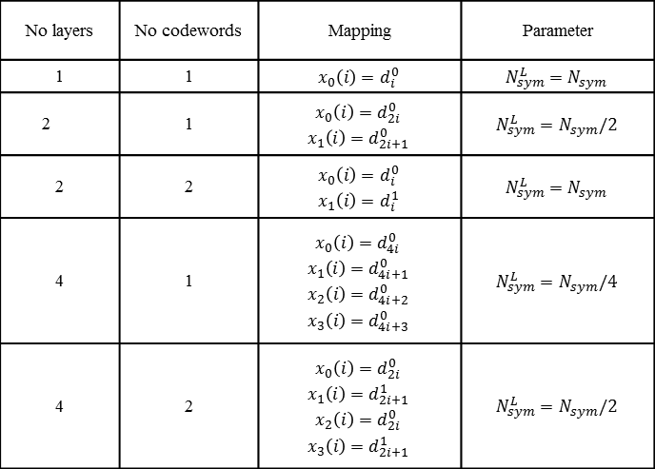
Layer mapping
Open loop spatial multiplexing (parallel data streams)
  Here $ν≤P$, where P is the number of antennas.
No layers | No codewords | Mapping | Parameter
1 | 1 | $$x_{0}\left(i\right)=d_{i}^{0}$$ | $$N_{sym}^{L}{=N}_{sym}$$
2 | 1 | $$x_{0}\left(i\right)=d_{2i}^{0}$$ $$x_{1}\left(i\right)=d_{2i+1}^{0}$$ | $$N_{sym}^{L}{=N}_{sym}/2$$
2 | 2 | $$x_{0}\left(i\right)=d_{i}^{0}$$ $$x_{1}\left(i\right)=d_{i}^{1}$$ | $$N_{sym}^{L}{=N}_{sym}$$
4 | 1 | $$x_{0}\left(i\right)=d_{4i}^{0}$$ $$x_{1}\left(i\right)=d_{4i+1}^{0}$$ $$x_{2}\left(i\right)=d_{4i+2}^{0}$$ $$x_{3}\left(i\right)=d_{4i+3}^{0}$$ | $$N_{sym}^{L}{=N}_{sym}/4$$
4 | 2 | $$x_{0}\left(i\right)=d_{2i}^{0}$$ $$x_{1}\left(i\right)=d_{2i+1}^{1}$$ $$x_{2}\left(i\right)=d_{2i}^{0}$$ $$x_{3}\left(i\right)=d_{2i+1}^{1}$$ | $$N_{sym}^{L}{=N}_{sym}/2$$

Slide 32

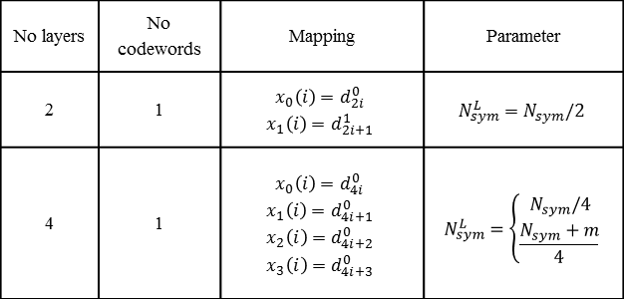
Layer mapping
Transmit diversity (same information is Tx from multiple antennas)
  $ν=P$
  m null symbols at the end such that N_{sym}+m Mod4=0
No layers | No codewords | Mapping | Parameter
2 | 1 | $$x_{0}\left(i\right)=d_{2i}^{0}$$ $$x_{1}\left(i\right)=d_{2i+1}^{1}$$ | $$N_{sym}^{L}{=N}_{sym}/2$$
4 | 1 | $$x_{0}\left(i\right)=d_{4i}^{0}$$ $$x_{1}\left(i\right)=d_{4i+1}^{0}$$ $$x_{2}\left(i\right)=d_{4i+2}^{0}$$ $$x_{3}\left(i\right)=d_{4i+3}^{0}$$ | $$N_{sym}^{L}=\left\{\begin{matrix}N_{sym}/4 \\ \frac{N_{sym}+m}{4}\end{matrix}\right.$$

Slide 33
Precoding
Precoding allows to increase system performance and robustness by feeding back to the transmitter CSI.
Schematic diagram of MIMO support with precoding

Slide 34
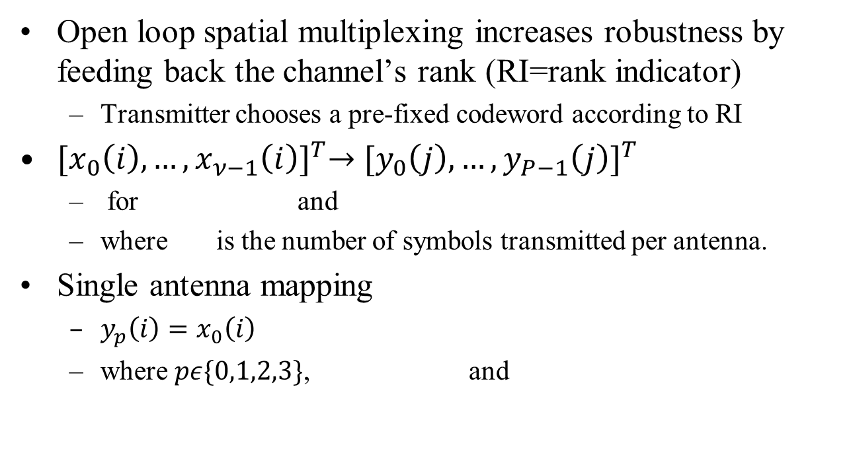
Precoding (Open loop spatial multiplexing )
Open loop spatial multiplexing increases robustness by feeding back the channel’s rank (RI=rank indicator)
  Transmitter chooses a pre-fixed codeword according to RI
${[x_{0}\left(i\right),…,x_{ν−1}\left(i\right)]}^{T}→{[y_{0}\left(j\right),…,y_{P−1}\left(j\right)]}^{T}$
  for and
  where is the number of symbols transmitted per antenna.
Single antenna mapping
  $y_{p}\left(i\right)=x_{0}\left(i\right)$
  where $pε\{0,1,2,3\}$, and

Slide 35
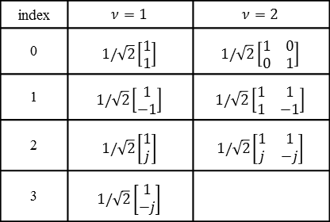
Precoding (open loop spatial multiplexing )
Multiple antennas mapping
  for and
Transmitter chooses a codeword according to reported ν
Codebook for 2 antennas
index | $$ν=1$$ | $$ν=2$$
0 | $$1/\sqrt{2}\left[\begin{matrix}1 \\ 1\end{matrix}\right]$$ | $$1/\sqrt{2}\left[\begin{matrix}1 & 0 \\ 0 & 1\end{matrix}\right]$$
1 | $$1/\sqrt{2}\left[\begin{matrix}1 \\ −1\end{matrix}\right]$$ | $$1/\sqrt{2}\left[\begin{matrix}1 & 1 \\ 1 & −1\end{matrix}\right]$$
2 | $$1/\sqrt{2}\left[\begin{matrix}1 \\ j\end{matrix}\right]$$ | $$1/\sqrt{2}\left[\begin{matrix}1 & 1 \\ j & −j\end{matrix}\right]$$
3 | $$1/\sqrt{2}\left[\begin{matrix}1 \\ −j\end{matrix}\right]$$

Slide 36
Precoding (open loop spatial multiplexing )
Codebook for 4 antennas is based on the Householder theorem:
  If x and y are vectors with the same norm, then exists an orthogonal symmetric matrix W such that y=Wx, where
  W=I-2uu^{T} and ||u||=1.
  Since W is orthogonal and symmetric, then W=W⁻¹ simplifying receiver’s complexity considerably.

Slide 37
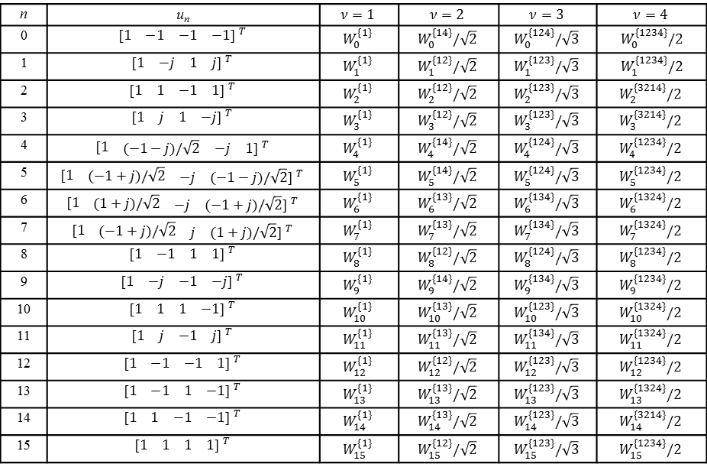
Precoding (open loop spatial multiplexing )
Codebook for 4 antennas
n | u_{n} | $$ν=1$$ | $$ν=2$$ | $$ν=3$$ | $$ν=4$$
0 | $$\begin{matrix}[1 & \begin{matrix}−1 & \begin{matrix}−1 & −1] ^{T}\end{matrix}\end{matrix}\end{matrix}$$ | $$W_{0}^{\{1\}}$$ | $$W_{0}^{\{14\}}/\sqrt{2}$$ | $$W_{0}^{\{124\}}/\sqrt{3}$$ | $$W_{0}^{\{1234\}}/2$$
1 | $$\begin{matrix}[1 & \begin{matrix}−j & \begin{matrix}1 & j] ^{T}\end{matrix}\end{matrix}\end{matrix}$$ | $$W_{1}^{\{1\}}$$ | $$W_{1}^{\{12\}}/\sqrt{2}$$ | $$W_{1}^{\{123\}}/\sqrt{3}$$ | $$W_{1}^{\{1234\}}/2$$
2 | $$\begin{matrix}[1 & \begin{matrix}1 & \begin{matrix}−1 & 1] ^{T}\end{matrix}\end{matrix}\end{matrix}$$ | $$W_{2}^{\{1\}}$$ | $$W_{2}^{\{12\}}/\sqrt{2}$$ | $$W_{2}^{\{123\}}/\sqrt{3}$$ | $$W_{2}^{\{3214\}}/2$$
3 | $$\begin{matrix}[1 & \begin{matrix}j & \begin{matrix}1 & −j] ^{T}\end{matrix}\end{matrix}\end{matrix}$$ | $$W_{3}^{\{1\}}$$ | $$W_{3}^{\{12\}}/\sqrt{2}$$ | $$W_{3}^{\{123\}}/\sqrt{3}$$ | $$W_{3}^{\{3214\}}/2$$
4 | $$\begin{matrix}[1 & \begin{matrix}(−1−j)/\sqrt{2} & \begin{matrix}−j & 1] ^{T}\end{matrix}\end{matrix}\end{matrix}$$ | $$W_{4}^{\{1\}}$$ | $$W_{4}^{\{14\}}/\sqrt{2}$$ | $$W_{4}^{\{124\}}/\sqrt{3}$$ | $$W_{4}^{\{1234\}}/2$$
5 | $$\begin{matrix}[1 & \begin{matrix}(−1+j)/\sqrt{2} & \begin{matrix}−j & (−1−j)/\sqrt{2}] ^{T}\end{matrix}\end{matrix}\end{matrix}$$ | $$W_{5}^{\{1\}}$$ | $$W_{5}^{\{14\}}/\sqrt{2}$$ | $$W_{5}^{\{124\}}/\sqrt{3}$$ | $$W_{5}^{\{1234\}}/2$$
6 | $$\begin{matrix}[1 & \begin{matrix}(1+j)/\sqrt{2} & \begin{matrix}−j & (−1+j)/\sqrt{2}] ^{T}\end{matrix}\end{matrix}\end{matrix}$$ | $$W_{6}^{\{1\}}$$ | $$W_{6}^{\{13\}}/\sqrt{2}$$ | $$W_{6}^{\{134\}}/\sqrt{3}$$ | $$W_{6}^{\{1324\}}/2$$
7 | $$\begin{matrix}[1 & \begin{matrix}(−1+j)/\sqrt{2} & \begin{matrix}j & (1+j)/\sqrt{2}] ^{T}\end{matrix}\end{matrix}\end{matrix}$$ | $$W_{7}^{\{1\}}$$ | $$W_{7}^{\{13\}}/\sqrt{2}$$ | $$W_{7}^{\{134\}}/\sqrt{3}$$ | $$W_{7}^{\{1324\}}/2$$
8 | $$\begin{matrix}[1 & \begin{matrix}−1 & \begin{matrix}1 & 1] ^{T}\end{matrix}\end{matrix}\end{matrix}$$ | $$W_{8}^{\{1\}}$$ | $$W_{8}^{\{12\}}/\sqrt{2}$$ | $$W_{8}^{\{124\}}/\sqrt{3}$$ | $$W_{8}^{\{1234\}}/2$$
9 | $$\begin{matrix}[1 & \begin{matrix}−j & \begin{matrix}−1 & −j] ^{T}\end{matrix}\end{matrix}\end{matrix}$$ | $$W_{9}^{\{1\}}$$ | $$W_{9}^{\{14\}}/\sqrt{2}$$ | $$W_{9}^{\{134\}}/\sqrt{3}$$ | $$W_{9}^{\{1234\}}/2$$
10 | $$\begin{matrix}[1 & \begin{matrix}1 & \begin{matrix}1 & −1] ^{T}\end{matrix}\end{matrix}\end{matrix}$$ | $$W_{10}^{\{1\}}$$ | $$W_{10}^{\{13\}}/\sqrt{2}$$ | $$W_{10}^{\{123\}}/\sqrt{3}$$ | $$W_{10}^{\{1324\}}/2$$
11 | $$\begin{matrix}[1 & \begin{matrix}j & \begin{matrix}−1 & j] ^{T}\end{matrix}\end{matrix}\end{matrix}$$ | $$W_{11}^{\{1\}}$$ | $$W_{11}^{\{13\}}/\sqrt{2}$$ | $$W_{11}^{\{134\}}/\sqrt{3}$$ | $$W_{11}^{\{1324\}}/2$$
12 | $$\begin{matrix}[1 & \begin{matrix}−1 & \begin{matrix}−1 & 1] ^{T}\end{matrix}\end{matrix}\end{matrix}$$ | $$W_{12}^{\{1\}}$$ | $$W_{12}^{\{12\}}/\sqrt{2}$$ | $$W_{12}^{\{123\}}/\sqrt{3}$$ | $$W_{12}^{\{1234\}}/2$$
13 | $$\begin{matrix}[1 & \begin{matrix}−1 & \begin{matrix}1 & −1] ^{T}\end{matrix}\end{matrix}\end{matrix}$$ | $$W_{13}^{\{1\}}$$ | $$W_{13}^{\{13\}}/\sqrt{2}$$ | $$W_{13}^{\{123\}}/\sqrt{3}$$ | $$W_{13}^{\{1324\}}/2$$
14 | $$\begin{matrix}[1 & \begin{matrix}1 & \begin{matrix}−1 & −1] ^{T}\end{matrix}\end{matrix}\end{matrix}$$ | $$W_{14}^{\{1\}}$$ | $$W_{14}^{\{13\}}/\sqrt{2}$$ | $$W_{14}^{\{123\}}/\sqrt{3}$$ | $$W_{14}^{\{3214\}}/2$$
15 | $$\begin{matrix}[1 & \begin{matrix}1 & \begin{matrix}1 & 1] ^{T}\end{matrix}\end{matrix}\end{matrix}$$ | $$W_{15}^{\{1\}}$$ | $$W_{15}^{\{12\}}/\sqrt{2}$$ | $$W_{15}^{\{123\}}/\sqrt{3}$$ | $$W_{15}^{\{1234\}}/2$$

Slide 38
Precoding (open loop spatial multiplexing )
W is conformed from the codebook for 4 antennas table, where denotes the matrix formed by the columns {c₁…c_{m}} of the matrix

Slide 39
Precoding (transmit diversity)
Support for 2 or 4 antenna configurations and one data stream. Transmit diversity is aimed to increase robustness in scenarios with low SNR, low delay tolerance or no feedback to the transmitter is available or reliable.
Case of 2 antennas
  STBC (Alamouti scheme) for DTF-Spread OFDM
  SFBC (equivalent of STBC) for OFDM

Slide 40
Precoding (transmit diversity)
SFBC for 2 antennas
  for and

Slide 41
Precoding (transmit diversity)
In case of 4 antennas a combination of SFBC (2 antennas) with frequency switch transmission diversity is employed.
  for and

Slide 42
DFT-S OFDM or OFDM
Parameters
is constant and equal to 15 KHz.
Maximum FFT size M=1024
Sampling time
Timing based on a common clock at

Slide 43
[DFT-S] OFDM
Frame structure (FDD)
One slot contains 7 [DTF-S] OFDM symbols.
T_{slot}=7680T_{s}=0.5 msec

Slide 44
Frame structure (TDD)
S-L₁=synchronization for L₁
L₁=PD₁ transmits and PD₂ receives
RS-L₁=reference signals for L₁
L₂=PD₂ transmits and PD₁ receives
RA=random access or channel sounding for MIMO or beamforming.
GP=guard period

Slide 45
Frame structure (TDD)
GP=(73+1024)T_{s}=71.42 µsec
T_{p}=1 Km/3x10⁸m/s=3.3 µsec (worst case).
Last symbol of PD₁ arrives to PD₂ after T_{p}, the symbol is detected, PD₂ switches from Rx to Tx. Then, the first transmitted symbol of PD₂ arrives to PD₁ after T_{p}.
T_{p}+T_{dec}+T_{sw}+T_{comp}+T_{p}=GP
  T_{dec}=time to detect the last symbol
  T_{sw}=time to switch from Rx to Tx or vice-versa
  T_{comp}=compensation time to align to GP

Slide 46
[DFT-S] OFDM
Cyclic prefix
73T_{s}=4.75 usec

Slide 47
Resource Block
RB is a set of time-frequency slots enabling multiple access

Slide 48
Resource Block
BW is obtained by concatenating RBs
DFT-S OFDM symbols
(2 upper and lower subcarriers are empty)

Slide 49
Resource Block
Proposed bandwidths

Slide 50
Reference signals
Considering a maximum speed of v=100 Km/h (27.78 m/s)
Doppler spread: f_{d}=f_{c} v/c
Min. sampling time to reconstruct the channel: T_{c}=1/2f_{d}
Slot time T_{slot}=0.5 msec. Then, one reference symbol per slot is needed in the time domain to estimate the channel correctly.

Slide 51
Reference signals
Considering 90%, 50% coherence bandwidth:
  where is the RMS delay spread.
Outdoor RMS delay spread is estimated as:
If then freq. selective fading and FDE is needed.
  We propose that the spacing between 2 reference symbols in frequency in a RB is 30 KHz to resolve frequency variations.
d=500m

Slide 52
Aid for Coherent Detection, FDE, Synchronization, Random Access and Scheduling
Preambles or beacons and reference signals (RSs) are formed with Zadoff-Chu (ZC) sequences of length N.
  Constant-amplitude zero-correlation (CAZAC) sequences
where W_{N} is a primitive nth root of unity, r is a relative prime to N, sequence index k = 0, 1, ...,N-1and q is any integer.

Slide 53
ZC sequences
ZC sequences have constant amplitude and so its N-point DFT.
  This limits the PAPR and simplifies implementation as only phases have to be generated and stored, besides of bypassing the FFT at transmitter for DFT-S OFDM.
ZC sequences have ideal cyclic autocorrelation, i.e., the correlation with its shifted version is a delta function
  Thus, a [large] set of orthogonal preambles or reference signals is possible to generate.

Slide 54
Receiver
Optimum detection of coded MIMO systems is given in terms of joint detection and decoding.
  However, implementation complexity is very high.
There are plenty of proposed suboptimum techniques like MMSE-SIC detection

Slide 55
Receiver
However, iterative MIMO decoding is the most promising approach for low complexity and close optimum performance.
  Core idea: independent MIMO detection and channel decoding.
We present 2 promising systems for spatial multiplexing
  SISO MMSE PIC and sphere decoding

Slide 56
Receiver
For lack of space and not being part of standard, we do not give details of receivers, only the core ideas and results.
Iterative MIMO decoding
  Reliability information of coded bits (LLRs) is iteratively exchange between SISO MIMO detector and SISO decoder to improve error-rate.

Slide 57
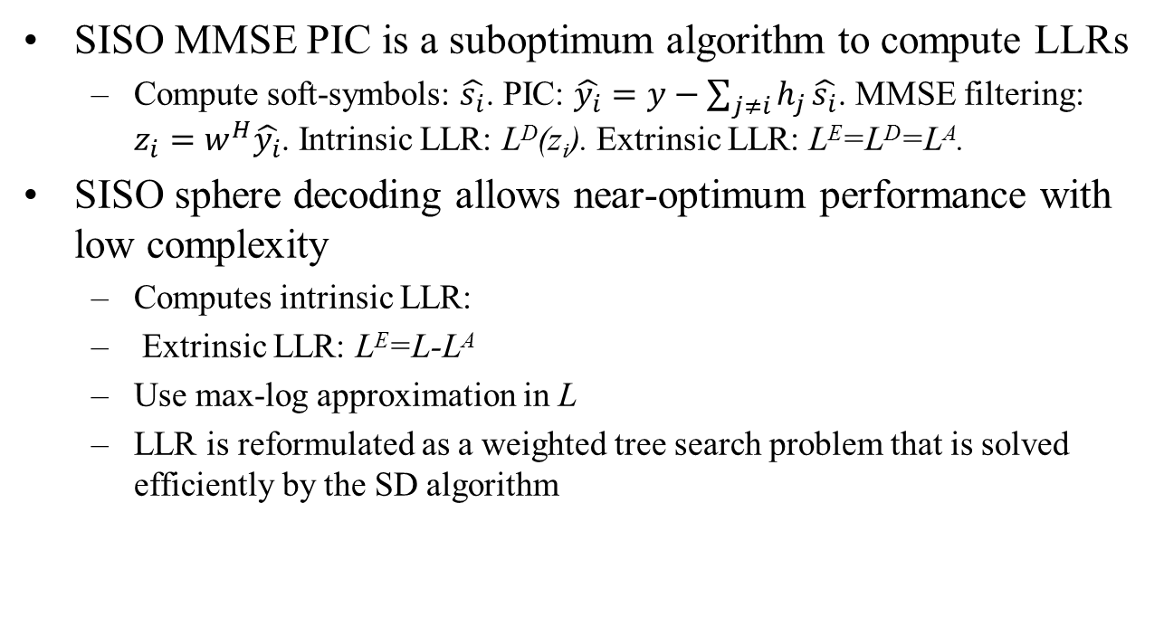
Receiver
SISO MMSE PIC is a suboptimum algorithm to compute LLRs
  Compute soft-symbols: $\hat{s_{i}}$. PIC: $\hat{y_{i}}=y−\sum_{j≠i}{h_{j}}\hat{s_{i}}$. MMSE filtering: $z_{i}=w^{H}\hat{y_{i}}$. Intrinsic LLR: L^{D}(z_{i}). Extrinsic LLR: LE=L^{D}=L^{A}.
SISO sphere decoding allows near-optimum performance with low complexity
  Computes intrinsic LLR:
  Extrinsic LLR: LE=L-L^{A}
  Use max-log approximation in L
  LLR is reformulated as a weighted tree search problem that is solved efficiently by the SD algorithm

Slide 58
Receiver
  PER performance, ½ rate CC, OFDM (1 MHz) with 16QAM symbols in the form of spatial multiplexing for 4x4 antennas with ITU MIMO channel, low correlation and pedestrian.

Slide 59
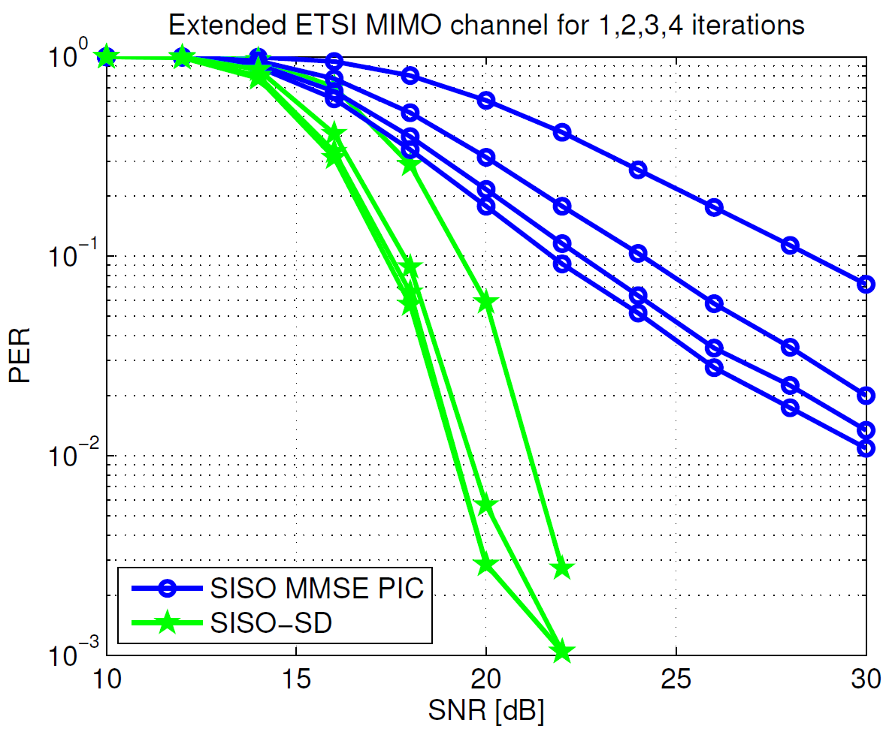
Receiver
  PER performance, ½ rate CC, OFDM (1 MHz) with 16QAM symbols in the form of spatial multiplexing for 4x4 antennas with ETSI MIMO channel, low correlation and model A.

Slide 60
Receiver
Regarding transmit diversity, it is accepted that a wireless system with transmit diversity performs better compared to the same system without transmit diversity.

Slide 61
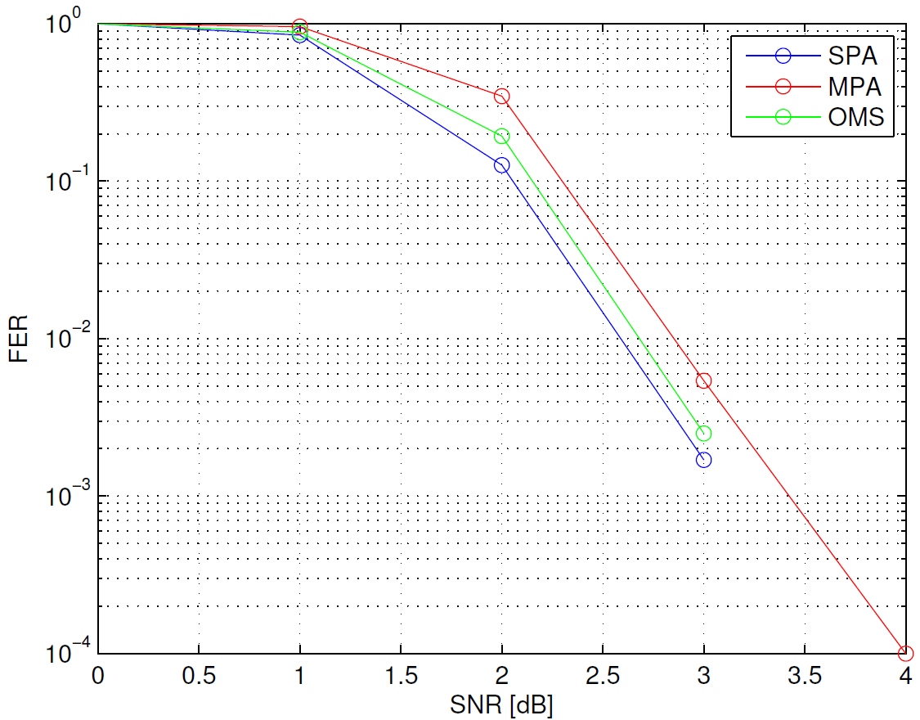
Receiver
  PER performance, QC-LDPC(324,648), R=1/2, OFDM (1 MHz) with BPSK symbols for 1x1 antennas with ITU channel pedestrian. SPA=sum-product algorithm. MPA=message passing algorithm. OMS=offset min-sum algorithm.

Slide 62
End
Thanks for your attention

