Slide 1
Project: IEEE P802.15 Working Group for Wireless Personal Area Networks (WPANs)
Submission Title: Considerations for optimal data rates
Date Submitted: May 2013
Source: Frederik Beer¹, Jörg Robert¹;
¹Friedrich-Alexander-Universität Erlangen-Nürnberg, Information Technology
Phone: +4991318525123, Fax: +4991318525102
E-Mail: frederik.beer@fau.de
Abstract: Some basic considerations about optimal data rates based upon chosen range and sensitivity of selected transceiver chips
Purpose:
Notice: This document has been prepared to assist the IEEE P802.15. It is offered as a basis for discussion and is not binding on the contributing individual(s) or organization(s). The material in this document is subject to change in form and content after further study. The contributor(s) reserve(s) the right to add, amend or withdraw material contained herein.
Release: The contributor acknowledges and accepts that this contribution becomes the property of IEEE and may be made publicly available by P802.15.
Frederik Beer, Jörg Robert

Slide 2
Considerations for optimal data rates

Slide 3
Outline
TX-Power efficiency
Energy per bit
Path Loss
Datarate equation
Transceiver sensitivity
Results
Summary & Conclusion
Outlook

Slide 4
Objective
Show how the efficiency of transceiver chips can easily be estimated
Derive an equation for achievable datarates based on sensitivity and range
Material for discussion about optimal datarates for 4q

Slide 5
TX-Power consumption (1)
Transceivers usually have a basic power consumption irrespective of the actual TX-Power
At low datarates (and lower TX-Power) this basic consumption becomes dominant
At high datarates (and higher TX-Power) this basic consumption can be omitted

Slide 6
TX-Power consumption (2)
Extracted values for several transceivers:
AT86R231, CC2520, AT86R212, CC1101, SX1231
Example AT86R231 (2.4 GHz, 3V V_{DD}):
P_{TX} [dBm] | P_{TX} [mW] | I [mA] | P_{total} [mW]
3 | 1.995 | 14 | 42
0 | 1 | 11.6 | 34.8
-17 | 0.01995 | 7.4 | 22.2

Slide 7
TX-Power consumption (3)
If this values are plotted and a linear fitting is applied, we get a linear curve like:
$$P_{\text{total}}=P_{\text{tx}}∙\frac{1}{η_{\text{max}}}+P_{\text{base}}$$
For AT86RF231:
$1/{η_{\text{max}}}=10.017$
$P_{\text{base}}=22.933 \text{mW}$

Slide 8
TX-Power consumption (4)
Transceiver Chip | $$1/{η_{\text{max}}}$$ | $$P_{\text{base}}$$
AT86RF231 | 10.017 | 22.933 mW
CC2520 | 14.809 | 58.192 mW
AT86RF212 | 3.8817 | 36.675 mW
CC1101 | 3.6122 | 48.577 mW
SX1232 | 3.9153 | 46.426 mW
Example (AT86RF231):
80 Octets @ 250 kbps, 0 dBm: $95.77 \text{μJ}$
80 Octets @ 500 kbps, 3 dBm: $61.82 \text{μJ}$

Slide 9
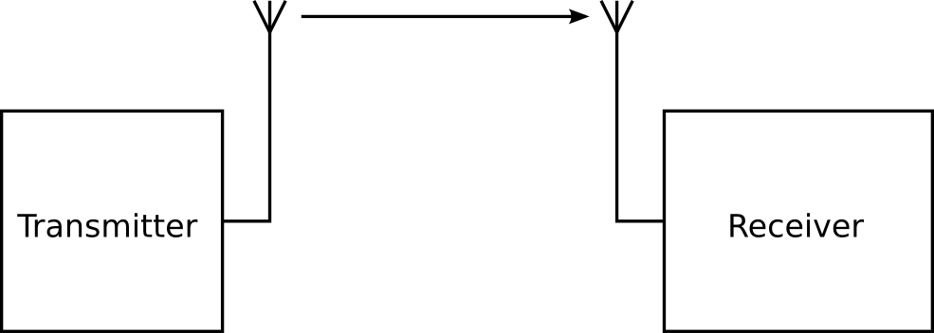
Energy per bit (1)
Most considerations are based upon the E_{b}, i.e. the energy per bit
Energy per bit at transmitter can be expressed as:
$$E_{b,TX}={P_{TX}}/R$$
with R being the data rate in bit/s
$$E_{b,TX}$$

Slide 10
Energy per bit (2)
For successful signal reception a certain amount of energy per bit has to be guaranteed
Energy per bit at the receiver:
$$E_{b,RX}=E_{b,TX}∙L$$
With L being the path loss
$$E_{b,RX}$$

Slide 11
Path loss
For the following considerations the path loss will be assumed to be the free space loss
$$L=\frac{λ^{2}}{{16π^{2}d}^{α}}∙G_{TX}∙G_{RX}$$
$\text{with} α=2,G_{TX}$= $G_{RX}$=1
$$G_{TX}$$
$$L$$
$$G_{RX}$$

Slide 12
Datarate equation
Combining the former equations, the datarate can be expressed as a function of the transmit power, distance, wavelength
$R≤\frac{P_{TX}}{E_{b,RX}}∙$ $\frac{λ^{2}}{{16π^{2}d}^{α}}$ ${∙G}_{TX}∙G_{RX}$
The minimum energy per bit ($E_{b,RX}$) can be calculated by equations for different modulation types or derived from the sensitivity of transceiver chips

Slide 13
Transceiver sensitivity
TI CC1101:
GFSK, 1200 bps: -111dBm
➔1bps: -141dBm, $E_{b,RX}=7.9∙{10}^{−15}\text{mJ}$
38,400 bps: -104dBm
➔1bps: -150dBm, $E_{b,RX}=1∙{10}^{−15}\text{mJ}$
SX1232:
FSK, 1200 bps: -119dBm
➔1bps: -150dBm, $E_{b,RX}=1∙{10}^{−15}\text{mJ}$
38,400 bps: -106dBm
➔1bps: -152dBm, $E_{b,RX}=6.3∙{10}^{−16}\text{mJ}$

Slide 14
Transceiver sensitivity
AT86RF212
BPSK, 20,000 bps: -110dBm
➔1bps: -153dBm, $E_{b,RX}=5∙{10}^{−16}\text{mJ}$
40,00 bps: -108dBm
➔1bps: -154dBm, $E_{b,RX}=4∙{10}^{−16}\text{mJ}$
Approx. $E_{b,RX}=1∙{10}^{−15}\text{mJ}$ necessary for successful reception, independent from data rate.

Slide 15
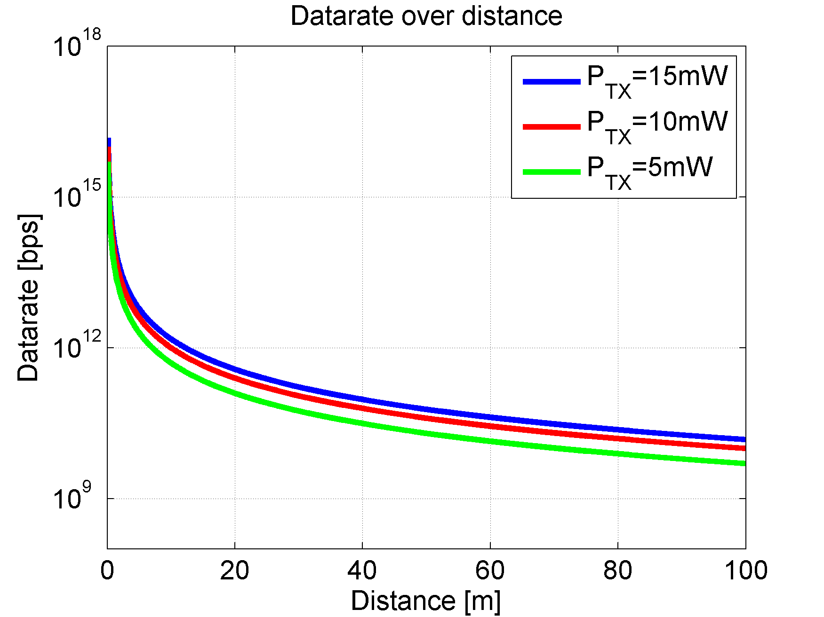
Results (1)
$$α=2$$
868 (915) MHz
2.4 GHz

Slide 16
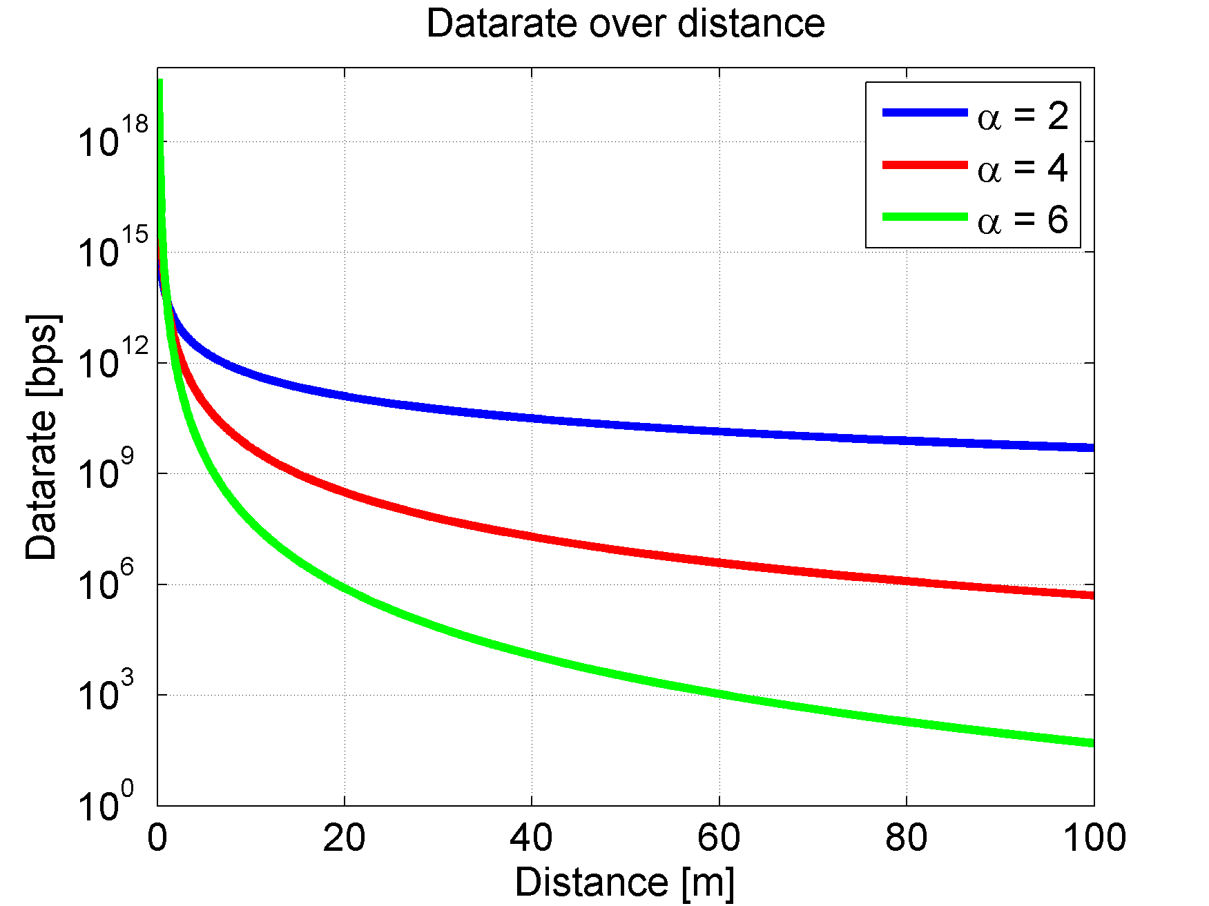
Results (2)
$$P_{\text{TX}}=5 \text{mW}$$
868 (915) MHz
2.4 GHz

Slide 17
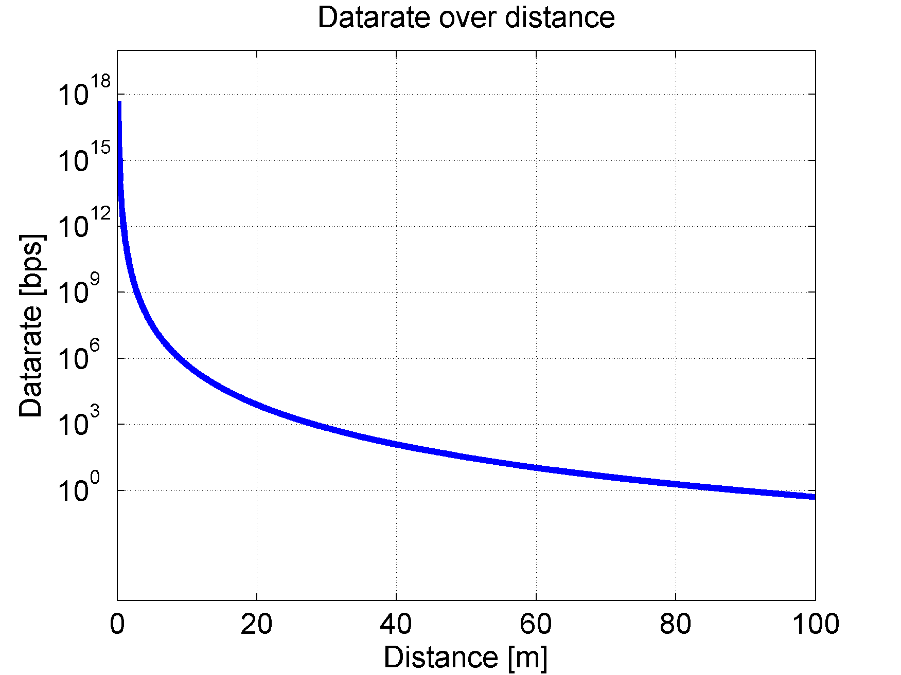
Results (3)
Worst case scenario: $P_{\text{TX}}=0.5 \text{mW}\text{, }α=6, G_{\text{RX}}=G_{\text{TX}}=−5 \text{dB}$
868 (915) MHz
2.4 GHz

Slide 18
Summary
For maximum efficiency higher transmission powers and data rates are favorable, within limits of hardware capabilities, maximum current consumption and available spectrum
The maximum datarate is limited by the desired range, TX-Power, frequency and RF environment

Slide 19
Conclusion
Define the desired range, frequency band and application scenarios
THEN define the best datarate for this

Slide 20
Outlook
FEC might be a favorable option for some application scenarios
Examine other techniques, e.g. hopping
More detailed channel models for the application scenarios necessary

