Slide 1
Project: IEEE P802.15 Working Group for Wireless Personal Area Networks (WPANs)
Submission Title: Joint Filtered FSK PHY Proposal
Date Submitted: May , 2013
Source:
Kenichi Mori (ken1.morius@gmail.com), individual;
Shinsuke Hara (shinsukehara0122@gmail.com ), QoL-SN;
Masahiro Kuroda (marsh@nict.go.jp), QoL-SN&NICT;
Andy Bottomley (andy.bottomley@microsemi.com), Microsemi;
Abstract: Merged technical proposal for wearable 15.4n device
Purpose: Merged modulation scheme of Filtered FSK
Notice: This document has been prepared to assist the IEEE P802.15. It is offered as a basis for discussion and is not binding on the contributing individual(s) or organization(s). The material in this document is subject to change in form and content after further study. The contributor(s) reserve(s) the right to add, amend or withdraw material contained herein.
Release: The contributor acknowledges and accepts that this contribution becomes the property of IEEE and may be made publicly available by P802.15.

Slide 2
Abstract
Joint Proposal of specs of Filtered FSK PHY

Slide 3
Background
As far, there are two specs proposals on Filtered FSK shown as below
- DCN 13-0041-02
- DCN 13-0037-04
Same channel bandwidth
500kHz
Same maximum output power level (10mW, ERP)
Gaussian filtered FSK
Different modulation index
0.5, 1.0

Slide 4
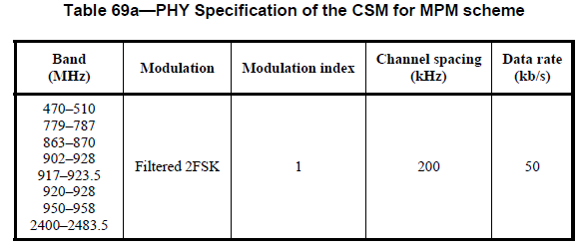
Filtered FSK proposal 1
Preparation for Common Signal Mode
- 15.4g specified the common signal mode to facilitate multi-
PHY scheme as shown below.
- 50kbps, Modulation index = 1.0
When requested, a device that supports CSM Filtered FSK shall transmit Filtered FSK with 50kbps data rate and modulation index 1.0.
Reference:
IEEE803.15.4g-2012

Slide 5
Proposed Optional Filtered FSK
(modulation index)
Band | Modulation | Data Rate | Modulation Index
174 – 216 407-425 608-630 | 2-FFSK | 100 | 0.5 and 1.0
 |  | 200 | 0.5 and 1.0
FFSK: Filtered FSK
Based on Gaussian filter with BT=0.7

Slide 6
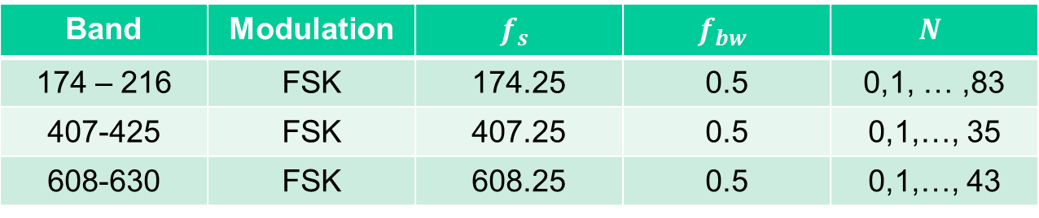
Proposed Channel Plan
Center frequencies for each channels for each modulation schemes can be calculated as follows;
    $f_{c}=f_{s}+Nf_{bw}$ (MHz)
Band | Modulation | $$f_{s}$$ | $$f_{bw}$$ | $$N$$
174 – 216 | FSK | 174.25 | 0.5 | 0,1, … ,83
407-425 | FSK | 407.25 | 0.5 | 0,1,…, 35
608-630 | FSK | 608.25 | 0.5 | 0,1,…, 43
Note: Output power level may have to back-off on the end channels to meet Chinese regulation (Chinese MIIT DOC423-2005, DCN 12-0105/r1 and DCN 13-313/r1)

Slide 7
Summary
Band | Modulation | Data Rate (kbps) | Modulation Index | Channel Bandwidth (kHz)
174 – 216 407-425 608-630 | 2-FFSK (common) | 50 | 1.0 | 500
 | 2-FFSK (optional) | 100 | 0.5 and 1.0 | 500
 |  | 200
Maximum output power level for all Filtered FSK (Gaussian FSK) mode is 10mW (ERP).

Slide 8
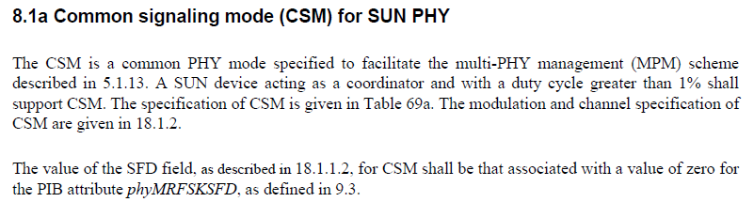
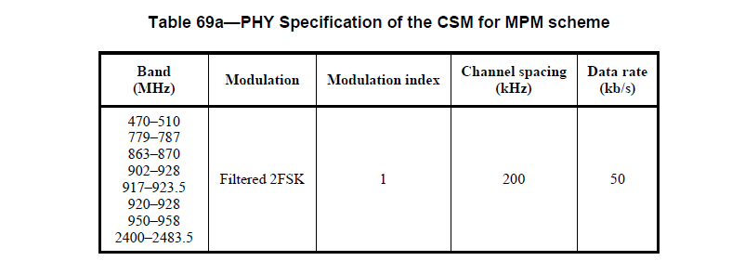
Annex

Slide 9
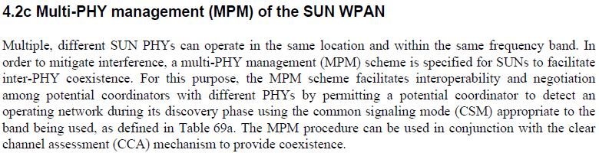
Annex (cont.)

