Slide 1
Project: IEEE P802.15 Working Group for Wireless Personal Area Networks (WPANs)
Submission Title: Response to WG request regarding TC ERM requested enhancements to 15.4e
Date Submitted: 14 May 2013
Sources: Mike McInnis Tim Harrington
The Boeing Company Zebra
E-Mail: michael.d.mcinnis@boeing.com E-Mail: tharrington@zebra.com
Re : Response to 802.15 WG regarding .4e enhancements requested by ETSI TC ERM.
Abstract: ETSI TC ERM document dated 18 Dec. 2012 requests enhancement of 802.15.4e standard
Purpose: Provide an IEEE 802.15.4f perspective to ETSI TC ERM requested 802.15.4 enhancements
Notice :This document has been prepared to assist the IEEE P802.15. It is offered as a basis for
discussion and is not binding on the contributing individual(s) or organization(s). The material in
this document is subject to change in form and content after further study. The contributor(s)
reserve(s) the right to add, amend or withdraw material contained herein.
Release:The contributor acknowledges and accepts that this contribution becomes the property of IEEE
and may be made publicly available by P802.15.
Tim Harrington, Zebra
Mike McInnis, The Boeing Company

Slide 2
Response to IEEE 802.15 Working Group Request for External Comments
document 15-13-0220-02-0000-802-15-wg-request-for-participation.docx
May 14, 2013
Mike McInnis - IEEE 802.15.4f (in hibernation) – Chairman
Tim Harrington - IEEE 802.15.4f (in hibernation) – Vice Chairman and Technical Editor
Tim Harrington, Zebra
Mike McInnis, The Boeing Company

Slide 3
ETSI TC ERM Statements to 802.15
Frame Type and Information Element Identifiers
The use of Frame Type and Information Element Identifiers to distinguish between different data structures provides committees in ETSI (and other SDOs) with the ideal mechanism to build on 802.15.4 standards. However, the Unmanaged address space for Information Elements does not provide the necessary guarantees for ETSI to use this range of identifiers for its data structures. In the case of Frame Type identifiers, the range of values is almost fully used and there is a need to define further Frame Type identifier values to allow ETSI (and any other external SDO) to add major functionality over and above that possible by adding Information Element definitions.
ETSI TC ERM respectfully requests IEEE 802.15 to seriously consider how certain ranges of Information Element identifiers may be made available for allocation to external SDOs building their standards on IEEE 802.15.4 published standards.
TC ERM also requests that IEEE 802.15 define a mechanism to extend the range of values of the 802.15.4 Frame Type and similarly defines a mechanism to allow use of one or more of the extended Frame Type identifier values by an external SDO. TC ERM recognises the mechanism identified in ANSI/TIA-PN-4957.200 as being a suitable extension of the Frame Type identifier range.
In both of the cases of Frame Type and Information Element identifier values, the mechanism for allocation and management of the values for use by external SDOs should ensure their uniqueness in all product contexts.
Tim Harrington, Zebra
Mike McInnis, The Boeing Company

Slide 4
ETSI TC ERM Statements to 802.15
Definition of the structure of Information Elements
Secondly, TC ERM would like to draw to the attention of the 802.15 Working Group that the definition of the structure of Information Elements in 802.15.4e is contrary to many other standards which use very similar Type-Length-Value structures. TC ERM/TG28 members do not see any value in defining a different structure and would highly recommend revision of the 802.15.4e standard to bring it into line with the many other standards using Information Element TLV structures to allow combination of such standards to have a uniform and consistent definition of Information Element structures.
Tim Harrington, Zebra
Mike McInnis, The Boeing Company

Slide 5
IEEE 802.15 Working Group Request for External Comments - Summary
The proposed changes are summarized here and detailed in Annex A:
Use a Frame Type ID value, as an extension, to indicate that the following bits are new Frame types
Restructure Information Element IDs to allow IDs to be assigned to external SDOs
Change the order of the Information Element Length and Type fields.
Tim Harrington, Zebra
Mike McInnis, The Boeing Company

Slide 6
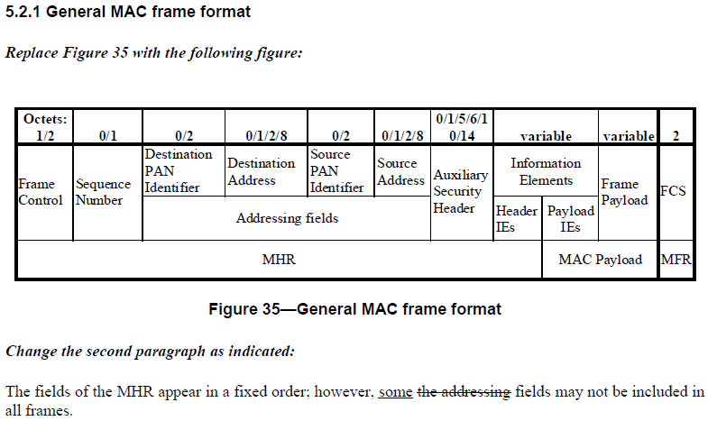
802.15.4e General MAC Frame Format
Tim Harrington, Zebra
Mike McInnis, The Boeing Company

Slide 7
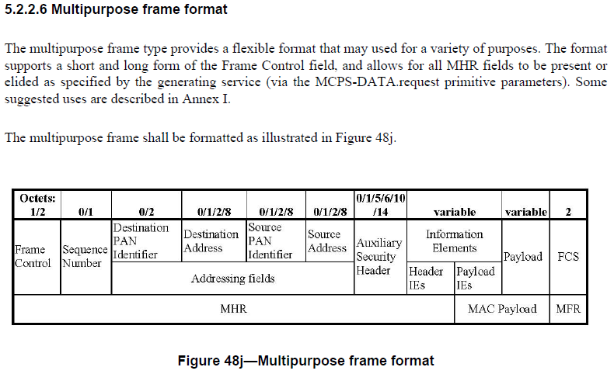
802.15.4e Multipurpose Frame Format
Variations from General MAC Frame Format
Tim Harrington, Zebra
Mike McInnis, The Boeing Company

Slide 8
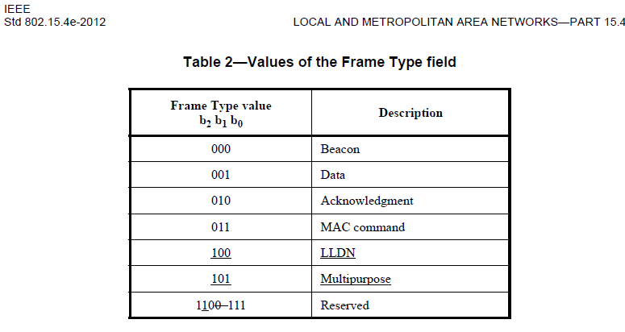
802.15.4e Frame Types
802.15.4f implementations use the Multipurpose Frame Type to generate short, simple, mono-direction “blink” frames.
Tim Harrington, Zebra
Mike McInnis, The Boeing Company

Slide 9
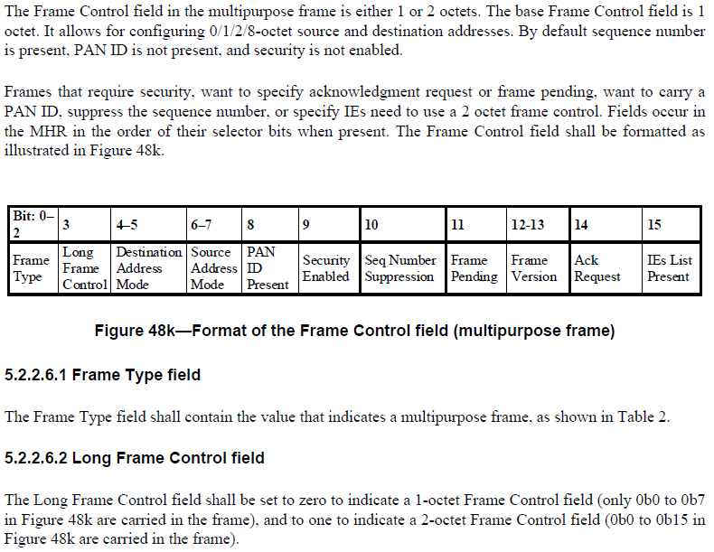
802.15.4f implementations use the 1 octet control field Multipurpose Frame. This is essential in order to maximize range of the simple UWB PHY for RFID and still meet ETSI output power requirements. It is also essential to maximize battery life.
Tim Harrington, Zebra
Mike McInnis, The Boeing Company

Slide 10
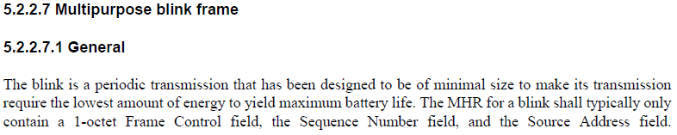
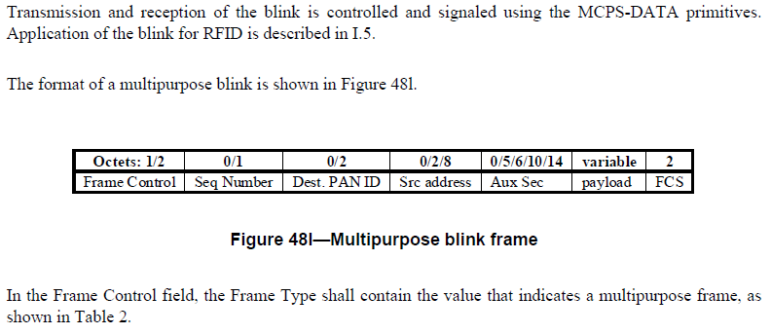
802.15.4e Multipurpose Blink Frame
802.15.4f implementations use the Multipurpose Blink Frame with these values set to 0. ISO 24730-61 and -62 are currently in FDIS and build an upper layer with ISO addressing schema on top of the minimal length frame.
802.15.4f implementations currently use the Multipurpose Frame 1 octet control field.
Tim Harrington, Zebra
Mike McInnis, The Boeing Company

Slide 11
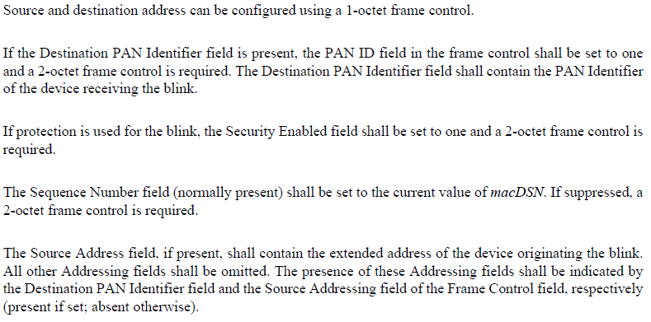
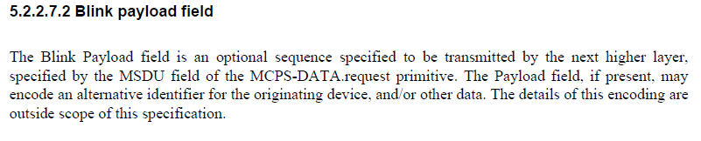
802.15.4e Multipurpose Blink Frame
Tim Harrington, Zebra
Mike McInnis, The Boeing Company

Slide 12
Topic #1 Need for additional frame identifiers
Recommendation - Use 2 octet Frame Type ID values to include IEs
Use Frame Type ID 111, as an indicator that the first three bits of the first octet in the data field identifies additional new frame types. The remaining 5 bits could be used for additional element ID’s.
For Frame Type ID 111 require use of 2 octet frame control field.
Make no changes to Frame Type values 000-101.
Advantages:
Preserves octet boundaries
Allows expansion
Provides IE for external SDO

Slide 13
Topic # 2 Restructure IE IDs to allow SDO IDs
If frame type ID 111 information elements require backwards compatibility with the current 802.15.4e standard then do not restructure information element IDs.

Slide 14
Topic # 3 Change Order of IE IDs
If frame type ID 111 information elements require backwards compatibility with the current 802.15.4e standard then do not change the order of information element IDs.
Tim Harrington, Zebra
Mike McInnis, The Boeing Company

