Slide 1
Project: IEEE P802.15 Working Group for Wireless Personal Area Networks (WPANs)
Submission Title: [Table of contents for WNG meeting slide]
Date Submitted: [June 20, 2013]
Source: [Shoichi Kitazawa] Company [ATR]
Address [2-2-2, Hikaridai, Seika, Kyoto, Japan]
Voice:[+81-774-95-1511], FAX: [ ], E-Mail:[kitazawa@atr.jp]
Re: []
Abstract: [This presentation is table of contents of July WNG meeting]
Purpose: [Discussion]
Notice: This document has been prepared to assist the IEEE P802.15. It is offered as a basis for discussion and is not binding on the contributing individual(s) or organization(s). The material in this document is subject to change in form and content after further study. The contributor(s) reserve(s) the right to add, amend or withdraw material contained herein.
Release: The contributor acknowledges and accepts that this contribution becomes the property of IEEE and may be made publicly available by P802.15.

Slide 2
Abstract
We will be making a presentation at the WNG meeting in July 2013, for starting a successive study group following IG-SRU
This material is a draft of the WNG presentation

Slide 3
ToC of presentation for WNG meeting
Title: Establishing a Study Group on Spectrum Resource Usage (SG-SRU)
Goals
Brief overview of IG-SRU
Scope & Objectives
  RRMM
Use case examples
  Hospital/Medical/Healthcare
  Industrial Automation
  Infrastructure Monitoring
Proposed Timeline

Slide 4
Establishing a Study Group on Spectrum Resource Usage (SG-SRU)
Shoichi Kitazawa
ATR
Chair IEEE 802.15 IG SRU

Slide 5
Contributors

Slide 6
Goals
Address motivations of starting an SG and its goals
Heavy interference has been occurred due to various wireless systems are operating in the unlicensed band.
In order for these wireless systems to operate in better quality, more efficient Spectrum Resource Utilization needs to be considered.
The SG-SRU will aim at creating a new PAR submittal focusing on mechanisms of Radio Resource Measurement and Management (RRMM) for WPAN.
  Creating PAR and 5C (CSD)
  Identifying use cases
  Investigation of other related standards

Slide 7
Overview of IG-SRU
The IG SRU (Spectrum Resources Usage in WPANs) started in November 2010.
  The IG was established based on “A Proposal Toward Better Use of Spectrum Resources in future WPAN (15-10-0739-01)” at September 2010.
Objectives
  To explorer advanced technologies for improving the efficiency of spectrum usage in ISM and unlicensed band
  To summarize informative ideas to judge to establish SG
Discussion topics
  Measurements and simulations of congestion situation in 2.4GHz
  System and mechanism proposals
Achievements (deliverables) of IG SRU so far
  IG SRU Technical Document (15-12-184r1) has been released

Slide 8
Overview of IG-SRU
History
  Ten F2F and three telecon meetings were held.
  Average number of attendee is 10.
Year | Month | Venue | Agenda | Closing Report | Minutes | Number of participant
2010 | November | Dallas | 15-10-0839-01 | 15-10-0924-01 | 15-10-0934-00 | 10
2011 | March | Singapore | 15-11-0159-01 | 15-11-0298-00 | 15-11-0440-00 | 8
 | July | San Francisco | 15-11-0456-00 | 15-11-0552-00 | 15-11-755-00 | 11
 | November | Atlanta | 15-11-0757-01 | 15-11-0830-00 | 15-12-0106-00 | 13
2012 | March | Waikoloa | 15-12-0107-00 | 15-12-0191-00 | 15-12-0197-00 | 4
 | July | San Diego | 15-12-0326-01 | 15-12-0425-00 | 15-12-0440-00 | 11
 | November | San Antonio | 15-12-0595-01 | 15-12-0628-01 | 15-12-0659-01 | 9
2013 | January | Vancouver | 15-12-0681-02 | 15-13-0078-00 | 15-13-0093-00 | 10
 | March | Orlando | 15-13-105-01 | 15-13-0225-00 | 15-13-0305-00 | 12
 | May | Waikoloa | 15-13-260-01 | 15-13-0318-00 | 15-13-0344-00 | 9

Slide 9
Scope and Objectives
To be removed later
At this stage, it seems good to focus on Radio Resource Measurement and Management (RRMM) for this first PAR
As the Scope and Objectives are the expected outcomes from the SG activities, any inputs are welcome so we will discuss further

Slide 10
Scope and Objectives
Scope
  SG-SRU focuses on mechanisms of Radio Resource Measurement and Management (RRMM) for WPAN.
    Primary target may be on 802.15.4
Objectives
  A common RRMM mechanisms for WPAN will be established for achieving efficient spectrum resource utilization.
P6のGoals記載の表現と合せる？

Slide 11
Related Issues on Other Standards
802.11k
  Channel load
  Noise histogram
  Beacon
  Frame
  STA statics
  LCI(Location Configuration Information)
  Transmit stream/category measurement
802.xx
To be added

Slide 12
Use Case Examples
Three major use cases have been in consideration
  Hospital/Medical/Healthcare
  Industrial Automation
  Infrastructure Monitoring

Slide 13
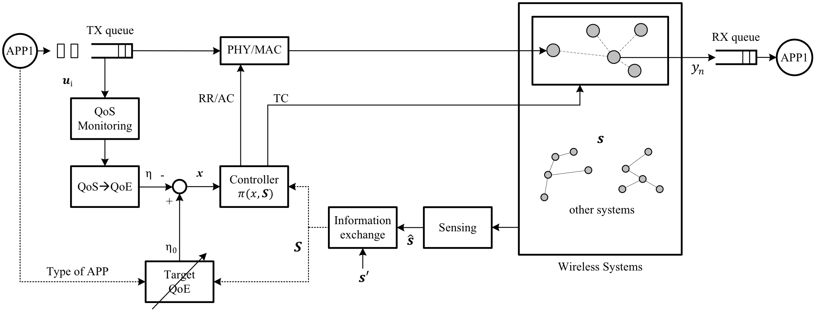
Use case: Hospital
Self-organizing wireless system
Spectrum sensing of whole band for searching vacant radio resources
Radio resource assignment and network topology management
RR: Radio resource assignment,
AC: Access control,
TC: Topology control
A Use Case of Self-Organizing Wireless Network for Medical System(15-13-0306r0)

Slide 14
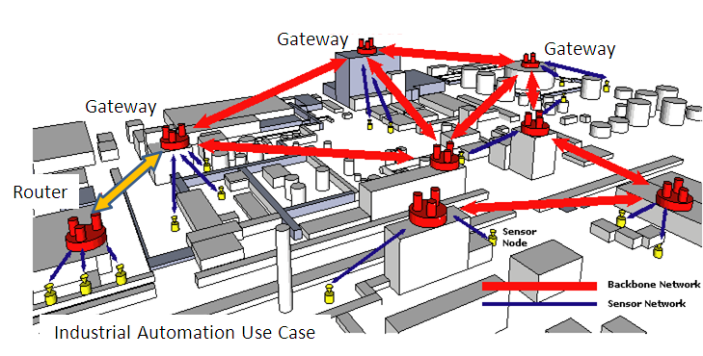
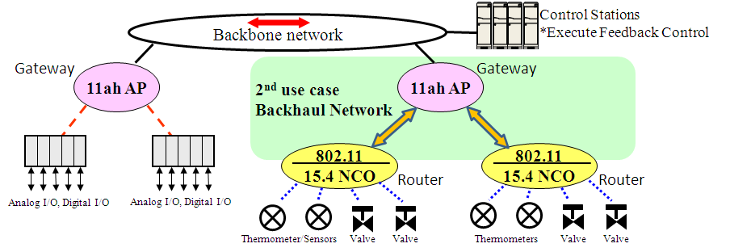
Use case: Industrial Automation

Slide 15
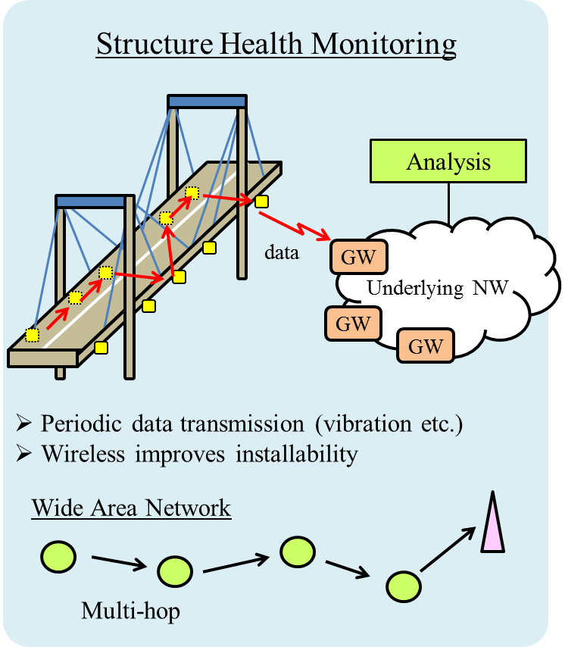
Use case: Infrastructure monitoring
Application
Status Management
Report
Request
Radio Resource
Management Entity
Optimization Function
Report
Request
Wireless Node
Radio Resource
Measurement
Configuration
Modification
Proposal of radio resource management architecture(15-13-0285r1)

Slide 16
Proposed Timeline
Year |  | 2013 |  |  |  |  |  | 2014
Month |  | 1 | 3 | 5 | 7 | 9 | 11 | 1 | 3 | 5 | 7 | 9 | 11
Preparatory phase (IG)
Technical presentation & Use cases
SG Work Items | PAR development
 | Use Cases
 | Title
 | Scope & Purpose
 | 5C analyses
 | Interaction with other TG/WG (to identify relationship )
 | Submission to WG
Standard development phase (TG) |  |  |  |  |  |  |  |  |  | Ad Hoc
Target dates:
  PAR submission to NesCom in March 2014
  SASB approval in June 2014

Slide 17
References
Proposal of radio resource management architecture(15-13-0285r1)
A Use Case of Self-Organizing Wireless Network for Medical System(15-13-306-0)
IG SRU Working Draft RRMM-usecases and 5C(15-13-0294r1)
IG SRU Usecase requirements table(15-13-0293r1)

