Slide 1
Doc: IEEE 15-13-0288-08-004m
Project: IEEE P802.15 Working Group for Wireless Personal Area Networks(WPANs)
Submission Title: Comment for FEC method NRNSC
Date Submitted: May 2013
Source: Matthew Gillmore (ITRON)
Contact: matthew.gillmore@itron.com
Voice: +1.517.745.7350
Re: LB90 Comment on FEC
Abstract:
Purpose: Notice: This document has been prepared to assist the IEEE P802.15. It is offered as a basis for discussion and is not binding on the contributing individual(s) or organization(s). The material in this document is subject to change in form and content after further study. The contributor(s) reserve(s) the right to add, amend or withdraw material contained herein.
Release: The contributor acknowledges and accepts that this contribution becomes the property of IEEE and may be made publicly available by P802.15.
Slide 1

Slide 2
FSK FEC in 4m
Doc: IEEE 15-13-0288-08-004m
Current draft, Section 20.1.2.4, supports one optional FEC method from 802.15.4k
This submission proposes to add the optional FEC schemes (RSC and NRNSC FEC schemes) from 802.15.4g, as follows
  Replace text from Section 20.1.2.2 lines 33-36 with
    “FEC support is optional. The use of FEC is controlled by the PIB attribute phyFSKFECEnabled, as defined in 9.3. Three FEC schemes are included. The FEC scheme is controlled by the PIB attribute phyTVWSFSKFECScheme as defined in 9.3. The first FEC scheme shall be according to sub-clause 19.2.2.4. For this scheme, interleaving shall always be used when FEC is enabled and the interleaving scheme shall be as defined in 19.2.2.5. The second FEC scheme shall be according to the RSC FEC scheme defined in sub-clause 18.1.2.4. For this scheme, interleaving shall be controlled by the value of the phyFSKFECInterleavingRSC PIB attribute as defined in 18.1.2.5. The third FEC scheme shall be according to the NRNSC FEC scheme defined in sub-clause 18.1.2.4. For this scheme, interleaving shall always be used when FEC is enabled and the interleaving scheme shall be as defined in 18.1.2.5.

Slide 3
New PIB attribute
Doc: IEEE 15-13-0288-08-004m
  Add a new PIB attribute phyTVWSFSKFECScheme in clause 9.3, Table 71, with the following description:
      “A value of zero indicates that the first FEC scheme as defined in 20.1.2.2 is employed. A value of one indicates that the second FEC scheme as defined in 20.1.2.2 is employed. A value of two indicates that the third FEC scheme as defined in 20.1.2.2 is employed.
      “The attribute is only valid for the TVWS-FSK PHY”
  Modify the description for the existing PIB attribute phyFSKFECInterleavingRSC in clause 9.3, Table 71,
    from “This attribute is only valid for the MR-FSK PHY“
    to “This attribute is only valid for the TVWS-FSK PHY and MR-FSK PHY”

Slide 4
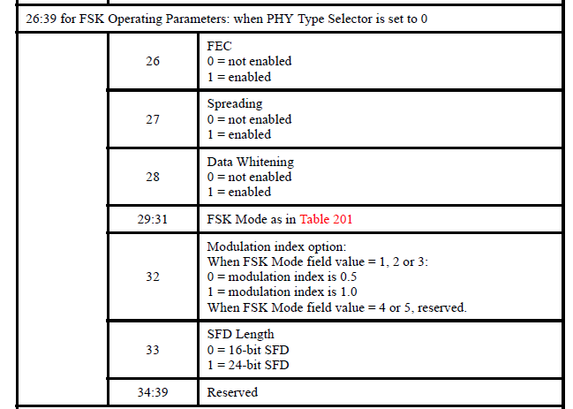
Table 4ia Changes required
Doc: IEEE 15-13-0288-08-004m
26:39 for FSK operating Parameters when PHY Type Selector is set to 0
 | 26 | FEC 0 = not enabled 1 = enabled
 | 27:28 | FEC Scheme 0 = the first FEC scheme as per 20.1.2.2 1= the second FEC scheme as per 20.1.2.2 2= the third FEC scheme defined in 20.1.2.2 NOTE: This field is reserved if FEC is not enabled.
 | 29 | Interleaving 0 = No Interleaving 1 = Interleaving NOTE: This field is reserved if FEC is not enabled or FEC Scheme field is a value of 0 or 2.
 | 30 | Spreading 0 = not enabled 1 = enabled
 | 31 | Data Whitening 0 = not enabled 1 = enabled
 | 32-34 | FSK mode as in Table 201
 | 35 | Modulation index option: When FSK Mode field value = 1, 2 or 3: 0 = modulation index is 0.5 1 = modulation index is 1.0 When FSK Mode field value = 4 or 5, reserved.
 | 36 | SFD Length 0 = 16-bit SFD 1 = 24-bit SFD
 | 37:39 | Reserved

Slide 5
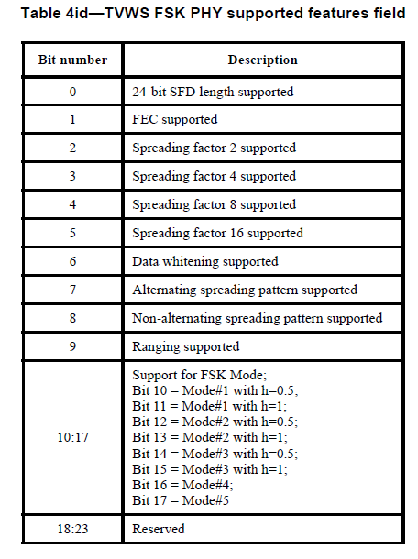
FSK FEC in 4m (cont’d)
Doc: IEEE 15-13-0288-08-004m
In table 4id, borrow 3 bits from the reserved bits and do the following changes
Bit number | Description
0 | 24-bit SFD length supported
1 | First FEC scheme as defined in 20.1.2.2
2 | Second FEC scheme as defined in 20.1.2.2
3 | Interleaver for the second FEC scheme as defined in 20.1.2.2.
4 | Third FEC scheme as defined in 20.1.2.2
5 | Spreading factor 2 supported
6 | Spreading factor 4 supported
7 | Spreading factor 8 supported
8 | Spreading factor 16 supported
9 | Data whitening supported
10 | Alternating spreading pattern supported
11 | Non-alternating spreading pattern supported
12 | Ranging supported
…. | ….

Slide 6
Technical Justification
Doc: IEEE 15-13-0288-08-004m
These schemes are complementary
  Scheme defined in 19.2.2.4 has better range at the expense of throughput
  Schemes defined in 18.1.2.4 has better throughput at the expense of communication range; additionally, RSC FEC scheme defined in 18.1.2.4 allow for low cost implementation, where receivers not implementing a RSC FEC scheme can still correctly decode a RSC encoded frame.
Systems designers can pick the one that better fits their application requirements
Millions of devices will support the method from 18.1.2.4 by the time 15.4m is approved

