Slide 1
Doc: IEEE 15-13-0288-05-004m
Project: IEEE P802.15 Working Group for Wireless Personal Area Networks(WPANs)
Submission Title: Comment for FEC method NRNSC
Date Submitted: May 2013
Source: Matthew Gillmore (ITRON)
Contact: matthew.gillmore@itron.com
Voice: +1.517.745.7350
Re: LB90 Comment on FEC
Abstract:
Purpose: Notice: This document has been prepared to assist the IEEE P802.15. It is offered as a basis for discussion and is not binding on the contributing individual(s) or organization(s). The material in this document is subject to change in form and content after further study. The contributor(s) reserve(s) the right to add, amend or withdraw material contained herein.
Release: The contributor acknowledges and accepts that this contribution becomes the property of IEEE and may be made publicly available by P802.15.
Slide 1

Slide 2
FSK FEC in 4m
Doc: IEEE 15-13-0288-05-004m
Current draft, Section 20.1.2.4, supports one optional FEC method from 802.15.4k
This submission proposes to add the optional FEC schemes (RSC and NRNSC FEC schemes) from 802.15.4g, as follows
  Replace text from Section 20.1.2.4 lines 33-36 with
    “FEC support is optional. The use of FEC is controlled by the PIB attribute phyFSKFECEnabled, as defined in 9.3. The FEC scheme shall be according to sub-clause 19.2.2.4 or the FEC schemes in sub-clause 18.1.2.4. The use of the FEC scheme shall be controlled by the PIB attribute phyTVWSFSKFECScheme, as defined in 9.3.
  Add a new PIB attribute phyTVWSFSKFECScheme in clause 9.3, Table 71, with the following description:
      “A value of zero indicates that the FEC scheme in 19.2.2.4 is employed, with an interleaving scheme as define in 19.2.2.5. A value of one indicates that the RSC FEC scheme in 18.1.2.4 is employed, with an interleaving scheme as define in 18.1.2.5. A value of two indicates that the NRNSC FEC scheme in 18.1.2.4 is employed, with an interleaving scheme as define in 18.1.2.5.”
      “The attribute is only valid for the TVWS-FSK PHY”.

Slide 3
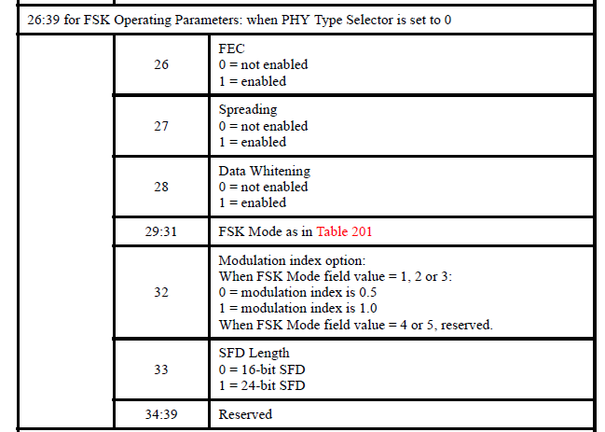
Table 4ia Changes required
Doc: IEEE 15-13-0288-05-004m
26:39 for FSK operating Parameters when PHY Type Selector is set to 0
 | 26:27 | 0 = no FEC 1 = FEC, as defined in 19.2.2.4 2 = RSC FEC, as defined in 18.1.2.4. 3 = NRNSC FEC, as defined in 18.1.2.4
 | 28 | Spreading 0 = not enabled 1 = enabled
 | 29 | Data Whitening 0 = not enabled 1 = enabled
 | 30-32 | FSK mode as in Table 201
 | 33 | Modulation index option: When FSK Mode field value = 1, 2 or 3: 0 = modulation index is 0.5 1 = modulation index is 1.0 When FSK Mode field value = 4 or 5, reserved.
 | 34 | SFD Length 0 = 16-bit SFD 1 = 24-bit SFD
 | 35:39 | Reserved

Slide 4
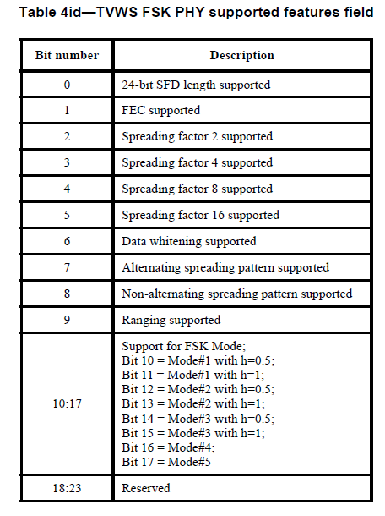
FSK FEC in 4m (cont’d)
Doc: IEEE 15-13-0288-05-004m
In table 4id, borrow 2 bits from the reserved bits and do the following changes
Bit number | Description
0 | 24-bit SFD length supported
1 | RSC FEC supported, as defined in 18.1.2.4
2 | NRNSC FEC supported, as defined in 18.1.2.4.
3 | FEC supported, as defined in 19.2.2.4.
4 | Spreading factor 2 supported
5 | Spreading factor 4 supported
6 | Spreading factor 8 supported
7 | Spreading factor 16 supported
8 | Data whitening supported
9 | Alternating spreading pattern supported
10 | Non-alternating spreading pattern supported
11 | Ranging supported
12:19 | Support for FSK Mode; Bit 12 = Mode#1 with h=0.5; Bit 13= Mode#1 with h=1; Bit 14 = Mode#2 with h=0.5; Bit 15 = Mode#2 with h=1; Bit 16 = Mode#3 with h=0.5; Bit 17 = Mode#3 with h=1; Bit 18 = Mode#4; Bit 19 = Mode#5
20:23 | Reserved

Slide 5
Technical Justification
Doc: IEEE 15-13-0288-05-004m
These schemes are complementary
  Scheme defined in 19.2.2.4 has better range at the expense of throughput
  Schemes defined in 18.1.2.4 has better throughput at the expense of communication range; additionally, RSC FEC scheme defined in 18.1.2.4 allow for low cost implementation, where receivers not implementing a RSC FEC scheme can still correctly decode a RSC encoded frame.
Systems designers can pick the one that better fits their application requirements
Millions of devices will support the method from 18.1.2.4 by the time 15.4m is approved

