Slide 1
Project: IEEE P802.15 Working Group for Wireless Personal Area Networks (WPANs)
Submission Title: [UWB PHY Proposal to TG8]
Date Submitted: [11th July 2013 ]
Source: [Billy Verso, Michael McLaughlin]
Company: [DecaWave]
Address: [Adelaide Chambers, Peter Street, Dublin 8, Ireland]
Voice:[+353 1 6975030] Fax: [] E-Mail:[billy.verso “at” decawave.com, michael.mclaughlin “at” decawave.com ]
Re: [In response to call for technical proposals to TG8]
Abstract: [ Proposes that TG8 adopts 802.15.4a UWB as PHY for TG8]
Purpose: [PHY proposal for 802.15.8]
Notice: This document has been prepared to assist the IEEE P802.15. It is offered as a basis for discussion and is not binding on the contributing individual(s) or organization(s). The material in this document is subject to change in form and content after further study. The contributor(s) reserve(s) the right to add, amend or withdraw material contained herein.
Release: The contributor acknowledges and accepts that this contribution becomes the property of IEEE and may be made publicly available by P802.15.

Slide 2
UWB PHY Recommendation for 802.15.8
This PHY is proposed to cover the following requirements:
  To operate in unlicensed UWB bands and support relative positioning
  To provide various data rates in support of different applications
  To support mobility and to have a low complexity solution
The 802.15.4a UWB PHY has all the necessary characteristics for peer-aware-communications. Our proposal is that 802.15.8 should adopt the 4a UWB PHY with little or no modification
  There may be some scope for optional extensions to give more flexibility but in general 4a UWB addresses the PAC requirements well
  The 802.15.8 MAC can use the PHY to provide the PAC functionality of peer discovery, peer relative positioning, and various communications topologies.

Slide 3
Reasons TG8 should adopt the 4a UWB PHY(1)
Precision Ranging support allows peer relative positioning
Immunity to multipath effects
15 channels cover unlicensed UWB bands from 3 to 10 GHz
Data rates give trade-off between range and high speed data
  110 kbps, 850 kbps, 6.81 Mbps and 27 Mbps
Efficient spectral usage
  pseudo random burst hopping fills out the spectrum, allowing more power to be transmitted within the regulatory limits
Modulation and coding combination close to ideal
  The concatenated codes are low complexity, (e.g. the Viterbi decoder can be implemented in <3k gates), but despite this the performance is less than 2dB shy of the Shannon limit

Slide 4
Reasons TG8 should adopt the 4a UWB PHY (2)
Perfect channel sounding
  The preamble uses an Ipatov sequence which has with Perfect Periodic Autocorrelation. The ideal channel autocorrelation is an impulse or Kronecker delta function. The preamble allows the channel impulse response and the direct path to be extracted allowing the RX time to be determined accurately – this is key to precision range measurements enabling accurate relative positioning of peer devices
Choice of higher/lower complexity implementations
  A coherent transceiver can be implemented in small area of silicon
  A non-coherent receiver is possible with a simple energy detector
  FEC is systematic – so receiver designer can choose to decode or ignore
    Systematic Convolutional Code, and, Reed Solomon code
Low time to market as commercial implementations are available

Slide 5
Narrowband versus Ultra-Wideband
Notes:
Graphical representation of narrowband and UWB pulses:
Time Domain: Fast Rising and Falling Edges
Frequency Domain: Large Bandwidth
Time scales corresponding to
Narrowband: 20 MHz bandwidth (‘best case’ narrowband, most technologies have much smaller bandwidths)
Ultra-wideband: 500 MHz Bandwidth (‘worst case’, since we can go up to 1.3 GHz in 4a)

Slide 6
In the Presence of Noise
Notes:
Narrowband: noise creates uncertainty about crossing of threshold
UWB: removes uncertainty due to sharp rising time, hence suitable for time of arrival based ranging

Slide 7
In the Presence of Multipath
Notes:
UWB:
UWB receiver perceives two distinct pulses
Ranging and localisation are not affected
Communications benefits from combining the energy of both paths
Narrowband:
Pulses overlap; phase difference between paths leads to fading.
Communications suffers from fading signal strength.
Changed slope of the edge degrades time of arrival estimate.
Conclusion:
Narrowband versus Ultra Wideband: UWB allows for steep edges
In the presence of noise UWB removes threshold crossing uncertainty.
In the presence of multipath, UWB Ranging not affected, Communications benefit

Slide 8
An international standard for precision location and communication
802.15.4a
Baseline: Q1 ’05
Completed: Q4 ’06
Ratified: Q1 ’07
Rolled into 802.15.4 Q3 ‘11
up to 27 Mbps,
> 300m range,
with location & mobility
802.15.4a
Ratified Q1 ‘07
Location,
Communication,
Control
IEEE Standard
Capability
Utility

Slide 9





Bandplan facilitating Worldwide Deployment
15
Double-ended arrows
show allowed UWB frequency
bands in various regions.
LDC = low duty cycle
i.e. infrequent TX
14
Pink and purple
lines show the .4a defined
frequency channels
and bandwidths
13
12
11
10
9
8
802.15.4a UWB Channel Number
7
6
5
4
3
2
1
0
0
1000
2000
3000
4000
5000
6000
7000
8000
9000
10000
Frequency, MHz
US Indoors & handheld
US Indoors & mobile out
Europe, China, others
Europe with LDC
Japan @ >50Mbps
Japan with DAA
Korea
Korea with LDC
.4a 500MHz
.4a >1GHz
Notes:
9

Slide 10
IEEE 802.15.4a Preamble
Benefit of ternary codes:
  support both coherent and non-coherent detection
  Perfect autocorrelation allows precise measurement of channel impulse response
Notes:
Explain how ranging is supported in 4a.
Ternary preamble code: contains silences and pulses positive and negative (i.e. Opposite phase)
Non-coherent RX: can only use silence/presence of signal to detect: less reliable.
Perfect auto-correlation: allows receiver to reconstruct the channel impulse response.
Advanced: explain that the standard only contains ranging and the rest is up to the system implementer. Allows flexible system where same PHY supports ToA, TDOA and two-way ranging, in fact any time-of-arrival based location method.

Slide 11
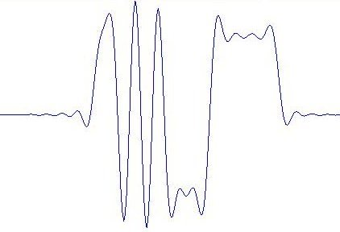
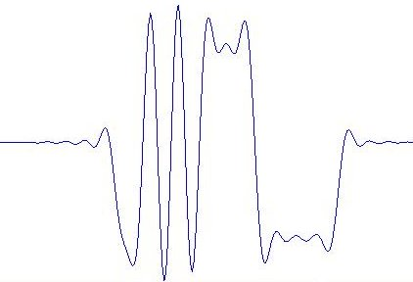
Convolutional Coding of Data Bits
Represents 0
Guard interval 0
Represents 1
Guard interval 1
All data bits are encoded with the convolutional encoder
The systematic bit determines the burst position in the symbol (PPM)
The parity bit determines the polarity of the burst

Slide 12
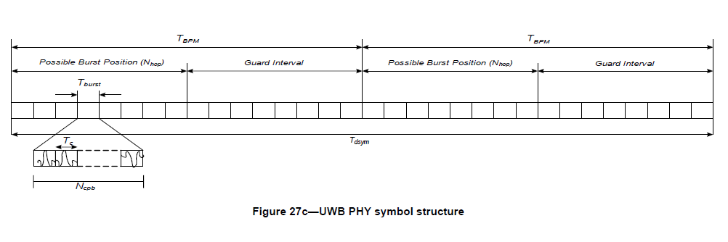
IEEE 802.15.4a Payload
Non-coherent RX can only use burst position information to decode bits
Coherent RX benefits
  Burst phase contains error correction information
  Non-coherent demodulation squares the noise
  Burst spreading code allows noise suppression
Notes:
Explain how 4a supports communications with burst phase and position modulation.
To smoothen spectrum, burst position hops randomly within active quarter, and burst itself consists of a pseudo random spreading code.
Because we’re coherent, we can use error correction contained in burst phase, gives about 9dB extra coding gain and another >6dB gain that coherent demodulation has over non-coherent.
We can also use spreading code, giving data rate dependent processing gain up to 27dB.
Result is that we can dig up signal from far below the noise floor.

Slide 13
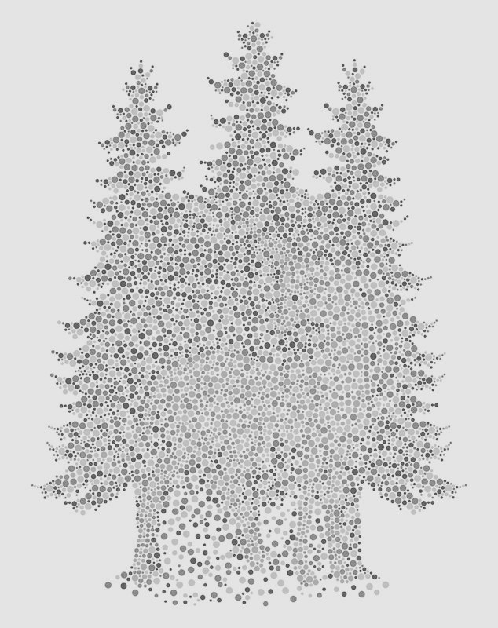
Find the unicorn (non-coherent version)
Notes:
Coherent compared to non-coherent means that we use the information contained in the phase of the arriving signal.
Non-coherent corresponds to colour blind, coherent corresponds to colour vision.
Because you have the extra information, it becomes much easier to distinguish signal from noise:
Figure: unicorn clearly stands out against background when we have the ‘extra’ colour info
UWB equivalent: using the phase as ‘extra information’, coherent is much better at digging the signal out from the noise floor
(unfortunately, figure looks the same for colourblind people)
Later is important, since UWB regulations reuse licensed spectrum and have to stay below noise floor of licensed devices (-41.3 dBm/MHz limit)

Slide 14
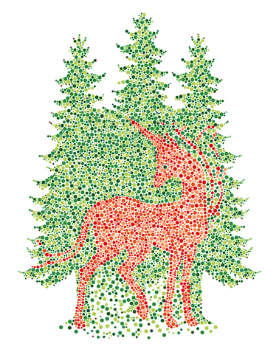
Find the unicorn (coherent version)
Image credit: Nick Ace, Colorblind Unicorn

Slide 15
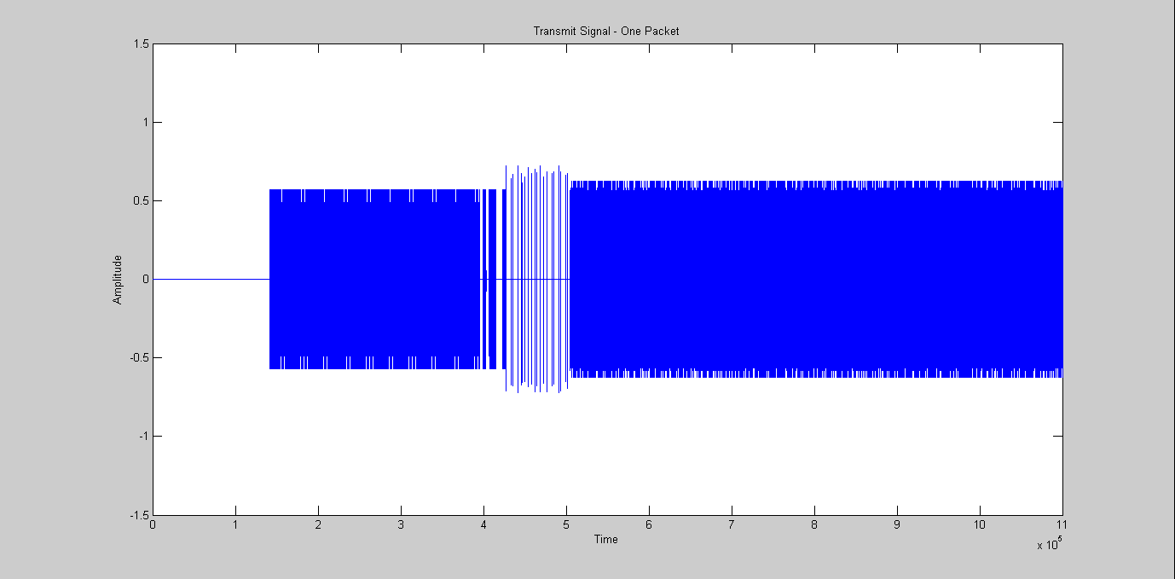
The 4a Transmit Signal
4a Transmit frame @ 6.8Mbps
Notes:
15

Slide 16
The 4a Transmit Signal
4a Transmit frame @ 6.8Mbps. Portion of preamble indicated in red
Notes:
16

Slide 17
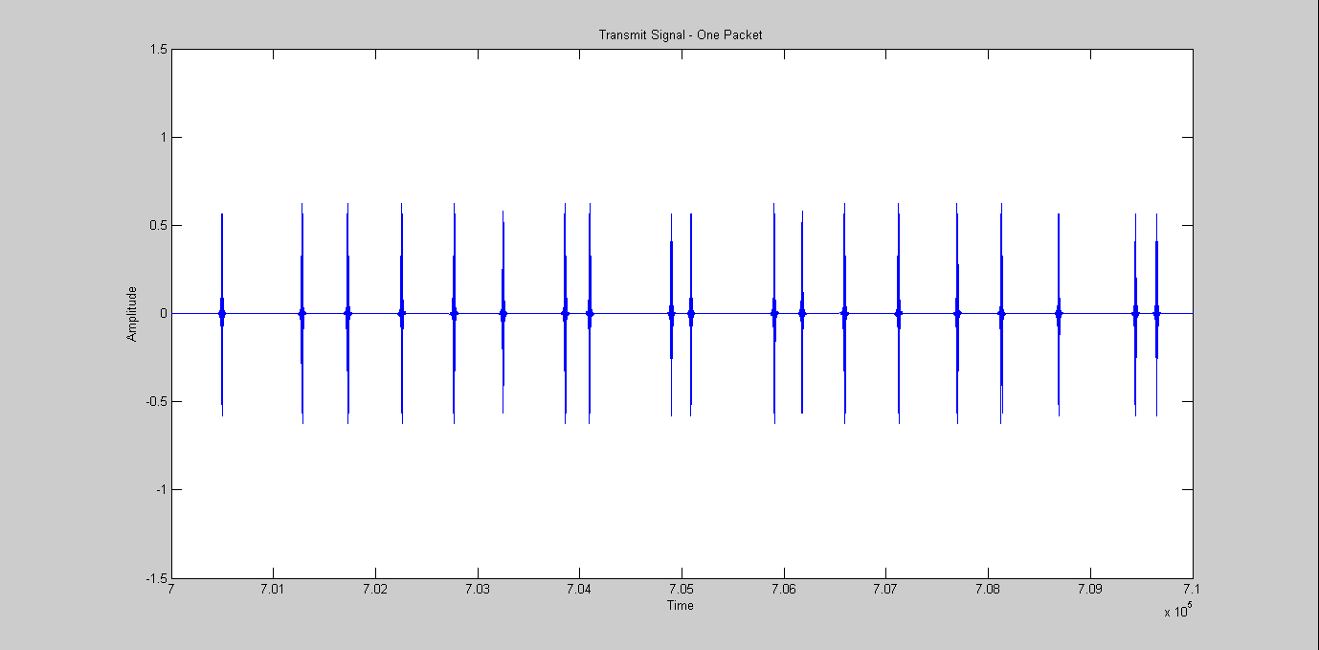
4a Transmit Preamble – Zoomed In
4a Transmit preamble

Slide 18
4a Transmit Preamble – Zoomed In
4a Transmit preamble. Pulse of preamble indicated in red

Slide 19
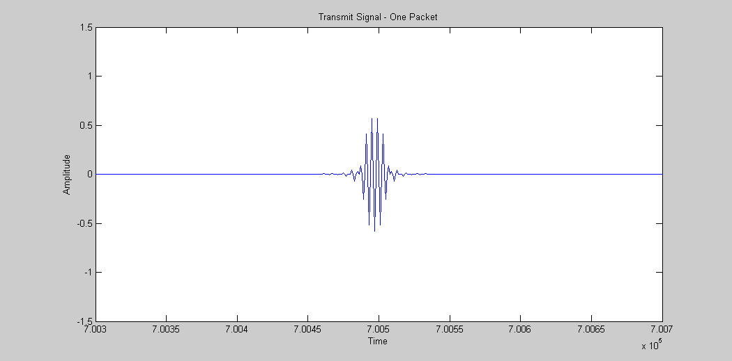
4a Transmit – One pulse

Slide 20
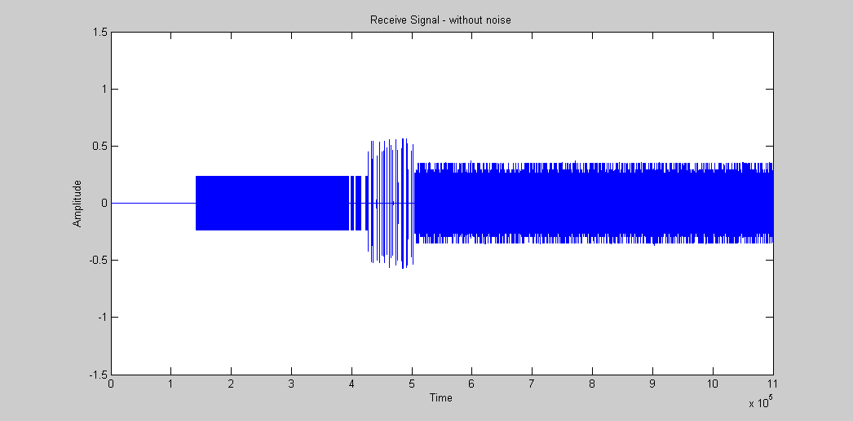
The 4a Receive Frame – No Noise
4a Receive Signal @ 6.8Mbps

Slide 21
The 4a Receive Frame – No Noise

Slide 22
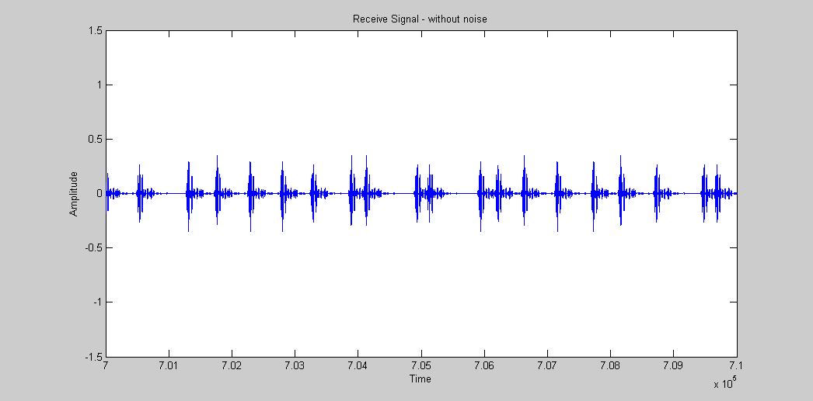
The 4a Receive Signal – Zoomed In

Slide 23
The 4a Receive Signal – Zoomed In

Slide 24
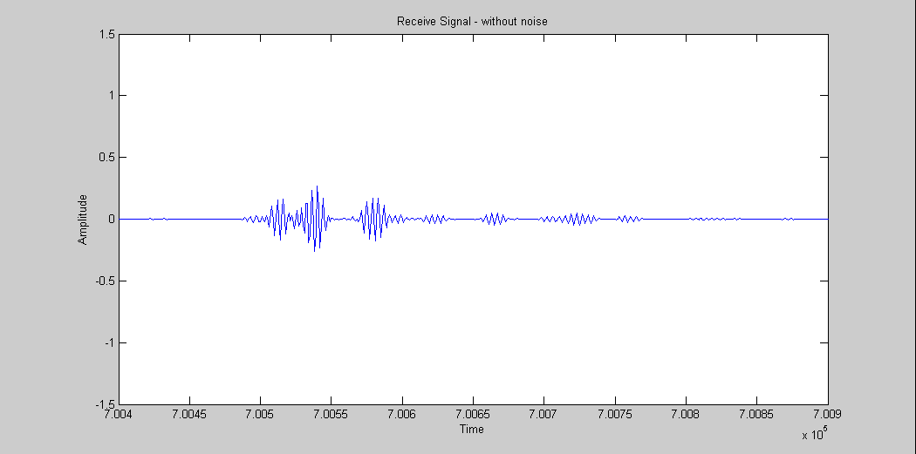
One 4a Receive Burst– No Noise

Slide 25
The 4a Receive Frame – No Noise
4a Receive Signal @ 6.8Mbps

Slide 26
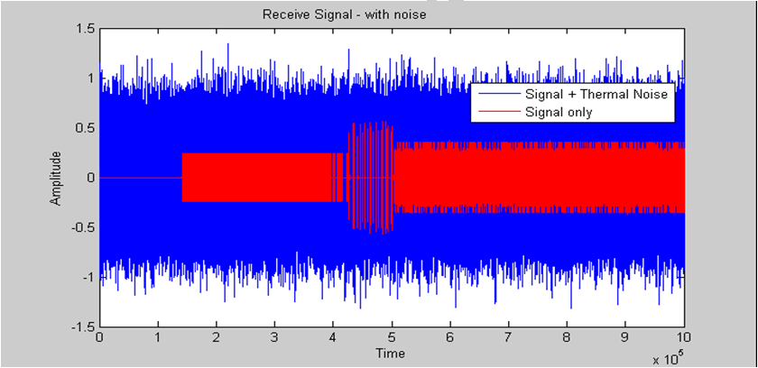
4a Receive Signal 6.8Mbps + Thermal Noise
4a Receive Signal @ 6.8Mbps and noise at -14dB SNR
This corresponds to a distance of 60 meters outdoors, 20 meters indoors

Slide 27
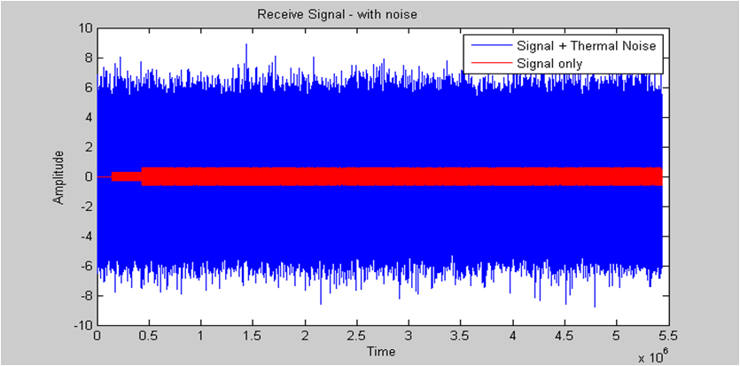
4a Receive Signal 850kbps +Thermal Noise
4a Receive Signal @ 850kps and noise at -20dB SNR
Equivalent to a distance of 150 meters outdoors, 28 meters indoors

Slide 28
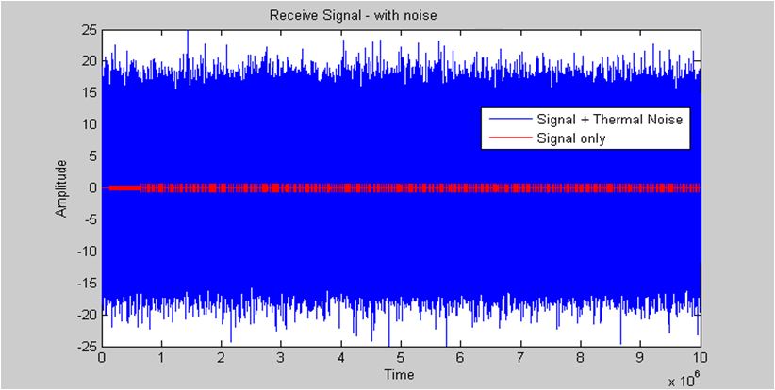
4a Receive Signal 110kbps +Thermal Noise
4a Receive Signal @ 110kps and noise at -25dB SNR
This corresponds to a distance of 250 meters outdoors, 34 meters indoors

Slide 29
AWGN Channel Test Results 16MHz PRF

Slide 30
AWGN Channel Test Results 64MHz PRF

Slide 31
IEEE 802.15.4a Channel Model Simulation Results
CM6: Outdoor NLOS. Longest multipath channel.
Total Channel Power is normalised to 1
  This will not happen in practice. Multipath will add energy and improve performance

Slide 32
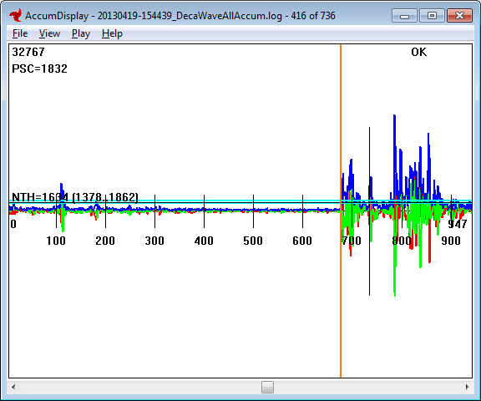
Example CIR read from DW1000 802.15.4a IC
This is an unusually long channel
First Path

Slide 33
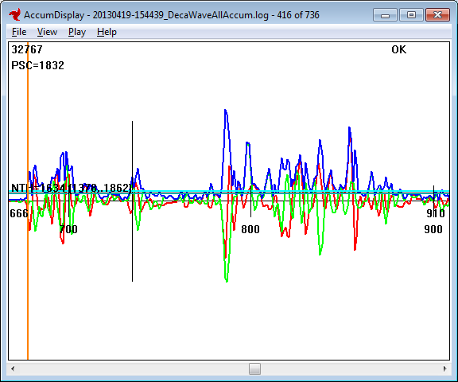
Example CIR read from DW1000 802.15.4a IC
Zoomed In
First Path

Slide 34
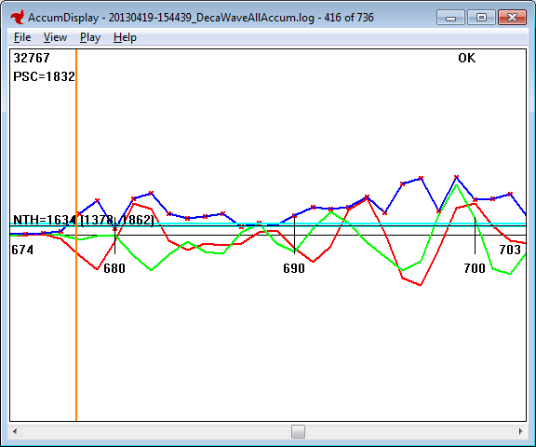
Example CIR read from DW1000 802.15.4a IC
Zoomed in more
First Path

Slide 35
LOS Ranging Test Results

Slide 36
LOS Ranging accuracy
50cm / div

Slide 37
Conclusion
The proposal is to reuse the 4a UWB PHY for TG8
It gives good performance with operational choices for range vs. data rate, and a choices for implementation complexity
It has properties allowing accurate message time-stamping giving the ability for precision peer relative positioning
    <end>

