Slide 1
Project: IEEE P802.15 Working Group for Wireless Personal Area Networks (WPANs)
Submission Title: Technical Pre-proposal for IEEE 802.15 TG8 PAC Standard
Date Submitted: May 6, 2013
Source: Byung-Jae Kwak (ETRI), Kapseok Chang (ETRI), Sunggeun Jin (Daegu University)
Address: bjkwak@etri.re.kr
Re: TG8 Call for Proposal (CFP; IEEE P802.15-13-0069-05-0008)
Abstract: This document presents technical proposals for IEEE 802.15. TG8 PAC standard
Purpose: Discussion
Notice: This document has been prepared to assist the IEEE P802.15. It is offered as a basis for discussion and is not binding on the contributing individual(s) or organization(s). The material in this document is subject to change in form and content after further study. The contributor(s) reserve(s) the right to add, amend or withdraw material contained herein.
Release: The contributor acknowledges and accepts that this contribution becomes the property of IEEE and may be made publicly available by P802.15.

Slide 2
D2D – The time is right!
Advent of powerful mobile devices (smartphone, tablets, etc)
Growing demand for hi-fidelity wireless multimedia services
Saturation of core network
Need for new wireless services/applications
Technologies with similar goals:
  FlashLinQ^{[2]}
  Wi-Fi Direct^{[3]}
  LTE Direct (Proximity Services; ProSe) ^{[6]}

Slide 3
D2D – Why PAC?
Infrastructureless
Optimized PHY & MAC: No burden of legacy system
State of the art features
  Fully distributed coordination
  Discovery without association
  Scalable data rate
  (Relative) positioning
  Multi-hop relay
Licensed/unlicensed

Slide 4
Obstacles for PAC (1/2)
A technology that is ahead of its time?
  Fully distributed D2D
  One stone, many birds: performance, scalability, security, fairness, …
Killer Applications,
  that only PAC can provide
Competition
  New Technologies: Wi-Fi Direct ( + 802.11ai, 802.11aq), LTE Direct, etc^{[3,4,5,6]}
  Infrastructure of legacy technologies + Social Network Services
  …

Slide 5
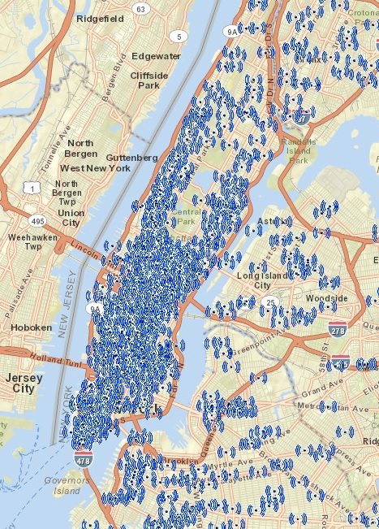
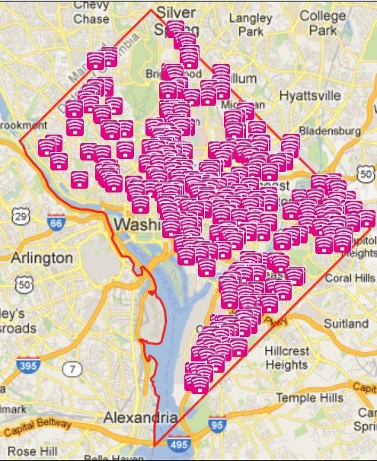
Obstacles for PAC (2/2)
Wi-Fi Hot Spots
Manhattan
Washington DC

Slide 6
Challenges in PAC
Scalability
  Large # neighboring devices
  Coverage extension (e.g., multi-hop relay)
Distributed coordination
  Fast discovery & link connection
  QoS (Quality of Service)
  Performance
  Security
Trailblazer: No reference to benchmark

Slide 7
PAC Architecture
Synchronized operation
  Resource efficiency, protocol efficiency, power management
OFDM
  Less stringent timing sync requirement
Random access based
  Simple (e.g., CSMA/CA)
User centric^{[8,9]}
  Intuitive
  Minimum user intervention

Slide 8
Medium Access for PAC
CSMA/CA of IEEE 802.11
  Simple
  Reasonable performance
  Fully distributed (cf. DCF)
  Does not scale well beyond a few dozen devices
  Designed for single hop wireless networks
  Assumes “No ACK == collision”

Slide 9
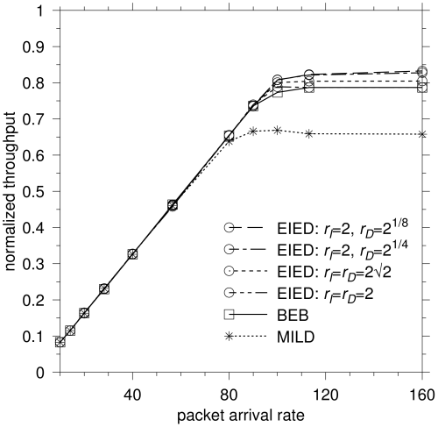
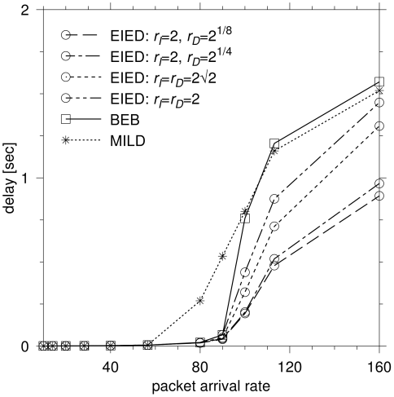
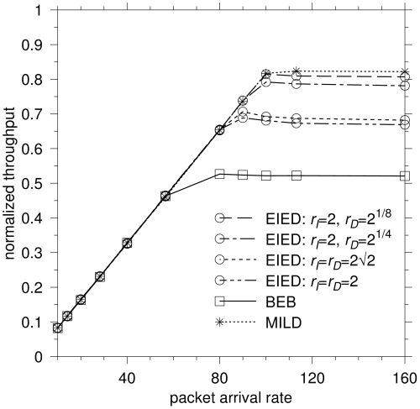
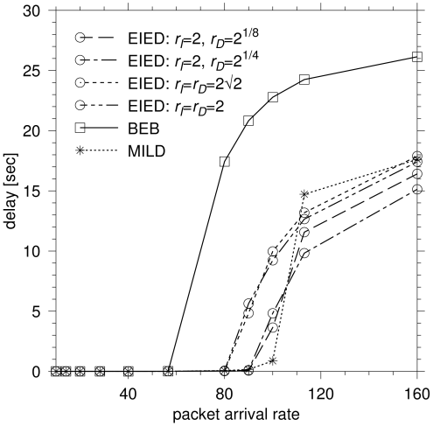
Medium Access for PAC
Preliminary Work
  EIED^{[7]}
    Optimization of Backoff algorithm dramatically improves CSMA/CA performance
    Single hop wireless network assumed
    Minimum CW = 16, maximum CW = 1024
    BEB handle light load very well, but performance suffers when the load is heavy
N=5
N=60

Slide 10
Medium Access for PAC
Preliminary Work
  Further improvement of CSMA/CA possible
    “No ACK != collision”
    Implement collision detection mechanism (also helps rate adaptation)

Slide 11
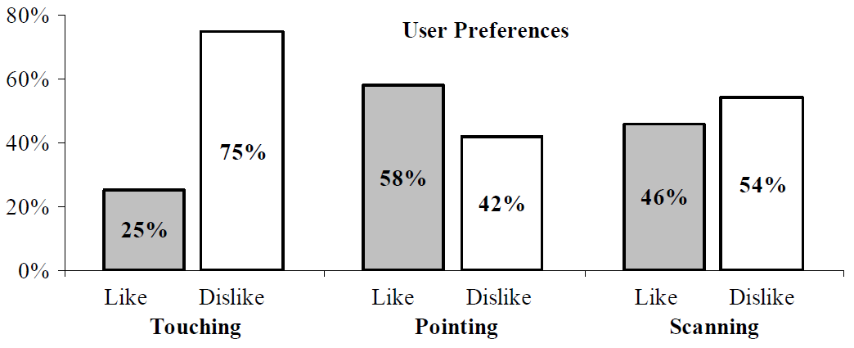
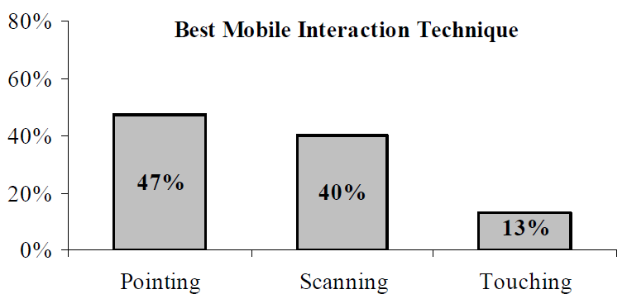
Discovery with Spatial Filtering for PAC
“Pointing” is the preferred mobile interaction technique^{[8]}
  Related work: Point & Connect (PnC) by Microsoft^{[10]}
 | Touching | Pointing | Scanning
Natural interaction, intuitiveness | Good | Good | Average
Felt error resistance, non-ambiguous | Good | Average | Bad
Performance (within interaction distance) | Good | Average | Bad
Cognitive load | Low | Medium | High
Physical effort (outside interaction distance) | High | Medium | Low

Slide 12
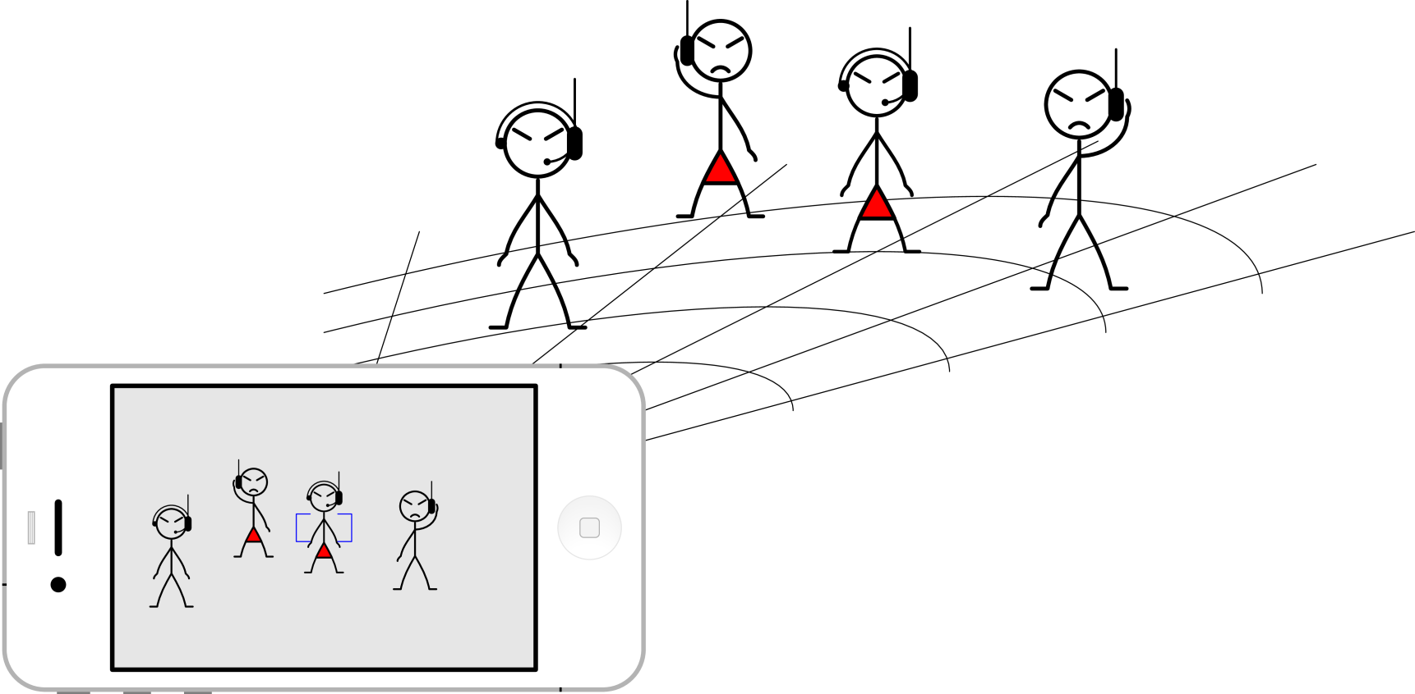
Discovery with Spatial Filtering for PAC
PAC usage scenario with pointing (spatial filtering)^{[9]}

Slide 13
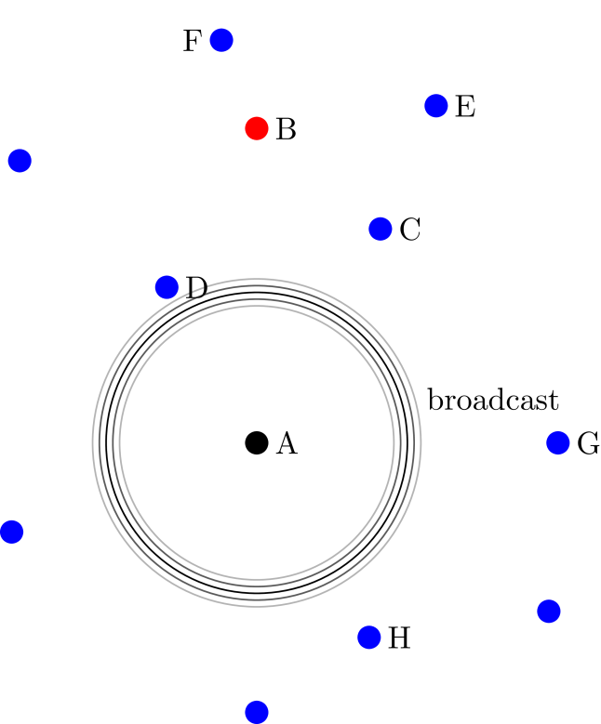
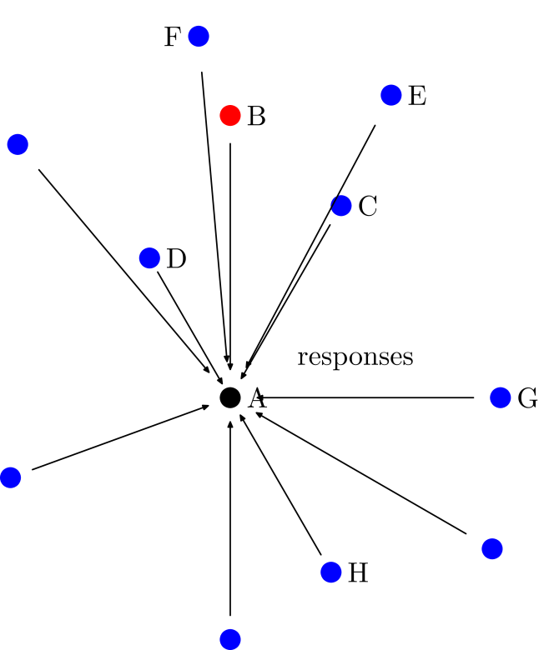
Discovery with Spatial Filtering for PAC
Discovery without spatial filtering

Slide 14
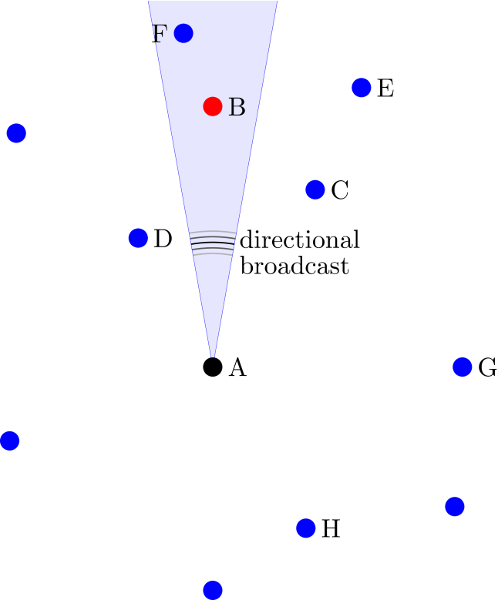
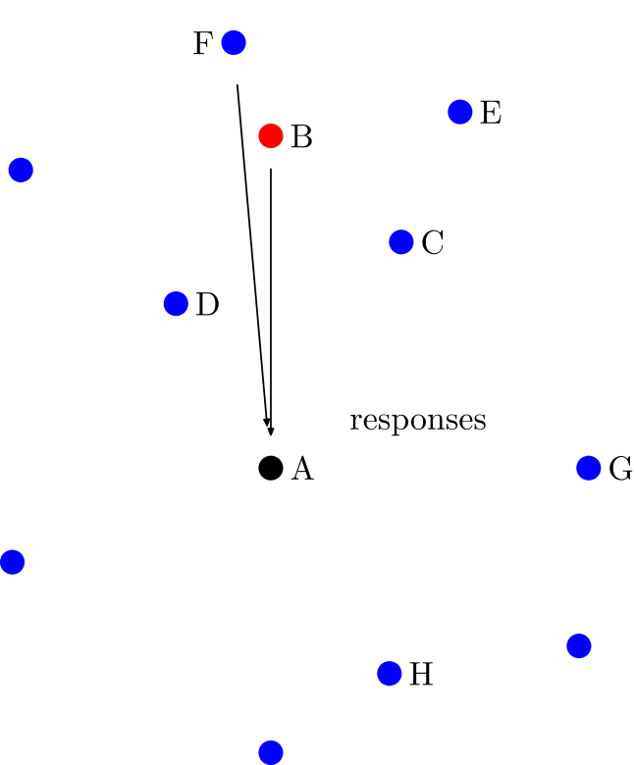
Discovery with Spatial Filtering for PAC
Discovery with spatial filtering

Slide 15
Discovery with Spatial Filtering for PAC
Benefit of spatial filtering
  Minimize signaling overhead
  Minimize interference
  Faster discovery
  Improved user experience
    Intuitive operation
    Minimal user intervention
H/W requirement
  Transmitter: array antenna
  Receiver: single antenna

Slide 16
A View on Distributed Synchronization
Necessity of distributed synchronization (DS) ^{[11]}
  Low duty cycling for discovery
  High efficiency in terms of scheduling/interference management based on a channel access with common time
A DS approach to be proposed and its requirement
  A physical-layer approach for fast and accurate synchronization
  A synchronization signal design robust to frequency offset (FO) in the absence of knowledge of initial carrier FO and timing synchronization in a DS environment

Slide 17
Conclusion
Discussed PAC in the context of D2D
  Comparison with other D2D technologies
  Obstacles and challenges
  Strategy
Introduced several key areas of PAC
  With focus on basic concept and expected benefits
Detailed proposal on the key areas with simulation results in preparation
  Comments are welcome

Slide 18
References
[1] TG8 Call for Proposals (CFP), IEEE P802.15-13-0069-05-0008, March 2013.
[2] M. Scott Corson et al., “Toward Proximity-Aware Internetworking,” IEEE Wireless Communications, December 2010, pp. 26-33.
[3] http://www.wi-fi.org/discover-and-learn/wi-fi-direct
[4] http://www.ieee802.org/11/Reports/tgai_update.htm
[5] http://www.ieee802.org/11/Reports/tgaq_update.htm
[6] 3GPP TR 22.803, “Feasibility study for Proximity Services (ProSe),” Release 12, 3GPP, 2013.
[7] Nah-Oak Song et al., “Enhancement of IEEE 802.11 Distributed Coordination Function with Exponential Increase Exponential Decrease Backoff Algorithm,” VTC 2003-Spring, vol. 4, pp. 2775-2778.
[8] E. Rukzio, “Physical Mobile Interaction: Mobile Devices as Pervasive Mediators for Interactions with the Real World,” PhD Thesis, University of Munich, 2006.
[9] “Response to the Call for Applications: Look-and-Link Communication,” IEEE P802.15-12-0227-01-0008, May 2012.
[10] Chunyi Peng et al., “Point & Connect: Intention-based Device Pairing for Mobile Phone Users,” Mobisys’09, June 2009.
[11] “PAC Synchronous Operation,” IEEE P802.15-13-0121-00-0008, March 2013.

Slide 19
Extra…
http://www.youtube.com/watch?v=je2lWjfpywQ (Wi-Fi Direct clip)

