Slide 1
Project: IEEE P802.15 Working Group for Wireless Personal Area Networks (WPANs)
Submission Title: LB89 MAC Additions for RCC
Date Submitted: 4 May 2013
Source: Benjamin A. Rolfe (BCA), Yale Lee (LiLee)
Company: Blind Creek Associates, LiLee Systems
Address: PO Box 798 Los Gatos CA 95031
Voice: +1 408 332 0725, E-Mail: ben @ blindcreek.com
Re: Comment submission for WG 15 LB89
Abstract: Presents proposed changes in support of submitted coments; proposes additional MAC content to support the proposed RCC PHY and scope of the amendment.
Purpose: Comment submission
Notice: This document has been prepared to assist the IEEE P802.15. It is offered as a basis for discussion and is not binding on the contributing individual(s) or organization(s). The material in this document is subject to change in form and content after further study. The contributor(s) reserve(s) the right to add, amend or withdraw material contained herein.
Release: The contributor acknowledges and accepts that this contribution becomes the property of IEEE and may be made publicly available by P802.15.

Slide 2
Add 4.1b.1 RCC Network
A typical RCC Network (RCCN) needs to concurrently support both Star and peer-to-peer topologies to allow communication between the control center and various endpoints as depicted in figure xxx [figure on next slide]. An RCCN base station is a fixed device that provides gateway access to the backhaul network.
An RCCN endpoint may be a locomotive, or a fixed wayside device. Communication between the wayside devices and mobile devices may be through a base station or directly peer-to-peer. In some cases a base station may not be in range of the endpoints.
When a base station is available, it acts as an RCCN PAN coordinator, transmitting a periodic beacon and defining an RCCN superframe as described in 5.1.1.x [new subclause – see next slide].
When an RCCN devices is not receiving beacons from an RCCN PAN, RCCN devices communicate directly using random channel access (CSMA-CA with PCA). An example is shown in figure [figure on slide 4]: the locomotive uses the enhanced beacon request command to discover wayside devices or other locomotives that may be in range, and uses the information provided to communicate directly with peer devices.

Slide 3


Rail Communication & Control Network
Add Figure in 4.1b.1 RCC Network
Backhaul network
Basestation
(Gateway)
peer-to-peer
Wayside
(Device)
Locomotive
(Device)
Wayside status Update
(Broadcast)

Slide 4
Peer-to-Peer without Coordinator
RCCN Device (wayside)
RCCN Device (wayside)
RCCN Device (locomotive)
MAC-Command: Enhanced Beacon request
IE: DevType=wayside
Enhanced Beacon
discovery
Enhanced Beacon
Data
Data

Slide 5
RCCN Superframe Structure
Enhanced beacon with new superframe type
request/response timeslots
Broadcast/peer-to-peer using slotted CSMA-CA with PCA
GTS
management
timeslots
shared group
timeslots
bidirectional
timeslots
beacon
downlink
uplink
S
S
S
S
…
S
S
S
S
S
…
S
time
Add figure and text after 5.1.1.6:
The RCCN superframe structure is shown in [figure]. The superframe begins with an enhanced beacon containing the RCCN Descriptor IE. The management downlink and uplink slots are sued for management request and response transmissions between the RCCN coordinator and RCCN; channel access in the management period is using CSMA-CA. Following the uplink slots is a contention access period, in which communication between any devices in the RCCN may occur; access in the CAP is using CSMA-CA optionally with PCA. Following the CAP is a CFP with GTS allocated by the RCCN PAN Coordinator. See [xref to superframe IE]. An example communication flow in an RCCN is illustrated in [figure on next slide].

Slide 6
RCCN Example
RCCN Device
RCCN coordinator
RCCN Device
Enhanced Beacon
Clock alignment
Enhanced Beacon
MAC-Command: Association Request
Association +
Timeslot configuration
MAC-Command: Association response
Data (in GTS)
Data (Broadcast in shared timeslot)
Data (in shared timeslot)

Slide 7
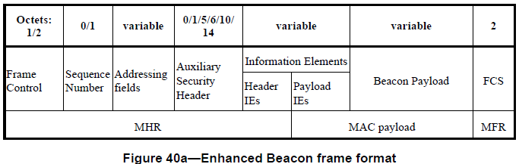
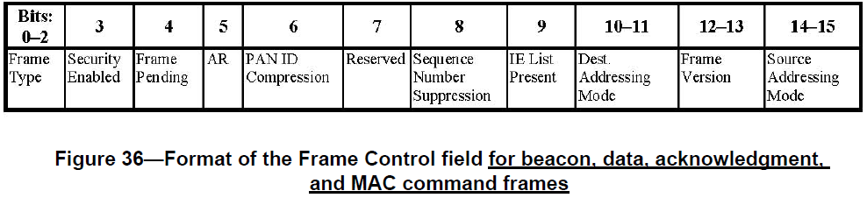
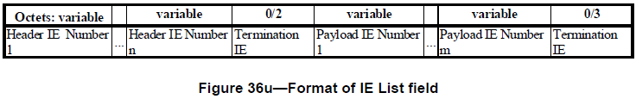
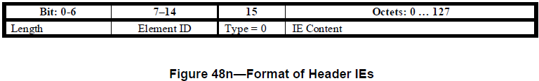
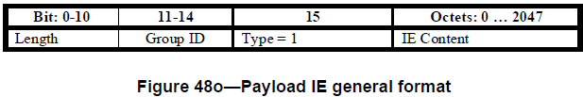
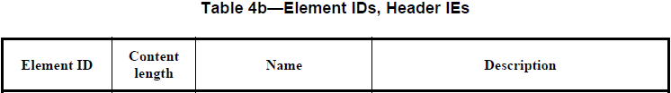
RCCN Superframe
set to 1 in RCCN Beacons
Add two rows to Table 4b
0x21 | variable | RCCN descriptor | RCCN PAN descriptor
0x22 | integer | Global Time | Global Time stamp if available

Slide 8
New IE
Add new subclause in 5.2.4:
RCCN descriptor IE
Octet: 1 |  | 1 | 1 | 1 | variable | 1 | variable
bits:0-3 | Bit:4-7
version | reserved | Shared TS | Management TS | GTS TS | Network ID | Device Type | capabilities
The RCC Network (RCCN)Descriptor IE is used in enhanced beacons to signal that an RCCN PAN is present and describes the superframe configuration in use. The Version field indicates the superframe version and shall be set to 0 for this version of the standard
The TS field indicates the total number of superframe slots in the superframe; Slots not indicated as management or GTS slots are allocated to the shared CAP.
The management TS field indicates the number of superframe slots in the management period with floor(n/2) slots allocated for downlink (response) and the remainder allocated for uplink (request).
The GTS TS field indicates the number of superframe slots allocated for the CFP.
The Netowrk ID field contains an counted string of octets which contains a network specific identification; the first octet is the length of the string;
The Device Type field contains an application specific device type indication – the definition of device types is out of scope of this standard
The capabilities field includes TBD [should instead just add an RCC Capabilities IE?)

Slide 9
New IE
Octets: 4
Global Time in seconds
Add new subclause in 5.2.4:
Global Time IE is used to distribute a network wide time reference. Presenence of this IE indicates the transmitting device has a reference to global time, for example, GPS reference time. The Global Time field contains the number of seconds since since 00:00:00 UTC, Jan 1,1970.

Slide 10

MAC PIB for RCCN
macRCCNenabled | Boolean | True or False | If TRUE, the device is using functionality specific to RCCNs | Implementation specific
Table 52? – RCCN MAC PIB attributes
macRCCNnumTimeSlots | integer | 0 ~ 254 | Number of timeslots within superframe excluding timeslot for beacon frame and management timeslots | 48
macRCCNnumMgntTS | integer | 0-254 | Number of management timeslots | 4
macRCCNnumGtsTS | integer | 0 -254 | Number of GTS timeslots | 24
macRCCNNetID | octets | variable | Network ID | 0
macRCCNdevType | Enumeration | True or False | Indicates whether the RCCN device is the RCCN PAN coordinator, fixed or mobile | False
macRCCNcap | octets | variable | Phy capabilities supported | Implementation specific
Read Only

Slide 11
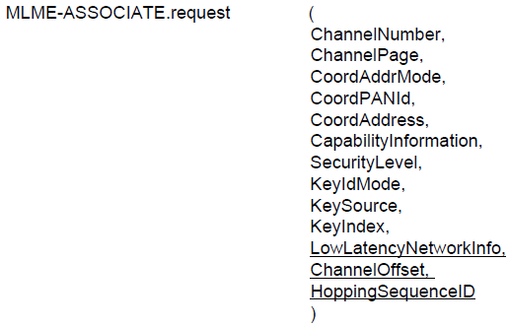
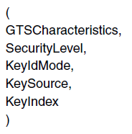
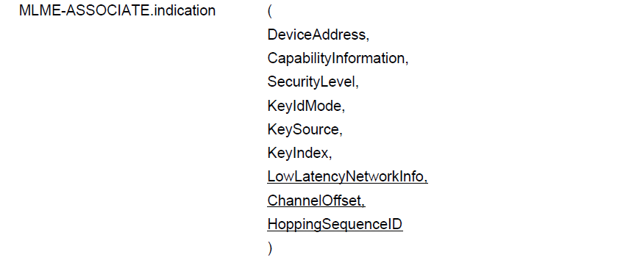
MLME primitives
As defined in 802.15.4e-2012
GTSrequestInfo[]
As defined in 5.3.9
As defined in 802.15.4e-2012
GTSrequestInfo[]
As defined in 5.3.9

Slide 12
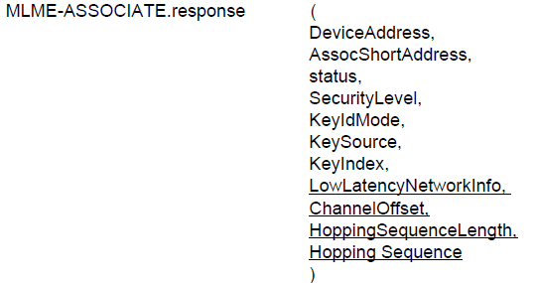
MLME primitives
As defined in 802.15.4e-2012
GTSrequestInfo[]
As defined in 5.3.9

Slide 13
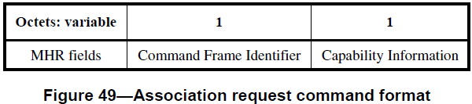
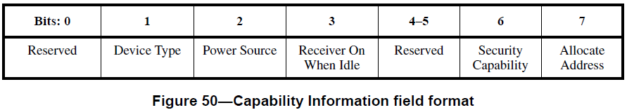
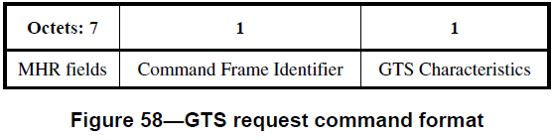
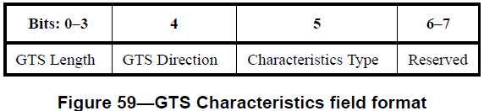
GTS carried in Association Request
Change 5.3.1 figure 49 to add fields as indicated
Change figure 49
MHR | Command frame ID | Capability Info | GTS characteristics | GTS characteristics
Change figure 50:
Bit 4 becomes “GTS Req” field:
Description:
GTS Req field is set to indicate that the a GTS Request is included in the association request command
Change figure 58: Show GTS Characteristics field length as “variable”.
Bit 6 becomes “More” field:
The More field indicates that additional GTS Characteristics descriptions follow
Change figure 59:

