Slide 1
Project: IEEE P802.15 Working Group for Wireless Personal Area Networks (WPANs)
Submission Title: LB89 MAC Additions for RCC
Date Submitted: 4 May 2013
Source: Benjamin A. Rolfe (BCA), Yale Lee (LiLee)
Company: Blind Creek Associates, LiLee Systems
Address: PO Box 798 Los Gatos CA 95031
Voice: +1 408 332 0725, E-Mail: ben @ blindcreek.com
Re: Comment submission for WG 15 LB89
Abstract: Presents proposed changes in support of submitted coments; proposes additional MAC content to support the proposed RCC PHY and scope of the amendment.
Purpose: Comment submission
Notice: This document has been prepared to assist the IEEE P802.15. It is offered as a basis for discussion and is not binding on the contributing individual(s) or organization(s). The material in this document is subject to change in form and content after further study. The contributor(s) reserve(s) the right to add, amend or withdraw material contained herein.
Release: The contributor acknowledges and accepts that this contribution becomes the property of IEEE and may be made publicly available by P802.15.

Slide 2


Rail Communication & Control Network
Concurrently support both Star and peer-to-peer topologies to allow communication between
Control center and wayside/Locomotive
Locomotive to wayside
Backhaul network
Basestation
(Gateway)
peer-to-peer
Wayside
(Device)
Locomotive
(Device)
Wayside status Update
(Broadcast)

Slide 3
RCCN Superframe Structure
Enhanced beacon with new superframe type
request/response timeslots
Broadcast/peer-to-peer using slotted CSMA-CA with PCA
GTS
management
timeslots
shared group
timeslots
bidirectional
timeslots
beacon
downlink
uplink
S
S
S
S
…
S
S
S
S
S
…
S
time

Slide 4
RCCN Protocol
RCCN Device
RCCN coordinator
RCCN Device
Enhanced Beacon
Clock alignment
Enhanced Beacon
MAC-Command: Association Request
Association +
Timeslot configuration
MAC-Command: Association response
Data (in GTS)
Data (Broadcast in shared timeslot)
Data (in shared timeslot)

Slide 5
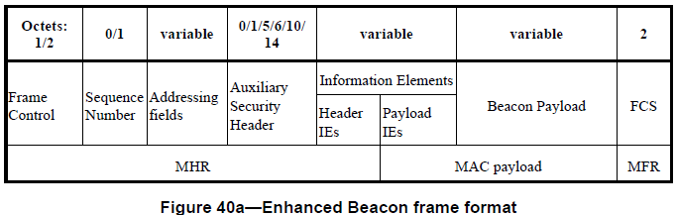
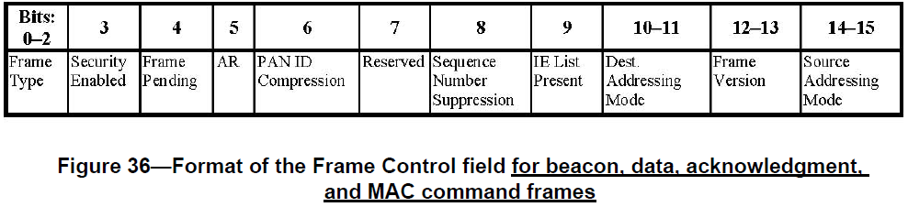
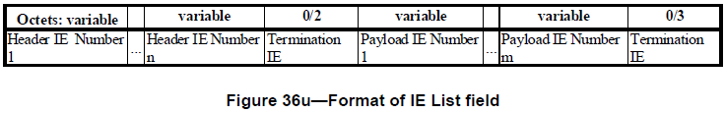
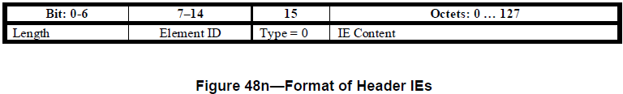
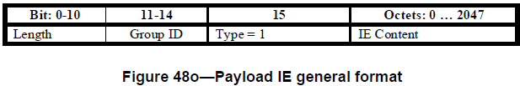
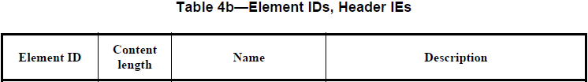
RCCN Superframe
set to 1
0x21 | variable | RCCN descriptor | RCCN PAN descriptor
0x22 | integer | Global Time | Global Time stamp if available

Slide 6
New IE
RCCN PAN descriptor IE
Octet: 1 |  | 1 | 1 | 1 | variable | 1 | variable
bits:0-3 | Bit:4-7
version | reserved | TS | mgntTS | gtsTS | Network ID | DevType | capabilities
Global Time IE
The IE indicates whether the device is synchronized to global time (ie. GPS time)
The IE contains a 32-bit number measured in second since 00:00:00 UTC, Jan 1,1970
Octets: 4
Global Time in seconds

Slide 7

MAC PIB for RCCN
macRCCNenabled | Boolean | True or False | If TRUE, the device is using functionality specific to RCCNs | Implementation specific
Table 52? – RCCN MAC PIB attributes
macRCCNnumTimeSlots | integer | 0 ~ 254 | Number of timeslots within superframe excluding timeslot for beacon frame and management timeslots | 48
macRCCNnumMgntTS | integer |  | Number of management timeslots | 4
macRCCNnumGtsTS | integer |  | Number of GTS timeslots | 24
macRCCNNetID | octets | variable | Network ID | 0
macRCCNdevType | Enumeration | True or False | Indicates whether the RCCN device is the RCCN PAN coordinator, fixed or mobile | False
macRCCNcap | octets | variable | Phy capabilities supported | -

Slide 8
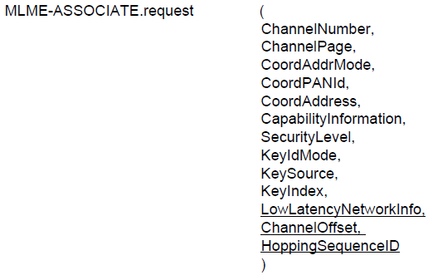
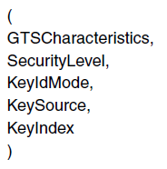
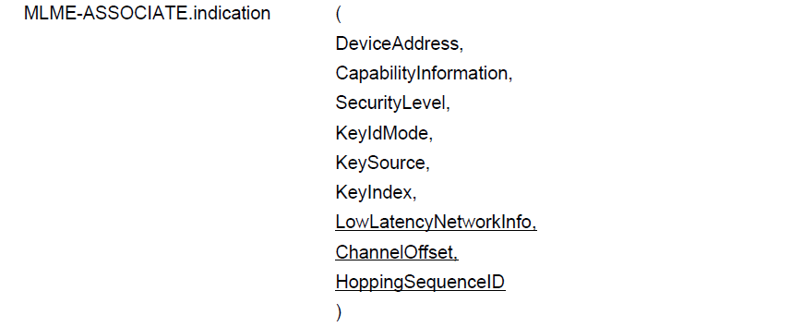
MLME primitives
GTSrequestInfo[]
GTSrequestInfo[]

Slide 9
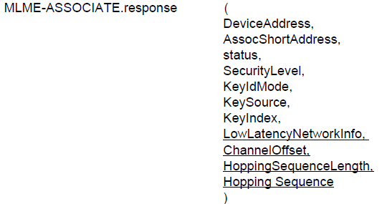
MLME primitives
GTSrequestInfo[]

Slide 10
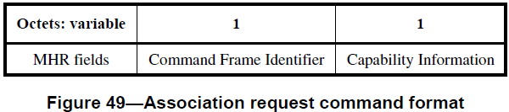
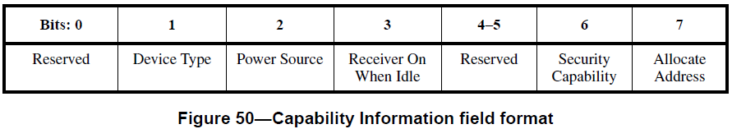
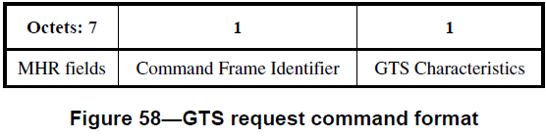
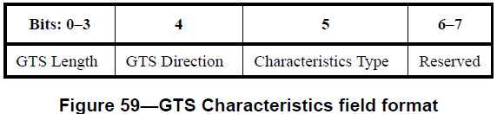
GTS carried in Association Request
MHR | Command frame ID | Capability Info | GTS characteristics | GTS characteristics
Use 4th bit to indicate GTS request attached
Use 6th bit to indicate more GTS requests

Slide 11
Peer-to-Peer without Coordinator
When devices stop receiving beacons (lose time synchronization with the coordinator), they fall back to peer-to-peer mode using un-slotted CSMA-CA with PCA
RCCN Device (wayside)
RCCN Device (wayside)
RCCN Device (locomotive)
MAC-Command: Enhanced Beacon request
IE: DevType=wayside
Enhanced Beacon
discovery
Enhanced Beacon
Data
Data

