Slide 1
Project: IEEE P802.15 Working Group for Wireless Personal Area Networks (WPANs)
Submission Title: Coexistent technical proposal for wearable 15.4n device
Date Submitted: March , 2013
Source:
Shinsuke Hara (shinsukehara0122@gmail.com ), QoL-SN; Kenichi Mori (ken1.morius@gmail.com) ; Kaoru Yokoo (kaoru.yokoo.ieee@gmail.com); Masahiro Kuroda (marsh@nict.go.jp), QoL-SN&NICT; Wei-Xia Zou, BUPT; Zhongliang Deng, BUPT; Liang Li (liangli@vinnotech.com), Vinno; Andy Bottomley (andy.bottomley@microsemi.com), Microsemi; Rick Powell (rick.powell@microsemi.com) ,Microsemi
Abstract: Merged technical proposal for wearable 15.4n device
Purpose: Merged modulation scheme of OQPSK and Filtered FSK
Notice: This document has been prepared to assist the IEEE P802.15. It is offered as a basis for discussion and is not binding on the contributing individual(s) or organization(s). The material in this document is subject to change in form and content after further study. The contributor(s) reserve(s) the right to add, amend or withdraw material contained herein.
Release: The contributor acknowledges and accepts that this contribution becomes the property of IEEE and may be made publicly available by P802.15.

Slide 2
Abstract
Proposal of basic PHY features based on the already proposed idea
(Detail specs are T.B.D.)
Follow PHY channel alignment

Slide 3
Background
As far, there are two PHY proposals shown as below
- DCN 12-0584-04
- DCN 12-0588-02
About coexistence and channelization, the following was proposed
- DCN 13-0041-02
- DCN 13-0037-01

Slide 4
PHY proposal
DSSS OQPSK
- consistent with IEEE802.15.4c (included in 15.4-2011)
,15.4g and 15.4j sub 1GHz PHY
- good anti-interference due to spread coding
Filtered FSK
- consistent with IEEE802.15.4g
- consistent with IEEE802.15.6 (BAN; Body Area Network) in
case of Gaussian filtered FSK
- good frequency agility due to narrower bandwidth
DSSS-OQPSK and Filtered FSK should be prepared to support various application

Slide 5
Proposal of maximum transmission power
Section 1.4 (Biomedical Telemetry Device) in the DCN 12-0105-00 mentions allowable maximum transmission power is 10mW.
The 10mW can support on-body/off-body wireless communications (bed-side monitoring) as well as on-body/on-body wireless communications.
As the maximum transmission power for 15.4n, 10mW should be specified.

Slide 6
Proposal of channel alignment
Align channel edge of DSSS OQPSK and Filtered FSK to realize good coexistence between the two PHYs
Support two band aggregation to realize higher data rate of Filtered FSK
- 200kbps x 2 = 400kbps, close to DSSS OQPSK (8,4) @2FSK
Support channel overlapping to maximize frequency agility to avoid suffering from interference of already existing system
- When there is no interference, follow the rule of item A.
OQPSK
2MHz mode
OQPSK
2MHz mode
Frequency
500kHz

Slide 7
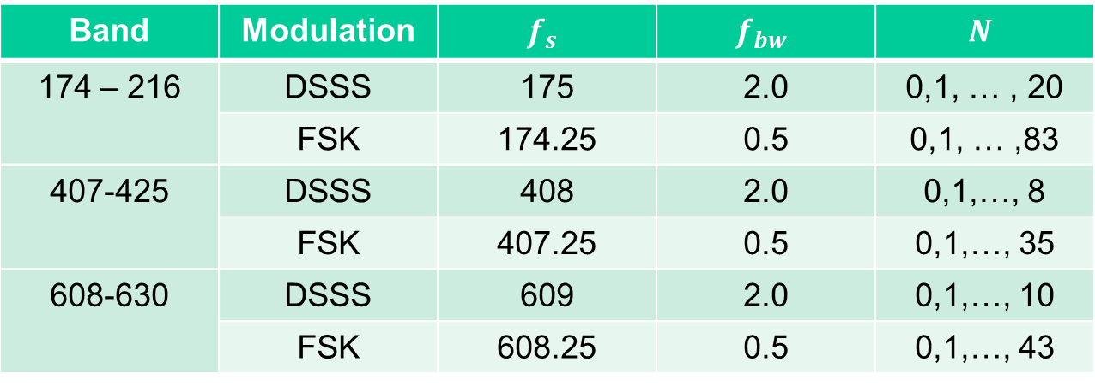
Proposed Channel Plan
Center frequencies for each channels for each modulation schemes can be calculated as follows;
    $f_{c}=f_{s}+Nf_{bw}$ (MHz)
Band | Modulation | $$f_{s}$$ | $$f_{bw}$$ | $$N$$
174 – 216 | DSSS | 175 | 2.0 | 0,1, … , 20
 | FSK | 174.25 | 0.5 | 0,1, … ,83
407-425 | DSSS | 408 | 2.0 | 0,1,…, 8
 | FSK | 407.25 | 0.5 | 0,1,…, 35
608-630 | DSSS | 609 | 2.0 | 0,1,…, 10
 | FSK | 608.25 | 0.5 | 0,1,…, 43

Slide 8
Proposal basic PHY features
DSSS OQPSK
Frequency Band (MHz) | Bandwidth | Chip Rate (kchip/s) | Modulation | Symbols | DSSS table | Bit Rate (kb/s) | Symbol Rate (k symbols/s)
174-216 | 2MHz | 1000 | QPSK | 16-ary | (16,4) | 250 | 62.5
 |  |  |  |  | (8,4) | 500 | 125
407-425 | 2MHz | 1000 | QPSK | 16-ary | (16,4) | 250 | 62.5
 |  |  |  |  | (8,4) | 500 | 125
608-630 | 2MHz | 1000 | QPSK | 16-ary | (16,4) | 250 | 62.5
 |  |  |  |  | (8,4) | 500 | 125
Filtered FSK without considering channel overlapping
Frequency Band [MHz] | Modulation | Symbol Rate [ks/s] | Channel Spacing [kHz] | Number of Channels
174 – 216 | Filtered FSK | 200 | 500 | 84
407-425 | Filtered FSK | 200 | 500 | 36
608-630 | Filtered FSK | 200 | 500 | 44

Slide 9
Summary
DSSS OQPSK and Filtered FSK are preferable for wearable devices used for healthcare applications in hospitals and clinics
Basic features of DSSS OQPSK and Filtered FSK are proposed
OQPSK/Filtered FSK coexistence and channel alignment plan are proposed
Maximum transmission power, i.e. 10mW, is proposed
Detail specifications of the two PHY are T.B.D..

Slide 10
Annex
Interference signal
CH #N-3
CH #N-2
CH
#N-1
CH
#N
CH
#N+1
CH #N+2
Channel center frequency shift by 0.5 channel bandwidh
frequency
Interference signal
CH #N-3
CH #N-2
CH
#N-1
CH
#N
CH
#N+1
CH #N+2
frequency
An example where channel overlapping is needed (Described in the slide6)

