Slide 1
Project: IEEE P802.15 Working Group for Wireless Personal Area Networks (WPANs)
Submission Title: [IEEE 802.15.4p Positive Train Control Task Group Closing Session]
Date Submitted: [21 March 2013]
Source: [Jon Adams] Company [Lilee Systems Ltd.]
Address [2905 Stender Way, Suite 78, Santa Clara, CA 95054 USA]
Voice:[+1 480.628.6686], FAX: [Add FAX number], E-Mail:[jonadams@ieee.org]
Re: [If this is a proposed revision, cite the original document.]
[If this is a response to a Call for Contributions, cite the name and date of the Call for Contributions to which this document responds, as well as the relevant item number in the Call for Contributions.]
[Note: Contributions that are not responsive to this section of the template, and contributions which do
not address the topic under which they are submitted, may be refused or consigned to the “General Contributions” area.]
Abstract: []
Purpose: []
Notice: This document has been prepared to assist the IEEE P802.15. It is offered as a basis for discussion and is not binding on the contributing individual(s) or organization(s). The material in this document is subject to change in form and content after further study. The contributor(s) reserve(s) the right to add, amend or withdraw material contained herein.
Release: The contributor acknowledges and accepts that this contribution becomes the property of IEEE and may be made publicly available by P802.15.

Slide 2
15.4p Positive Train Control
Closing Report
Jon Adams
Lilee Systems

Slide 3
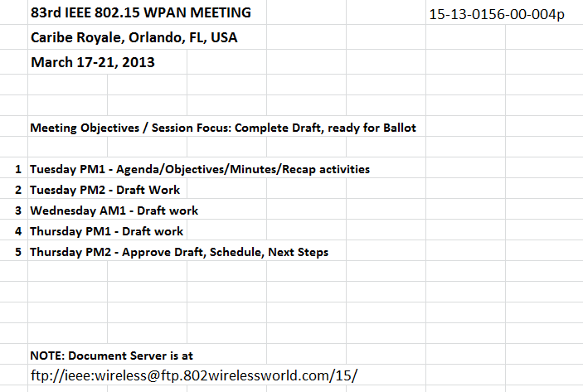
Week’s Agenda

Slide 4
90+ Participants from 70 Entities
Herzog
TI
GuardRFID
Inha University
OneAccess Networks
Meiji University
ARINC
Siemens
US DOT
Sunrise Micro
US DOT FTA
Samsung Information Systems America
The Ohio State University
Inside Secure
Electronics and Telecommunications Research Institute
US DOT Volpe
Safetran (Invensys Rail)
Union Pacific RR
University of Salzburg
Orthotron
Semtech
CalAmp
Rail Safety Consulting
Institute for Infocomm Research
National Taiwan University
Qualcomm
Freescale
Kyocera
Interdigital
Tensorcom
Analog Devices
CSX
National Technical Systems
Parsons Brinckerhoff
Stantec
Bombardier Transportation
Rohde and Schwarz
Korea Railroad Research Institute
Lilee Systems
Parsons
The Boeing Company
Vinnotech
Yokogawa
Sony
Notor Research
American University of Beirut
Noblis
Tohoku University REIC
Beijing Univ of Posts and Telecommunications
NXP
Verizon
Authentec
Sensus
TU Braunschweig
Via Technologies
Halcrow
US DOT FRA
Philips
Astrin Radio
China Academy of Telecomm Research
Gannett Fleming
Bravin Consulting
GE
APTA
Semaphore Group
Anritsu
Oki
Commsource

Slide 5
15.4p Session Work this Week
Continue to flesh out combined contribution to reflect the technical proposals presented
Complete Coexistence Document (15-13-0212-01)
Move to establish an approved draft, pending completion and inclusion of edits to 15-13-0097-05 in accordance with document 15-13-0217-02, as document d1P802-15-4p_Draft_Standard.pdf
Moved: John Notor (Notor Research)
Seconded: Liang Li (Vinnotech)
Y/N/A: 5/0/0

Slide 6

IEEE 802.15.4p Schedule
Interest Group Jul 2011
Study Group Nov 2011
Approval of PAR/5C Docs Jan 2012
Preparation for Task Group Phase
  Approval by NESCOM and 802 EC of IEEE802.15.4p TG Apr 2012
Task Group
Proposal Effort
  Technical Guidance Document May 2012
  Call for Proposals May 2012
  Preliminary Proposals July 2012
  Final Proposals Sep 2012
  Adopt Baseline Sep 2012
Contribution Merging
  Begin Drafting Oct 2012
  First Preliminary Draft Jan 2013
  Approve draft Mar 2013
Final Draft
  WG Letter Ballot(s) Mar 2013
  Comment resolution Apr-Sep 2013
Specification Approval and Final Release
  802 EC, NESCOM, IEEE-SA End of 2013

Slide 7
Motion
Move that 802.15 WG start a WG Letter Ballot requesting approval to forward document d1P802-15-4p_Draft_Standard.pdf, pending the completion of edits to 15-13-0097-05 in accordance with document 15-13-0217-02, to Sponsor Ballot.
Moved by: Clint Powell
Seconded by: Steve Jillings

