Slide 1
Project: IEEE P802.15 Working Group for Wireless Personal Area Networks (WPANs)
Submission Title: Channel Models for IEEE 802.15.4q
Date Submitted: March 20, 2013
Source: Jinesh P Nair¹, Kiran Bynam¹, Youngsoo Kim¹;
¹Samsung Electronics
Phone: +918041819999-464, Fax: +918041819999
E-Mail: jinesh.p@samsung.com
Abstract: Preliminary document on Channel Models for IEEE 802.15.4q
Purpose: Reference on channel models for fair comparison of proposals and system evaluation
Notice: This document has been prepared to assist the IEEE P802.15. It is offered as a basis for discussion and is not binding on the contributing individual(s) or organization(s). The material in this document is subject to change in form and content after further study. The contributor(s) reserve(s) the right to add, amend or withdraw material contained herein.
Release: The contributor acknowledges and accepts that this contribution becomes the property of IEEE and may be made publicly available by P802.15.
Jinesh P Nair, Kiran Bynam and Youngsoo Kim

Slide 2
Outline
Objective
Considerations from Application Scenarios
Large Scale Fading - Path loss Models
  Outdoor Path loss Models
  Indoor Path loss Models
Small Scale Fading
  Considerations in Small Scale Fading
  Power Delay Profiles
References

Slide 3
Objective
Propose Channel Models for IEEE 802.15.4q
  Path loss models
  Impulse Response
Purpose
  Fair comparison of the proposals
  System Evaluation

Slide 4
Considerations from Application Scenarios
No | Applications | Indoor | Outdoor | LOS | NLOS | Shadowing | Range (m) | Comments
1 | Smart Utility | Yes | Yes | Yes | Yes | Low | < 50m
2 | Building Automation | Yes | No | Yes | Yes | Low | 5 m to 50 m
3 | Inventory and Warehouse Management | Yes | No | Yes | Yes | Low | < 100 m | Corridor Fading
4 | Medical and Healthcare | Yes | Yes | Yes | No | Low | Typ: < 5m Max: ~ 10m
5 | Retail Service | Yes | No | Yes | Yes | High | 5 m to 100 m | Good cases of NLOS, Corridor Fading
6 | Telecom Services | Yes | Yes | Yes | No | Low | 2m to 10m
7 | Industrial and Infrastructure Monitoring | Yes | Yes | Yes | Yes | Moderate to High | ~ 100 m | Account losses due Industrial environment
8 | Environmental Monitoring | No | Yes | Yes | Yes | Moderate | ~ 100 m

Slide 5
Observations
Range
  Max Range to be supported is around 100 m
  In most cases it is below 30 m
Outdoor/Indoor
  Both cases exist in most scenarios
LOS/NLOS
  LOS cases exist in all scenarios
  NLOS cases most severe in Retail Service Outlets
Shadowing
  Low to moderate in most cases
  High in cases like Retail Outlets etc.

Slide 6
Path Loss Models
Outdoor Path loss Models
  LOS Model
  NLOS Model
    Model for 900 MHz
    Model for 2.4 GHz
Indoor Path loss Models
    Model for 2.4 GHz and 900 MHz
    Model for 900 MHz

Slide 7
Outdoor Path Loss Models
ITU-R 1411-6
  Outdoor radio systems
    Smart Utility
    Telecom Services
    Industrial and Environmental monitoring
  Short range
    Less than 1 Km
  Frequency Range
    300 MHz to 100 GHz
    Covers UHF, SHF and EHF bands

Slide 8
Outdoor Path Loss Models
Propagation influenced by
  Environment
    Urban/Sub-urban/Residential/Rural
  Usage of Mobile
    Pedestrian/Vehicular
  Relative Antenna Heights
    Micro-cell
    Dense Urban Micro-cell
    Pico-cell

Slide 9
Outdoor Path Loss Models
LoS in Street Canyons (900 MHz and 2.4 GHz)
  Characterized by two slopes and a single breakpoint
BS Antenna Height
MS Antenna Height

Slide 10


Outdoor Path Loss Models
LoS within Street Canyons (900 MHz and 2.4 GHz)
 | A | B
Lower Bound | 0 | 20
Median | 6 | 20
Upper Bound | 20 | 25
Upper
Median
L_{LOS}
Lower
d/R_{bp} $≤1$
d/R_{bp} $>1$
d/R_{bp}

Slide 11
Outdoor Path Loss Models
NLOS cases
w₁Street Width at the position of the BS (m)
w₂ Street width at the position of the MS (m)
x₁ distance BS to street crossing (m)
x₂ distance MS to street crossing (m)
α is the corner angle (radians)

Slide 12
Outdoor Path Loss Models
NLoS in Street Canyons ( 900 MHz (800M to 2 G) )
Characterized by diffraction and reflection losses
Reflection Path Loss defined by L_{r}
Diffraction Path Loss defined by L _{d}

Slide 13


Outdoor Path Loss Models
NLoS in Street Canyons ( 900 MHz (800M to 2 G) )
 | x₁=x₂ =5 m | x₁=x₂ =10 m | x₁=x₂ =15 m | x₁=x₂ =20 m | x₁=x₂ =25 m
w₁=w₂ =10m | 45.97 | 57.40 | 62.59 | 66.61 | 70.37
w₁=w₂ =20m | 41.31 | 53.97 | 60.24 | 63.87 | 66.51
w₁=w₂ =30m | 39.43 | 51.51 | 58.43 | 62.63 | 65.43
 | x₁=x₂ =5 m | x₁=x₂ =10 m | x₁=x₂ =15 m | x₁=x₂ =20 m | x₁=x₂ =25 m
w₁=w₂ =10m | 45.97 | 57.40 | 62.59 | 66.61 | 70.37
w₁=w₂ =20m | 41.31 | 53.97 | 60.24 | 63.87 | 66.51
w₁=w₂ =30m | 39.43 | 51.51 | 58.43 | 62.63 | 65.43
Values of L_{NLOS2} for $α=π/2$radians,
Values of L_{NLOS2} for $α=π/4$radians,

Slide 14

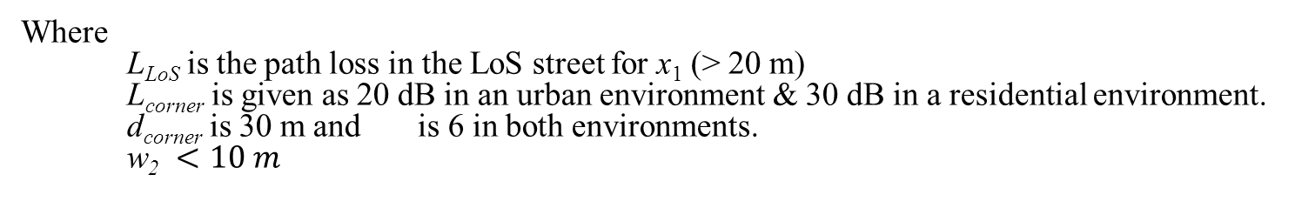
Outdoor Path Loss Models
3. NLoS in Street Canyons ( 2.4 GHz (2 G to 16 G) )
$α=π/2$radians,
Where
L_{LoS} is the path loss in the LoS street for x₁ (> 20 m)
L_{corner} is given as 20 dB in an urban environment & 30 dB in a residential environment.
d_{corner} is 30 m and is 6 in both environments.
w₂ $<10 m$

Slide 15
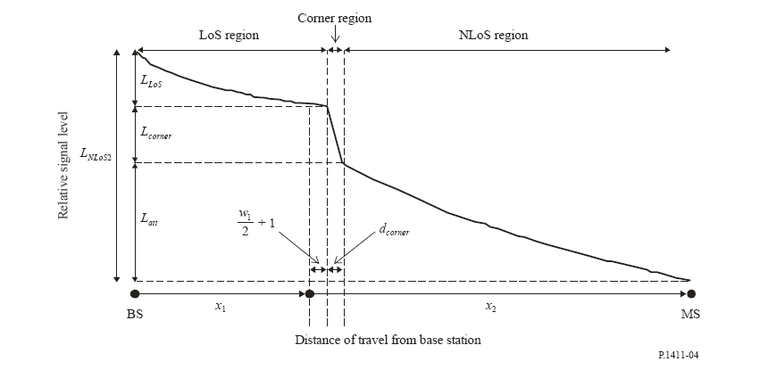
Outdoor Path Loss Models
3. NLoS in Street Canyons ( 2.4 GHz (2 G to 16 G) )

Slide 16
Indoor Path loss Models
ITU-R P.1238-7
  Indoor radio systems
    All applications except environmental monitoring
  Short range
    Less than 1 Km
  Frequency Range
    900 MHz to 100 GHz
    Covers UHF, SHF and EHF bands

Slide 17
Indoor Path Loss Models
1. ITU-R P.1238-7 Channel Model for 2.4 GHz & 900MHz
    L_{total} = 20 log10 f + N log10 d + L_{f} (n) – 28
where: N :distance power loss coefficient;
f : frequency (MHz);
d : separation distance (m) between the base station and
portable terminal (where d > 1 m);
L_{f} : floor penetration loss factor (dB);
n : number of floors between base station and portable
terminal (n ≥ 1).

Slide 18
Indoor Path Loss Models
1. ITU-R P.1238-7 Channel Model for 2.4 GHz and 900MHz
Table : Values of N and L_{f} in different scenarios
Parameter | Frequency | Residential | Office | Commercial
N | 2.4 GHz | 28 | 30 | -
L_{f} | 2.4 GHz | 10(Per concrete wall in apartment) 5 (house) | 14 | -
N | 900 MHz | 33 | 33 | 20
L_{f} | 900 MHz | 9 (1 Floor) 19 (2 Floors) 24 (3 Floors) | 9 (1 Floor) 19 (2 Floors) 24 (3 Floors) | -

Slide 19
Indoor Path Loss Models
ITU-R P.1238-7 Channel Model for 2.4GHz and 900 MHz
  For LOS scenarios N = 20, L_{f} (n)=0
    Open Rooms in offices, factories, sports arenas, retail stores
  Corridors have N = 18
    Grocery stores with long aisles
  Loss due to obstacles and through walls N= 40
    Paths between rooms, closed office buildings
  Beyond the breakpoint distance N=40

Slide 20
Indoor Path Loss Model
2. Seidel Rappaport Channel Model for 900 MHz ….contd
d₀ is a reference distance
c is the speed of light
f_{c} is the frequency
n_{SF} is the exponent of the same floor measurement
FAF is the floor attenuation factor
P is the number of Soft Partition Attenuation Factor between the Trx. and Rx.
q is the number of Concrete Wall Attenuation Factor between the Trx. and Rx.

Slide 21
Indoor Path Loss Model
2. Seidel Rappaport Channel Model for 900 MHz …. Contd.
Table: Floor Attenuation Factors
Table: Path Loss Exponents
Building | FAF (dB) | σ (dB)
Office building 1
Through 1 floor | 12.9 | 7.0
Through 2 floor | 18.7 | 2.8
Through 3 floor | 24.4 | 1.7
Through 4 floor | 27.0 | 1.5
Office building 2
Through 1 floor | 16.2 | 2.9
Through 2 floor | 27.5 | 5.4
Through 3 floor | 31.6 | 7.2
Building | n_{SF} | σ (dB)
All buildings
All locations | 3.14 | 16.3
Same floor | 2.76 | 12.9
Grocery store | 1.81 | 5.2
Retail store | 2.18 | 8.7
Office building 1
Entire building | 3.54 | 12.8
Same floor | 3.27 | 11.2
Office building 2
Entire building | 4.33 | 13.3
Same floor | 3.25 | 5.2

Slide 22
Small Scale Fading
Specify Power Delay Profiles
  Identify time after which multi-paths become significant
Flat fading in good number of cases
  Ricean/Rayleigh
  Medical/Healthcare, Telecom Services, Building Automation, Retail Service
Mobility may be pedestrian or below
  Less than 5km/hr
  Doppler spectrum : Classic/Flat

Slide 23
Choosing Power Delay Profiles
For a signal of BW 3MHz,
Let us take this 3 MHz as the 75 % channel coherence bandwidth
Corresponding channel delay spreads
  σ_{τ} ≈ 1/(30 ×3 ×10⁶) ≈ 10ns
Beyond this frequency selectivity becomes important
Look for PDPs with significant multi-paths beyond 10 ns
  Corresponding distances at which multi-paths become significant is 3m ( d =st = 3×10⁸×10×10⁻⁹)

Slide 24
Small Scale Fading Channel Models
Impulse Response Models based on
  Delay Spread
  Power Delay Profile

Slide 25

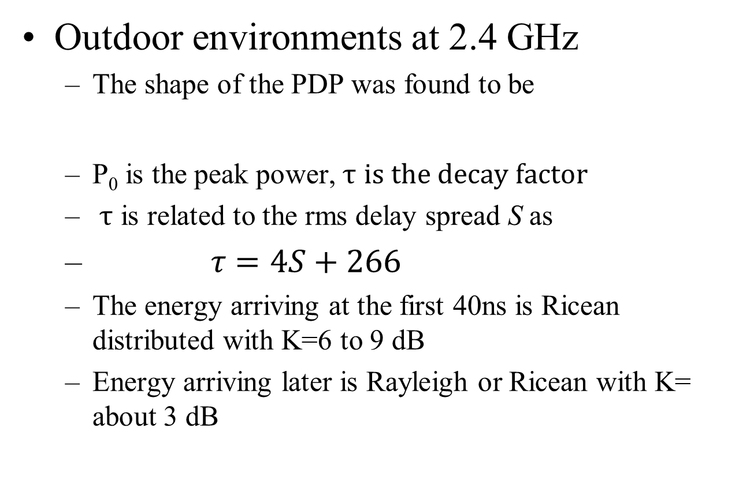
Delay Spread based Models
Outdoor environments at 2.4 GHz
  The shape of the PDP was found to be
  P₀ is the peak power, $τ$ $is the decay factor$
  $τ$ is related to the rms delay spread S as
  $τ=4S+266$
  The energy arriving at the first 40ns is Ricean distributed with K=6 to 9 dB
  Energy arriving later is Rayleigh or Ricean with K= about 3 dB
$$P(t)=P_{0}+50(e^{−t/τ}−1)$$

Slide 26
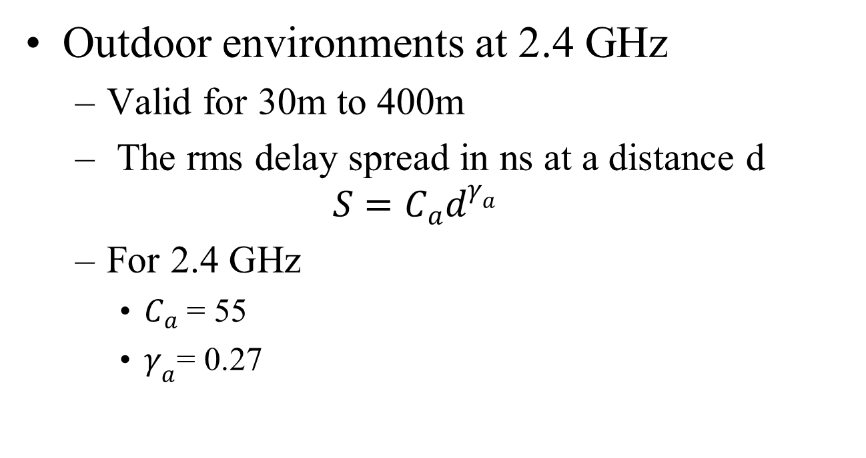
Delay Spread based Models
Outdoor environments at 2.4 GHz
  Valid for 30m to 400m
  The rms delay spread in ns at a distance d
  $$S=C_{a}d^{γ_{a}}$$
  For 2.4 GHz
    $C_{a}$ = 55
    $γ_{a}$= 0.27

Slide 27
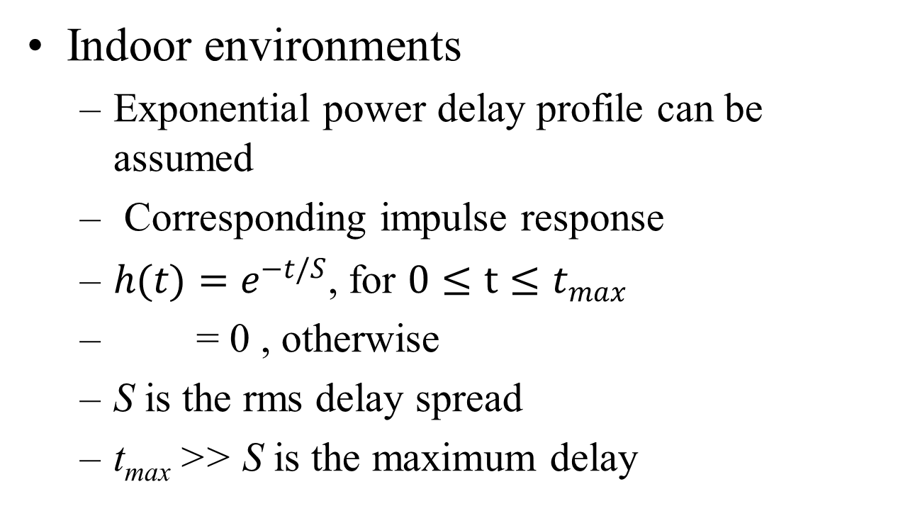
Delay Spread based Models
Indoor environments
  Exponential power delay profile can be assumed
  Corresponding impulse response
  $h(t)=e^{−t/S}$, for $0≤t≤t_{max}$
  = 0 , otherwise
  S is the rms delay spread
  t_{max} >> S is the maximum delay

Slide 28
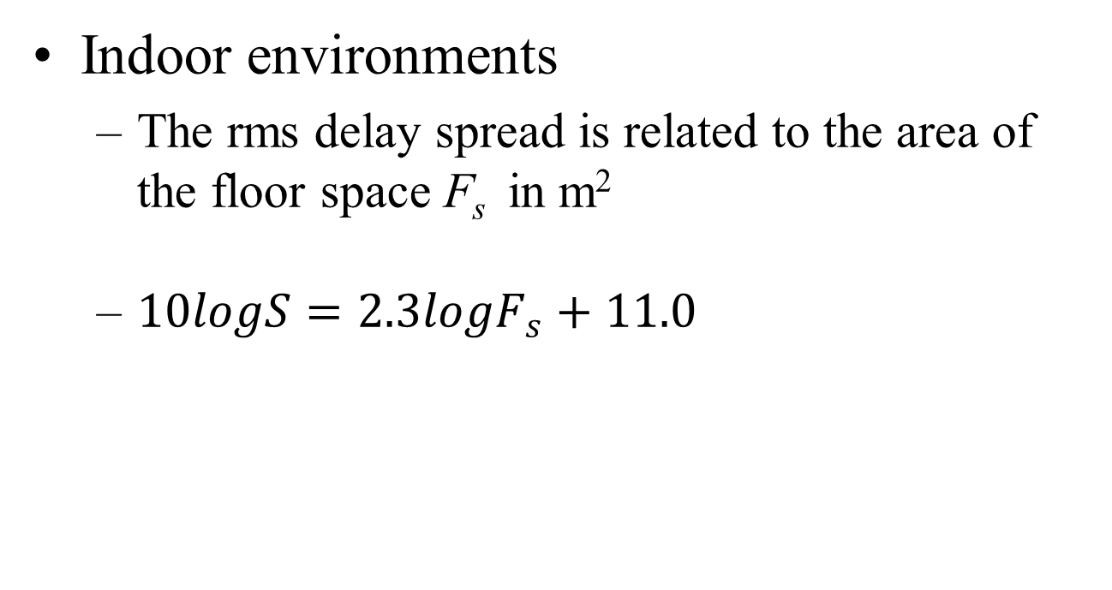
Delay Spread Models
Indoor environments
  The rms delay spread is related to the area of the floor space F_{s} in m²
  $10logS=2.3logF_{s}+11.0$

Slide 29
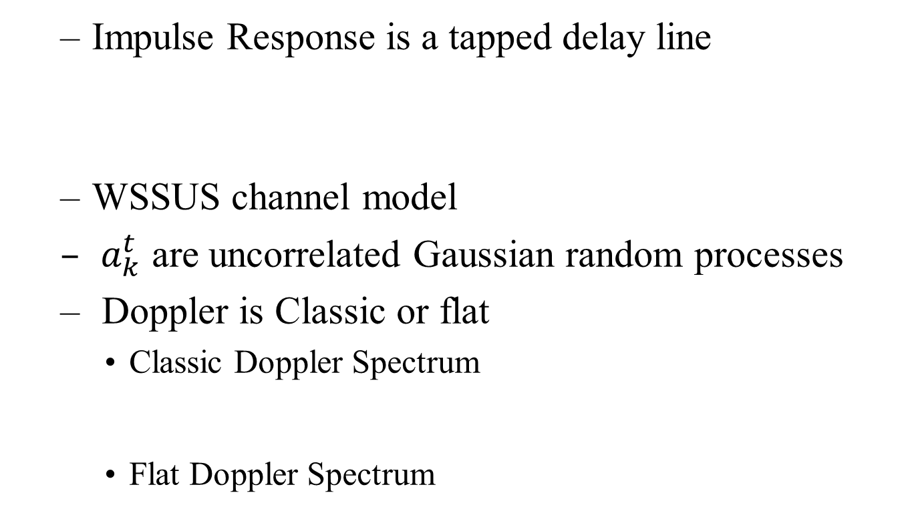
PDP based Models
  Impulse Response is a tapped delay line
  WSSUS channel model
  $a_{k}^{t}$ are uncorrelated Gaussian random processes
  Doppler is Classic or flat
    Classic Doppler Spectrum
    Flat Doppler Spectrum

Slide 30
PDP based Models
Examples :
  ITU Models
    Indoor Office, Outdoor to Indoor and Pedestrian
  ITU Extended Models at 2.4 GHz
    Outdoor to Indoor and Pedestrian, Typical Urban

Slide 31
Power Delay Profiles
ITU Models
ITU Indoor Model
Tap | Relative delay (ns) | Average power (dB) | Doppler spectrum
1 | 0 | 0 | flat
2 | 50 | -3 | flat
3 | 110 | -10 | flat
4 | 170 | -18 | flat
5 | 290 | -26 | flat
6 | 310 | -32 | flat
ITU Indoor to Outdoor and Pedestrian
Tap | Relative delay (ns) | Average power (dB) | Doppler spectrum
1 | 0 | 0 | classic
2 | 110 | -9.7 | classic
3 | 190 | -19.2 | classic
4 | 410 | -22.8 | classic

Slide 32
Power Delay Profiles
ITU Extended Models for 2.4 GHz
Extended ITU outdoor to indoor and pedestrian
Tap | Relative delay (ns) | Average power (dB) | Doppler spectrum
1 | 0 | 0 | classic
2 | 30 | -1 | classic
3 | 70 | -2 | classic
4 | 80 | -3 | classic
5 | 110 | -8 | classic
6 | 190 | -17.2 | classic
7 | 410 | -20.8 | classic
Extended ITU Typical Urban
Tap | Relative delay (ns) | Average power (dB) | Doppler spectrum
1 | 0 | -1 | classic
2 | 50 | -1 | classic
3 | 120 | -1 | classic
4 | 200 | 0 | classic
5 | 230 | 0 | classic
6 | 500 | 0 | classic
7 | 1600 | -3 | classic
8 | 2300 | -5 | classic
9 | 5000 | -7 | classic

Slide 33
Summary
Path loss Models
  Short Range Outdoor/Indoor
  LOS/NLOS
  900 MHz and 2.4 GHz
Small Scale Fading Models
  Basic Approach to identify suitable PDPs
  Few channel models are suggested

Slide 34
References
1. ITU-R P.1411-6 “Propagation methods for the planning of short range outdoor radiocommunication systems and radio local area networks in the frequency range 300 MHz to 100 GHz” 02/2012
ITU-R P.1238-7 “Propagation data and prediction methods for the planning of indoor radiocommunication systems and radio local area networks in the frequency range 900 MHz to 100 GHz” 02/2012
Marco Hernandez et al, “Channel models for TG8” IEEE P802.15 Working Group for Wireless Personal Area Networks (WPANs), Sept 2012
Seidel P and Rappaport T.S, “914 MHz Path Loss Prediction Models for Indoor Wireless Communications in Multi-floored Buildings” IEEE Transactions on Antennas and Propagation, vol. 40, no. 2, Feb. 1992
Chunhui (Allan) Zhu , Betty Zhao, Hou-Cheng Tang “Applications of ULP Wireless Sensors” ” IEEE P802.15 Working Group for Wireless Personal Area Networks (WPANs), May 2012

