Slide 1
Project: IEEE P802.15 Working Group for Wireless Personal Area Networks (WPANs)
Submission Title: [IEEE 802.15.4p Positive Train Control Task Group Opening Session]
Date Submitted: [19 March 2013]
Source: [Jon Adams] Company [Lilee Systems Ltd.]
Address [2905 Stender Way, Suite 78, Santa Clara, CA 95054 USA]
Voice:[+1 480.628.6686], FAX: [Add FAX number], E-Mail:[jonadams@ieee.org]
Re: [If this is a proposed revision, cite the original document.]
[If this is a response to a Call for Contributions, cite the name and date of the Call for Contributions to which this document responds, as well as the relevant item number in the Call for Contributions.]
[Note: Contributions that are not responsive to this section of the template, and contributions which do
not address the topic under which they are submitted, may be refused or consigned to the “General Contributions” area.]
Abstract: []
Purpose: []
Notice: This document has been prepared to assist the IEEE P802.15. It is offered as a basis for discussion and is not binding on the contributing individual(s) or organization(s). The material in this document is subject to change in form and content after further study. The contributor(s) reserve(s) the right to add, amend or withdraw material contained herein.
Release: The contributor acknowledges and accepts that this contribution becomes the property of IEEE and may be made publicly available by P802.15.

Slide 2
15.4p Positive Train Control
Opening Session
Jon Adams
Lilee Systems

Slide 3
Welcome – Record Your Attendance!
https://imat.ieee.org

Slide 4
Participants, Patents, and Duty to Inform
All participants in this meeting have certain obligations under the IEEE-SA Patent Policy.
  Participants [Note: Quoted text excerpted from IEEE-SA Standards Board Bylaws subclause 6.2]:
    “Shall inform the IEEE (or cause the IEEE to be informed)” of the identity of each “holder of any potential Essential Patent Claims of which they are personally aware” if the claims are owned or controlled by the participant or the entity the participant is from, employed by, or otherwise represents
      “Personal awareness” means that the participant “is personally aware that the holder may have a potential Essential Patent Claim,” even if the participant is not personally aware of the specific patents or patent claims
    “Should inform the IEEE (or cause the IEEE to be informed)” of the identity of “any other holders of such potential Essential Patent Claims” (that is, third parties that are not affiliated with the participant, with the participant’s employer, or with anyone else that the participant is from or otherwise represents)
  The above does not apply if the patent claim is already the subject of an Accepted Letter of Assurance that applies to the proposed standard(s) under consideration by this group
  Early identification of holders of potential Essential Patent Claims is strongly encouraged
  No duty to perform a patent search

Slide 5
Patent Related Links
  All participants should be familiar with their obligations under the IEEE-SA Policies & Procedures for standards development.
  Patent Policy is stated in these sources:
  IEEE-SA Standards Boards Bylaws
  http://standards.ieee.org/develop/policies/bylaws/sect6-7.html#6
  IEEE-SA Standards Board Operations Manual
  http://standards.ieee.org/develop/policies/opman/sect6.html#6.3
  Material about the patent policy is available at
  http://standards.ieee.org/about/sasb/patcom/materials.html
If you have questions, contact the IEEE-SA Standards Board Patent Committee Administrator at patcom@ieee.org or visit http://standards.ieee.org/about/sasb/patcom/index.html
This slide set is available at https://development.standards.ieee.org/myproject/Public/mytools/mob/slideset.ppt

Slide 6
Call for Potentially Essential Patents
If anyone in this meeting is personally aware of the holder of any patent claims that are potentially essential to implementation of the proposed standard(s) under consideration by this group and that are not already the subject of an Accepted Letter of Assurance:
  Either speak up now or
  Provide the chair of this group with the identity of the holder(s) of any and all such claims as soon as possible or
  Cause an LOA to be submitted

Slide 7
Other Guidelines for IEEE WG Meetings
All IEEE-SA standards meetings shall be conducted in compliance with all applicable laws, including antitrust and competition laws.
  Don’t discuss the interpretation, validity, or essentiality of patents/patent claims.
  Don’t discuss specific license rates, terms, or conditions.
    Relative costs, including licensing costs of essential patent claims, of different technical approaches may be discussed in standards development meetings.
      Technical considerations remain primary focus
  Don’t discuss or engage in the fixing of product prices, allocation of customers, or division of sales markets.
  Don’t discuss the status or substance of ongoing or threatened litigation.
  Don’t be silent if inappropriate topics are discussed … do formally object.
---------------------------------------------------------------
See IEEE-SA Standards Board Operations Manual, clause 5.3.10 and “Promoting Competition and Innovation: What You Need to Know about the IEEE Standards Association's Antitrust and Competition Policy” for more details.

Slide 8
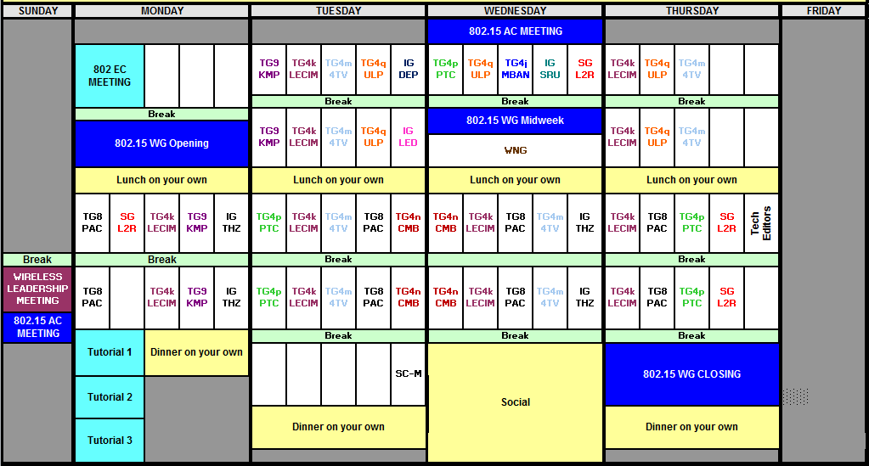
Overall Session Agenda (R0)

Slide 9


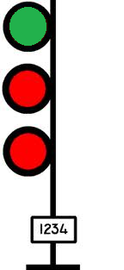
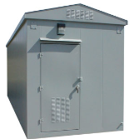

Where IEEE 802.15.4p Work Fits In
Adds vehicular mobility and new operating frequency bands to 802.15.4
Initial application is interoperable communications between
  Train and Wayside
  Train and Network Infrastructure
  Wayside and Network Infrastructure
Potential to see it extended to other vehicular functions
Network Control Center

Slide 10
15.4p Session Objectives
Continue to flesh out combined contribution to reflect the technical proposals presented
Vote on Th PM to accept combined contribution as draft

Slide 11
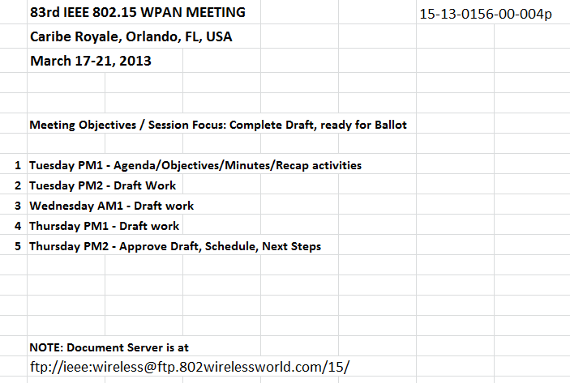
Week’s Agenda

Slide 12
Approval of March Meeting Agenda
Document 15-13-0156-00-004p
Motion to Approve Agenda as Submitted
  Mover: R. Moskowitz (Verizon)
  Second: T. Kivinen (Inside Secure)
  Yea/Nay/Abstain: Unanimous

Slide 13
Approval of January Meeting Minutes
Document 15-12-0184-00-004p
Motion to Approve Minutes as Submitted
  Mover: T. Kivinen (Inside Secure)
  Second: R. Moskowitz (Verizon)
  Yea/Nay/Abstain: Unanimous

Slide 14
90+ Participants from 70 Entities
Herzog
TI
GuardRFID
Inha University
OneAccess Networks
Meiji University
ARINC
Siemens
US DOT
Sunrise Micro
US DOT FTA
Samsung Information Systems America
The Ohio State University
Electronics and Telecommunications Research Institute
US DOT Volpe
Safetran (Invensys Rail)
Union Pacific RR
LG Electronics
Notor Research
Semtech
Orthotron
CalAmp
Rail Safety Consulting
Institute for Infocomm Research
National Taiwan University
Qualcomm
Freescale
Kyocera
Interdigital
Tensorcom
Inside Secure
Analog Devices
CSX
National Technical Systems
Parsons Brinckerhoff
Stantec
Bombardier Transportation
Rohde and Schwarz
Korea Railroad Research Institute
Lilee Systems
Parsons
The Boeing Company
Vinnotech
Yokogawa
Sony
Noblis
Tohoku University REIC
Beijing Univ of Posts and Telecommunications
NXP
Verizon
Authentec
Sensus
TU Braunschweig
Via Technologies
Halcrow
US DOT FRA
Philips
Astrin Radio
China Academy of Telecomm Research
Gannett Fleming
GE
APTA
Semaphore Group
Anritsu
Oki
Commsource
American University of Beirut

Slide 15
15.4p Officers
Chair: Jon Adams (Lilee Systems)
Vice Chair: Dr Alan Rao (DOT Volpe Center)
Secretary: Jon Adams (Lilee Systems)
Technical Editor: Monique Brown (M B Brown Consulting)
Slide 15

Slide 16
Chair’s Role
http://ieee802.org/Mike_Spring_Article_on_Stds_Process.pdf
…the chairperson of the working group is key to what and how fast a standard is produced.
The chair of the committee acts as a facilitator with little power to legislate. The chair must be knowledgeable about the subject but also know how a standard may be used by various segments of the industry. A chairperson should be a leader-diplomat-observer, in equal proportions. Also, the chairperson should not be a doer, perfectionist or obstructionist. This is consistent with the view of the chairperson as a skilled leader with strong negotiation skills who delegates.
Slide 16
Notes:
March 13
Page 16

Slide 17
15.4p PAR
This amendment specifies a PHYsical layer (PHY) for IEEE 802.15.4, and any Medium Access Control (MAC) changes needed to support this PHY
  For use in equipment intended to address industry needs and to meet United States (US) Positive Train Control regulatory requirements and similar regulatory requirements in other parts of the world
Operation in licensed or license-free radio bands
Operation up to 6 GHz
Depending on frequency band and operating rules, TX output power >>+30dBm
Meets performance requirements at speeds up to 600 km/h
Range up to 70 km
Allows operation in contiguous or non-contiguous channel bandwidths as narrow as 5 kHz
supports data rates up to 1 Mbps with flexible and robust quality of service
Provides modulation methods and spectral characteristics consistent with local regulatory requirements
Accommodates rapidly changing network membership.

