Slide 1
doc.: IEEE 802.15-13-0173-00-0led
Project: IEEE P802.15 Working Group for Wireless Personal Area Networks (WPANs)
Submission Title: [Future Direction of Study Group to Enhance IEEE 802.15.7]
Date Submitted: [March, 2013]
Source: [Yeong Min Jang, Ratan Kumar Mondal, and Nam Tuan Le]
[Kookmin University]
Address [Kookmin University, Seoul, Korea]
Voice:[82-2-910-5068], FAX: [82-2-910-5068], E-Mail:[yjang@kookmin.ac.kr]
Re: []
Abstract: [Future Direction of Study Group to Enhance IEEE 802.15.7]
Purpose: [Contribution to IEEE 802.15 IG-LED]
Notice: This document has been prepared to assist the IEEE P802.15. It is offered as a basis for discussion and is not binding on the contributing individual(s) or organization(s). The material in this document is subject to change in form and content after further study. The contributor(s) reserve(s) the right to add, amend or withdraw material contained herein.
Release: The contributor acknowledges and accepts that this contribution becomes the property of IEEE and may be made publicly available by P802.15.
Notes:
doc.: IEEE 802.15-09-0117-00-0007
<month year>

Slide 2
Contents
doc.: IEEE 802.15-13-0173-00-0led
Goals
Deployment Service Scenario
VLC Applications in Market
Development and Challenges
Enhancement Issues
Conclusions

Slide 3
Goals
doc.: IEEE 802.15-13-0173-00-0led
Need to study easy deployment strategies of VLC system
Need to modify current standard for LED-ID and LBS (Location Based Service) applications
Addressing user oriented services: challenges and study direction

Slide 4
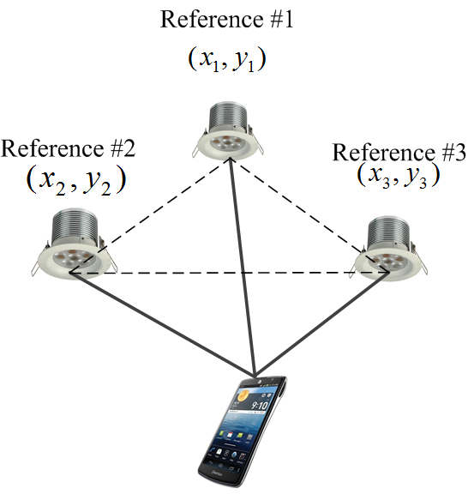
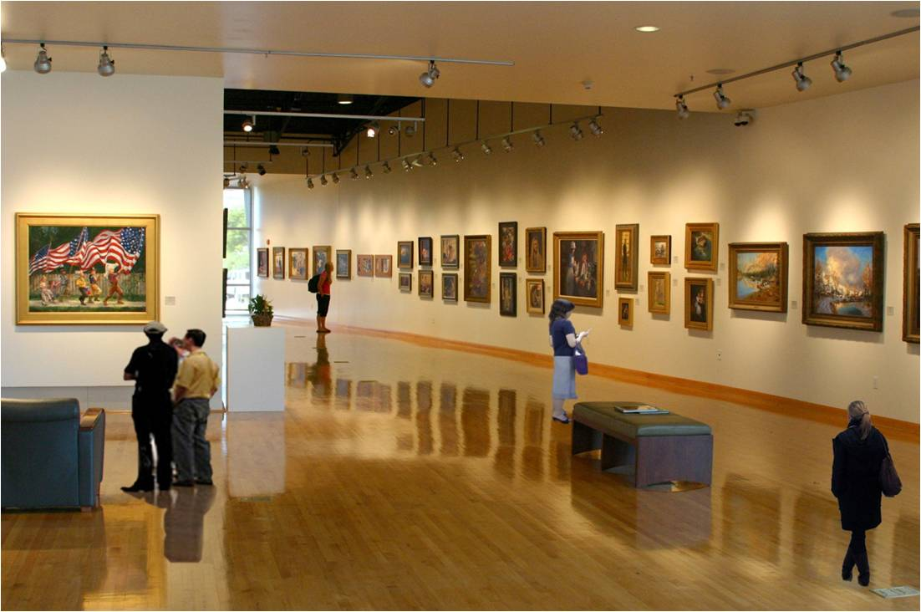
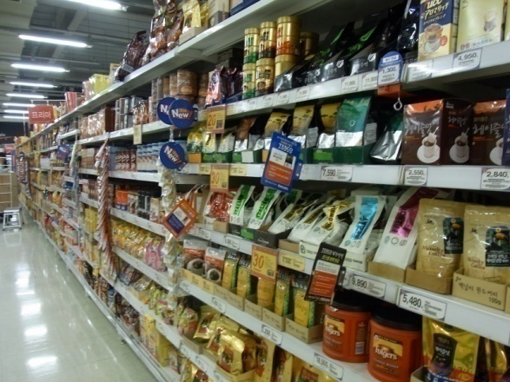
Deployment Service Scenario
doc.: IEEE 802.15-13-0173-00-0led
Indoor wireless networking and illumination: home networking through TV, PC monitor and LED lighting
Product information broadcasting, digital signage
Indoor positioning for LBS application
Guiding and authentication services in museum scenario
Streaming
Server
ID Server
IP Network
PLC
Tag # 2
Tag # 1
Tag # N
Tag # 3
Tag # N-1
Reader # N
Reader # 2
Reader # 1
LED-ID based museum scenario
Products information marketing
Localization by reference lighting system for LBS application

Slide 5
VLC Applications in Market
doc.: IEEE 802.15-13-0173-00-0led
VLC introductory phase:
Indoor networking
Location based services (LBS)
Products for other applications:
Intelligent Traffic Management System (ITMS)
In-flight entertainment and communication
Underwater communication
VLC is expected to penetrate:
LED based QR code: Long range(distance) readable
Guiding visitors in galleries and museums: plug n play with Smartphone oriented
Digital Signage Application: digital signage or displays can transmit discount and promotion information

Slide 6
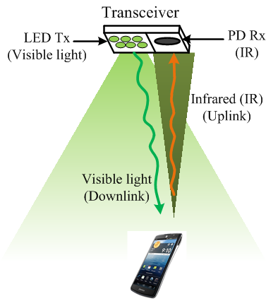
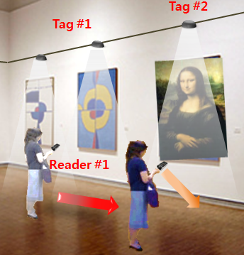
Development & Challenges
doc.: IEEE 802.15-13-0173-00-0led
Uplink transmission development with reliable and simultaneous communication : One possible solution is IR based uplink
Line-of-sight interruption problem
Need to provide seamless connectivity by fast and lossless link switching scheme
Cell overlap region:
Could communicate in two adjacent cell overlap region
Backhaul network & Supporting network:
Light fixture needs to plugged into wire network
Power line communication (PLC)
<VLC-IR combination for downlink-uplink communication>
<Seamless downloading in link switching scenario>

Slide 7
Enhancement Issues
doc.: IEEE 802.15-13-0173-00-0led
Uplink transmission medium: VLC or IR
Revision of PHY:
Modulation scheme: Sub-carrier based modulation, OFDM
MAC protocol modification: Need to modify
Channel Access Mechanism
Link Management and Link switching
MAC management service: Modify the primitives of MLME-SAP (Medium-access-control Link-Management Entity – Service Access Point) interface
Study directions:
VLC system for LBS support
LED-ID system
Smart device (Smartphone) oriented service: CamCom
OOK modulation
MIMO technology based on image sensor

Slide 8
Conclusions
doc.: IEEE 802.15-13-0173-00-0led
Need to modify the IEEE 802.15.7 standard for easy deployment in VLC based commercial products
Easy deployment strategies of the current standard for particular application: VLC based LBS system, LED-ID system
Study items and work items should be implementable
Smart device (smartphone) oriented services

Slide 9
References
doc.: IEEE 802.15-13-0173-00-0led
“VLC system deployment discussion,” R. Roberts, IEEE P802.15.7 working group for wireless personal area networks, March 2013.
“Technical Issues of Active LED-ID system,” Y. M. Jang, R. K. Mondal, and T. Nguyen, IEEE P802.15.7 working group for wireless personal area networks, November 2012.

