Slide 1
IEEE 802.15-13-0172-00-0led
Project: IEEE P802.15 Working Group for Wireless Personal Area Networks (WPANs)
Submission Title: [Amendment Issues of IEEE 802.15.7 Specification for LBS-based LED-ID]
Date Submitted: [March, 2013]
Source: [Yeong Min Jang, Ratan Kumar Mondal, Nam Tuan Le ] Kookmin University; [Youn-Kwan Kim] High Gain Telecom, Korea
Address [Kookmin University, Seoul, Korea]
Voice:[82-2-910-5068], FAX: [82-2-910-5068], E-Mail:[ yjang@kookmin.ac.kr]
Re: []
Abstract: [Amendment Issues of IEEE 802.15.7 Specification for LBS-based LED-ID]
Purpose: [Contribution to IEEE 802.15.7 IG-LED]
Notice: This document has been prepared to assist the IEEE P802.15. It is offered as a basis for discussion and is not binding on the contributing individual(s) or organization(s). The material in this document is subject to change in form and content after further study. The contributor(s) reserve(s) the right to add, amend or withdraw material contained herein.
Release: The contributor acknowledges and accepts that this contribution becomes the property of IEEE and may be made publicly available by P802.15.
Slide 1
Notes:
doc.: IEEE 802.15-09-0117-00-0007
<month year>

Slide 2
Contents
IEEE 802.15-13-0172-00-0led
LED-ID operation and protocol
Location based Modulation and Coding Scheme (MSC)
Amendment of IEEE 802.15.7 for LBS
Conclusion

Slide 3
LED-ID Service
IEEE 802.15-13-0172-00-0led

Slide 4
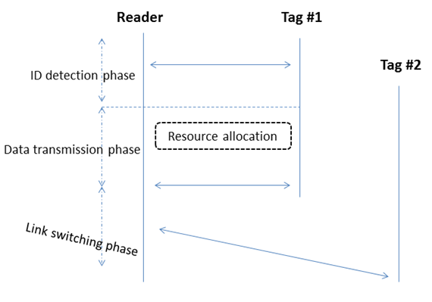
LED-ID Operation
IEEE 802.15-13-0172-00-0led

Slide 5
LED-ID Protocol
IEEE 802.15-13-0172-00-0led

Slide 6
LED-ID Challenges
IEEE 802.15-13-0172-00-0led
FOV limitation
Severe interference problems in small LED-ID cell
Slotted ALOHA
Limitation of sensing of CSMA-CA

Slide 7
Potential Indoor Localization Techniques
IEEE 802.15-13-0172-00-0led
 | Accuracy | Precision | Complexity | Scalability | Robustness | Cost
RSS | < 15cm | 50% within 15 cm | Medium | Good/2D | Good | Low
TDOA | 15cm ~ 30cm | 50% within 0.3m | Real time response frequency (0.1Hz -1Hz) | Good/2D, 3D | Poor | Medium to High
AOA | 15cm ~ 30cm | 99% within 0.3m | Real time response frequency (1Hz -10Hz) | 2-4 sensors per cell/2D, 3D | Poor | Medium to High
Finger-printing | 5m | 80% within 10m | Medium | Excellent/ 2D,3D | Good | Medium
GPS | 5m ~ 50m | 50% within 10m | Medium | Good/2D | Good | Medium

Slide 8
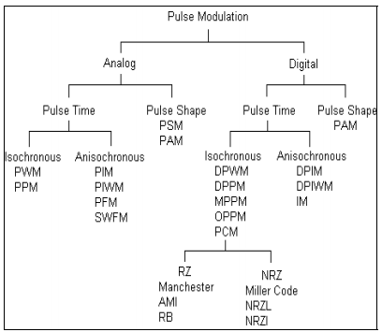
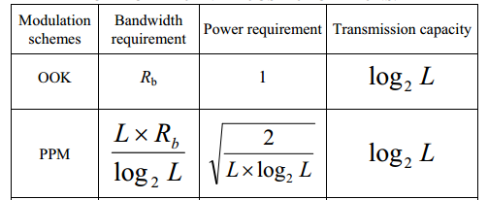
Modulation and Coding Scheme (MSC)
IEEE 802.15-13-0172-00-0led

Slide 9
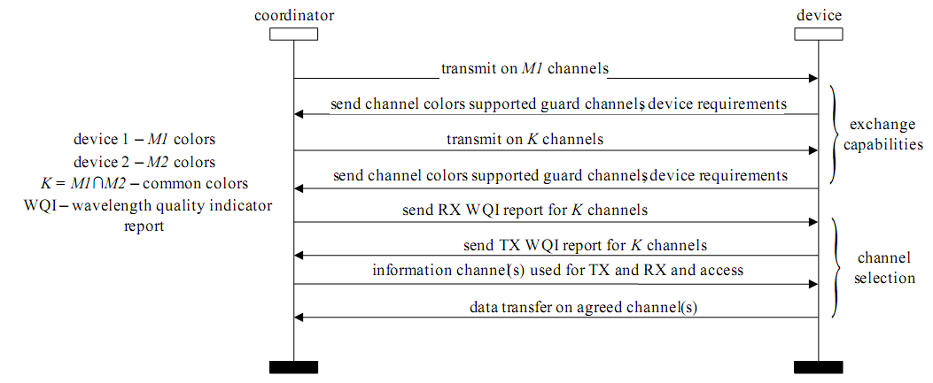
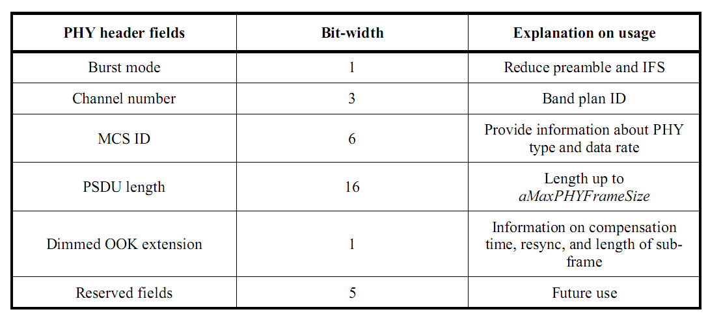
Modulation and Coding Scheme (MSC)
IEEE 802.15-13-0172-00-0led

Slide 10
Some Amendments for IEEE 802.15.7
IEEE 802.15-13-0172-00-0led
PHY functionality
Distance estimation (ORSSI, Image sensor)
MAC functionality
Location Estimation
MAC command frame modification for LBS
Location information broadcasting
Dynamic Modulation and Coding Scheme

Slide 11
IEEE 802.15-13-0172-00-0led
Conclusion
Proposed LED-ID protocol
Need to amend IEEE 802.15.7 for LBS
Should consider complexity of IEEE 802.15.7
Commercial deployment issues in smart devices

