Slide 1
Project: IEEE P802.15 Working Group for Wireless Personal Area Networks (WPANs)
Submission Title: Proposed OFDM Resolutions for CIDs 379 through 396 of LB #87
Date Submitted: March, 2013
Source: Cheolho Shin (ETRI), Sangsung Choi (ETRI) and Soo-Young Chang (SYCA)
Contact: sychang@ecs.csus.edu
Voice: +1-530-574-2741 E-Mail: sychang@ecs.csus.edu
Re: [802.15 TG4m]
Abstract: This document provides proposed OFDM resolutions CIDs 379 through 396 for LB#87.
Purpose: To provides proposed resolutions for LB#87
Notice: This document has been prepared to assist the IEEE P802.15. It is offered as a basis for discussion and is not binding on the contributing individual(s) or organization(s). The material in this document is subject to change in form and content after further study. The contributor(s) reserve(s) the right to add, amend or withdraw material contained herein.
Release: The contributor acknowledges and accepts that this contribution becomes the property of IEEE and may be made publicly available by P802.15.

Slide 2
Comments for TVWS OFDM Issues
CID 379
CID 380/381
CID 382/383
CID 384/385
CID 389
CID 390/391/392
CID 394
CID 395/396

Slide 3
CID 379, 20.2.1.1.3, 68, 18-19
CS: A
Comment
Replace “The STF …” with “The sync sequence …” and replace “1/8 STF symbol …” with “sync sequence …”
Proposed Change
(None)
Proposed Resolution - Accepted
Modify the text as explained in the comment.

Slide 4
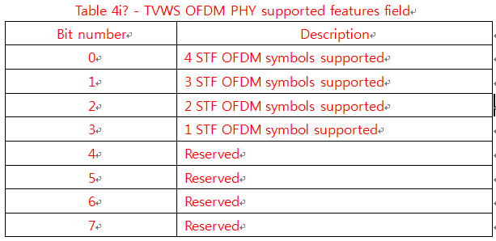
CID 380/381, 20.2.1.1.3, 68, 19-20
CS: A
Comment
How do we know how many STF repetition the Tx has to send?
Proposed Change
Specify a way for the transmitter to know how many STF to send
Proposed Resolution – Accepted
- Insert a table for the TVWS OFDM PHY supported features field
(Refer to CID 159)

Slide 5
CID 382/383, 20.2.1.1.4, 68, 39-40
CS: R
Comment
The STF should be normalized accordingly to the DATA to ensure the power of STF is the same than the DATA.
Proposed Change
Normalize the STF accordingly to the DATA.
Proposed Resolution - Rejected
We can use the STF power boosting to aid preamble detection.
We don’t need to normalize the STF accordingly to the DATA because the STF power boosting factor adjusts the power of the STF. (Refer to 15-12-0641-00-004m.)

Slide 6
CID 384/385, 20.2.1.1.3, 68, Fig. 116
CS: R
Comment
The last STF "s" should be negated: "-s" to help in STF timing detection.
Proposed Change
Negate the last "s" symbol in the STF repetition.
Proposed Resolution - Rejected
We don’t need to negate the last "s" symbols in the STF repetition because we can use the LTF detection algorithm using frequency-domain correlation characteristic of LTF. (Refer to 15-12-0641-00-004m.)

Slide 7
CID 389, 20.2.1.3, 70, 28-34
CS: R
Comment
16 bits of CRC is overkill.
Proposed Change
Reduce the size of CRC from 16 bits to 8 bits.
Proposed Resolution - Rejected
We don’t need to reduce the size of CRC from 16 bits to 8 bits because the PHY header fields for TVWS-OFDM have 50 bits that are enough to accommodate the 16 bits CRC in one OFDM symbol for PHR.
One OFDM symbol consists of 50 bits and there are enough bits available to allow 16 bit CRC.

Slide 8
CID 390/391/392, 20.2.1.3, 70, Fig. 118
CS: R
Comment
We don't need the scrambling seed to be 9-bit long.
Proposed Change
Specify only a limited set of scrambling seeds.
Proposed Resolution - Rejected
We don’t need to limit the set of scrambling seeds because the PHY header fields for TVWS-OFDM have 50 bits that are enough to accommodate the 9 bit scrambling seeds in one OFDM symbol for PHR.
One OFDM symbol consists of 50 bits and there are enough bits available to allow 9 bit scrambling seed.

Slide 9
CID 394, 20.2.2, 71, 21
CS: A
Comment
Devices shall support said mode iff the TVWS-OFDM PHY is supported. Also, heading in Table 137 that states "Mandatory Modes" should include similar qualification.
Proposed Change
Add qualification as follows: "For devices that support the TVWS-OFDM PHY, modes MCS0, MCS1 and MCS2 shall be supported, as shown in Table 137." Include footer to Table 137 corresponding to "Mandatory Modes" statement to say "for devices that support the TVWS-OFDM PHY".
Proposed Resolution - Accepted
(from) All devices shall support all BPSK, QPSK and 16-QAM (Quadrature Amplitude Modulation) and coding scheme levels (MCS0-2).
(to) For devices that support the TVWS-OFDM PHY, modes MCS0, MCS1 and MCS2 shall be supported, as shown in Table 137.
- Have a footer on Mandatory Modes in Table 137 to say "for devices that support the TVWS-OFDM PHY".

Slide 10
CID 395/396, 20.2.3.1, 72, Fig. 119
CS: AP
Comment
On this figure, we can believe the PHR is encoded. The puncturer doesn't appear.
Proposed Change
Clarify the picture. Make appear the PHR generation and puncturer block.
Proposed Resolution – Accepted in Principle
TVWS-OFDM PHY doesn’t use the Puncture block to increase the data rate.
Figure 119 can be modified as below.
PHR
PSDU
Whitener
Encoder

