Slide 1
Project: IEEE P802.15 Working Group for Wireless Personal Area Networks (WPANs)
Submission Title: [PHY Aspects for PAC]
Date Submitted: [ March 15th, 2013 ]
Source: [Marco Hernandez, Huan-Bang Li, Igor Dotlić, Ryu Miura ]
Company: [NICT]
Address: [3-4 Hikarino-oka, Yokosuka, 239-0847, Japan]
Voice:[+81 46-847-5439] Fax: [+81 46-847-5431] E-Mail:[]
Re: [In response to call for pre-proposals to TG8]
Abstract: [ ]
Purpose: [Material for discussion in 802.15.8 TG]
Notice: This document has been prepared to assist the IEEE P802.15. It is offered as a basis for discussion and is not binding on the contributing individual(s) or organization(s). The material in this document is subject to change in form and content after further study. The contributor(s) reserve(s) the right to add, amend or withdraw material contained herein.
Release: The contributor acknowledges and accepts that this contribution becomes the property of IEEE and may be made publicly available by P802.15.

Slide 2
Challenges of PAC-PHY
Multipath propagation
Spectrum limitations
Limited energy
User mobility
Resource management

Slide 3
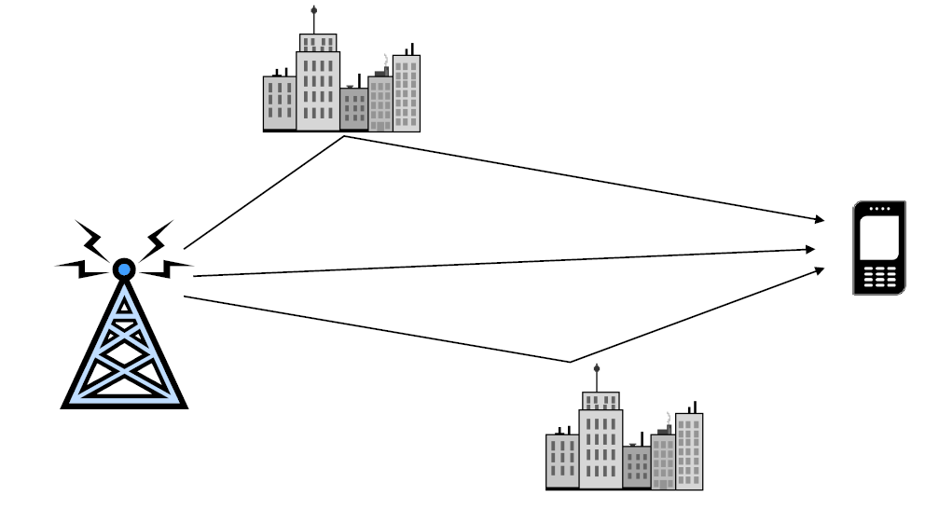
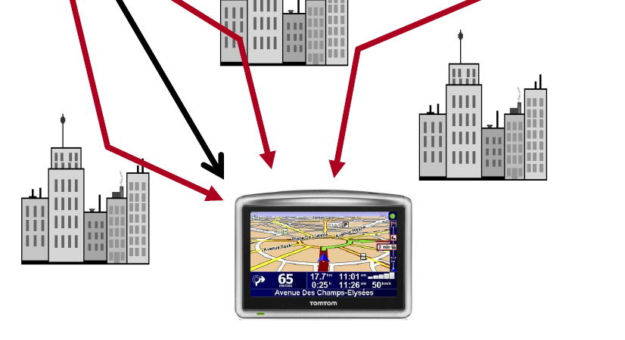
Multipath propagation
gg
Outdoor and indoor scenarios

Slide 4
Multipath propagation
Multi-path channel causes:
  Inter-symbol interference and fading in the time domain.
  Frequency-selectivity in the frequency domain.
In broadband wireless channels, ISI and frequency-selectivity become severe.

Slide 5
Multipath propagation
To solve ISI and frequency-selectivity various countermeasures are used:
  Channel equalization in the time domain or frequency domain
  Multi-carrier multiplexing, like OFDM
  Frequency hopping
  Channel-adaptive scheduling
  Channel coding
  Automatic repeat request (ARQ) and hybrid ARQ (H-ARQ)

Slide 6
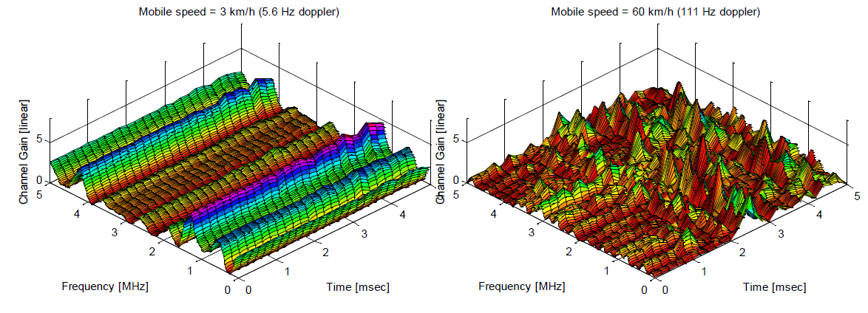
Multipath propagation
When the user is mobile, the channel becomes time-varying.
  There is also Doppler shift in the transmitted signal.

Slide 7
OFDM
Issues with OFDM
  High peak-to-average power ratio (PAPR): Since the transmitted signal is a composition of multiple subcarriers, high peaks occur.
  Carrier frequency offset: Frequency offset breaks the orthogonality between subcarriers and causes inter-carrier interference.
  Adaptive scheme or channel coding is required to overcome the spectral null in the channel.

Slide 8
Frequency Domain Equalization
For multi-path channels, conventional time domain equalizers are impractical because of complexity.
  Very long channel impulse response in the time domain.
  Impractical large tap size for time domain filter.
Using DFT, equalization can be done in the frequency domain.
  Because the DFT size does not grow linearly with the length of the channel response, the complexity of FDE is lower than time domain equalization.

Slide 9
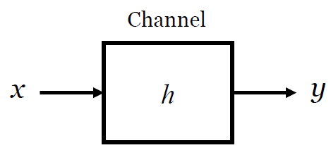
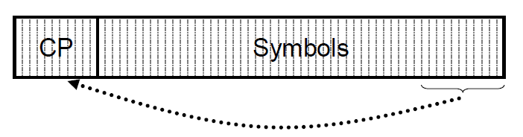
Frequency Domain Equalization
Time domain equalization
Frequency domain equalization
  It holds if convolution is circular (insertion of cyclic prefix):

Slide 10
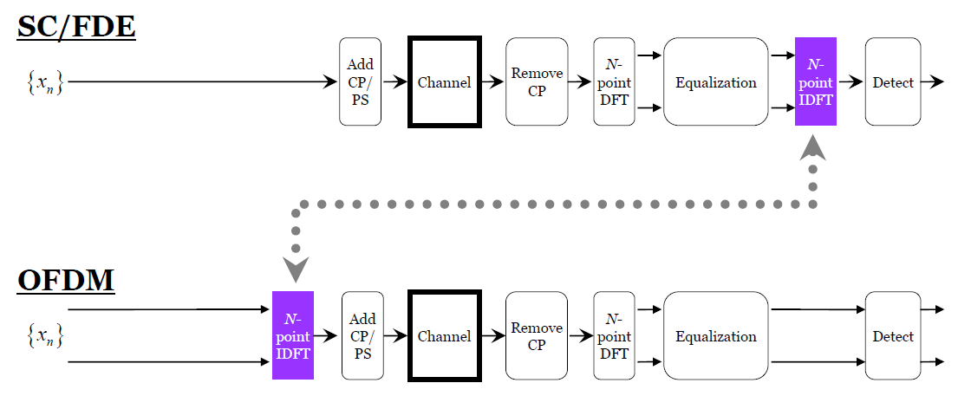
Single Carrier with FDE
SC/FDE as a form of OFDM

Slide 11
Single Carrier with FDE
SC/FDE delivers performance similar to OFDM with essentially the same overall complexity, even for long delay spread channels.
SC/FDE has advantages over OFDM in terms of:
  Low peak to average power ratio (PAPR).
  Robustness to spectral null.
  Less sensitivity to carrier frequency offset.
These have a strong impact on simpler, cheaper hardware implementations and better battery life.

Slide 12
PAPR
OFDM suffers from large variations of the instantaneous power of the transmitted signal
Such large power variations (PAPR) imply a reduced power amplifier efficiency and higher power amplifier cost.
This is critical in PAC devices due to the importance of mobile terminals with low power consumption (longer battery life) and cost.

Slide 13
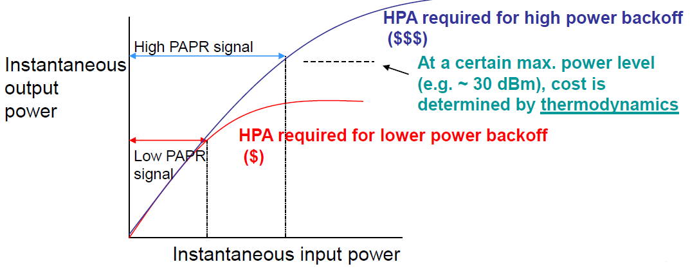
Power Amplifier Linearity Requirements and Cost
The greater the modulation’s PAPR requirement:
  the greater the required back-off,
  the greater the required maximum rated power to achieve the link budget,
  and the power amplifier’s cost rises sharply with maximum power rating.

Slide 14
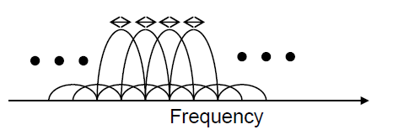
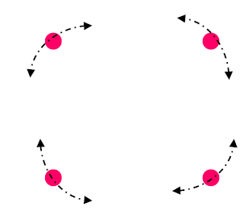
Phase Noise and Frequency Offset
OFDM
  Phase noise and frequency offset cause inter-subcarrier and intersymbol interference.
  Remedy: complex linear processing in the frequency domain.
SC/FDE
  Phase noise and frequency offset cause time domain rotation of serial data symbols.
  Remedy: decision-directed phase locked loop processing at equalizer output.

Slide 15
SC-FDE
A SC/FDE system gives similar results compared to OFDM, while avoiding its PAPR and synchronization problems.
An extension of SC/FDE to accommodate multiple-user access is known as Single carrier FDMA (SC-FDMA).
This technique can be generated in the time domain or in the frequency domain.
Frequency-domain-generated SC-FDMA is simply a precoded OFDM scheme known as DFT-Spread OFDM.

Slide 16
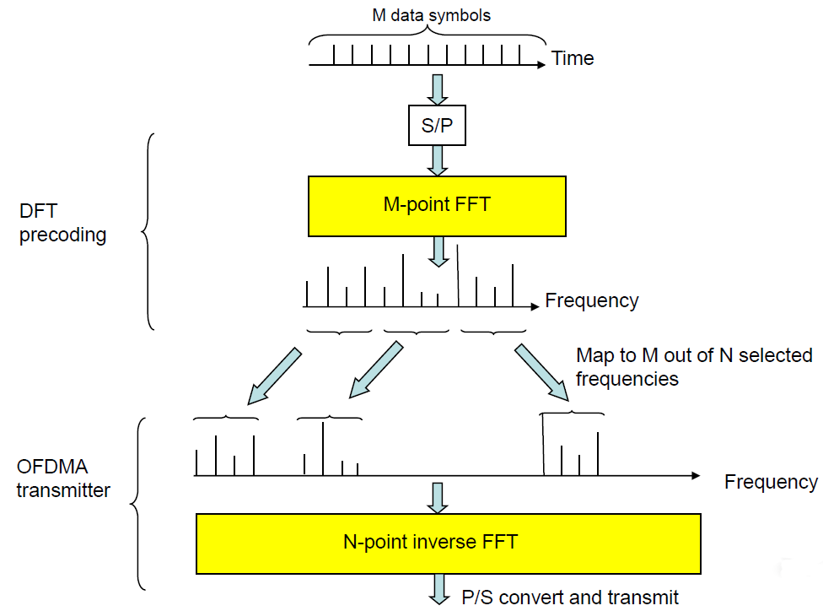
DFT-Spread OFDM

Slide 17
  DFT-Spread OFDM
It combines the desired properties for PAC mobile terminals:
  Small variations of the instantaneous power of the transmitted signal (low PAPR or low cost power amplifier and low power consumption for batteries).
  Low-complexity and high-quality frequency domain equalization.
  FDMA with flexible bandwidth assignment is similar to OFDMA (multiuser assignment of time slots and subcarriers in a time-frequency grid).
  Easy extension to MIMO transceivers.

Slide 18
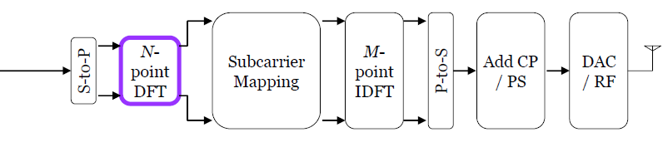


DFT-Spread OFDM scheme
DFT-Spread OFDM
OFDMA

Slide 19
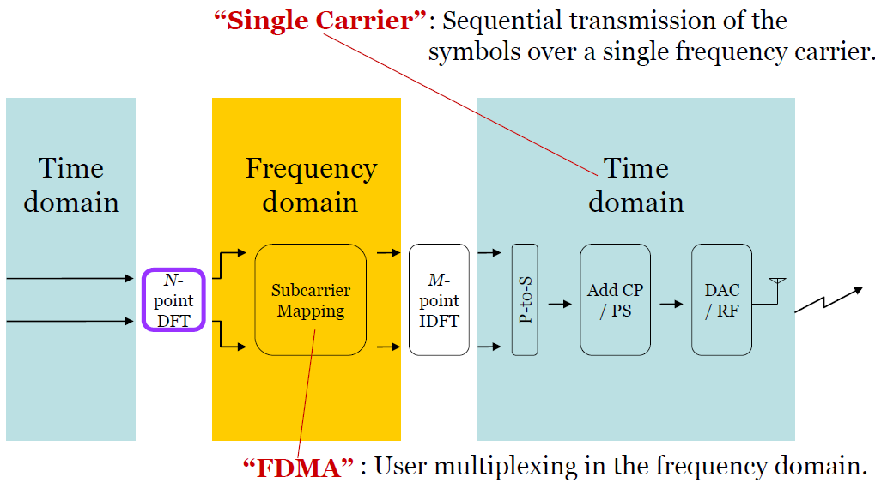
Why low PAPR

Slide 20
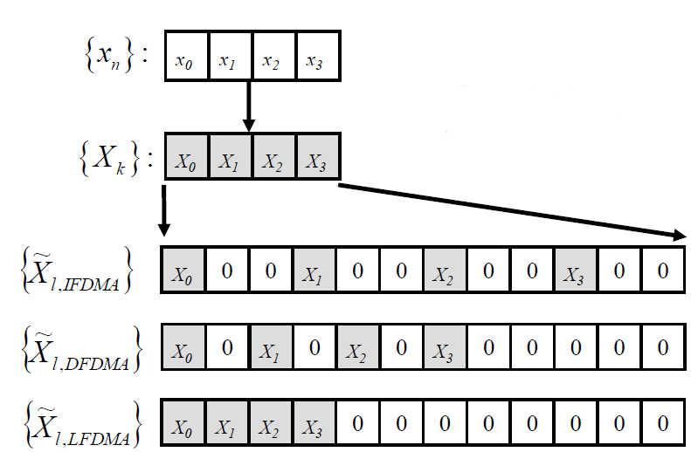
Sub-carrier mapping
Interleaved
Distributed
Localized

Slide 21
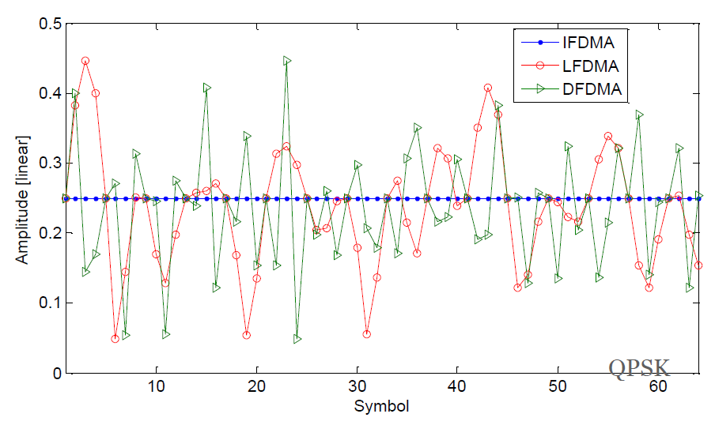
Why low PAPR
M-DFT=64, N-IDFT=16

Slide 22
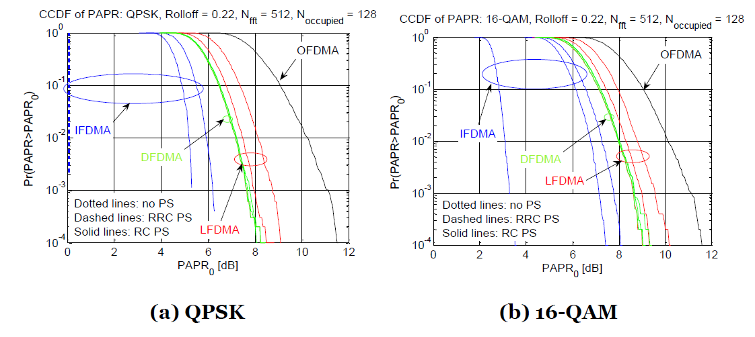
PAPR
H. G. Myung et al., “Peak-to-Average Power Ratio of Single Carrier FDMA Signals with Pulse Shaping", PIMRC 2006

Slide 23
Impact of nonlinear amplifier
When a signal with high PAPR passes through the HPA, which has nonlinear transfer function, spectral leakage occurs (in band and out band intermodulation) and the signal is distorted. This in turn causes PER degradation and Adjacent Channel Interference.
To reduce the non linear distortion effect, signal power is reduced before applying to the HPA input so that the probability of the signal peaks to be amplified in the linear region of the amplifier transfer function increases. This reduction of signal power is referred to as Back-Off.

Slide 24
Impact of nonlinear amplifier
The larger the Back-Off, higher the reduction of the distortion effect. However, It reduces the total available transmit power which eventually reduces the coverage area of the system.
There is a rule of thumb: 6 dB back-off from P1 compression point will be ok for most digital modulations, but 10 dB back-off for OFDM.

Slide 25
Impact of nonlinear amplifier
Rapp model for power amplifier
Input Back-Off
P_{s}=power when V_{i}=V_{s}, P_{i}=input power

Slide 26
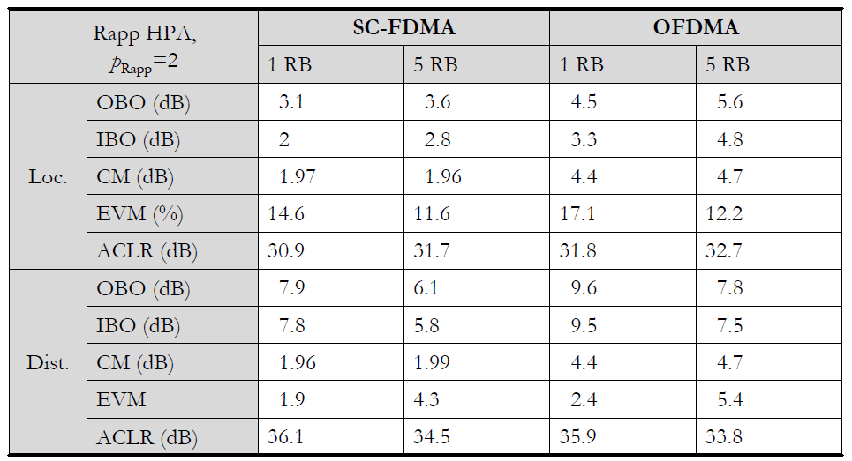
Nonlinear amplifier Rapp model
Output back-off
Input back-off
Error vector magnitude
Adjacent channel
leakage-power ratio

Slide 27
Impact of nonlinear amplifier
In terms of back-off SC-FDMA has an advantage of around 2 dB respect to OFDMA.

Slide 28
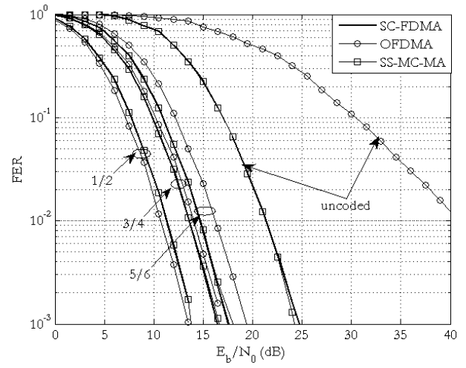
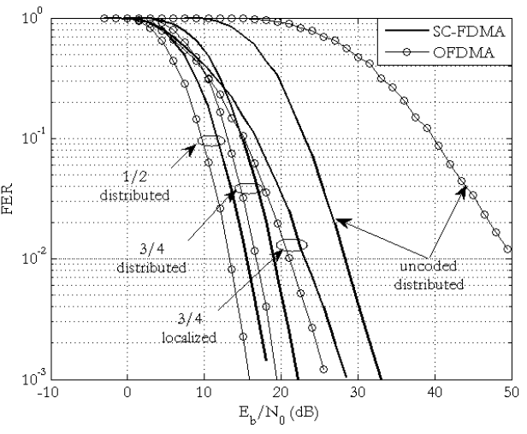
PER performance
QPSK
16-QAM

Slide 29
Conclusion
A SC/FDE systems and in particular DFT-Spread OFDM gives similar results compared to OFDM, while avoiding its PAPR and synchronization problems.
DFT-Spread OFDM implies implementations with low cost power amplifier and synchronization, and lower power consumption (longer battery life) compared to OFDM.
These are desired properties for PAC mobile terminals.

