Slide 1
Project: IEEE P802.15 Working Group for Wireless Personal Area Networks (WPANs)
Submission Title: Concurrent communications for PAC
Date Submitted: March 2013
Source: Suhwook Kim, Jinyoung Chun, Han Gyu Cho (LG Electronics)
Address: LG R&D Complex 533, Hogye-1dong, Dongan-gu, Anyang-shi, Kyungki-do, Korea
Voice: +82-31-450-1901, FAX: +82-31-450-4049, E-Mail: suhwook.kim@lge.com
Re:
Abstract: Introduce concurrent communications for PAC
Purpose:
Notice: This document has been prepared to assist the IEEE P802.15. It is offered as a basis for discussion and is not binding on the contributing individual(s) or organization(s). The material in this document is subject to change in form and content after further study. The contributor(s) reserve(s) the right to add, amend or withdraw material contained herein.
Release: The contributor acknowledges and accepts that this contribution becomes the property of IEEE and may be made publicly available by P802.15.
Slide 1

Slide 2
Concurrent communications
In these days, a user has many applications in a mobile device and wants to enjoy them simultaneously
On average, Korean has 46 apps in his phone [1]
Most famous apps are Gaming, SNS, Weather, Map, Music, News, etc..
We should consider multiple applications on PAC network
Support multiple application over infrastructure network is relatively easy because it is high layer issue
However, support multiple application over infrastructure-less network is NOT relatively easy because it is highly coupled with PHY/MAC
[1] http://www.kisa.or.kr/notice/pressView.jsp?b_No=8&d_No=1040&mode=view (written in Korean)
Slide 2

Slide 3
Recap of TGD
$ 4.2 Topology
IEEE 802.15.8 shall support a PD having simultaneous communication sessions for same or different applications
→ That is the Concurrent Communication
Slide 3

Slide 4
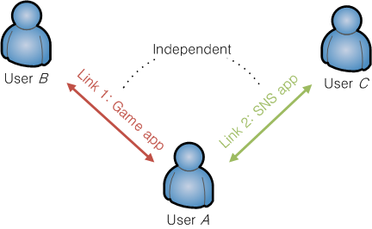
Concurrent communications type
Independent concurrent link model
Concurrent links are independent
Resource allocation is individual
Each link doesn’t affect operation of other links
For example
In 802.11-like system: Link 1 and 2 are operating on different channel
In FlashlinQ-like system: Link 1 and 2 are asynchronous
Characteristics
Protocol design is simple
Resource utilization is inefficient
System performance isn’t guaranteed
Slide 4

Slide 5
Concurrent communications type
Dependent concurrent link model
Concurrent links are dependent
Resource allocation is coupled
Each link affects operation of other links
For example
In 802.11-like system: Link 1 and 2 are operating on same channel
In FlashlinQ-like system: Link 1 and 2 are synchronized and operating on same phase
Characteristics
Resource utilization is efficient
System performance is guaranteed
Protocol design is complex
→ Suitable for PAC !
Slide 5

Slide 6
Current D2D standard
Wi-Fi Direct
The operation is based on IEEE 802.11 PHY/MAC
Concurrent communication can be supported over both models
However, the topology is highly limited, because it uses AP&STA technologies
There are AP-like device and STA-like device
AP-like device only communicates STA-like device, and vice versa
FlashLinQ
The operation is based on centralized synchronous system
Concurrent communication is supported over dependent concurrent link model
Global synchronization is required !
Slide 6

Slide 7
Conclusion
This proposal introduces concurrent communications issue for PAC
We proposed that PAC should satisfy demand for concurrent communications
Dependent concurrent link model is suitable for PAC
Main features of PAC should be guaranteed when we design concurrent communications model
Fully distributed topology
Infrastructure-less
Slide 7

