Slide 1
Project: IEEE P802.15 Working Group for Wireless Personal Area Networks (WPANs)
Submission Title: [IEEE 802.15.4p TG Overview for Joint Council on Transit Wireless Communications]
Date Submitted: [14 March 2013]
Source: [Jon Adams] Company [Lilee Systems Ltd.]
Address [2905 Stender Way, Suite 78, Santa Clara, CA 95054 USA]
Voice:[+1 480.628.6686], FAX: [Add FAX number], E-Mail:[jonadams@ieee.org]
Re: [If this is a proposed revision, cite the original document.]
[If this is a response to a Call for Contributions, cite the name and date of the Call for Contributions to which this document responds, as well as the relevant item number in the Call for Contributions.]
[Note: Contributions that are not responsive to this section of the template, and contributions which do
not address the topic under which they are submitted, may be refused or consigned to the “General Contributions” area.]
Abstract: []
Purpose: []
Notice: This document has been prepared to assist the IEEE P802.15. It is offered as a basis for discussion and is not binding on the contributing individual(s) or organization(s). The material in this document is subject to change in form and content after further study. The contributor(s) reserve(s) the right to add, amend or withdraw material contained herein.
Release: The contributor acknowledges and accepts that this contribution becomes the property of IEEE and may be made publicly available by P802.15.

Slide 2
Overview of 802.15.4p Activities for the Joint Council on Transit Wireless Communications
Jon Adams
Chair, IEEE 802.15.4p

Slide 3





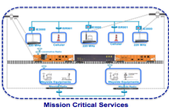

End-to-End IP Networks for Rail
NAS
Cisco Unified Computing System
SAN
NAS
Cisco Unified Computing System
SAN
Application
Data Center
Unified Fabric
Unified Network Services
Data Center
Unified Fabric
Unified Network Services
WCC
WCC
Control Center
Main
Control Center
backup
Core
Provider A
Provider B
Aggregation
Pre-Aggre
BCM
BCM
MCM
IE-3000 IE-2000
Access
WCM
WCM

Slide 4
IEEE 802.15.4
802.15 Working Group initiated in 1999
802.15.4 first released in 2003
Over 300 million units deployed in industrial, commercial, residential communications and control
ISO/IEC Standard 8802-15-4
Hundreds of active participants and over a dozen amendments

Slide 5
Recent 802.15.4 Enhancements
802.15.4e MAC Enhancements
  Sophisticated TDMA channel access structures
802.15.4g Smart Utility Network
  Wireless connectivity for secure, large-scale, meshable wide-area utility networks
802.15.4k Low-Energy Critical Infrastructure Monitoring
  Point to multi-thousand-point for critical infrastructure monitoring (bridges, buildings, highways, canals, etc.)
802.15.4m TV White Space Devices
  Adds new functionality to utilize TV white space

Slide 6



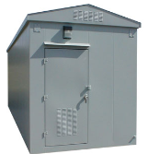

IEEE 802.15.4p RCC
In process of updating name to “Rail Communications and Control”
Adds vehicular mobility and new operating frequency bands to 802.15.4
Initial application is interoperable communications between
  Train and Wayside
  Train and Network Infrastructure
  Wayside and Network Infrastructure
Potential to see it extended to other vehicular functions
Network Control Center

Slide 7
90+ Participants from 70 Entities
Herzog
TI
GuardRFID
Inha University
OneAccess Networks
Meiji University
ARINC
Siemens
US DOT
Sunrise Micro
US DOT FTA
Samsung Information Systems America
The Ohio State University
Inside Secure
Electronics and Telecommunications Research Institute
US DOT Volpe
Safetran (Invensys Rail)
Union Pacific RR
University of Salzburg
Orthotron
Semtech
CalAmp
Rail Safety Consulting
Institute for Infocomm Research
National Taiwan University
Qualcomm
Freescale
Kyocera
Interdigital
Tensorcom
Analog Devices
CSX
National Technical Systems
Parsons Brinckerhoff
Stantec
Bombardier Transportation
Rohde and Schwarz
Korea Railroad Research Institute
Lilee Systems
Parsons
The Boeing Company
Vinnotech
Yokogawa
Sony
Notor Research
American University of Beirut
Noblis
Tohoku University REIC
Beijing Univ of Posts and Telecommunications
NXP
Verizon
Authentec
Sensus
TU Braunschweig
Via Technologies
Halcrow
US DOT FRA
Philips
Astrin Radio
China Academy of Telecomm Research
Gannett Fleming
Bravin Consulting
GE
APTA
Semaphore Group
Anritsu
Oki
Commsource

Slide 8
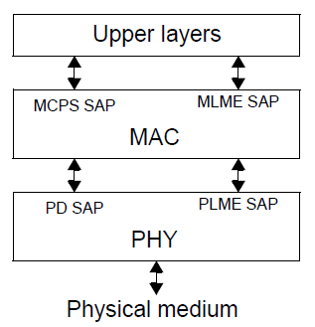
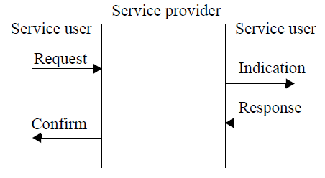
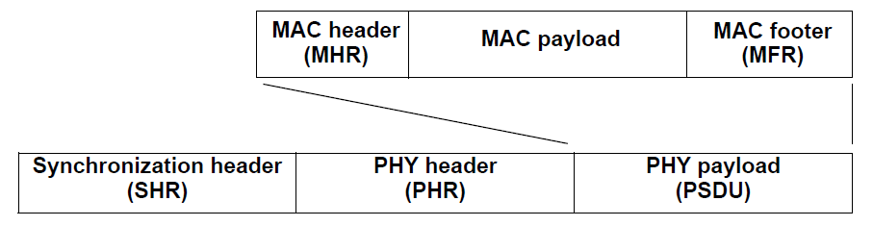
IEEE 802.15.4 Basic Architecture
Simple frame structure
Built in fragmentation for long IP packets
Unique 64-bit extended IEEE address or allocated 16-bit short address
Deterministic time slotting and/or CSMA-CA
Data rates from 9.6 upwards of 1000kbps
Forward error correction and error detection
Strong encryption (AES-128)
Ability for precision ranging and location
TDMA slotting 32/64/128 slots per second or more
  Short slots mean less fading during a slot
  More robust at high vehicular speeds
Layered Structure
Service Primitives
Frame Structure

Slide 9
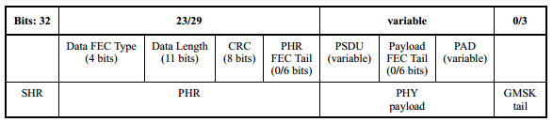
Proposed Features
IEEE compliant frame with low overhead for low-speed channels
Accommodates narrowband or wideband channels
Multiple coding, modulation, bandwidth methods to change C/I on the fly and manage interferers better

Slide 10
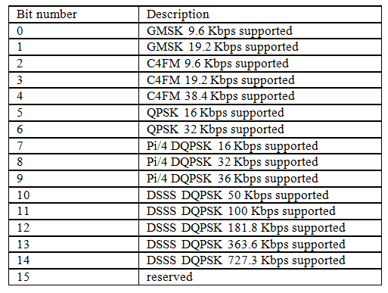
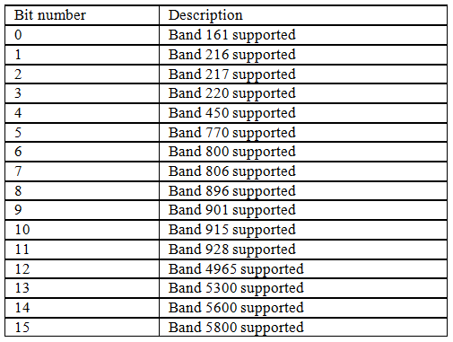
Bands, Modulation and Data Rates
From 5.2.4.28 RCC Capabilities Information Element

Slide 11

IEEE 802.15.4p Schedule
Interest Group Jul 2011
Study Group Nov 2011
Approval of PAR/5C Docs Jan 2012
Preparation for Task Group Phase
  Approval by NESCOM and 802 EC of IEEE802.15.4p TG Apr 2012
Task Group
Proposal Effort
  Technical Guidance Document May 2012
  Call for Proposals May 2012
  Preliminary Proposals July 2012
  Final Proposals Sep 2012
  Adopt Baseline Sep 2012
Text Drafting
  Begin Drafting Oct 2012
  First Preliminary Draft Jan 2013
  Approve draft Mar 2013
Final Draft
  WG Letter Ballot(s) Mar 2013
  Comment resolution Apr-Sep 2013
Specification Approval and Final Release
  802 EC, NESCOM, IEEE-SA End of 2013

Slide 12
Summary
Rail and Rail Transit wireless communications needs continue to grow
Participants from 70 companies, universities, government agencies, systems integrators, railroads and rail transits, engineering consultancies
802.15.4p standard expected for public release around end of 2013
Equipment expected nearly the same time

