Slide 1
Project: IEEE P802.15 Working Group for Wireless Personal Area Networks (WPANs)
Submission Title: [IEEE 802.15.4p TG Overview for IEEE Rail Transportation Standards Committee]
Date Submitted: [18 January 2013]
Source: [Jon Adams] Company [Lilee Systems Ltd.]
Address [2905 Stender Way, Suite 78, Santa Clara, CA 95054 USA]
Voice:[+1 480.628.6686], FAX: [Add FAX number], E-Mail:[jonadams@ieee.org]
Re: [If this is a proposed revision, cite the original document.]
[If this is a response to a Call for Contributions, cite the name and date of the Call for Contributions to which this document responds, as well as the relevant item number in the Call for Contributions.]
[Note: Contributions that are not responsive to this section of the template, and contributions which do
not address the topic under which they are submitted, may be refused or consigned to the “General Contributions” area.]
Abstract: []
Purpose: []
Notice: This document has been prepared to assist the IEEE P802.15. It is offered as a basis for discussion and is not binding on the contributing individual(s) or organization(s). The material in this document is subject to change in form and content after further study. The contributor(s) reserve(s) the right to add, amend or withdraw material contained herein.
Release: The contributor acknowledges and accepts that this contribution becomes the property of IEEE and may be made publicly available by P802.15.

Slide 2
Overview of 802.15.4p Activities for the IEEE VTS Rail Transportation Standards Committee
Jon Adams
Chair, IEEE 802.15.4p

Slide 3
Agenda
Brief History of Rail Communications Systems
Train Control Architectures
IEEE 802 (Computer Society)
IEEE 802.15.4p Task Group Activities

Slide 4

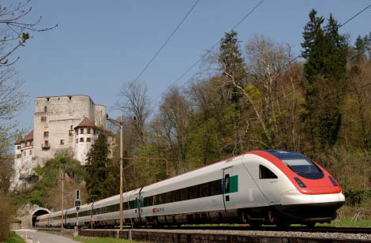
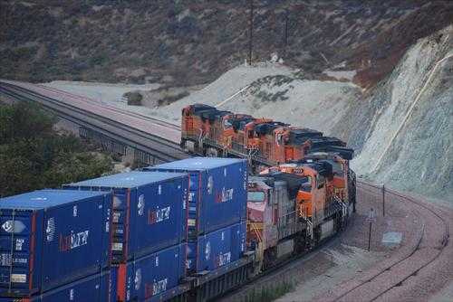
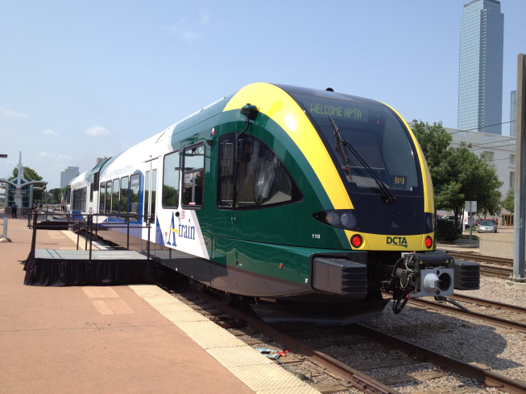
Goods and Human Transportation by Rail is Energy- and Cost-Efficient

Slide 5
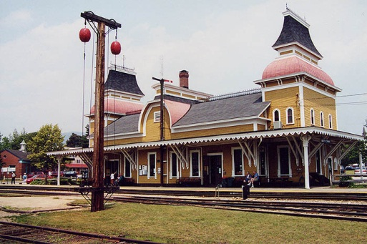
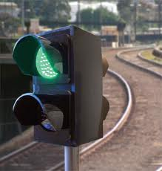
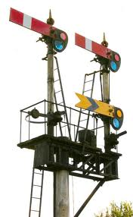
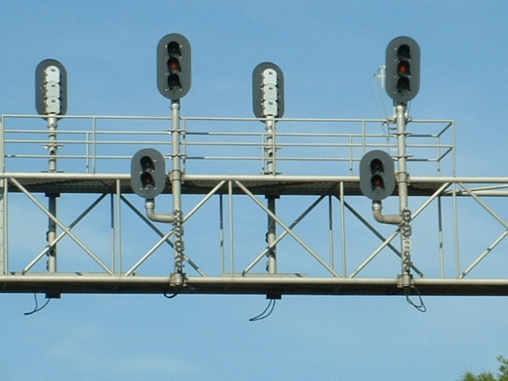
Rail Signaling and Communications Systems
Once there was more than one train on a track, collisions became possible
Methods to signal whether it was safe to proceed or to convey authority
Continuous improvement over 180 years to reduce accidents, improve safety, speed and efficiency

Slide 6
North American Radio-based Systems
< 1970s | 1980s | 1990s | 2000s | 2010s
Radio Code Line | ATCS | BART AATC | ACSES I | I-ETMS
Voice Radio | ARES | NJT ASES | NAJPTC (IDOT) | ACSES II
 |  | NYCT CBTC | ETMS | PATH CBTC
 |  | PTS | CBTM
 |  | ITCS
Ken Jackson, Rail Safety Consulting

Slide 7
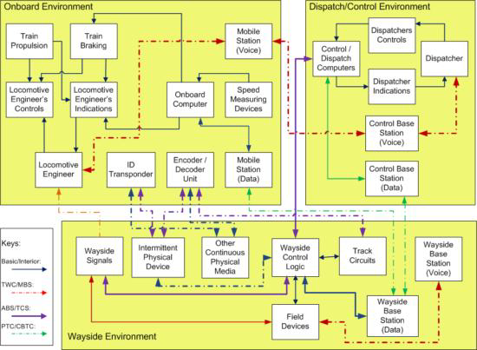
Train Control System Communications System

Slide 8





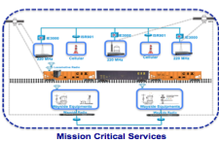


End-to-End IP Networks for Railroads
NAS
Cisco Unified Computing System
SAN
NAS
Cisco Unified Computing System
SAN
Application
Data Center
Unified Fabric
Unified Network Services
Data Center
Unified Fabric
Unified Network Services
WCC
WCC
Control Center
Main
Control Center
backup
Core
CRS-3
CRS-3
Provider A
Provider B
Aggregation
ASR 9K
ASR 9K
ME 3600
ME 3600
ME 3600
ME 3600
ASR 903
ASR 903
ASR 903
ASR 903
Pre-Aggre
BCM
BCM
MCM
IE-3000 IE-2000
Access
WCM
WCM

Slide 9
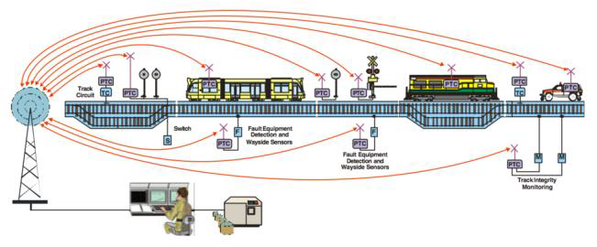
Train Control Architecture
Source: STI-CO – Ramon Abelleyro
Wireless is a critical component of successful rail data communications
Spectrum needs continue to grow

Slide 10


September 12, 2008 – Los Angeles CA
On September 12, 2008, a Metrolink passenger train collided with a Union Pacific freight train in Chatsworth, Los Angeles
Texting by Metrolink engineer
25 killed, 135 injured

Slide 11
Government Mandate
Rail Safety Improvement Act signed by President Bush on October 16, 2008 (“RSIA08”)
The bill mandates the implementation of Positive Train Control systems by December 31, 2015, on all
  Tracks with passenger service
  Tracks carrying hazardous materials which are poison or toxic by inhalation (PIH or TIH)
  Tracks carrying 5 million gross tons of freight or more per year

Slide 12
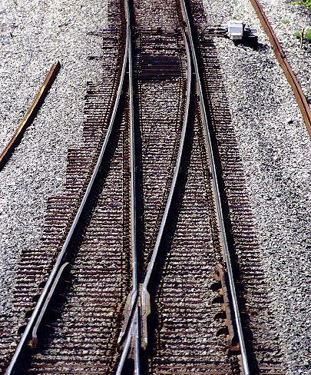
About Positive Train Control
Positive Train Control systems designed to prevent:
  Train-to-train collisions
  Overspeed derailments
  Incursions into work zones
  Movement through improperly configured switch
PTC systems are designed to override mistakes by human operators
Comprised of four subsystems
  Locomotive segment
  Wayside segment
  Communications segment
  Back office segment
Office
Communications Segment
Locomotive
Wayside

Slide 13
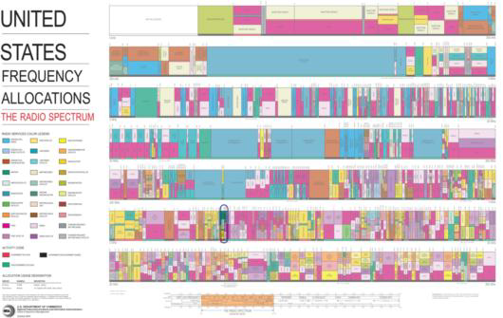
Many Users Competing for Scarce Spectrum

Slide 14
Current Spectrum Usage by RR/Transits
No spectrum set aside for PTC
Bands currently used by RR/Transit include
  Licensed (all Part 90)
    44.56-44.60 MHz
    160.0-161.565 MHz
    452/457 MHz paired
    700 and 800 MHz trunked
    896-987 / 935-936 MHz paired
    928-952 MHz narrow band
  License-free (all Part 15)
    902-928 MHz spread-spectrum, frequency hopping
    2400-2483.5 MHz spread spectrum
    5 GHz UNII bands

Slide 15
IEEE 802 LAN/MAN Standards Committee (LMSC)
Local Area and Metropolitan Area Networks
32-year history of creating world’s most successful, interoperable, networked wired and wireless data standards
Formal, coordinated, transparent, open and consensus-based process
Participation is by individual contributor
Six face-to-face meetings per year to allow sufficient vetting and promote timely development
Voting rights maintained with active participation
Broad international participation
Primarily physical and link layers of network stack
OSI Reference
Model
Application
Presentation
Session
Transport
Network
Data Link
IEEE
802
Physical
Medium

Slide 16
A Few of Those Dots
Working Group | Used For
IEEE 802.3 | Ethernet (Basis of the Internet)
IEEE 802.11 a/b/g/n… | Wireless Ethernet (Wi-Fi) (billions of units deployed)
IEEE 802.15 | Wireless PAN (ZigBee, Smart Grid) (hundreds of millions of units deployed)
IEEE 802.16 | Broadband Wireless Access (WiMAX) (tens of millions of units deployed)
IEEE 802.22 | Wireless Regional Area Network (TV White Spaces) (just starting, but promises to be large)

Slide 17
IEEE 802.15.4
Over 200 million units deployed for industrial, commercial and residential control and sensing
Accepted as ISO/IEC Standard 8802-15-4
Used by the ZigBee Alliance, ISA-100, Wireless HART, 6LoWPAN, others
Hundreds of participants working on new functions and performance enhancement

Slide 18


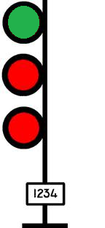
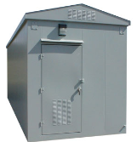

Where IEEE 802.15.4p Work Fits In
Adds vehicular mobility and new operating frequency bands to 802.15.4
Initial application is interoperable communications between
  Train and Wayside
  Train and Network Infrastructure
  Wayside and Network Infrastructure
Potential to see it extended to other vehicular functions
Network Control Center

Slide 19
Approved 15.4p Project Authorization Request
This amendment specifies a Physical layer (PHY) for IEEE 802.15.4, and any Medium Access Control (MAC) changes needed to support this PHY
Operation in licensed or license-free radio bands
Operation up to 6 GHz
Depending on frequency band and operating rules, TX output power >>+30dBm
Meets performance requirements at speeds up to 600 km/h
Range up to 70 km
Allows operation in contiguous or non-contiguous channel bandwidths as narrow as 5 kHz
Supports data rates up to 1 Mbps with flexible and robust quality of service
Provides modulation methods and spectral characteristics consistent with local regulatory requirements
Accommodates rapidly changing network membership.
Primary purpose of this amendment is to add high-speed mobility to the already-existing IEEE 802.15.4 specification
IEEE 802.15.4 devices now number in the 100’s of millions of volume

Slide 20
90+ Participants from 70 Entities
Herzog
TI
GuardRFID
Inha University
OneAccess Networks
Meiji University
ARINC
Siemens
US DOT
Sunrise Micro
US DOT FTA
Samsung Information Systems America
The Ohio State University
Inside Secure
Electronics and Telecommunications Research Institute
US DOT Volpe
Safetran (Invensys Rail)
Union Pacific RR
LG Electronics
Orthotron
Semtech
CalAmp
Rail Safety Consulting
Institute for Infocomm Research
National Taiwan University
Qualcomm
Freescale
Kyocera
Interdigital
Tensorcom
Analog Devices
CSX
National Technical Systems
Parsons Brinckerhoff
Stantec
Bombardier Transportation
Rohde and Schwarz
Korea Railroad Research Institute
Lilee Systems
Parsons
The Boeing Company
Vinnotech
Yokogawa
Sony
Notor Research
American University of Beirut
Noblis
Tohoku University REIC
Beijing Univ of Posts and Telecommunications
NXP
Verizon
Authentec
Sensus
TU Braunschweig
Via Technologies
Halcrow
US DOT FRA
Philips
Astrin Radio
China Academy of Telecomm Research
Gannett Fleming
Bravin Consulting
GE
APTA
Semaphore Group
Anritsu
Oki
Commsource

Slide 21
Recent 802.15.4 Enhancements
802.15.4e MAC Enhancements
  Sophisticated TDMA channel access structures
802.15.4g Smart Utility Network
  Wireless connectivity for secure, large-scale, wide-area utility networks
802.15.4k Low-Energy Critical Infrastructure Monitoring
  Point to multi-thousands of point for critical infrastructure monitoring (bridges, buildings, highways, canals, etc.)
802.15.4m TV White Space Devices
  Adds new functionality meeting TV white space regulatory requirements

Slide 22
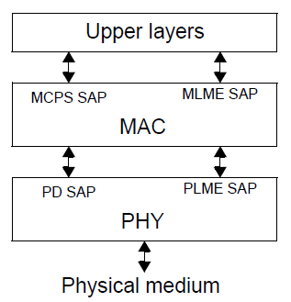
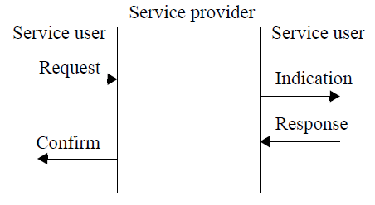
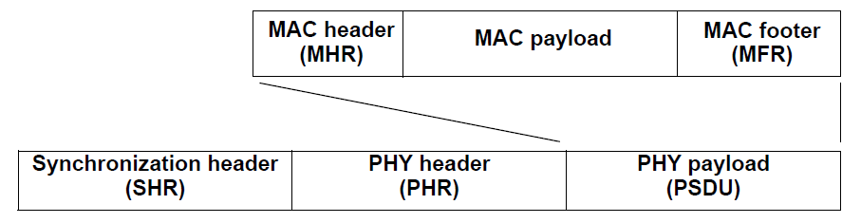
IEEE 802.15.4 Basic Architecture
Unique 64-bit extended IEEE address or allocated 16-bit short address
Deterministic time slotting or CSMA-CA
High reliability and robustness
Selection of bandwidths, data rates, modulation methods, coding, error correction or detection
Very power-efficient
Ability for precision ranging and location
Designed for interoperability
Layered Structure
Service Primitives
Frame Structure

Slide 23
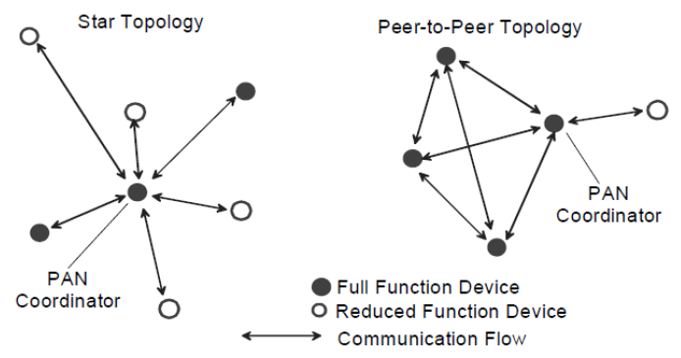
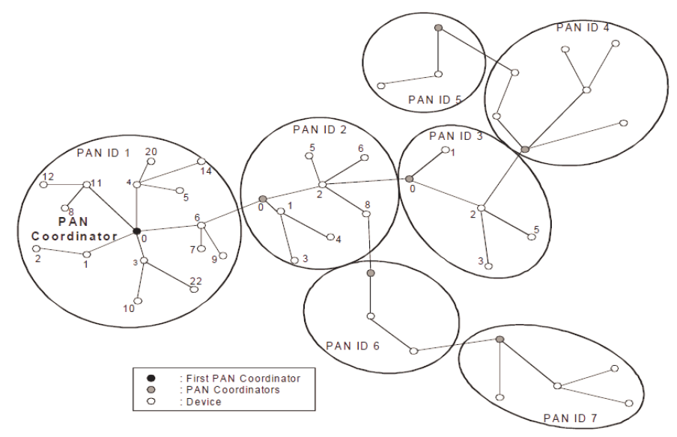
Basic Network Primitives

Slide 24
Built-in 15.4 Timeslotting Features
DSME
  Deterministic and Synchronous Multichannel extension
  Supports both star and peer-to-peer topologies
LLDN – Low Latency Deterministic Network
LEDN – Time Slotted Channel Hopping

Slide 25
Other Proposed Features
TDMA slotting 32/64/128 slots per second or more
  Short slots mean less fading during a slot
  More robust at vehicular speeds
IEEE compliant frame with low overhead for low-speed channels
Accommodates narrowband or wideband channels, depending on spectrum availability
Multiple coding, modulation, bandwidth methods to change C/I on the fly and manage interferers better

Slide 26

IEEE 802.15.4p Status
Study Group
Approval of Study Group Nov 2011
Completion of PAR/5C Docs Jan 2012
Approval of PAR/5C Docs Jan 2012
Preparation for Task Group Phase
  Call for Applications Dec 2011
  Extension of Call for Applications Mar 2012
  Approval by NESCOM and 802 EC of IEEE802.15.4p TG Apr 2012
Task Group
Proposal Effort
  Technical Guidance Document May 2012
  Call for Proposals May 2012
  Preliminary Proposals July 2012
  Final Proposals Sep 2012
  Adopt Baseline Sep 2012
Text Drafting
  Begin Drafting Oct 2012
  First Preliminary Draft Jan 2013
  Final Draft (ready for WG Letter Ballot) May 2013

Slide 27
Other Potential Rail Environment Applications of 802.15.4 Standards
Track and track infrastructure
  Switch/turnout operation and position
  Block occupancy
  Damage to rails
  Right of Way fouling
  Perimeter monitoring
  Bridge, viaduct, tunnel, culvert, etc.
  Highway / Rail grade crossing
Rolling Stock Defects
  Defect detection (hot box, dragging equipment, high/wide, etc.)
Signals
  Signal indication
  Signal function
  Grade crossing signaling and warning equipment
Maintenance of Way Vehicle
  On/off rail status
  Position, direction, speed
  Potential for active control
Maintenance workers
Rest-of-train car-to-car communication networks
  Hot box, brake line pressure, end of train marker, etc.

Slide 28
IEEE 802.15.4p Task Group Participation
Website
  http://www.ieee802.org/15/pub/TG4p.html
Subscribing to the reflector
  http://grouper.ieee.org/groups/802/15/pub/Subscribe.html#802.15.4p
Weekly Telecons
  0800 US Pacific time Wednesdays
  +1 530-881-1000 passcode 646359#
Every two months at IEEE 802 meetings
  January, March, May, July, September, November

Slide 29
Summary
Rail and Rail Transit wireless communications needs continue to grow
IEEE 802 has strong expertise in wireless systems
IEEE 802.15.4p Task Group
  IEEE 802.15.4 already ISO/IEC standard with hundreds of million units deployed
  PTC functionality will be added rapidly
  90+ participants from 70 entities
JOIN WITH US!

