Slide 1
Project: IEEE P802.15 Working Group for Wireless Personal Area Networks (WPANs)
Submission Title: [System level simulation parameters proposal ]
Date Submitted: [January 15th, 2013 ]
Source: [Marco Hernandez, Huan-Bang Li, Igor Dotlić, Ryu Miura, ad-hoc meeting attendees ]
Company: [NICT, ad-hoc meeting attendees ]
Address: [3-4 Hikarino-oka, Yokosuka, 239-0847, Japan]
Voice:[+81 46-847-5439] Fax: [+81 46-847-5431] E-Mail:[]
Re: [In response to call for technical guidance document contributions TG8]
Abstract: [ ]
Purpose: [Material for discussion in 802.15.8 TG]
Notice: This document has been prepared to assist the IEEE P802.15. It is offered as a basis for discussion and is not binding on the contributing individual(s) or organization(s). The material in this document is subject to change in form and content after further study. The contributor(s) reserve(s) the right to add, amend or withdraw material contained herein.
Release: The contributor acknowledges and accepts that this contribution becomes the property of IEEE and may be made publicly available by P802.15.

Slide 2
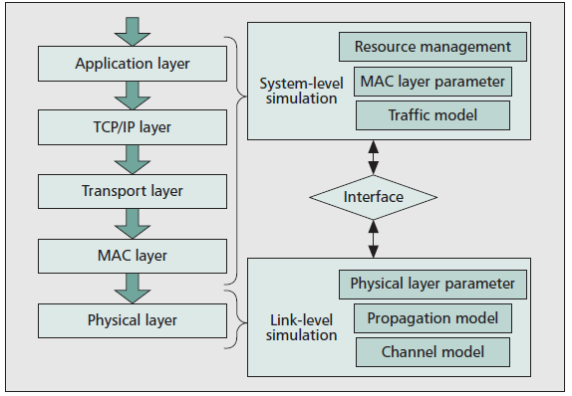
Wireless simulation methodology

Slide 3
Link-level vs system-level simulations
Link-level simulation focuses on the performance of a transmission between terminals.
  The performance metrics usually include the bit error rate (BER), signal to noise ratio (SNR), achievable data rate, etc.
The performance of modulation/demodulation or coding/decoding schemes in different radio channel models can be obtained from the link-level simulation

Slide 4
System level simulation
The scenario for the system-level simulation generally consists of a network with multiple terminals.
System-level simulation focuses on higher layer performance metrics as expressed by system throughput, user fairness, user-perceived quality of service (QoS), handover delay or success rate, etc.
  System-level simulation includes the scheduling process, traffic model, power control process, adaptive modulation and coding scheme (MCS) selection process, and other MAC layer processes.

Slide 5
System level simulation
Also, the system-level simulation needs to be operated with incorporation of the link-level simulation.
  The outputs of the link-level simulation are mapped through an interface to the system-level simulation as inputs of the system-level simulation.
The link-level simulation is separately abstracted to a set of SNR-BER curves on different Mod/Cod scenarios.

Slide 6
MAC protocols parameters
To analyze MAC protocols and their behavior, we may use five characteristics:
  Data goodput* throughput, in packets, the average amount of received packets in, say 100 rounds, per node.
  Data reception efficiency, the index for data throughput, the data packets successfully received to total data packets transmitted ratio.
  Collision Failure index, messages which did not reach their destination node, including control messages in relation to the sent attempts.
  *Goodput is the number of bits in the payload delivered by the network to a certain destination per unit of time.

Slide 7
MAC protocols parameters
  Time until success per message, is the average time a node needs to transmit successfully a complete message (latency).
  Fairness index, according to Jain’s fairness index.

Slide 8
Interference model
In the SINR model, the energy of a signal fades with the distance to the power of a path-loss law (channel models document).
  If the signal strength received by a device divided by the interfering strength of competitor transmitters is above some threshold , the receiver can decode the message, otherwise it cannot

Slide 9
System Simulation setup
Simulation Area: 1000 x 1000
Number of Nodes: 10, 100
Connectivity Model: UDG (unit disk graph):
  Assuming 10% of nodes pairing links (Tx and Rx), according to a transmission range including at most 2 hops.
Distribution model: Uniform random distribution
Interference model BER/PER vs SINR: given modulation and FEC coding, .
Packet length:1024, 256 bytes (communication),16 bytes (discovery)

Slide 10
System Simulation setup
Traffic model,
  Interrupted Poisson process, or interrupted discrete process, or interrupted renewal process
Link capacity
  1 Mbps

Slide 11
Comparing protocols
Assuming a proposed topology:
Density analysis
  Throughput, latency, fairness, etc., vs No of nodes
Packet length analysis
  Throughput, latency, data reception efficiency, vs packet length.

Slide 12
TBD for the link-level interface
As there is not any PHY approved for the TG8 specification, we may compromise into providing BER vs SNR for the different scenarios of the channel model document for a modulation and FEC approved during the ad-hoc meeting.
BER vs SINR if time allows.

Slide 13
TBD for the link-level interface
Proposed modulations: BPSK (discovery), QPSK 16QAM, 64QAM (communication).
FEC:
Shannon proposed to use theoretical BER curves in the AWGN:
  15-13-0058-00-0008-candidate-link-curve-snr-per.xlsx

Slide 14
TBD for the link-level interface

