Slide 1
Project: IEEE P802.15 Working Group for Wireless Personal Area Networks (WPANs)
Submission Title: Proposal of Ranging Capabilities with PHY supporting CMB
Date Submitted: January 14, 2013
Source: Wolfram Kluge, Dietmar Eggert, Liang Li
Company: [Atmel, Vinno]
Address: [Atmel, Koenigsbruecker Strasse 61, 01099 Dresden, Germany;
Vinnotech, Suite 202, Building D, No.2 Xinxi Lu, Beijing, China,]
Re: [Response to Call for Tech Proposals]
Purpose: [To present the method of performing ranging in a narrow-band transceiver using phase measurements]
Notice: This document has been prepared to assist the IEEE P802.15. It is offered as a basis for discussion and is not binding on the contributing individual(s) or organization(s). The material in this document is subject to change in form and content after further study. The contributor(s) reserve(s) the right to add, amend or withdraw material contained herein.
Release: The contributor acknowledges and accepts that this contribution becomes the property of IEEE and may be made publicly available by P802.15.

Slide 2
IEEE 802.15.4 PHY usage for Ranging
Widely adopted for wireless sensor networks, home control and industrial automation and similar applications
Proven technology
Although narrow-band, it is suitable for ranging even under multipath environments
Less additional hardware needed in existing transceiver design
Can be adapted to any frequency band
Proposal for Chinese MBAN bands:
  174 – 216 MHz
  407 – 425 MHz
  608 – 630 MHz

Slide 3
Active Reflector Principle (1)
Device A initiates ranging measurement
Device A transmits carrier ➔ device B performs phase measurement
changing transmit direction in both devices
Device B transmits carrier ➔ device A performs phase measurement
Device B transmits frame with measurement results to Device A
Device A is able to calculate range
Bidirectional traffic needed for devices with asynchronous time base

Slide 4
Active Reflector Principle (2)
PLL is running at same frequency at TX and RX mode
Receiver measures phase between LO signal and received carrier
Phase measurement is done at down-converted signal since frequency conversion maintains phase information
Propose phase measurement at IF frequency in low-IF receiver

Slide 5
Ranging with Active Reflector
Both, initiator and reflector device, have their own clock references which are not synchronized
Phase difference between both clock references results in a distance error
Proposal:
Device B measures phase of receives signal relative to its own LO signal phase.
Phase difference is transferred to device A used as correction factor.

Slide 6
Ranging Procedure (1)

Slide 7
Ranging Procedure (2)
Device A
Transmitting Ranging Request Frame
Receiving Ranging Ack
Locking AGC
Starting timer after RX end
Setting PLL to 1st meas. freq.
TX
Inverse IF position
Starting phase meas. sequence
Setting PLL to orig. freq.
Acking Result Frame
Releasing AGC Lock
Restoring IF position
Distance calculation
Device B
Request Frame receive
Locking AGC
Transmitting Ranging Ack
Starting Timer after TX end
Setting PLL to 1st meas. freq.
Starting phase meas. Sequence
RX to TX
TX
Setting PLL to orig. freq.
Transmitting results frame
Receiving Ack
Releasing AGC Lock

Slide 8
Ranging Request Frame
Initiator device sends Ranging Request Frame to reflector device.
Configuration parameters:
Start frequency
Stop frequency
Step frequency (0.5 … 2 MHz)
Slot time (0…255)*1μs
Step frequency sets max. distance that can be measured (ambiguity) .
Fstep (MHz) | 0.5 | 1 | 2
Max. Dist. (m) | 300 | 150 | 75

Slide 9
Ranging Results
The reflector device transmits its measurement results to the initiator device.
The initiator device calculates the distance based on phase measurements of both devices.
c is the speed of light and phase is measured with an 8-bit integer value
(2π == 256 (8bit)).

Slide 10
Implementation Example of Phase Measurement
Example: Low-IF receiver
Phase difference measured between IF signal and divided clock signal
Capturing time difference between signal edges (zero crossing of sine signals)
Phase difference independent of time (for zero frequency offset between devices)

Slide 11
Distance Calculation by Averaging for line-of-Sight channel
Simple method to cope with multipath effects
Adding all Δϕ to reconstruct phase over the bandwidth covered by phase measurements
Distance calculation:
Is identical to average group delay
Issue:
Δf must be small enough to avoid
cycle slip for largest distance

Slide 12
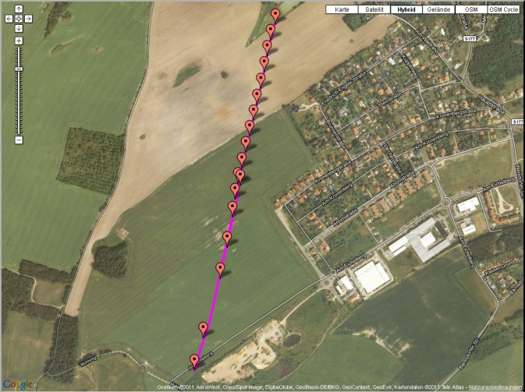
Outdoor Line-of-Sight Distance
Measurements

Slide 13
Multipath Propagation
Most significant error in ranging measurements
Narrow-band measurement (2MHz bandwidth) very prone to multipath channel
(Corresponds to sampling of channel group delay curve at arbitrary frequency)
Solution:
gathering information over as a wide frequency band as possible
Postprocess measurement results with IFFT techniques
Flexibility:
Depending on severity of multipath propagation (ratio of LOS signal power to signal power in delay paths) the number of frequencies used can be chosen

Slide 14
Advantage of Phase-Based Ranging
Fits to narrow-band transceiver design – only carrier transmitted
Any unknown delay in the transceiver (clock skew, filter group delay,…) has no impact on ranging accuracy (in contrary to Time of Arrival)
faster than Time-of-Arrival with IEEE 802.15.4 compliant frames
Needed to perform ranging measurements at multiple frequencies to mitigate multipath effect
Scalability: trading bandwidth for measurement speed and accuracy
Low additional implementation effort:
Transmitting carrier for short times (blocking modulation)
Phase measurement unit
State machine to coordinate transmit and receive mode with appropriate timing ➔ can be implemented in hardware or software
Slide 14
W. Kluge, D. Eggert, L. Li Atmel Vinno

Slide 15
Summary
Ranging with phase measurements fits to narrowband transceiver hardware utilized in IEEE 802.15.4 devices
Less hardware extensions needed to perform phase measurements
Distance resolution not prone to transceiver group delay – no transceiver calibration needed
Ranging at multiple channel frequencies allows mitigation of multipath effects

