Slide 1
Project: IEEE P802.15 Working Group for Wireless Personal Area Networks (WPANs)
Submission Title: TG procedure for PAC framework document
Date Submitted: January 2013
Source: Suhwook Kim, Jinyoung Chun, Han Gyu Cho (LG Electronics)
Address: LG R&D Complex 533, Hogye-1dong, Dongan-gu, Anyang-shi, Kyungki-do, Korea
Voice: +82-31-450-1901, FAX: +82-31-450-4049, E-Mail: suhwook.kim@lge.com
Re:
Abstract: TG procedure for PAC framework document
Purpose: For a discussion on the TG procedure for PAC framework document
Notice: This document has been prepared to assist the IEEE P802.15. It is offered as a basis for discussion and is not binding on the contributing individual(s) or organization(s). The material in this document is subject to change in form and content after further study. The contributor(s) reserve(s) the right to add, amend or withdraw material contained herein.
Release: The contributor acknowledges and accepts that this contribution becomes the property of IEEE and may be made publicly available by P802.15.
Slide 1

Slide 2
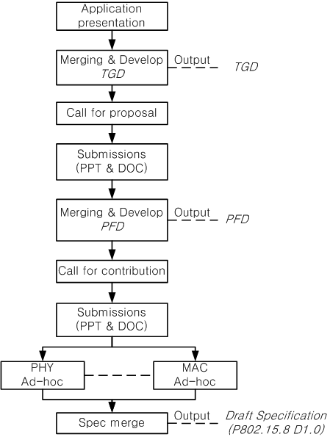
Approved TG procedure (May 2012)
DCN: 15-12-0264r3
Three official documents
Technical Guidance Document (TGD)
PAC Framework Document (PFD)
Draft Specification
Call for proposal
Submission of ppt&doc file for PFD
Based on TGD
Call for contribution
Submission of ppt&doc file for draft spec
Based on PFD

Slide 3
Current Status
We are still here !!
Slide 4

Slide 4
TGD to PFD
We had four meetings for TGD (July `12 ~ Jan. `13)
Now it is time to finalize TGD and move to PFD
We can update TGD after first finalization if we need to change
In order to save time, we should discuss some issues before the PFD working
Call for Proposal
Minimum technical depth of PFD/proposal
Determining specific value in PFD/proposal
Proposal selection criteria
Slide 4

Slide 5
Official documents (example from DCN: 264r3)
Technical Guidance Document (TGD)
Ex) Data rate: Typically <10Mbps, Up to 20Mbps
Ex) PAC features include relative positioning
PAC Framework Document (PFD)
Ex) Supported data rate: 1 Mbps(optional), 5Mbps, 10Mbps, 20Mbps(optional)
Ex) Resolution of relative positioning: 1m (optional), 10m
Draft Specification
Ex) Bandwidth, MCS, etc.
Ex) Frame structure/Signaling for relative positioning,

Slide 6
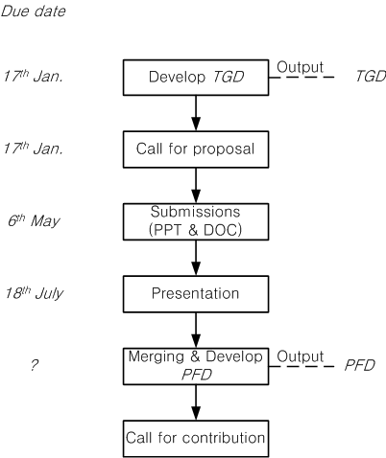
Proposed procedure for PFD
January meeting
Finalization of TGD
Call for Proposal
March meeting
Pre-proposal presentation
Discussion on contents of PFD
One week before May meeting (6th May)
Submission deadline
May/July meeting
Proposal presentation
Proposal evaluation
Discussion on merging
September meeting
PFD work

Slide 7
Timeline (Tentative)
TG formation Mar 12
Call for Application April 12
Application presentation May 12
TGD approval/Call for proposal Jan 13
Selection Criteria Mar 13
Proposal presentation July 13
PAC Framework Document/Call for contribution Nov. 13
Contribution presentation Mar. 14
Draft spec (P802.15.8 D1.0) complete/First Letter Ballot Sep. 14
Slide 5

Slide 8
Conclusion
This contribution proposed the procedure for PAC Framework Document
In order to facilitate the PFD, we should discuss some issues before the PFD working
Call for Proposal
Minimum technical depth of PFD/proposal
Determining specific value in PFD/proposal
Proposal selection criteria
Slide 6

Slide 9
Motion
Request that TG8 adopt the new procedure presented in DCN46r2
Moved by Suhwook Kim
Seconded by Marco Hernandez
Yes: 12, No: 0, Abstain: 1
Motion passed
Slide 9

