Slide 1
Project: IEEE P802.15 Working Group for Wireless Personal Area Networks (WPANs)
Submission Title: [Overview of IEEE 802.16m channel models]
Date Submitted: [9 January 2013]
Source: Chanho Yoon, Seungkwon Cho, Sungkyung Kim, Soojung Jung, Hyungjin Kim, and Sungcheol Chang
Company [ETRI]
Address [] Voice:[], FAX: [],
E-Mail:[chyoon@etri.re.kr]
Re: [In Response to Technical Guidance Document contributions for overview of 2.5GHz licensed band channel models]
Abstract: [Channel models for IEEE 802.16m]
Purpose: [For overview of reference channel models for proposals evaluation to TG8]
Notice: This document has been prepared to assist the IEEE P802.15. It is offered as a basis for discussion and is not binding on the contributing individual(s) or organization(s). The material in this document is subject to change in form and content after further study. The contributor(s) reserve(s) the right to add, amend or withdraw material contained herein.
Release: The contributor acknowledges and accepts that this contribution becomes the property of IEEE and may be made publicly available by P802.15.

Slide 2
Overview of IEEE 802.16m EMD channel models

Slide 3
Table of Contents
Introduction
Purpose
Test Scenarios
Highlights
System level channel models
Pass loss models (mandatory)
Pass loss models (optional)
Link level channel models
Power delay profile (PDP) for baseline test scenario (mandatory)
Power delay profile (PDP) for Cluster-Delay-Line models (optional)

Slide 4
Introduction

Slide 5
Introduction
Purpose
To provide sufficient details for evaluating the system proposals to IEEE 802.16m
Targeting the IMT-Advanced standard
Provide MIMO channel models as key enabling technology for 802.16m and IMT-Advanced
Suggested:
1) Mandatory & optional system level channel models
2) Mandatory & optional link level channel models

Slide 6
Introduction
Test scenarios
Scenario/Parameters | Baseline configuration TDD and FDD | NGMN configuration TDD and FDD | Urban Macrocell TDD and FDD
Requirement | Mandatory | Optional | Optional
Site-to-site distance | 1.5km | 0.5km | 1km
Carrier frequency | 2.5GHz | 2.5GHz | 2.5GHz
Operating bandwidth | 10MHz for TDD / 10MHz per UL and DL for FDD | 10MHz for TDD / 10MHz per UL and DL for FDD | 10MHz for TDD / 10MHz per UL and DL for FDD
BS height | 32m | 32m | 32m
BS Tx Power per sector | 46 dBm (4 0W) | 46 dBm (40 W) | 46 dBm (40 W)
MS Tx Power | 23 dBm (200 mW) | 23 dBm (200 mW) | 23 dBm (200 mW)
MS height | 1.5m | 1.5m | 1.5m
Penetration loss | 10 dB | 20 dB | 10 dB
Path loss model | 130.19+37.6*log10(R) (R in km) | 130.19+37.6*log10(R) (R in km) | 35.2+35*log10(d)+26* log10(f/2), (d in meters)
Lognormal shadowing standard deviation | 8dB | 8dB | 8dB

Slide 7
Introduction
Test scenarios
Scenario/Parameters | Baseline configuration TDD and FDD | NGMN configuration TDD and FDD | Urban Macrocell TDD and FDD
Correlation distance for shadowing | 50m | 50m | 50m
Mobility | 0-120 km/hr | 0-120 km/hr | 0-120 km/hr
Channel mix | ITU Pedestrian B 3 km/hr – 60% ITU Vehicular A 30 km/hr – 30% ITU Vehicular A 120 km/hr – 10% | Low mobility: 3 km/hr UL: typical urban, DL: SCM-C Mixed mobility: ITU Pedestrian B 3 km/hr – 60% ITU Vehicular A 30 km/hr – 30% ITU Vehicular A 120 km/hr – 10% | 3 km/hr – 60% 30 km/hr – 30% 120 km/hr – 10%
Spatial channel model | ITU with spatial correlation | Low mobility: 3 km/hr SCM Mixed mobility: ITU with spatial correlation | 10MHz for TDD / 10MHz per UL and DL for FDD
Error Vector Magnitude (EVM) | 30 dB | N/A | 30 dB

Slide 8
Introduction
Highlights in system-level channel modeling
Stochastic models
Spatial channel modeling
Mix of different speeds and channel scenarios
Pass loss, shadowing, cell radius, BS transmission power, antenna pattern, height, MS transmission power, height, gain factor, and etc. are included

Slide 9
Introduction
Highlights in link-level channel modeling
Stochastic models
Incorporated double-directional (reciprocal) impulse response
Angle of departure (AoD)
Angle of arrival (AoA)
Spatial correlation matrix (per tap)
Consideration of polarization
Incorporated MIMO matrix channel response
Antenna patters at transmitter and receiver
Antenna pattern for horizontal and vertical polarization
Considered elevation and azimuth
Spatial correlation matrix (per tap)
Generation of spatial channels (including MIMO channel)
1) Correlation based method
2) Ray based method

Slide 10
System level channel model

Slide 11
Pass loss models (mandatory)
1) Carrier frequency
2.5GHz
2) Uniform height of buildings
R in km, f in MHz, h_{BS} in meters
3) 15m above rooftop baseline configuration path loss
R in km
4) lognormal shadowing standard deviation
8dB

Slide 12
Pass loss models (optional)
1) Urban Macrocell (f[GHz]: 2 < f < 6)
BS height: 32m, MS height: 1.5m
2) Suburban Macrocell
BS height: 32m, MS height: 1.5m
3) Urban Microcell
BS: height: 12.5m, MS height: 1.5m
Refer to [1]

Slide 13
Pass loss models (optional)
5) Indoor Small Office
Refer to [2]
6) Indoor Hot Spot
LOS (20m < d < 60m, h_{BS} = h_{MS} = 1~2.5m)
NLOS (20m < d < 80m, h_{BS} = h_{MS} = 1~2.5m)

Slide 14
Pass loss models (optional)
7) Outdoor to Indoor
Refer to [2]
8) Open Rural Macrocell
Refer to [2]

Slide 15
Link level channel model

Slide 16
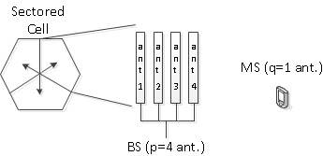
Baseline test scenario (Mandatory)
Case 1) Uncorrelated antennas at both BS and MS
Case 2) Uncorrelated antennas at MS, correlated antennas at BS
Spatial correlation calculation
Derived from 20 sub-paths resulting Laplacian PDF
Antenna spatial correlation coefficients

Slide 17
PDP for baseline test scenarios (Mandatory)
Modified ITU baseline channel models
ITU pedestrian B (6-taps => 24-taps)
ITU vehicular A (6-taps => 24-taps)
Realization of a time-varying spatial channel
Correlation based method: antenna correlation for each tap is computed first according the per-tap mean AoA/AoD, per-tap power angular profile, and antenna configuration parameters.
Considered for a 10MHz system bandwidth
TDD: 10MHz
FDD: 10MHz for both UL and DL

Slide 18
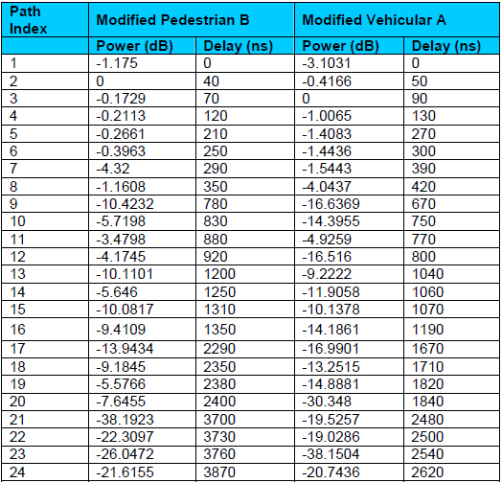
PDP for baseline test scenarios (Mandatory)
Modified ITU baseline channel models

Slide 19
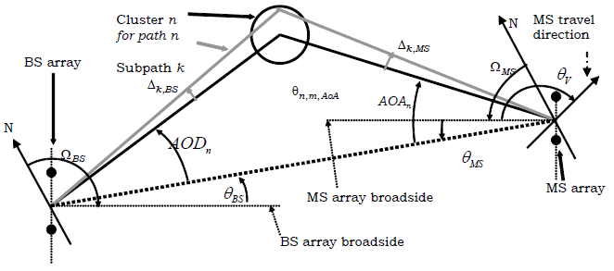
PDP for baseline test scenarios (Mandatory)
Angle parameters

Slide 20
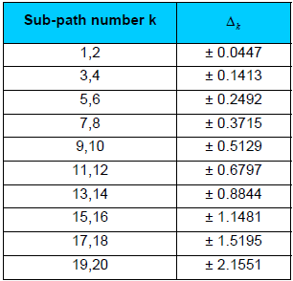
PDP for baseline test scenarios (Mandatory)
Spatial correlation matrix calculation (correlation based method)
Derived from 20 sub-paths resulting Laplacian PDF
Angular spread of 3 degrees
Inter-element spacing of 4 wavelengths
Angular offsets of the k-th (k=1,2,..20) sub-path are determined by

Slide 21
PDP for baseline test scenarios (Mandatory)
Spatial correlation matrix calculation
Step1) Derivation of antenna spatial correlation at the BS and MS between the p-th and q-th antenna as:
Step2) Denoting the spatial correlation matrix at BS and MS as R_{BS,n} and R_{MS,n}, the per-tap spatial correlation is determined as
is a 2x2 matrix if cross-polarized antennas are used at BS and MS

Slide 22
PDP for baseline test scenarios (Mandatory)
Spatial correlation matrix calculation
Step3) Generate NxM i.i.d. channels that satisfies Jake’s Doppler spectrum where N is the number of RX antennas and M is the number of TX antennas
Step4) compute the correlated channel at each tap as

Slide 23
Cluster-Delay-Line models (optional)
1) Urban Macrocell
2) Suburban Macrocell
3) Urban Microcell
4) Suburban Microcell
5) Indoor Small Office
6) Indoor Hot Spot
7) Outdoor to Indoor
8) Open Rural Macrocell

Slide 24
Cluster-Delay-Line models
CDL concept
Referred as conventional tap delayed line models of power delay profile with the addition of
1) Per-tap AoA, AoD information
2) Per-tap angular spread (power angular profile) information
A group of multi-path (taps) components form a cluster
Each cluster (tap) have 20 equal-power rays with fixed offset angles
Thus, the ray power is 1/20 of the mean tap power (i.e. -13dB)
A cluster can be divided into three sub-clusters

Slide 25
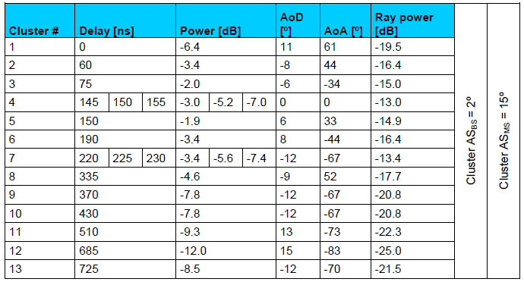
Cluster-Delay-Line models
Urban Macrocell
XPR = 5dB

Slide 26
Cluster-Delay-Line models
Urban Macrocell
XPR = 5dB

Slide 27
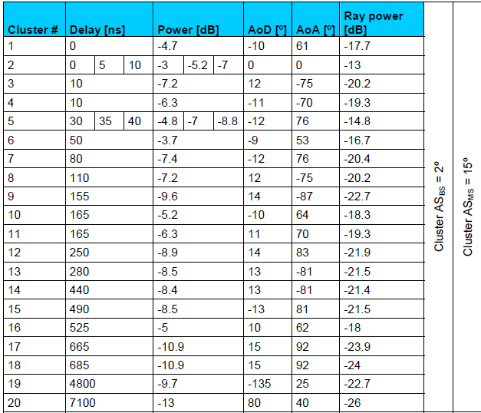
Cluster-Delay-Line models
Bad Urban Macrocell
XPR = 5dB

Slide 28
Cluster-Delay-Line models
Suburban Macrocell
XPR = 5.5dB

Slide 29
Cluster-Delay-Line models
Urban Microcell
LOS (Ricean K-factor is 3.3dB)
XPR = 9.5dB

Slide 30
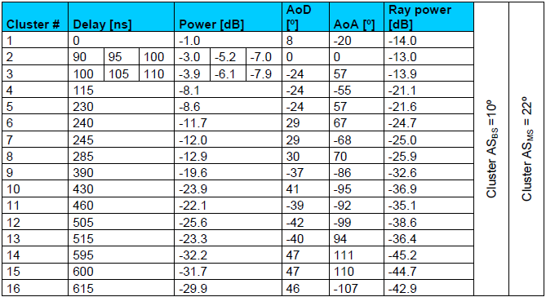
Cluster-Delay-Line models
Urban Microcell
NLOS
XPR = 7.5dB

Slide 31
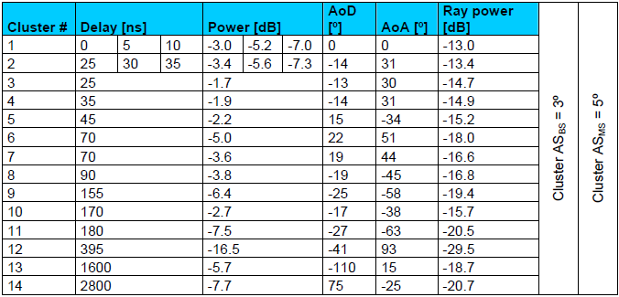
Cluster-Delay-Line models
Bad Urban Microcell
NLOS
XPR = 7.5dB

Slide 32
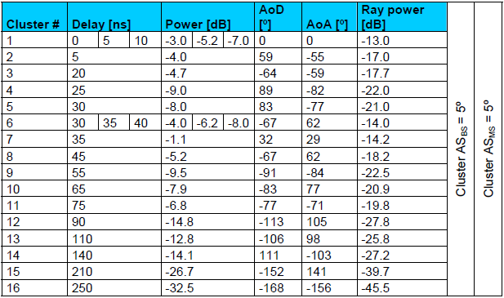
Cluster-Delay-Line models
Indoor Small Office
NLOS
XPR = 10dB

Slide 33
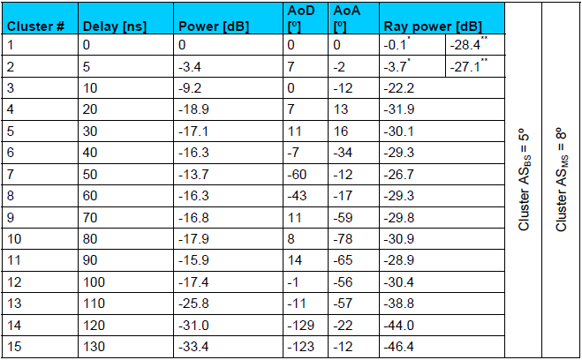
Cluster-Delay-Line models
Indoor Hotspot
LOS
XPR = 11dB

Slide 34
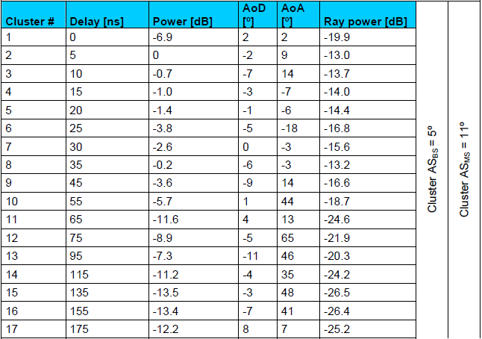
Cluster-Delay-Line models
Indoor Hotspot
NLOS, XPR = 11dB

Slide 35
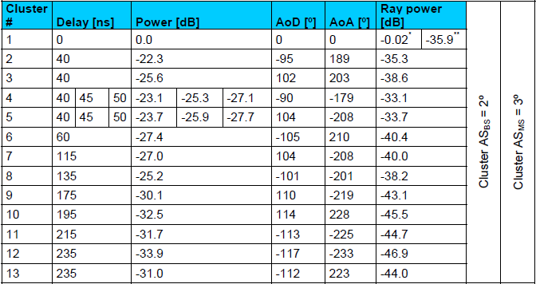
Cluster-Delay-Line models
Rural Macrocell
LOS, XPR = 7dB
Ricean K-factor is 13.7dB

Slide 36
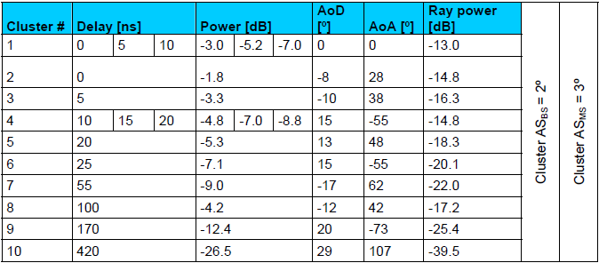
Cluster-Delay-Line models
Rural Macrocell
NLOS, XPR = 7dB

Slide 37
References
[1] IEEE 802.16m-08/004r2
[2] IST-WINNER II Deliverable D1.1.1 v1.0 “WINNER II Interim Channel Models”, December 2006

Slide 38
Thank You
Any Questions?

