Slide 1
Project: IEEE P802.15 Working Group for Wireless Personal Area Networks (WPANs)
Submission Title: Adaptive timeslot allocation scheme for WBAN
Date Submitted: Sept 10, 2012
Source: Wei-Xia Zou, BUPT; Liang Li, Vinno; Jin Shuai, Yi-Bo Wang, BUPT;
Suite 202, Building D, No.2 Xinxi Lu, Beijing, China,
Voice: 1-914-333-9687, FAX: 1-914-332-0615,
E-Mail: liangli@vinnotech.com
Abstract: Opening report for TG4n(MBAN) Task Group
Purpose: Outline accomplishments from the March 2012 meeting and planned tasks for this meeting.
Notice: This document has been prepared to assist the IEEE P802.15. It is offered as a basis for discussion and is not binding on the contributing individual(s) or organization(s). The material in this document is subject to change in form and content after further study. The contributor(s) reserve(s) the right to add, amend or withdraw material contained herein.
Release: The contributor acknowledges and accepts that this contribution becomes the property of IEEE and may be made publicly available by P802.15.

Slide 2
Informative Abstract
General View
  Suggest to add Data Priority Classification
  Priority timeslot Concept in IEEE802.15.4E
Data Priority and TimeSlot
Conclusion

Slide 3
General View
How to support diverse QoS requirements of various applications is one features of WBAN MAC operation. In this proposal, we classify the traffics in WBAN scenarios into several priorities. And then, based on the data priority classification, the adaptive timeslot allocation scheme is proposed. At last, we will discuss the process of the data transfer procedure.

Slide 4
Suggest to add Data Priority Classification
Aiming at special patient, for example, people with diabetes, blood sugar signal should be considered to be more important than the regular medical signal, such as EEG and ECG. So, we can rank the data priority class of people with special disease like this:
Priority level | Data Type | Examples
1 | Emergency alarm | Emergency vital signals
2 | medical signal related to Special disease | Blood sugar signal of people with Diabetes
3 | Regular medical signal | EEG/ECG/EMG
4 | Non-medical signal | Audio/video

Slide 5
Timeslot Definition in IEEE8021.5.4E
In IEEE802.15.4E, Timeslot is defined as:
  A defined period of time during which a frame and an acknowledgement may be exchanged between devices.
Timeslots may be applied for priority medical data.
Such data transmission procedures might be processed in 4E MAC protocol.

Slide 6
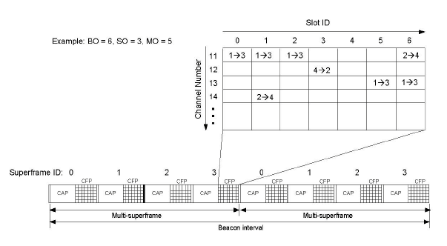
Timeslot Defined in DSME
DEME: Deterministic and synchronous multi channel extension
If DSME-GTSs in different slots in different channels are successfully allocated for a pair of a Source device and a Destination device, the Source device shall transmit data frames according to the scheduled timeslots and channels specified in macDSMEACT.

Slide 7
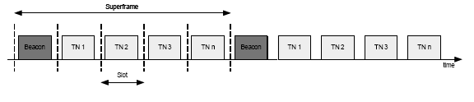
Timeslot Defined in LLDN
LLDN : Low Latency Operation Definition
The LLDN (Low Latency Operation Definition) superframe is divided into a beacon timeslot, management timeslots (, i.e., the downlink and uplink management timeslots), and remaining timeslots for LLDN devices.

Slide 8
Timeslot Defined in TSCH
Timeslotted channel hopping (TSCH) PANs are topology independent and can be used in star topologies as well as partial or full mesh topologies.
In a TSCH PAN, the concept of the superframe is replaced with a slotframe. The slotframe also contains defined periods of communications between peers that may be either CSMA-CA or guaranteed, but the
slotframe automatically repeats based on the participating devices’ shared notion of time, and does not require beacons to initiate communications. Unlike the superframe, slotframes and a device’s assigned timeslot(s) within the slotframe may initially be communicated by beacon, but are typically configured by a higher layer as the device joins the network.

Slide 9
TimeSlots in 15.4E MAC Services
The MLME-SET-LINK.request primitive requests to add a new link, or delete or modify an existing link at the MAC sublayer. The slotframeHandle and linkHandle are supplied by a higher layer. The semantics of this primitive are:
MLME-SET-LINK.request (
    operation,
    linkHandle,
    slotframeHandle,
    timeslot,
    channelOffset,
    linkOptions,
    linkType,
    nodeAddr
)
Here, Timeslot is one Integer 0x0000–0xffff
In TSCH and LLDN PIB Attributes, a serial of related Timeslots are defined.

Slide 10
Example: Priority classification based on
LLDN superframe structure
Timeslots are allocated based on the data priorities mentioned before. As shown in the figure, Phase-1 includes the timeslots that only belong to the device transmitting the highest priority data, and accordingly, Phase-2 belongs to the next highest while Phase-3 supports the lowest.

Slide 11
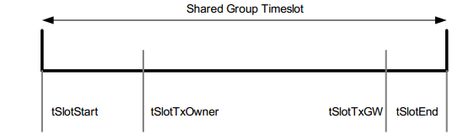
Example: Priority classification based on
LLDN superframe structure
Timeslot definition of the LLDN superframe structure
Attribute | Description
tSlotStart | Starting time of timeslot
tSlotTxOwner | End time of privileged access by device that owns the timeslot
tSlotTxGW | If timeslot is unused, BAN coordinator can use the timeslot
tSlotEnd | End time of timeslot

Slide 12
Example: Priority classification based on
LLDN superframe structure
From tSlotStart to tSlotTxOwner: the device that owns the slot, the slot owner, has exclusive access to the timeslot.
From tSlotTxOwner till tSlotTxGW: the device, transmitting data with priority higher or equal to that of the timeslot owner, may uses the timeslot for data transmission with CSMA-CA access if the timeslot is not used by the slot owner.
From tSlotTxGW till tSlotEnd:, the BAN coordinator may use the timeslot, if the timeslot is still unused.

Slide 13
Summary
The priority classification based on TSCH and DSME structure is also under consideration.
The Timeslot concepts are defined in IEEE802.15.4E.
The prioritized medical devices may communicated on the desired timeslots
Suggest IEEE802.15.4E as one option MAC spec of IEEE802.15.4N,

