Slide 1
Project: IEEE P802.15 Working Group for Wireless Personal Area Networks (WPANs)
Submission Title: Comments on discovery and discovery latency
Date Submitted: January 09, 2013
Source: Jinyoung Chun, Suhwook Kim, HanGyu Cho
Company: LG Electronics
Address: jiny.chun@lge.com
Re: Discussion on discovery and discovery latency
Abstract: Summary email discussion and propose the text for discovery and discovery latency in TGD
Purpose: Discussion
Notice: This document has been prepared to assist the IEEE P802.15. It is offered as a basis for discussion and is not binding on the contributing individual(s) or organization(s). The material in this document is subject to change in form and content after further study. The contributor(s) reserve(s) the right to add, amend or withdraw material contained herein.
Release: The contributor acknowledges and accepts that this contribution becomes the property of IEEE and may be made publicly available by P802.15.

Slide 2
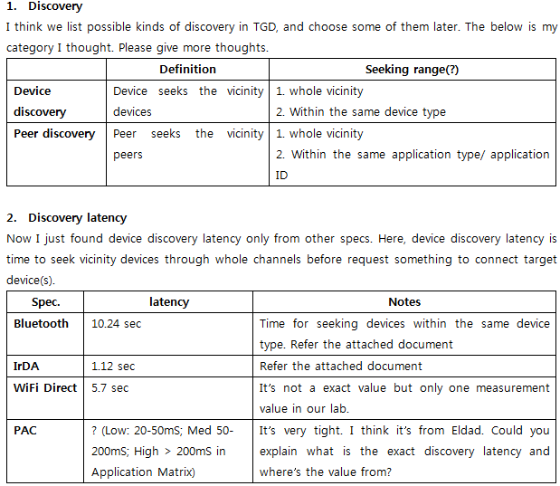
Email discussion
Jinyoung’s opinion

Slide 3
Email discussion (Cont’d)
Eldad’s opinion
“Discovery latency between two devices is the time from the moment when both devices have been given each other identity and any required keys and are told to discover each other, to the moment when they have established a communication link”
Marco’s opinion
15-12-0683-01-0008-definition-of-discovery-latency-in-pac
“Discovery latency refers to the delay between the moment two active PAC devices are within communication range to the moment when they first discover each other. The worst-case discovery latency determines the minimum amount of time two devices need to be in communication range to ensure discovery.”

Slide 4
Email discussion (Cont’d)
In Application matrix,
(2) Discovery latency, mS. Low: 20-50mS; Med 50-200mS; High > 200mS
(3) Data latency, mS. Very low 5-10mS; Low 10-20mS; Med 20-100mS; High > 100mS
Summary
It is difficult to define discovery latency as the exact trusted values because the references said different values and it depends on PAC system design.

Slide 5
My proposal
So I suggest writing the belows in 7.6.1 Discovery latency.
Definition
Brief requirement
The proposed text
7.6 Latency
7.6.1 Discovery latency
Discovery latency is the time from moment when PD first transmits or receives the discovery signal to moment before the PD establishes a communication link.
IEEE802.15.8 shall support the minimum latency but there is a trade-off between the latency and power consumption.
7.6.2 Data latency
IEEE 802.15.8 shall support differentiated data latency requirements of the supported QoS classes.
IEEE 802.15.8 shall support low data latency (TBD) communication
Comments: Add definition of discovery latency and data latency

