Slide 1
Project: IEEE P802.15 Working Group for Wireless Personal Area Networks(WPANs)
Submission Title: Correlation characteristics of STF and LTF for TVWS-OFDM PHY
Date Submitted: November 2012
Source: Cheol-ho Shin , Sangsung Choi (ETRI) and Soo-Young Chang (SYCA)
Contact: chshin@etri.re.kr
Voice: +82 42 860 6831, E-Mail: chshin@etri.re.kr
Re: Call for proposals
Abstract: This presentation show the correlation characteristics of STF and LTF for TVWS-OFDM PHY
Purpose:
Notice: This document has been prepared to assist the IEEE P802.15. It is offered as a basis for discussion and is not binding on the contributing individual(s) or organization(s). The material in this document is subject to change in form and content after further study. The contributor(s) reserve(s) the right to add, amend or withdraw material contained herein.
Release: The contributor acknowledges and accepts that this contribution becomes the property of IEEE and may be made publicly available by P802.15.
Slide 1

Slide 2
Contents
Frequency domain STF of TVWS-OFDM PHYPropose a
Frequency domain LTF of TVWS-OFDM PHY
Waveform of TVWS-OFDM packet
Time-domain Characteristic of preamble
Frequency-domain Characteristic of preamble
Conclusion

Slide 3
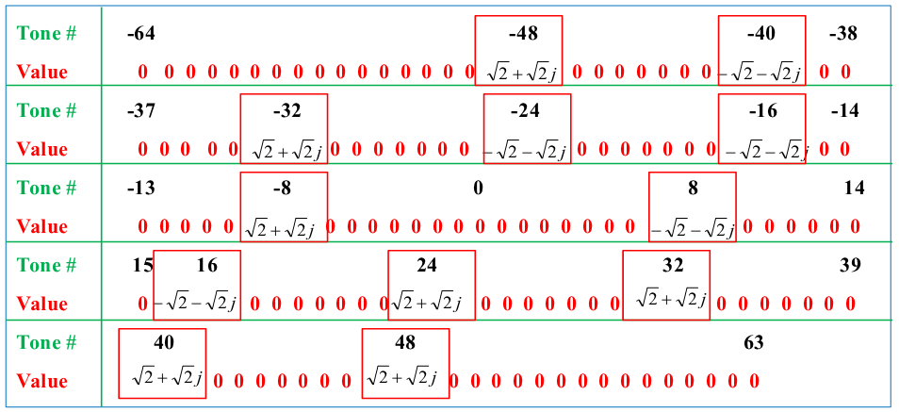
Frequency domain STF of TVWS-OFDM PHY
Frequency domain STF

Slide 4
Frequency domain LTF of TVWS-OFDM PHY
Frequency domain LTF
Tone #: -64 -33 Value : 0 0 0 0 0 0 0 0 0 0 1 1 -1 1 -1 1 1 1 1 1 -1 -1 -1 1 1 -1 1 -1 1 1 1 1
Tone #: -32 -1 Value: 1 1 -1 -1 1 1 -1 1 -1 1 -1 -1 -1 -1 -1 1 1 -1 -1 1 -1 1 -1 1 1 1 -1 -1 -1 -1 1 -1
Tone #: 0 31 Value: 0 -1 -1 1 1 -1 1 1 -1 -1 1 1 -1 1 -1 -1 1 1 1 1 1 -1 -1 1 1 -1 1 -1 1 1 1 -1
Tone #: 32 63 Value: 1 1 -1 -1 1 1 -1 1 -1 1 -1 -1 -1 -1 -1 1 1 -1 -1 1 -1 1 -1 0 0 0 0 0 0 0 0 0
Slide 4

Slide 5
Waveform of TVWS-OFDM packet at baseband
Number of OFDM Symbols:
- OFDM symbol is composed of 160
samples
- STF: 1 – 4, 2 in this figure and
STF power boosting of 2 is
assumed
- LTF: 2
- PLCP header: 1
- Payload: Variable
Slide 5

Slide 6
Time-domain Characteristic of preamble
The result of correlation between preamble and STF
- Twenty STF repetitions are detected.
Slide 6

Slide 7
Frequency-domain Characteristic of preamble
The result of correlation between preamble and LTF
- CP and two LTF sequences are detected.
Slide 7

Slide 8
Conclusion
Proposed STF and LTF are suitable for synchronization algorithms.
  Packet detection algorithm using time-domain correlation characteristic of STF
  LTF detection algorithm using frequency-domain correlation characteristic of LTF
Slide 8

