Slide 1
doc.: IEEE 15-12-0636-00-0led
Project: IEEE P802.15 Working Group for Wireless Personal Area Networks (WPANs)
Submission Title: [Technical Issues of Active LED-ID system]
Date Submitted: [November, 2012]
Source: [Yeong Min Jang, Ratan Kumar Mondal, and Tuan Nguyen]
[Kookmin University]
Address [Kookmin University, Seoul, Korea]
Voice:[82-2-910-5068], FAX: [82-2-910-5068], E-Mail:[yjang@kookmin.ac.kr]
Re: []
Abstract: [Technical Issues of Active LED-ID system]
Purpose: [Contribution to IEEE 802.15 IG-LED]
Notice: This document has been prepared to assist the IEEE P802.15. It is offered as a basis for discussion and is not binding on the contributing individual(s) or organization(s). The material in this document is subject to change in form and content after further study. The contributor(s) reserve(s) the right to add, amend or withdraw material contained herein.
Release: The contributor acknowledges and accepts that this contribution becomes the property of IEEE and may be made publicly available by P802.15.
Notes:
doc.: IEEE 802.15-09-0117-00-0007
<month year>

Slide 2
Contents
doc.: IEEE 15-12-0636-00-0led
Key issues of Active LED-ID system
Overview of Active LED-ID system
Technologies of Active LED-ID system
Required MAC & PHY functionalities for Active LED-ID
Conclusions

Slide 3
Key issues of Active LED-ID system
doc.: IEEE 15-12-0636-00-0led
Supportable network topologies
Channel access mechanism
Transmission reliability
Dimming and visibility support
Color function support
Security
Mobility support
High data rate
User location determination
Unique ID concept deployment

Slide 4
doc.: IEEE 15-12-0636-00-0led
Overview of Active LED-ID system
Light Emitting Diode Identification (LED-ID) is a technology that uses communication via visible light to exchange information among Tag(or Reader) to one or more identified Readers (or Tags)
Active LED-ID system:
Unique identification
Visibility support
Active reader & tag: Not derived from external light signal
Self powered and activated device.

Slide 5
doc.: IEEE 15-12-0636-00-0led
Technologies of Active LED-ID system
Amendment of IEEE 802.15.7 WPAN(IEEE802.7a)
Network architecture
Link switching
Resource management: TDMA based slot allocation
LBS supported applications

Slide 6
doc.: IEEE 15-12-0636-00-0led
Comparison of ID technologies
 | RFID | LED-ID
Signal Format (Transmission medium) | RF | LED light (Visible Light Infra-red Light/ Ultra Violet Light etc)
Reliability | Flawless read rate | Flawless read rate
Readable through objects | Yes | Depend on FOV
Orientation dependence | No | Yes
Read speed | Variable Speed | Variable Speed
Multiple tags | Yes (10-1000 tags per second) | Yes
Updateable (programmable) | Yes | Yes
Data type | Non real-time | Non real-time and real-time
Tag and reader position | No need to bring the tag near the reader | Need to bring within the FOV
Transmission data type | text | Text & Multimedia
Duplex | Full | Full
Existing Home network Infrastructure (Light etc.) | No, New setup | Yes ( LED light)

Slide 7
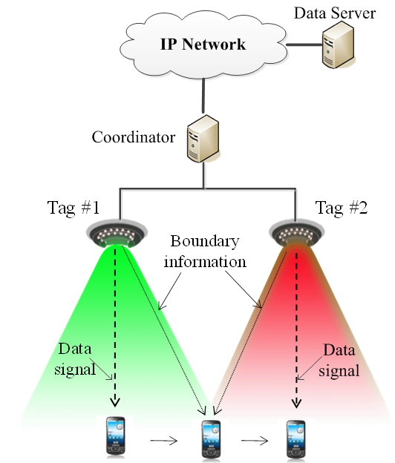
doc.: IEEE 15-12-0636-00-0led
Link switching
Link switching:
Guaranteeing seamless connectivity in the system
Improving quality of service (QoS) in boundary areas of tags
Problems:
Link switching delay
Data packet loss

Slide 8
doc.: IEEE 15-12-0636-00-0led
Localization for LBS applications
Some of indoor positioning techniques:
Received Signal Strength Indication (RSSI)
Time Different of Arrival (TDOA)
Time of Arrival (TOA)
Angle of Arrival (AOA)
Multipath pattern
RSSI is the simplest technique for implementation
Advantage of LED localization
Higher resolutions (cm level )
Problems of LED localization:
Narrow coverage
Short distance

Slide 9
doc.: IEEE 15-12-0636-00-0led
MAC functionalities for Active LED-ID
For deployment of active LED-ID system the MAC sub layer should be responsible for the following tasks:
Generating network beacons if the device is a coordinator
Synchronizing to network beacons
Supporting VPAN association and disassociation
Supporting color function
Supporting visibility
Supporting dimming
Flicker removal scheme
Supporting visual indication of device status and channel quality
Supporting device security
Providing a reliable link between two peer MAC entities
Supporting mobility

Slide 10
doc.: IEEE 15-12-0636-00-0led
PHY functionalities for Active LED-ID
For deployment of active LED-ID system the PHY sub layer should be responsible for the following tasks:
Activation and deactivation of the VLC transceiver
Channel selection
Data transmission and reception
WQI for received frames
Error correction
Synchronization

Slide 11
November 2012
doc.: IEEE 15-12-0636-00-0led
Conclusions
Some technical issues for active LED-ID system
Active LED-ID system: amendment of IEEE 802.15.7 WPAN visible light communication (Expecting IEEE802.15.7a)
The required technologies should be developed for standardizing the active LED-ID system
A call for contribution in next meeting
Slide 11
Yeong Min Jang, Kookmin University

