Slide 1
Project: IEEE P802.15 Working Group for Wireless Personal Area Networks (WPANs)
Submission Title: FSK and PPM PHY proposal for SG4q
Date Submitted: Nov 12, 2012
Source: Guido Dolmans¹, Maarten Lont¹, Peng Zhang², Li Huang¹, F. Willems²;
¹Holst Centre / Imec-NL, ²TU/e Eindhoven University of Technology
High Tech Campus 31, P.O. Box 8550, 5605 KN Eindhoven, the Netherlands
Phone: +31404020436, Fax: +31404020699
E-Mail: guido.dolmans@imec-nl.nl
Abstract: PHY proposal based on FSK and PPM modulation for SG4q
Purpose: Proposing low power modulations for easy implementation and lower power operation
Notice: This document has been prepared to assist the IEEE P802.15. It is offered as a basis for discussion and is not binding on the contributing individual(s) or organization(s). The material in this document is subject to change in form and content after further study. The contributor(s) reserve(s) the right to add, amend or withdraw material contained herein.
Release: The contributor acknowledges and accepts that this contribution becomes the property of IEEE and may be made publicly available by P802.15.
G. Dolmans, M. Lont , P. Zhang, L. Huang, F. Willems; Holst Centre / Imec-NL, TU/e

Slide 2
PPM and FSK proposals for ULP operation
This proposal is based on IC design experience on a multi-standard BT-LE (FSK), 15.4 (OQPSK), and 15.6 (DxPSK) transceiver (ISSCC 2012, ISSCC 2013). Current consumption is 3.2 mA @ 1.2 V with I/Q sliding IF dual conversion Rx.
Further current consumption decrease can be made when avoiding non constant envelope modulations (e.g. 15.6)
Such an ULP architecture can be single branch sigma-delta techniques (‘all-digital’) for constant envelope modulation
Simple and low cost constant-envelope modulation can be FSK (preferable wideband FSK)
If SG4q for some reason chooses for non-constant envelope modulation, pulse-position modulation (PPM) is the best choice.
G. Dolmans, M. Lont , P. Zhang, L. Huang, F. Willems; Holst Centre / Imec-NL, TU/e

Slide 3
Non-constant envelope: PPM proposal as ULP modulation scheme
Non-constant ULP simple modulation schemes: examples are OOK, ASK, PPM.
PPM detection schemes compares the energy in different positions and choose the symbol that corresponds to the peak energy.
Advantage of PPM over OOK is avoiding a detector threshold. Implementation loss due to incorrect setting of threshold is a disadvantage of OOK.
Another advantage of PPM is that for the same data rate, compared to OOK with direct-sequence spread spectrum (DSSS) PPM requires less number of pulses for transmission. For the same transmission power, more energy could be allocated to one pulse in PPM and results in better receiver symbol error performance.
G. Dolmans, M. Lont , P. Zhang, L. Huang, F. Willems; Holst Centre / Imec-NL, TU/e

Slide 4
Non-constant envelope: PPM proposal as ULP modulation scheme
Pulse-position modulation (PPM):k message bits encoded into one of 2^{k} possible positions. OOK is special case of PPM (k=1).
Multiple pulse-position modulation: extension where multiple pulses are allowed to be transmitted in these possible positions.
G. Dolmans, M. Lont , P. Zhang, L. Huang, F. Willems; Holst Centre / Imec-NL, TU/e

Slide 5
Low power modulation
PPM
P
P
Send pulses only in one of the chips
P
P
MPPM
P1
P2
Send pulses in several chips
P1
P2
P1
P2
P2
P1
G. Dolmans, M. Lont , P. Zhang, L. Huang, F. Willems; Holst Centre / Imec-NL, TU/e

Slide 6
BER analysis 1/2
Study showed that MPMM was not an optimal choice. Therefore, focus changed towards optimizing PPM parameters.
G. Dolmans, M. Lont , P. Zhang, L. Huang, F. Willems; Holst Centre / Imec-NL, TU/e

Slide 7
BER analysis 2/2
RS coded PPM has better performance than uncoded PPM in AWGN channel. RS(63,51) with PPM k=6 has a performance close to the Shannon limit
G. Dolmans, M. Lont , P. Zhang, L. Huang, F. Willems; Holst Centre / Imec-NL, TU/e
Notes:
Model the receiver with Gaussian background noise

Slide 8
Constant envelope: FSK proposal as ULP modulation scheme
Simple / low power architecture
Can be designed for 3.2mA (ISSCC 2013).
Power consumption can be further decreased by
  Moving from conventional I/Q architectures to all-digital sigma-delta type of architectures. Only possible for constant-envelope modulation.
  Increasing the modulation index of FSK. This would relax the specifications of the oscillator phase noise.
Challenges
    LO feed-through
    Low frequency noise
G. Dolmans, M. Lont , P. Zhang, L. Huang, F. Willems; Holst Centre / Imec-NL, TU/e
Notes:
Envelope detection -> + Low power
- Bad selectivity
- Bad linearity

Slide 9
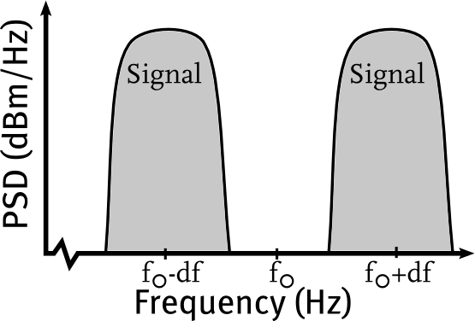
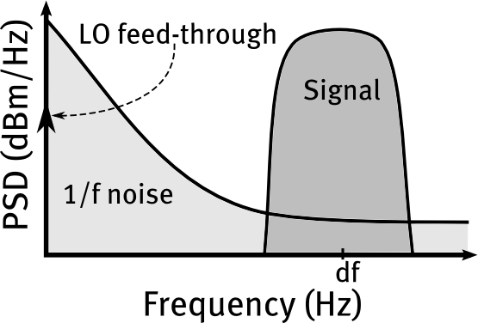
Wideband FSK
“0”
“1”
For details: 263-4n document
Wideband: df >> R_{b} (bit rate)
Signal mostly around f₀±df
Signal at df not round DC
    Can be used to filter 1/f noise
    Remove LO feed-through
    Will relax the phase noise specs
Down-conversion
G. Dolmans, M. Lont , P. Zhang, L. Huang, F. Willems; Holst Centre / Imec-NL, TU/e
Notes:
Df: Frequency offset

Slide 10
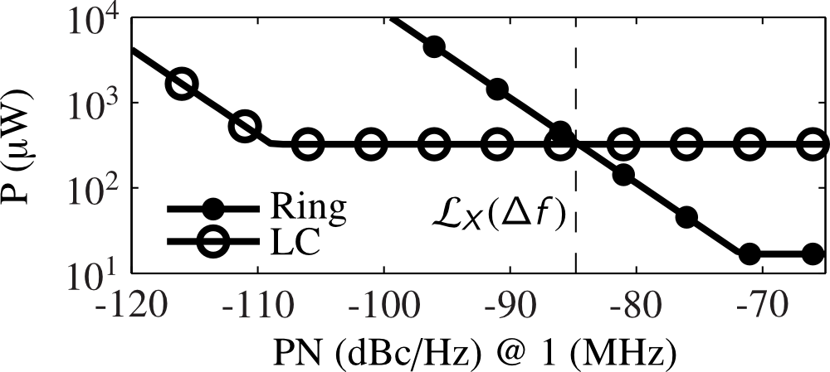
Trade-off of power consumption of LC and ring oscillators
Higher Phase Noise – Less Power. Ring oscillator becomes an ULP candidate.
Technology will determine actual power consumption
G. Dolmans, M. Lont , P. Zhang, L. Huang, F. Willems; Holst Centre / Imec-NL, TU/e

Slide 11
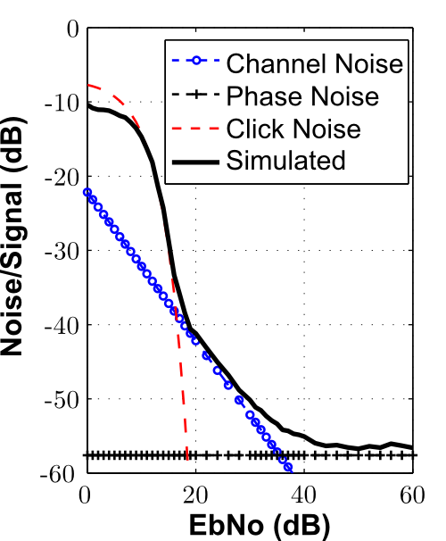
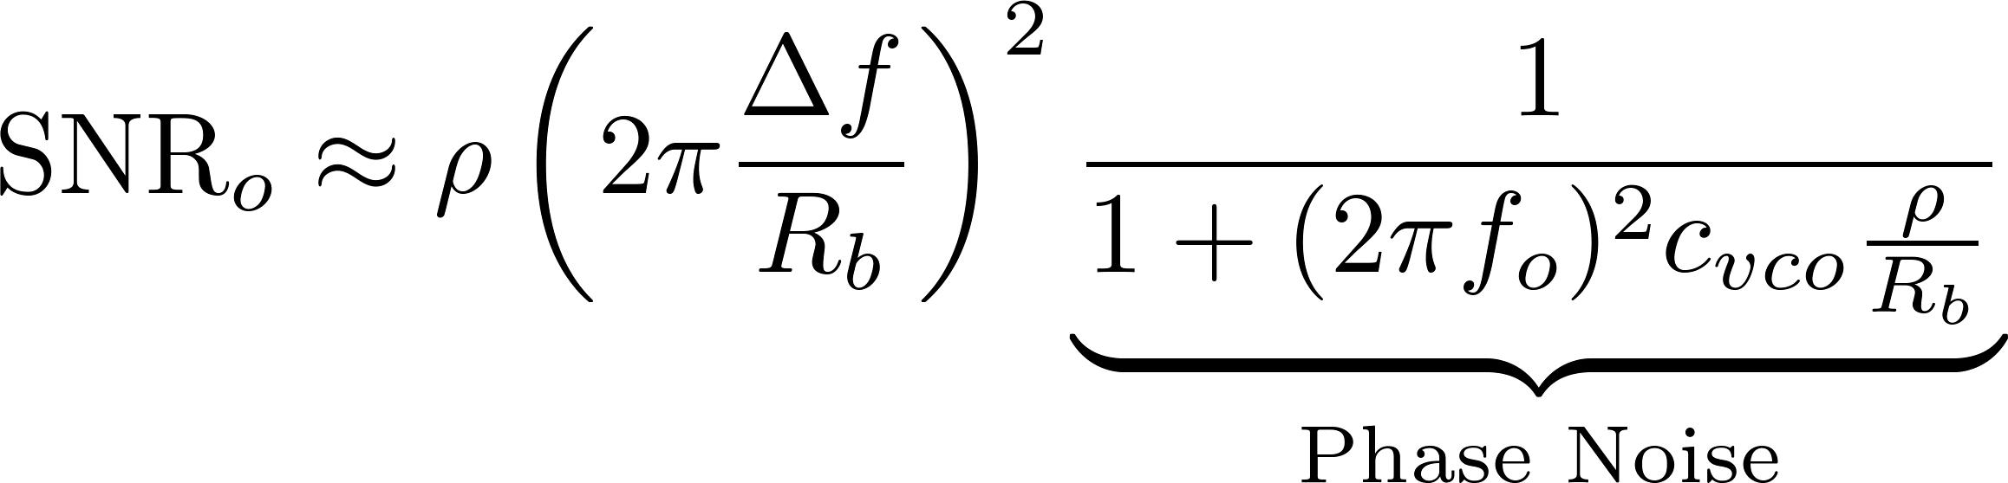
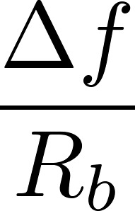
Wideband FSK and Phase Noise
SNR out (CNR in = ρ)
Increase modulation index ( ):
    More bandwidth
    More resilient to Phase Noise
    (lowering bit-error floor)
G. Dolmans, M. Lont , P. Zhang, L. Huang, F. Willems; Holst Centre / Imec-NL, TU/e

Slide 12

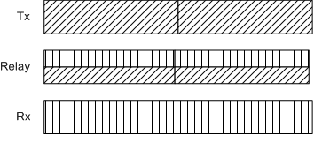
Single hop capabilities of PPM: Capacity Study of Relay Communication
Capacity study of relay scenarios
  Gaussian relay channel and PPM modulations are considered
  Decode-and-forward strategy at relay is considered
Status
  Best scenario for best performance is a full duplex relay; can also be added to network without disruption (source needs not be informed)
Work is not complete (ongoing)
Source (X1)
Relay (Y2: X2)
Destination(Y3=Y)
Scenario, full duplex relay
  Relay transmit and receive simultaneously
G. Dolmans, M. Lont , P. Zhang, L. Huang, F. Willems; Holst Centre / Imec-NL, TU/e

Slide 13
Capacity Study of Relay Communication
Objective
  Investigate capacity behavior of a relay channel based on PMM with half-duplex or full-duplex relay node.
Achievable-rate study in non-coherent channel
  Full-duplex schemes achieve higher rates which result in better energy efficiency.
  Full-duplex scheme with cooperation is superior to the one without cooperation.
BER evaluation based on PPM
  Focusing on a BER level of 10⁻⁴, about 3 to 4 dB can be saved by using duplex schemes.
  About extra 0.7dB can be gained by using the cooperative full-duplex scheme.
G. Dolmans, M. Lont , P. Zhang, L. Huang, F. Willems; Holst Centre / Imec-NL, TU/e

Slide 14
Conclusion
PHY proposal for non-constant envelope (PPM) and constant envelope (FSK). These two modulation formats have ULP advantages.
Preferred 1st choice would be constant envelope FSK (preferable wideband FSK); current state-of-the art ULP BT-LE/15.6/15.4 consumes 3.2 mA Rx peak current; could be reduced to below 2mA when constant envelope modulation is chosen (all digital sigma-delta type of receivers and/or wideband modulation index).
2nd choice based on non-constant envelope would be RS encoded PPM.
PPM can be utilized to efficiently relay packets (using the time-nature of the PPM symbol structure).
G. Dolmans, M. Lont , P. Zhang, L. Huang, F. Willems; Holst Centre / Imec-NL, TU/e

