Slide 1
Project: IEEE P802.15 Working Group for Wireless Personal Area Networks (WPANs)
Submission Title: TG4m OFDM PHY Updates for TBDs
Date Submitted: November 11, 2012
Source: Soo-Young Chang (SYCA) and Cheol-ho Shin (ETRI)
Voice: +1 530 574 2741, E-mail: sychang@ecs.csus.edu
Re: [802.15 TG4m]
Abstract: Merged TG4m OFDM PHY was submitted in September 2012. This document is to provide updates for TBDs in this merged PHY document.
Purpose: To update the 802.15 TG4m group regarding merged TG4m OFDM PHY
Notice: This document has been prepared to assist the IEEE P802.15. It is offered as a basis for discussion and is not binding on the contributing individual(s) or organization(s). The material in this document is subject to change in form and content after further study. The contributor(s) reserve(s) the right to add, amend or withdraw material contained herein.
Release: The contributor acknowledges and accepts that this contribution becomes the property of IEEE and may be made publicly available by P802.15.

Slide 2
TG4m OFDM PHY Updates for TBDs
Soo-Young Chang and Cheol-ho Shin

Slide 3
TBDs IN MERGED OFDM PHY
20.2.1.1.4 STF power boosting → put numbers to TBDs
“Power boosting shall be applied to the STF OFDM symbols in order to aid preamble detection, The boost should be a multiplication by TBD, which is approximately TBD dB.”
Refer to doc. 15-12-0620-00.
This document provides a solution.
* 15-12-0575-00-004m-preliminary-draft-for-tg4m

Slide 4
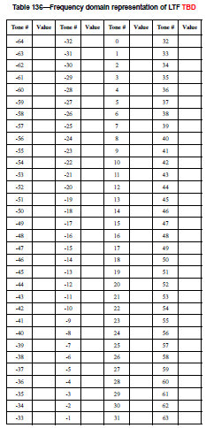
TBDs IN MERGED OFDM PHY
20.2.1.2.1 Frequency domain LTF → put numbers to Table 136
“Table 136 shows the frequency domain representation of the LTF.”
Refer to doc. 15-12-0620-00.
This document provides a solution.
* 15-12-0575-00-004m-preliminary-draft-for-tg4m

Slide 5
SUMMARY
TG4m OFDM PHY in the TG4m preliminary draft (doc. 15-12-0575-00-004m-preliminary-draft-for-tg4m) has two TBDs.
Doc. 15-12-0620-00 provides solutions for these two TBDs.
* 15-12-0575-00-004m-preliminary-draft-for-tg4m

