Slide 1
Project: IEEE P802.15 Working Group for Wireless Personal Area Networks (WPANs)
Submission Title: 917 MHz license exempt band in Korea
Date Submitted: 12 November 2012
Source: Tae-Joon Park, Juderk Park, Wun-Cheol Jeong, Chang-Sub Shin, Hoyong Kang
Company: ETRI
Address: 161 Gajeong-dong, Yuseong-gu, Daejeon, KOREA
Voice: +82-42-860-6902, FAX: +82-42-860-4197, E-Mail: tjpark@etri.re.kr
Re:
Notice: This document has been prepared to assist the IEEE P802.15. It is offered as a basis for discussion and is not binding on the contributing individual(s) or organization(s). The material in this document is subject to change in form and content after further study. The contributor(s) reserve(s) the right to add, amend or withdraw material contained herein.
Release: The contributor acknowledges and accepts that this contribution becomes the property of IEEE and may be made publicly available by P802.15.

Slide 2
917 MHz License Exempt Band in Korea
Tae-Joon Park,
Wun-Cheol Jeong, Chang-Sub Shin,
Juderk Park, Hoyong Kang
ETRI

Slide 3
Unlicensed band for RFID/USN
Frequency band : 917 MHz ~ 923.5 MHz
  Assigned for RFID and Wireless Sensor Network applications since 2008.
  Unit channel bandwidth for RFID: 200KHz
    Total number of RFID channels: 32
    Fn = 917.1 + (n-1) x 0.2MHz , RFID channel number n=1,2,~32
Frequency tolerance : within ±40x10⁻⁶
Permitted output power :
  10mW for 20 channels ( n= 2,5,8,11,14,17,19,20,21,…,32 )
  3mW for 12 channels ( n= 1,3,4,6,7,9,10,12,13,15,16,18 )

Slide 4
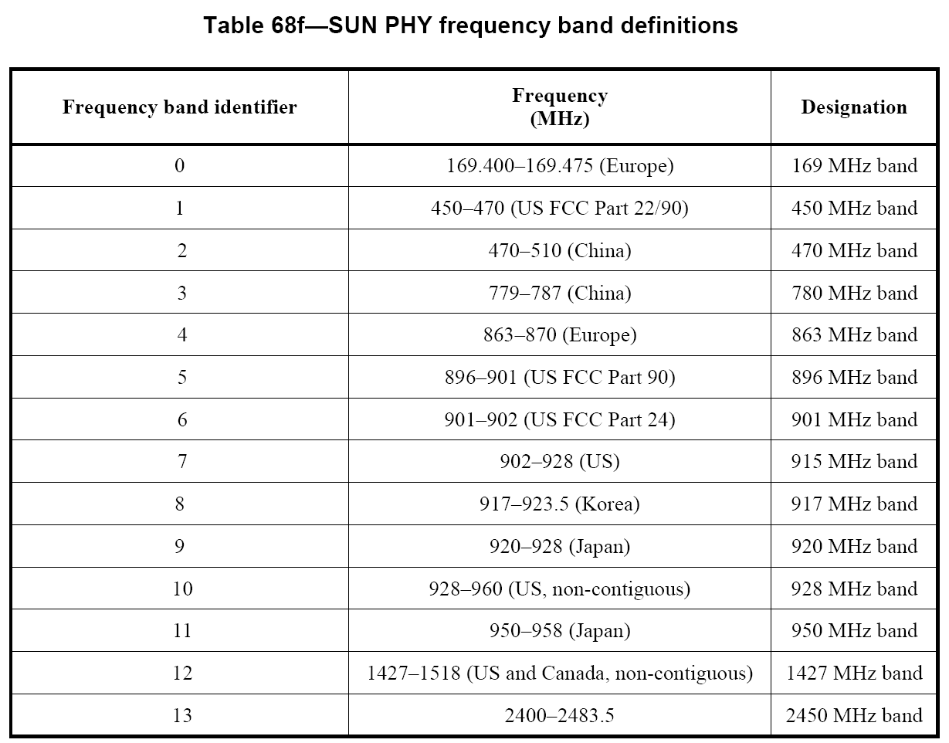
IEEE Std 802.15.4g™-2012

Slide 5
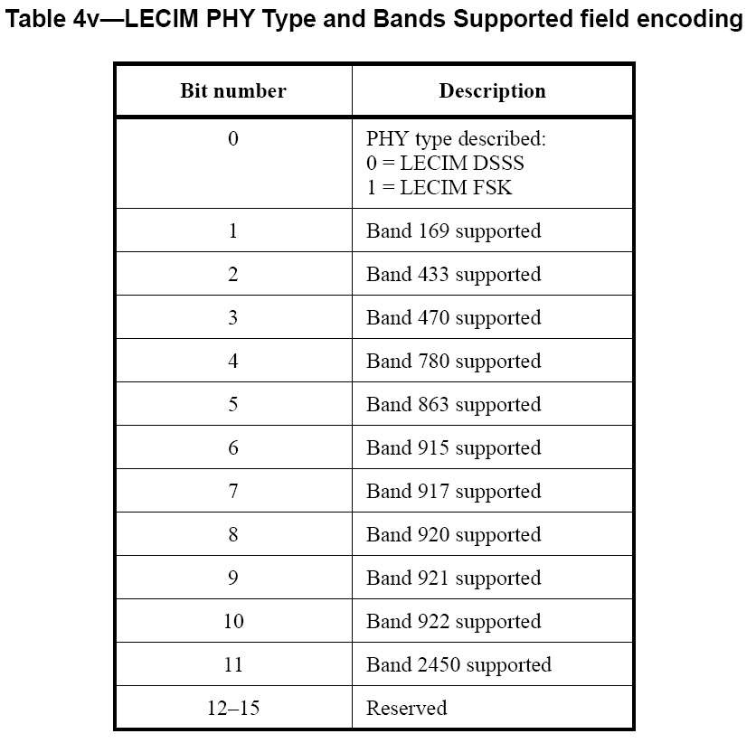
IEEE P802.15.4k/D2, 2012

Slide 6
Thank you very much for your attention.
Any Questions?

