Slide 1
Project: IEEE P802.15 Working Group for Wireless Personal Area Networks (WPANs)
Submission Title: FSK PHY proposal for IEEE802.15.4n
Date Submitted: Nov 12, 2012
Source: Guido Dolmans, Maarten Lont; Holst Centre / Imec-NL
High Tech Campus 31, P.O. Box 8550, 5605 KN Eindhoven, the Netherlands
Phone: +31404020436, Fax: +31404020699
E-Mail: guido.dolmans@imec-nl.nl
Abstract: FSK benefits for TG4n (Chinese MBAN) Task Group
Purpose: Proposing FSK mode for easy implementation and lower power operation
Notice: This document has been prepared to assist the IEEE P802.15. It is offered as a basis for discussion and is not binding on the contributing individual(s) or organization(s). The material in this document is subject to change in form and content after further study. The contributor(s) reserve(s) the right to add, amend or withdraw material contained herein.
Release: The contributor acknowledges and accepts that this contribution becomes the property of IEEE and may be made publicly available by P802.15.
G. Dolmans, M. Lont ; Holst Centre / Imec-NL

Slide 2
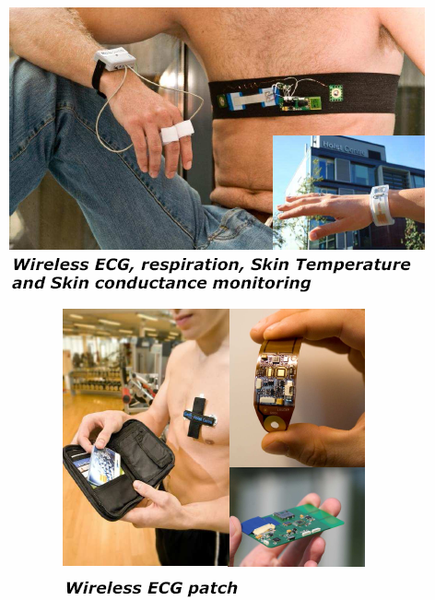
Body Vital Signs Monitoring Systems
Notes:
Simulate sleeping. From lager-> small EEG
ECG: finger pulse oximeter (hand)
Flexiable PCB, attech on body

Slide 3
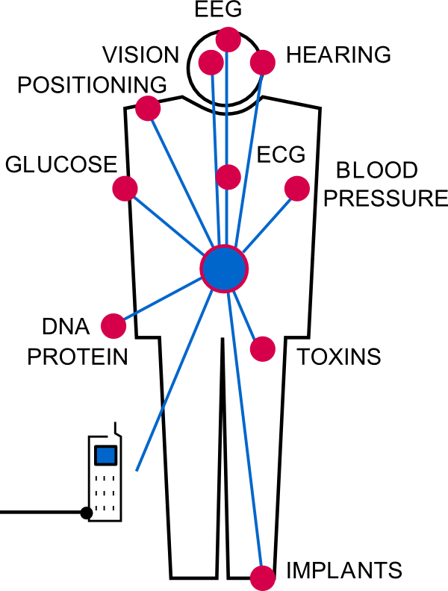
Wireless Body Area Networks
Short distance < 5m
Asymmetric network
  Master node: high power, synchronization
  Sensor node: low power, less processing
    Receiver: relaxed specifications by
    simple modulation: enabling low-power operation
    Proposing low data-rate PHY mode: e.g. 50 kbps

Slide 4
When to activate medical sensors on body
Sensor node in deep sleep to save energy
  Sensor node knows when to transmit -> transmitter only on when needed
Only needs to be synchronized before transmission
Receiver listens for master control signal
Sensor node needs to be very low power
Sensor listening can be duty cycled for further lowering power consumption

Slide 5
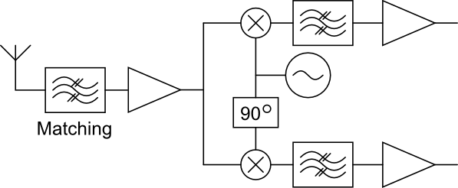
Example of Zero-IF RX architecture
Simple / low power architecture
Power consumption
    Can be reduced by designing for relaxed specifications of oscillator phase noise : ring oscillator
Challenges
    LO feed-through
    Low frequency noise
LO feed-through
Notes:
Envelope detection -> + Low power
- Bad selectivity
- Bad linearity

Slide 6
Low Power Oscillator
Phase noise is an important design constraint
Leeson:
Decrease power- increase phase noise
Different oscillator types
  LC oscillator
  Ring oscillator

Slide 7
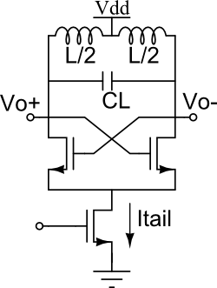
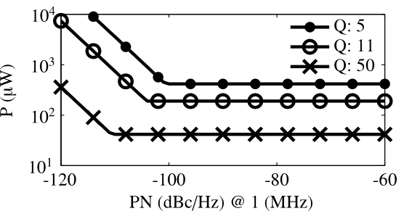
Low Power Oscillator - LC
Tuned tank
Power needed to compensate tank losses
Power limited by maximal Q (loss) & L

Slide 8
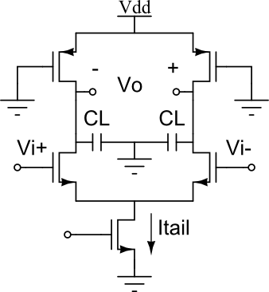
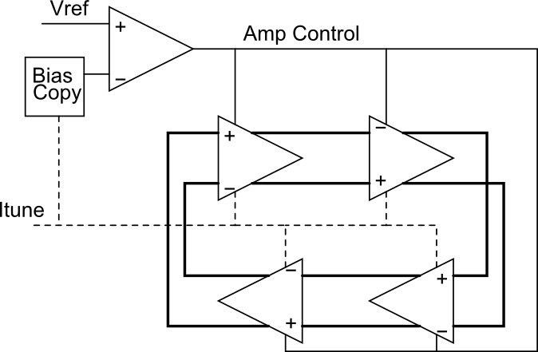
Low Power Oscillator - Ring
Series (ring) of amplifiers, gain ~ RL
Frequency sensitive to Vdd, Temp, …
Power limited by maximal RL / minimal CL
RL

Slide 9
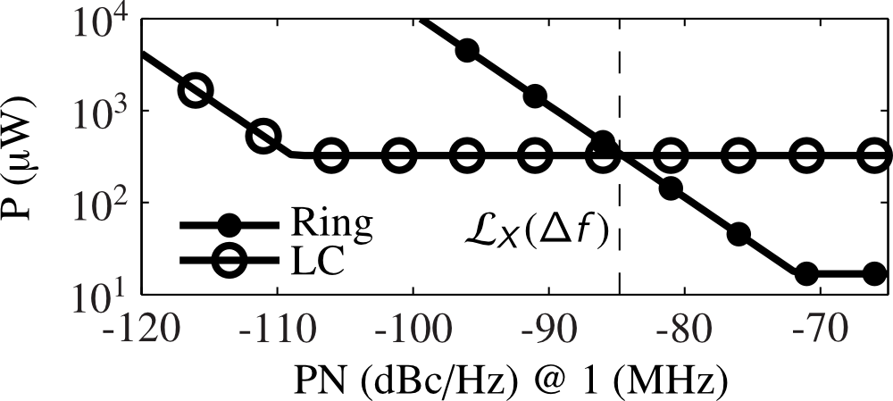
Low Power Oscillator
Max Q=11, L=20nH, Cmin=3fF
Higher Phase Noise – Less Power
Technology limits power

Slide 10
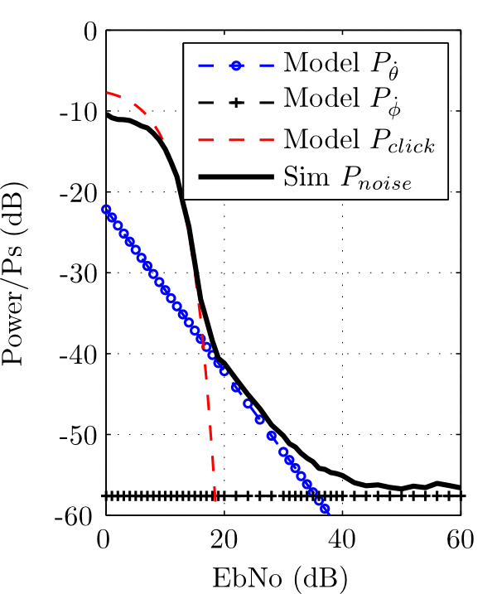
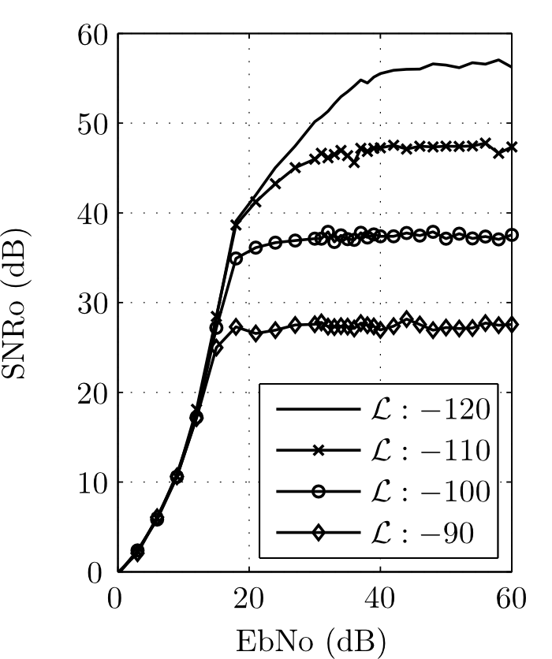
Effects of Phase Noise on FSK

Slide 11
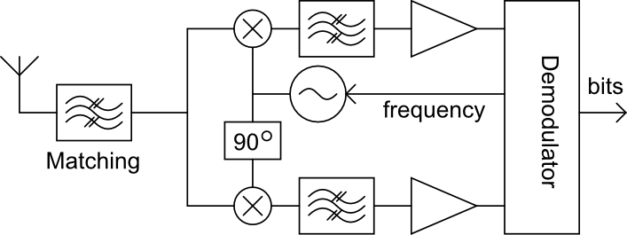
Frequency instability
Frequency of ring oscillator is sensitive
  Supply voltage
  Temperature
Frequency offset at output of demodulator
Use frequency feedback

Slide 12
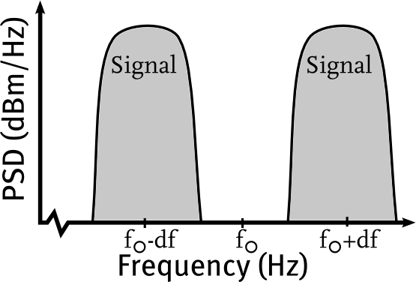
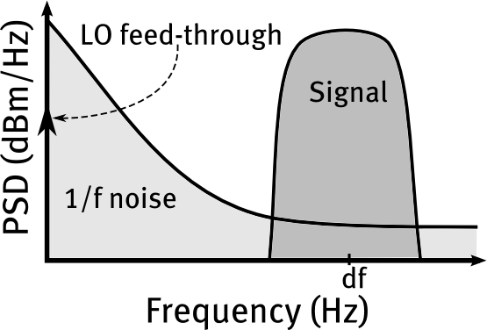
Wideband FSK
“0”
“1”
Wideband: df >> R_{b} (bit rate)
Signal mostly around f₀±df
Signal at df not round DC
    Filter low frequency noise
    Remove LO feed-through
Down-conversion
Notes:
Df: Frequency offset

Slide 13
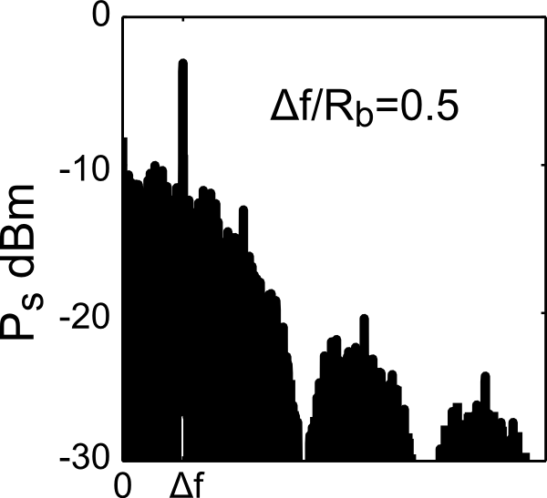
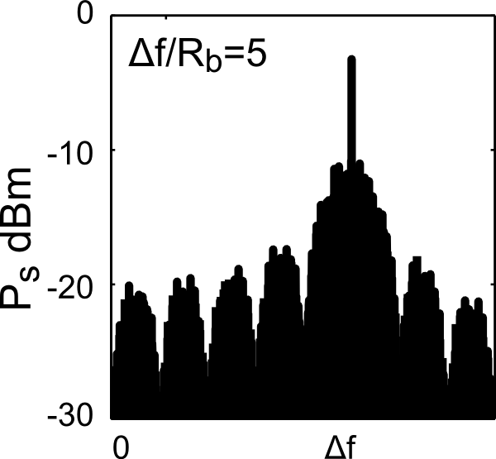
Wideband FSK
Increase modulation index (∆f/Rb)
  Signal concentrates round ∆f
  Use band-pass filter to filter 1/f noise and DC offsets
  Reduces phase noise sensitivity

Slide 14
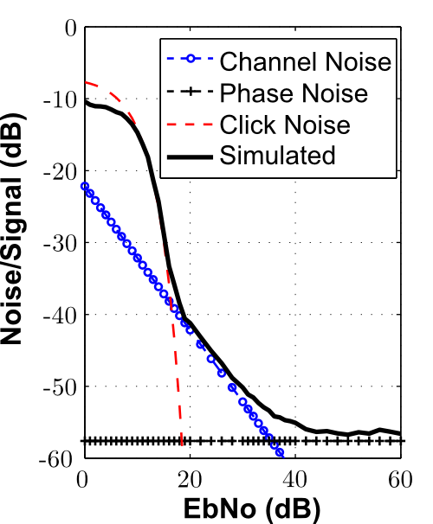
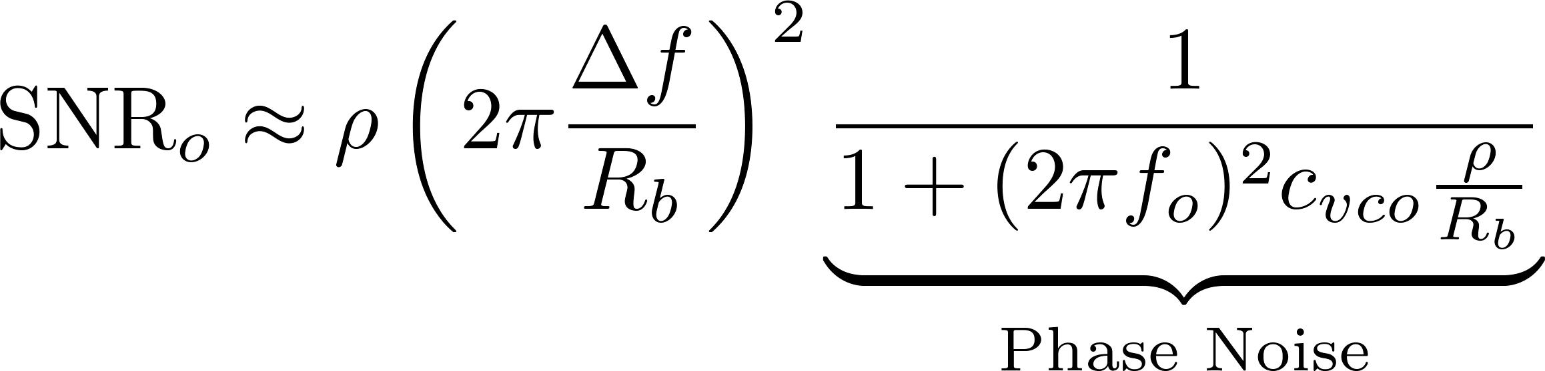
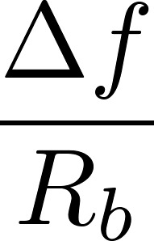
Wideband FSK and Phase Noise
SNR out (CNR in = ρ)
Increase modulation index ( ):
    More bandwidth
    More resilient to Phase Noise

Slide 15
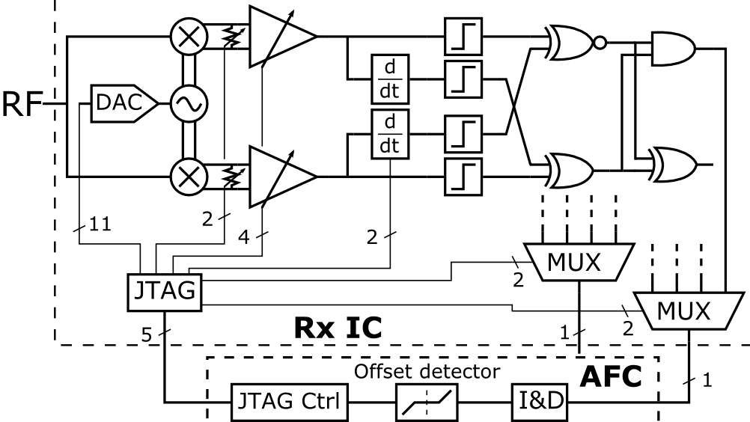
Example of wideband FSK Rx system (ESSCIRC 2012)

Slide 16
Comparison
 | Typical IEEE 802.15.4/ Zigbee | This proposal
Power (uW) | ±30.000 | 250 - 2000
Bit Rate (kbps) | 250 | <50
PN (dBc/Hz @ 1MHz) | < -90 | < - 80
Tuning (MHz) | 900, 2400 | 900, 2400
IIP3 (Linearity) | > -40 dBm | ~ 20 dBm

Slide 17
Conclusion
PHY proposal based on wideband FSK
Wideband FSK lowers the required phase noise specs of the oscillator
Oscillator is a major power consumer. With reduced phase nose specs, the power consumption can be lowered significantly.
Reduced phase noise specs enables the use of ring oscillators
A frequency feedback loop is needed for robustness of the ring oscillator

