Slide 1
Project: IEEE P802.15 Working Group for Wireless Personal Area Networks (WPANs)
Submission Title: Statistical Multi-path Propagation Modeling and Fading Analysis in Terahertz Band Communication Networks
Date Submitted: 12 November, 2012
Source: Chong Han, Josep Miquel Jornet and Ian F. Akyildiz, Georgia Institute of Technology
Address: 777 Atlantic Drive NW, Atlanta, GA 30332, USA
Voice: +1 404 894 6616, Fax:+1 404 894 7883, E-Mail: {chong.han, jmjornet, ian}@ece.gatech.edu
Re:
Abstract: In Terahertz Band, molecular absorption and rough surface scattering exert significant impact on ultra-broadband channels, which make the existing multipath models inaccurate for Terahertz communication. In this work, a statistical multi-path channel is proposed for indoor environment, which captures: (i) the spreading loss and molecular absorption loss in free space propagation, by means of radiative transfer theory, and (ii) multi-path fading loss due to stochastically distributed scatters. The resulting distance-dependent channel behavior requires the development of dynamic distance-adaptive solutions for Terahertz Band communication networks.
Purpose: Statistical Multi-path channel model in Terahertz Band.
Notice: This document has been prepared to assist the IEEE P802.15. It is offered as a basis for discussion and is not binding on the contributing individual(s) or organization(s). The material in this document is subject to change in form and content after further study. The contributor(s) reserve(s) the right to add, amend or withdraw material contained herein.
Release: The contributor acknowledges and accepts that this contribution becomes the property of IEEE and may be made publicly available by P802.15.

Slide 2
Statistical Multi-path Propagation Modeling and Fading Analysis in Terahertz Band Communication Networks
Chong Han, Josep Miquel Jornet and Ian F. Akyildiz
Broadband Wireless Networking Laboratory
School of Electrical and Computer Engineering
Georgia Institute of Technology
http://www.ece.gatech.edu/research/labs/bwn/

Slide 3
Outline
Introduction
Related Work
Free Space Propagation Model
Specular Scattering Model
Statistical Multi-path Channel Model
Conclusions

Slide 4
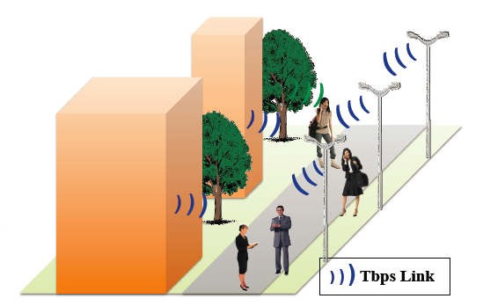
Terahertz Band Communication Applications in the Macroscale (1)
Ultra-high-speed cellular networks
  Terahertz Band communication can be used in future small-cell systems, i.e., as a part of hierarchical cellular networks
Notes:
both in classical networking scenarios, such as increased wireless capacity in small cell scenarios, as well as novel networking paradigms at the nanoscale.

Slide 5
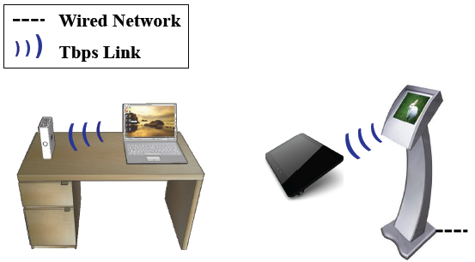
Terahertz Band Communication Applications in the Macroscale (2)
Terabit/second (Tbps) short-range interconnected devices
  Tbps links among devices in close proximity are possible with Terahertz Band communication (e.g., multimedia kiosks).

Slide 6
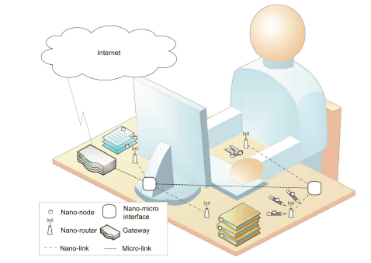
Terahertz Band Communication Applications in the Nanoscale
Nanoscale machine communication and networks
  The state of the art in nanoscale antennas and transceiver design points to the Terahertz Band as the frequency range for nano-machines communication
Notes:
The Internet of Nano-Things (IoNT) in an office

Slide 7
EM Wave Transmission Scheme
Multi-path is present in many scenarios
  both in classical networking scenarios, such as in small cell systems, as well as novel networking paradigms at the nanoscale
High-directivity/gain antennas (e.g., 35 dBi) are advocated
  Combat the channel impairments
  Infeasible for mobile devices
  Impossible for nano-antennas
We need generic multi-path channel model for
  Terahertz Band
Notes:
dB(isotropic) – the forward gain of an antenna compared with the hypothetical isotropic antenna: uniformly distributes energy in all directions

Slide 8
Outline
Introduction
Related Work
Free Space Propagation Model
Specular Scattering Model
Statistical Multi-path Channel Model
Conclusions

Slide 9
Relevant Multi-path Channel Model (1)
Rayleigh and Rician fading models assume that
  There is a large number of statistically independent reflected and scattered path
  Each tap gain is modeled as a circular symmetric Complex Gaussian random variable
  →The magnitude of each channel tap follows a Rayleigh distribution when LOS is absent and a Rician distribution when LOS is dominant
However, these models neglect the high propagation loss and scattering loss of THz Band communication
Notes:
Become invalid when the assumptions of many independent scatters/reflectors is not available

Slide 10
Relevant Multi-path Channel Model (2)
Priebe, S., Jacob, M., Kürner, T., “AoA, AoD and ToA Characteristics of Scattered Multipath Clusters for THz Indoor Channel Modeling”, 17th European Wireless Conference (EW), April 2011
Existing Terahertz multi-path channel models
  Capture the peculiarities of the EM wave transmission in Terahertz Band
  Conduct ray-tracing techniques to measure the channel response at 300 GHz
However, these models are subject to specific experimental settings and focus on the single transmission window (300 GHz) instead of the entire Terahertz Band
Therefore, an analytical multi-path channel model that is adaptive for stochastically varying scenarios and generic for the entire Terahertz Band is demanded

Slide 11
Outline
Introduction
Related Work
Free Space Propagation Model
Specular Scattering Model
Statistical Multi-path Channel Model
Conclusions
Notes:
To develop the multi-path model, we first need to know the free space propagation model in THz Band

Slide 12
Motivation for Free Space Channel Model in Terahertz Band
Due to the very high attenuation created by molecular absorption, current efforts both on:
  device development and
  channel characterization
  are focused on the absorption-defined window at 300 GHz with transmission distance in the order of meters
However, some of the properties of this band in the very short range and higher frequencies need to be better understood and analyzed

Slide 13
Terahertz Band Free Space Channel Model
J. M. Jornet and I. F. Akyildiz, “Channel Modeling and Capacity Analysis of Electromagnetic Wireless Nanonetworks in the Terahertz Band”, IEEE Trans. On Wireless Communications, October 2011
Based on the radiative transfer theory, the free space frequency response consists of
  Spreading loss: accounts for the attenuation due to the expansion of the wave as it propagates in the medium
  Absorption loss: accounts for the attenuation that the propagating wave suffers because of molecular absorption, i.e., the process that the EM wave energy is converted into vibrational kinetic energy in gaseous molecules
Notes:
This LOS model is general for any gaseous medium

Slide 14
Parameter Notations
: spreading loss
: molecular absorption loss
: speed of light
: signal frequency
: transmission distance (Tx-Rx)
: frequency-dependent medium absorption coefficient, dependent on the system pressure in atm, the temperature in Kelvin, the molecular volume density in molecules/m³ and the molecular absorption cross-section m²/molecule
Notes:
where $p$ refers to the system pressure in atm, $p_0$ is the reference pressure ($1$ atm), $T$ is the system temperature in Kelvin, and $T_{\text{STP}}$ is the reference temperature at standard pressure. For the isotopologue $i$ of gas $g$, $Q^{i,g}$ is the molecular volumetric density in molecules$/\text{m}^3$ and $\sigma^{i,g}(f)$ is the absorption cross section in $\text{m}^2/$molecule.

Slide 15
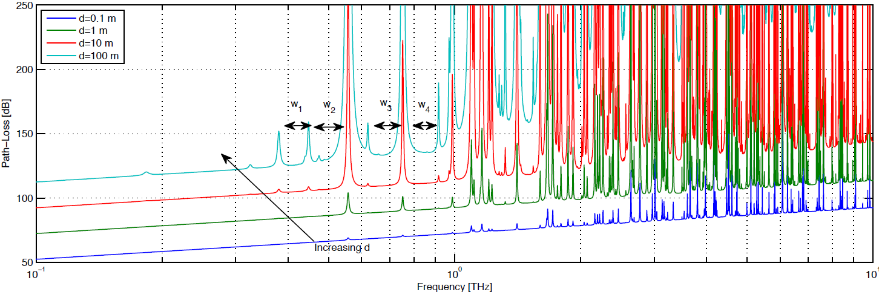
LOS Path-loss in dB
The Terahertz Band communication channel has a strong dependence on:
  Signal frequency
  Transmission distance

Slide 16
Terahertz Band Free Space Channel Properties
In Terahertz Band, free space channel path-loss increases with frequency due to the spreading loss
The path-loss can easily go above 100 dB for transmission distances in the order of just a few meters
The molecular absorption defines several transmission windows (w1, w2, w3, w4), whose position and width depend on the transmission distance
  For longer transmission links, more molecular resonances become significant, and the windows become narrower
  For short range (less than 1m) communication, Terahertz Band offers incredibly huge bandwidth (almost a 10 THz wide window)

Slide 17
Terahertz Band LOS Channel Additional Challenges
Obtain realistic numbers for the achievable transmission rates of different transmission windows
  account for the transmitter and the receiver antenna directivity as well as for the gain and noise factor
Locate the best transmission windows in Terahertz Band in light of information capacity for communication with different transmission distances

Slide 18
Outline
Introduction
Related Work
Free Space Propagation Model
Specular Scattering Model
Statistical Multi-path Channel Model
Conclusions
Notes:
For this work, we appreciate the excellent work done from Prof Kuner’s group. Here we briefly introduce it because we will need them for our multi-path channel model.

Slide 19
Terahertz Band Reflection Challenge
When the LOS is blocked by moving people or obstacles, NLOS scenario is considered
  Introduces the rough surface scattering loss in addition to the free space propagation loss
Origin: wavelength of EM wave in the Terahertz Band is [0.03 mm, 3 mm]
Any surface with roughness comparable to the wavelength
  Scatters the EM wave
  Has to be considered as rough surface

Slide 20
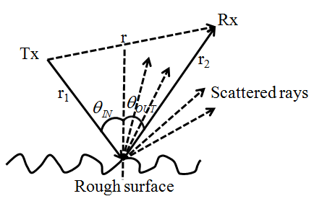
Terahertz band Specular Scattering Model Considerations
Scattered rays have no significant contribution to the received signal
Rays which suffer from multiple consecutive reflections have no significant contribution to the received signal
No cross-polarization occurs in forward scattering directions (including the specular direction)
We consider the specular scattering only ( )
Notations:
r: transmission distance between Tx and Rx
r1: distance between Tx and the scatter
r2: distance between the scatter and Rx
: incident angle of the transmission wave

Slide 21
Reflection Coefficient of Rough Surface
R. Piesiewicz, T. Kurner, “Scattering analysis for the modeling of THz communication systems”, IEEE Transactions on Antennas and Propagation, Nov. 2007
P. Beckmann and A. Spizzichino, “The scattering of electromagnetic waves from rough surfaces," Norwood, MA, Artech House, Inc., 1987
Definition: the received signal amplitude loss with reference to the incident signal at the scattering point
Includes the scattering loss as well as the propagation loss between the scatter and the receiver
The assumptions are
  In practice when the scattering surface area is large
  The specularly reflected signal is contained in a single reflected ray as if there is no scattering occurred due to edge effects
  The effect of the surface roughness is captured in the Rayleigh roughness coefficient

Slide 22
Terahertz Band Specular Scattering Model
According to Kirchhoff theory for rough surface, the reflection coefficient is obtained as the multiplication of the smooth surface reflection coefficient derived from the Fresnel equations with the Rayleigh roughness factor
A: scattering surface area
The complete NLOS channel frequency response is
where
: Reflection coefficient of smooth surface for TE part
: Rayleigh roughness factor

Slide 23
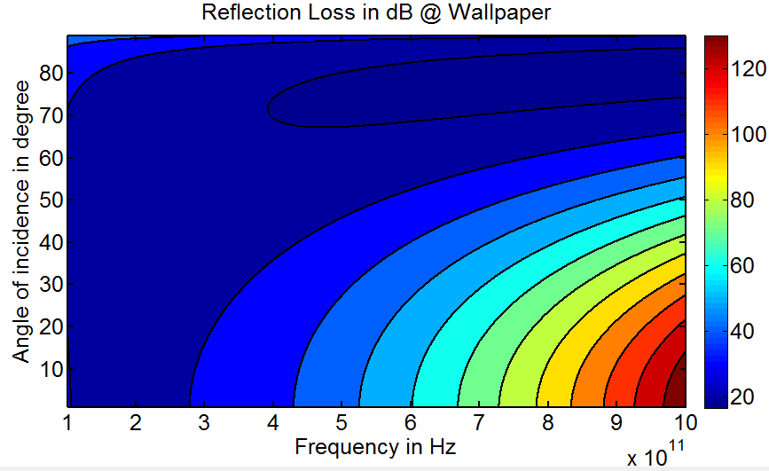
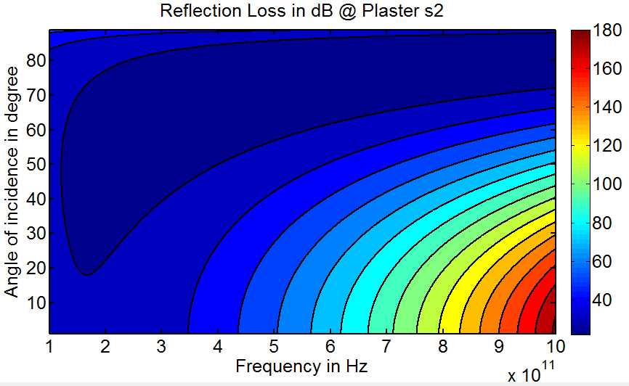
Reflection Coefficient for Different Materials
  Reflection loss is dependent on the material of rough surface and increases when
  Angle of incidence wave decreases
  Frequency increases

Slide 24
Terahertz Band NLOS Channel Additional Challenges
There is a need to determine the reflection coefficients for common materials (e.g., ingrain wallpaper and plaster in indoor environments) for the entire Terahertz Band, in order to obtain realistic values for NLOS path-loss
NLOS communication deployed with directed reflection on dielectric mirrors will be studied as supplementary for the case when LOS is unavailable

Slide 25
Outline
Introduction
Related Work
Free Space Propagation Model
Specular Scattering Model
Statistical Multi-path Channel Model
Conclusions

Slide 26
Statistical Multi-path Channel Model
The multi-path channel frequency response is
Notations:
: the indicator of the LOS
: the number of NLOS Multi-Path Components (MPCs) and an indicator of the density of the scatters and reflectors
: the LOS and i^{th} NLOS propagation delay
: the phase change at the scatter
: i^{th} scatter location

Slide 27
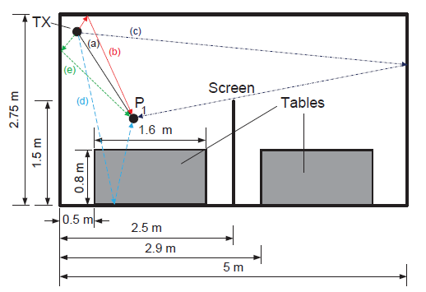
One Static Indoor Scenario
Priebe, S., Jacob, M., Kürner, T., “AoA, AoD and ToA Characteristics of Scattered Multipath Clusters for THz Indoor Channel Modeling”, 17th European Wireless Conference (EW), April 2011
Aim: validate our channel model by verifying in one deterministic setting case
Indoor scenarios with scattering on Plaster s2
  Frequency = 300 GHz
  Tx location: (0.25 m, 2.5 m, 2.3 m)
  Rx location: (1.125 m, 1.375 m, 2.3 m)

Slide 28
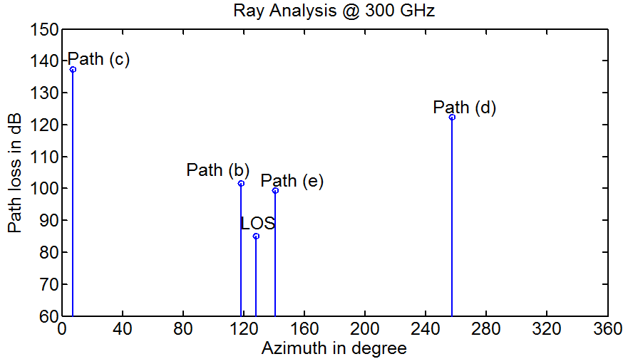
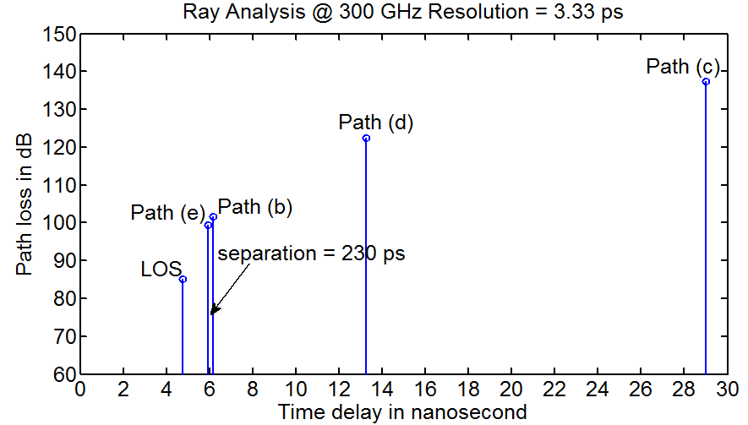
Individual Ray Analysis
LOS ray arrives first and has the smallest path-loss in dB
  Smallest free space propagation loss since it travels the shortest distance
  No scattering loss
Two rays are resolvable only if the difference of their Time-of-Arrival (ToA) is larger than 3.33 ps for 300 GHz EM wave

Slide 29
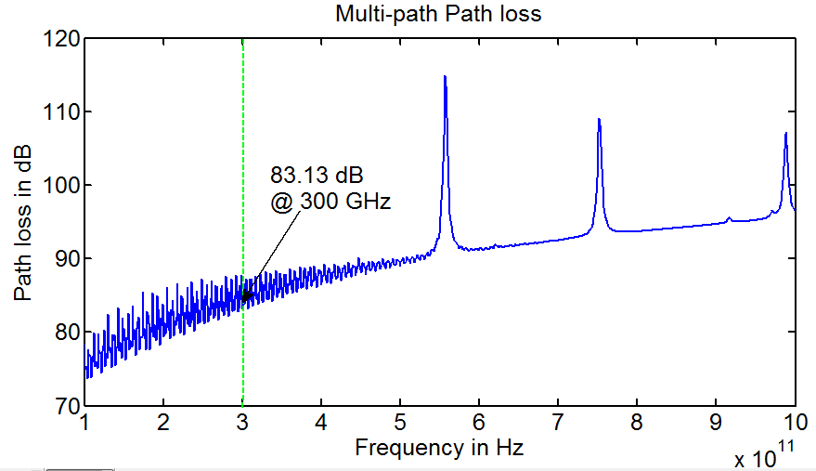
Multi-path Channel Loss Analysis
Fast fading
  Due to constructive and destructive interference of the multiple signal paths
  Characterizes the rapid fluctuations of the received signal strength over short distances or short time duration.
  Path-loss is 83.13 dB at 300 GHz
Simulation results of our model match with those using ray-tracing techniques

Slide 30
Expected Multi-path
Channel Frequency Response
The p.d.f. of the multi-path channel is
The expected channel frequency response can be calculated as

Slide 31
Analytical Form of Expected Channel Frequency Response
Scatter locations follow Uniform distributions
  When r is large
  When r is small

Slide 32
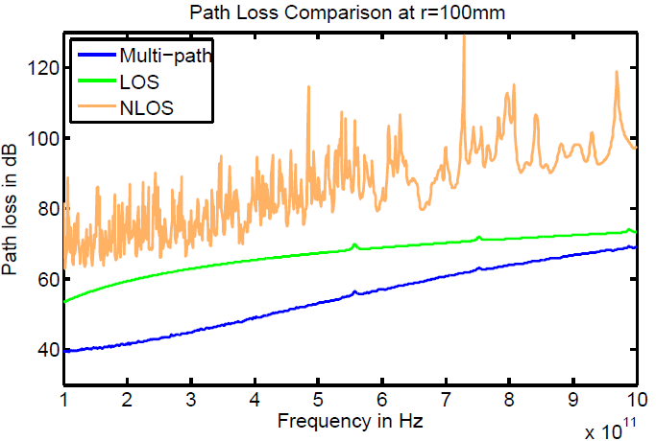
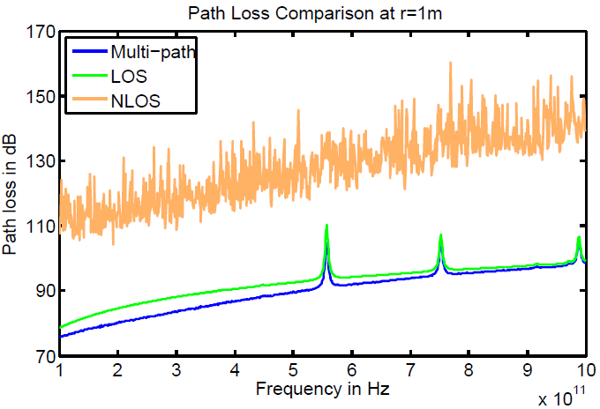
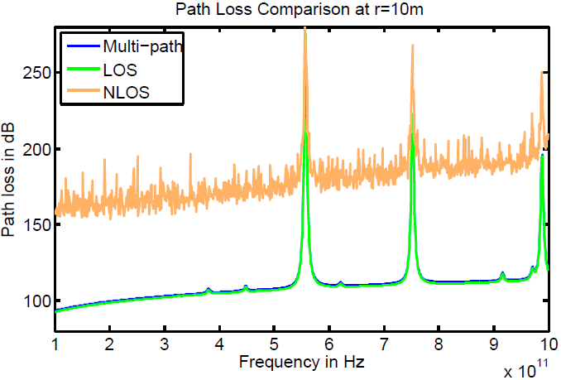
Simulations Results (1)

Slide 33
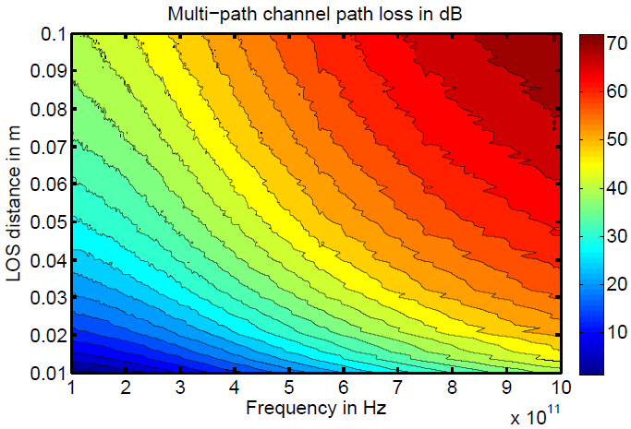
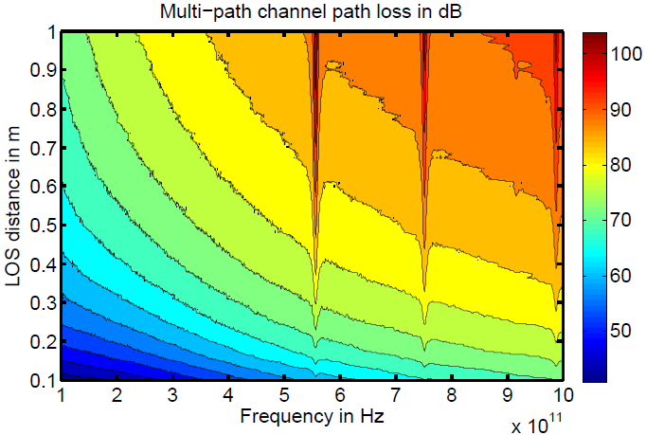
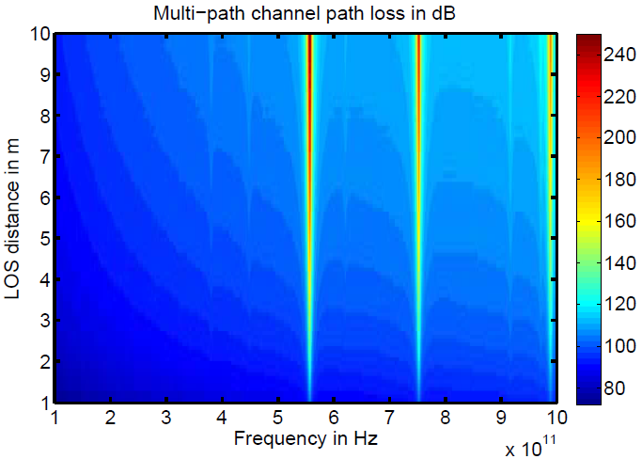
Simulations Results (2)

Slide 34
Terahertz Band Multi-path Channel Properties
The total path-loss of the multi-path channel in the Terahertz Band
  Increases with the transmission distance as well as the system frequency
  Depends on the composition of the transmission medium and the properties of the reflected rough surfaces
For short transmission distances (below one meter)
  Terahertz Band channel behaves as a single transmission window almost 10-THz wide
  Multi-path fading plays an important role
With increasing transmission distance (larger than one meter)
  The impact of scattered rays diminishes
  Molecular absorption limits the Terahertz Band channel to a set of multi-GHz-wide windows

Slide 35
Outline
Introduction
Related Work
Free Space Propagation Model
Specular Scattering Model
Statistical Multi-path Channel Model
Conclusions

Slide 36
Conclusions
The proposed multi-path channel model captures
  Spreading loss and molecular absorption loss in free space propagation, by means of radiative transfer theory
  Reflection loss due to scattering in rough surfaces, by means of Kirchhoff theory
  Multi-path fading loss due to stochastically distributed scatters
The model is adaptive for stochastically varying scenarios and generic for the entire Terahertz Band (0.1 – 10 THz)
  The simulation is conducted over (0.1 – 1 THz) due to the lack of physical characterization for the materials at beyond frequencies
The distance-dependent channel behavior requires the development of dynamic distance-adaptive solutions for Terahertz Band communication networks

Slide 37
Thank You!
Chong Han – chong.han@ece.gatech.edu
Josep Miquel Jornet – jmjornet@ece.gatech.edu
Prof. Dr. Ian F. Akyildiz – ian@ece.gatech.edu
Broadband Wireless Networking Laboratory @ Georgia Tech www.ece.gatech.edu/research/labs/bwn

