Slide 1
Project: IEEE P802.15 Working Group for Wireless Personal Area Networks (WPANs)
Submission Title: [Conceptual proposal of autonomously distributed wireless system based on dynamic multi-layer control for fair satisfaction of QoE]
Date Submitted: [12 November, 2012]
Source: [Masahiro Uno] Company [ATR ]
Address [2-2-2 Hikaridai Seika, Kyoto 619-0288 Japan]
Voice:[+81-774-95-1511], FAX: [+81-774-95-1508], E-Mail:[uno@atr.jp]
Re: []
Abstract: [This presentation proposed new concept of a dynamic radio resource controlled wireless system based on Quality of Experience (QoE) targeting for medical and disaster situations. ]
Purpose: [For discussion.]
Notice: This document has been prepared to assist the IEEE P802.15. It is offered as a basis for discussion and is not binding on the contributing individual(s) or organization(s). The material in this document is subject to change in form and content after further study. The contributor(s) reserve(s) the right to add, amend or withdraw material contained herein.
Release: The contributor acknowledges and accepts that this contribution becomes the property of IEEE and may be made publicly available by P802.15.

Slide 2
Conceptual proposal of autonomously distributed wireless system based on dynamic multi-layer control for fair satisfaction of QoE
Authors:

Slide 3
Motivation
Self Organized Wireless System for Medical and Disaster situations
  Public protection and disaster relief (PPDR)
  For Efficient medical works (Kyoto Univ. Hospital & ATR)
Various Applications with Easy-to-Setup, Enough Quality
  from Text to Video under limited radio resources
  Dynamic Resource Assignment / Topology control based on Quality of Experience (QoE) of all users

Slide 4
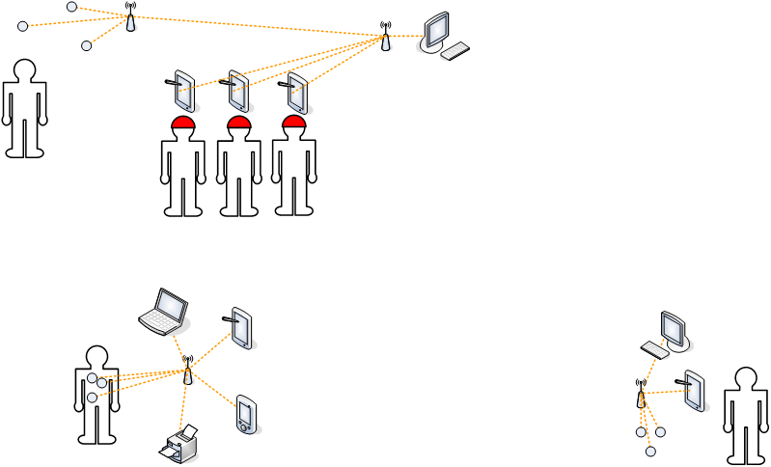
Use Case of Medical / Disaster Situation
sensors
Information gathering
& distribution
Comm. tools
Rescue
interoperability
Self-Organized
Network
interoperability
sensors
Medical Treatment
Cross-border operation

Slide 5
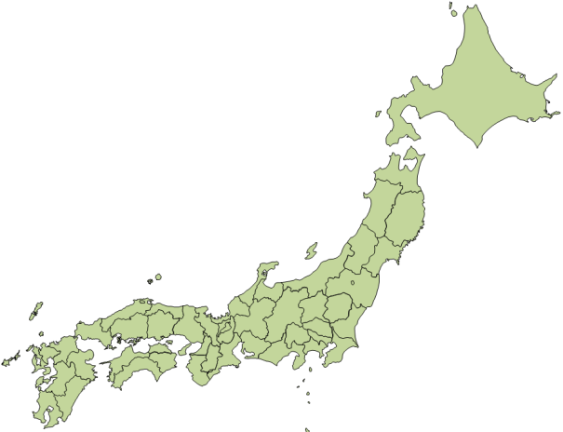
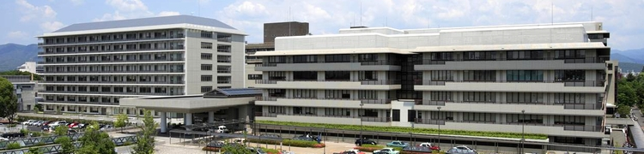
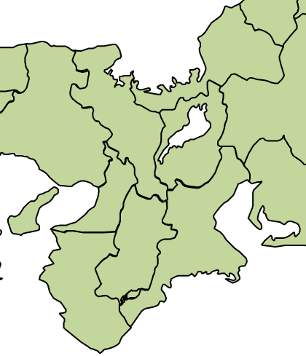
Kyoto University Hospital
Founded in 1901
Over 30 department (internal medicine, surgical,
obstetrics, pediatrics, ophthalmologic, etc.)
2,700 medical workers and 2,600 patients/day
Research & practice of advanced medical care
(organ transplantation, iPS cells, etc.)
Huge wireless medical information system throughout a hospital is employed
Notes:
・32,000 patients/year
・アニュアルレポートより引用 http://www.kuhp.kyoto-u.ac.jp/~annual/H22/siryou/ichinichi.pdf

Slide 6

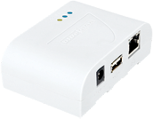
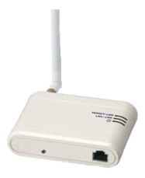

Medical information system in hospital
BT-AP (for data exchange)
Bluetooth Barcode Reader
Bluetooth AP network connected with WiFi
Nurse
Laptop PC for nurses
WiFi (IEEE 802.11b/g)
WiFi AP
DB
Medicine
BT-ID
(for location)
Electronic medical record
Patient

Slide 7


Medical information system in the hospital
Prescription check system
1,500 Bluetooth barcode readers
Medical device network
system (experimental)
Outpatients navigation
system
600 Bluetooth access points (BT-AP)
Medical devices
2,700 Bluetooth navigation tablets
1,100 Bluetooth identification beacon
(BT-ID)
WiFi WLAN system
Database
1,000 Laptop PC
650 WiFi access points
Notes:
medical thermometer

Slide 8
Problems in actual operation
Nurses complain about...
Connectivity of their Laptop PCs by WiFi, especially around 8 A.M.
Service coverage at certain places (for example, behind a large pillar).
These would come from...
Interference between devices operated in the same 2.4 GHz ISM band.
Not only hospital equipment (microwave ovens, etc.), but also private devices (mobile routers, portable game machines, etc.) are used.
Blind area due to unsuitable placement for access points (behind some objects, etc.).
Notes:
morning medical check
*After switching WiFi operation from IEEE 802.11g (2.4 GHz) to 802.11n (5 GHz), connectivity might have been improved somehow.

Slide 9
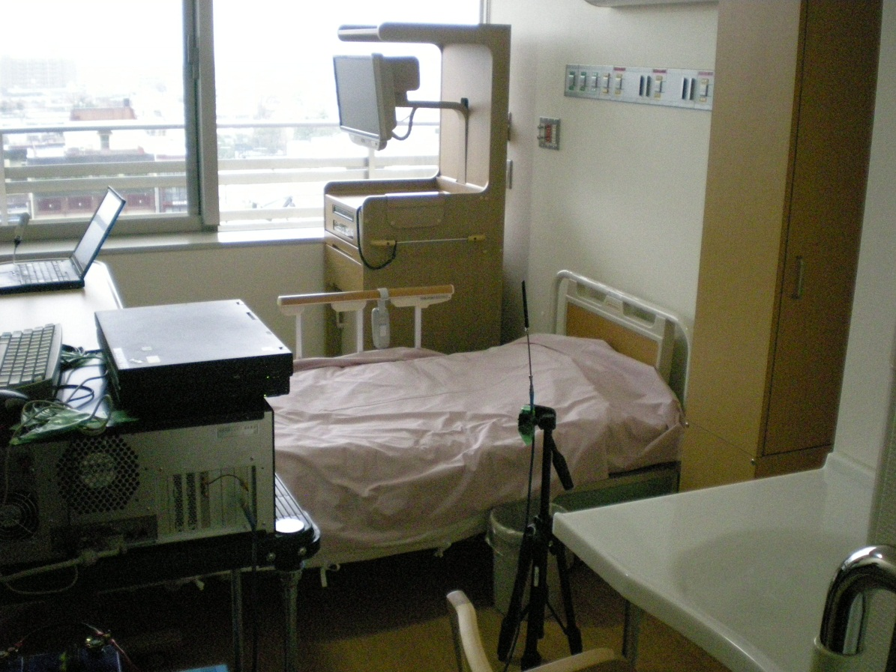
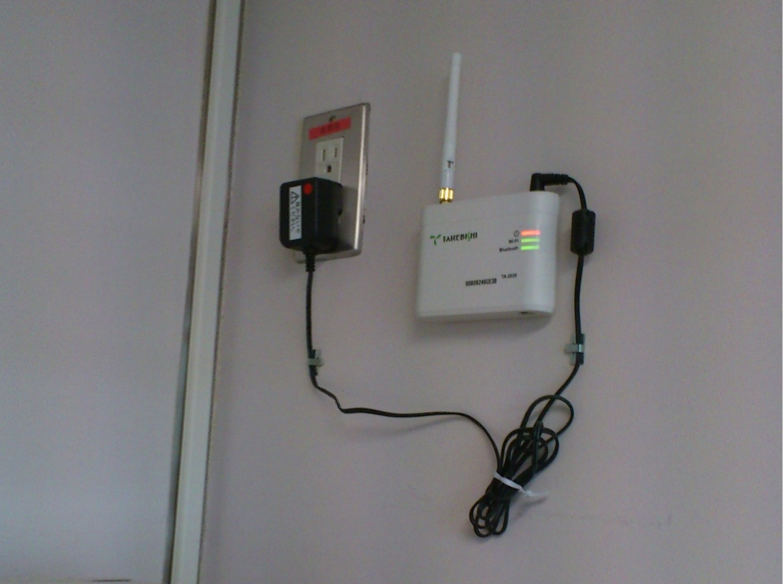
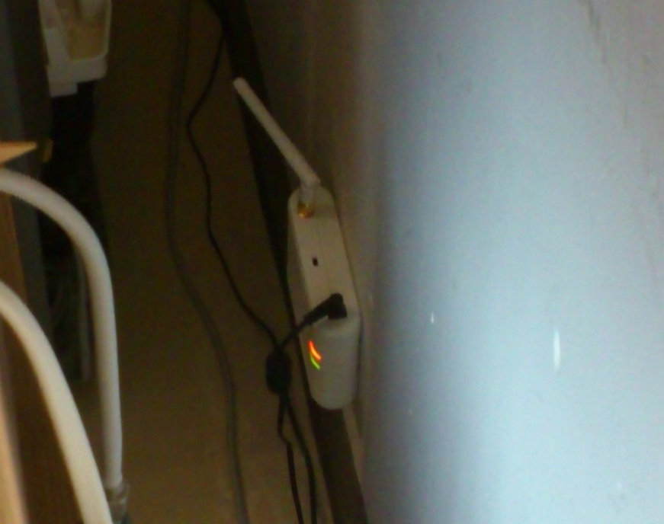
Measurement detail
BT-AP
7 m
6 m
70 m
BT-ID
30 m
Microwave oven
WiFi AP

Slide 10
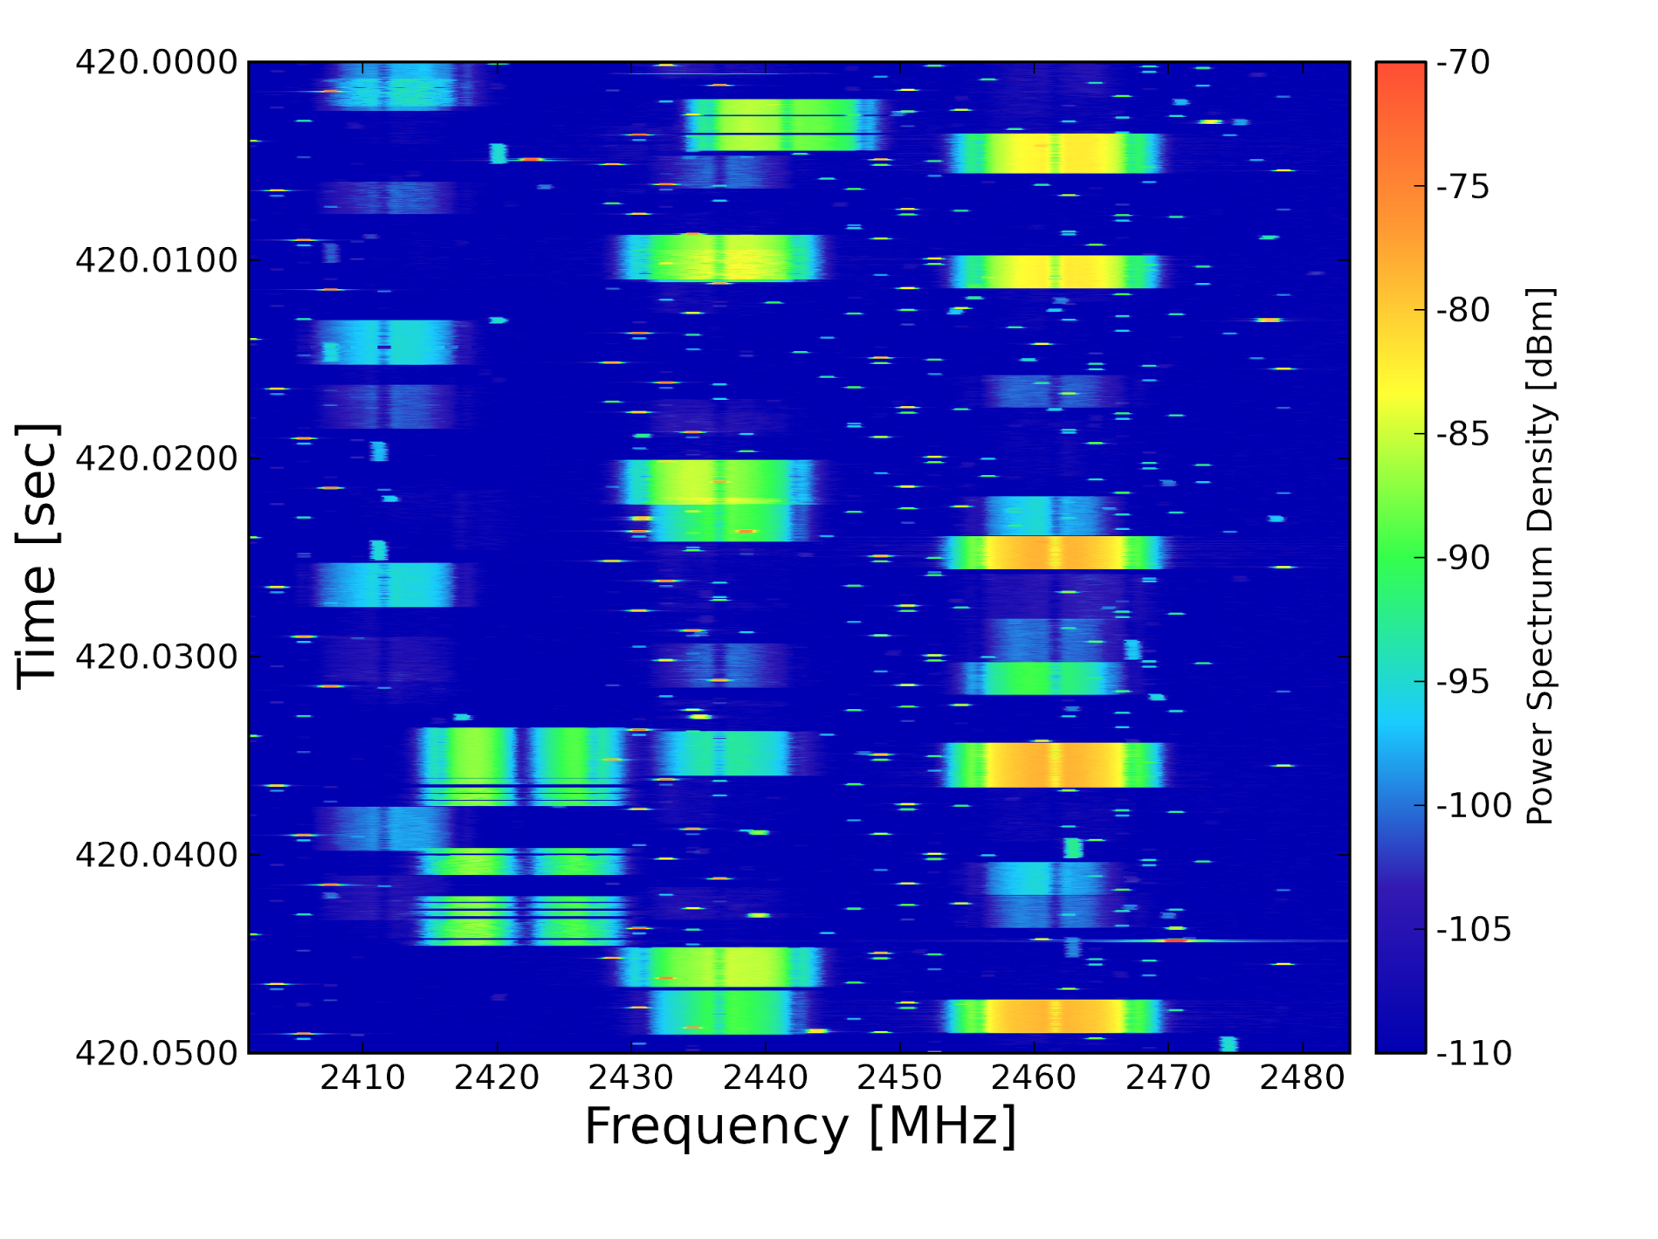
Measurement results: WiFi
Hospital WiFi service is provided on channel 1, 6, and 11
Other private devices operated on other channels would cause interference to existing WiFi devices.
50 ms
2400 2410 2420 2430 2440 2450 2460 2470 2480 2490
Frequency [MHz]
Notes:
ks8f1000_2012.03.02.10.09.25.546.png

Slide 11
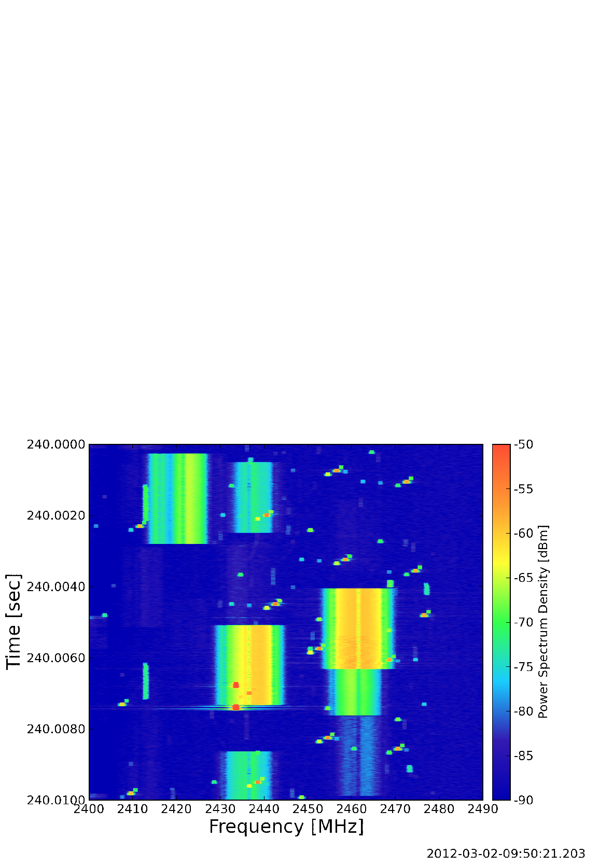
Measurement results: WiFi and Bluetooth
-50
-55
-60
-65
WiFi and Bluetooth packets would cause collisions
10 ms
Power Spectrum Density [dBm]
-70
-75
-80
-85
-90
2400 2410 2420 2430 2440 2450 2460 2470 2480 2490
Frequency [MHz]

Slide 12
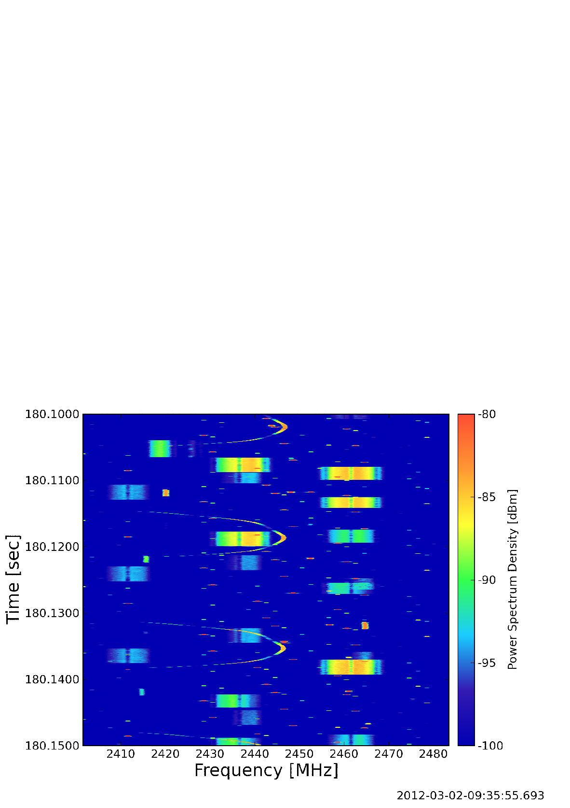
Measurement Results: Microwave Oven
-80
-85
Noise from microwave oven is measured
Nearby wireless devices would not be able to communicate when microwave oven is being operated
50 ms
Power Spectrum Density [dBm]
-90
-95
-100
2400 2410 2420 2430 2440 2450 2460 2470 2480 2490
Frequency [MHz]

Slide 13
Problems and Solutions Proposed
From the measurement results:
It’s hard to build and operate large scale wireless networks of autonomously operated devices.
These networks need to be self-organized and dynamically reconfigurable in the real situation (huge disaster time, etc.).
Solutions proposed
Self-organized wireless system for flexible and maintenance-free utilization in medical and disaster area
Spectrum sensing of whole band for searching vacant radio resources
Radio resource assignment and network topology management controlling bandwidth and interference between wireless systems based on quality of experience (QoE) of each applications

Slide 14
Concept of our Proposed System
Shares limited Radio Resources with Various Applications
Controls dynamically based on QoE
The parameters of QoE f(x): data rate, latency, BER,
priority, subjective assessment (i.e., mean opinion score)

Slide 15
Concept of system
Other System
Proposed System
QoE
estimation
sensing environment
QoE
estimation
antenna control
resource assign
resource assign
topology optimization
network reconfiguration

