Slide 1
Project: IEEE P802.15 Working Group for Wireless Personal Area Networks (WPANs)
Submission Title: Tamed Spread Spectrum Proposal for IEEE802.15.4N
Date Submitted: Sept 10, 2012
Source: Ning Li, BUPT; Liang Li, Vinno; Tul Shui, BUPT ;
Suite 202, Building D, No.2 Xinxi Lu, Beijing, China,
Voice: 1-914-333-9687, FAX: 1-914-332-0615,
E-Mail: liangli@vinnotech.com
Abstract: Tech Proposal for TG4n(MBAN) Task Group
Purpose: Outline accomplishments from the March 2012 meeting and planned tasks for this meeting.
Notice: This document has been prepared to assist the IEEE P802.15. It is offered as a basis for discussion and is not binding on the contributing individual(s) or organization(s). The material in this document is subject to change in form and content after further study. The contributor(s) reserve(s) the right to add, amend or withdraw material contained herein.
Release: The contributor acknowledges and accepts that this contribution becomes the property of IEEE and may be made publicly available by P802.15.

Slide 2
Outline
IEEE 802.15-12-0585-00-004N
Requirements for IEEE 802.15.4n medical applications
-- regulation
-- robustness
-- low complexity and power consumption
Details about BUPT physical layer proposal
-- band plan
-- Tx/Rx architecture
-- system parameters
-- physical layer frame structure
-- coding and spreading
-- modulation : GMSK
-- Pulse-shape filter
-- Receiver sensitivity
Future works

Slide 3
Regulation and Features for IEEE 802.15.4n proposals
IEEE 802.15-12-0585-00-004N
Regulation:
15-12-0105-00-004n-translation-of-chinese-miit-doc423-2005
-- band: 176-214、407-425、608-630MHz
-- transmitting power limit: 10mW (ERP)
-- frequency offset tolerance : 100ppm
Robustness
15-12-0471-01-004n-Detail-Report-for-Interference-on-Chinese-Medical-Bands
-- rejection to interferences: TV signal 、wireless microphone、interphone et al.
-- complex environment on human body surface : very-low transmitting power 、
shelter of human body
-- adjacent channel interference
low complexity and power consumption

Slide 4
General View of New Proposal
IEEE 802.15-12-0585-00-004N
One proposal focuses on the 0-3M range and Sensor Signal Transmission around body
Proposal is similar to Taped Spread Spectrum ones in IEEE802.15.6
The TRX adopted the proposal shall has the anti-interference ability

Slide 5
IEEE 802.15-12-0585-00-004N
The characteristic of Proposal (1)
● Low power consumption due to
-- Low data rate : 50 kbps can meet most medical applications include
EEG/ECG/EMG et.al,
-- Short distance : ≤3m .
-- GMSK is a power efficient modulation .
● Low complexity due to
-- Mature BCH code technology ,
-- Tamed Spread Spectrum adopted IEEE 802.15.4-2006,
-- No interleaving technology .
● High compatible with IEEE 802.15.4-2006 standard:
-- GMSK is similar to OQPSK + half-sine shape filter ,
-- Same tamed spread spectrum technology.

Slide 6
The characteristic of Proposal (2)
● High robustness due to
-- GMSK modulation
-- Tamed Spread Spectrum technology
-- Mature BCH code
-- Two preambles for adjacent channel
● High safety to human body especially on head applications, for
example EEG, due to low Tx power .

Slide 7
Bandwidth of TX with New Proposal
band plan
Frequency band （MHz) | Relationship between fc and nc
407-425
608-630
-- 176-214MHz is not used , because miniaturized antenna is a problem.

Slide 8
System Definition
IEEE 802.15-12-0585-00-004N
Frequency band （MHz) | Modulation | Information Data Rate (kbps) | Code Rate (k/n) | Spreader | Chip Rate (kcps) | Pulse shape
407-425 | GMSK | 50 | 39/63 | 8 | 247.6 | SRRC
608-630 | GMSK | 50 | 39/63 | 8 | 247.6 | SRRC

Slide 9
Tx Architecture
IEEE 802.15-12-0585-00-004N
Tx block diagram

Slide 10
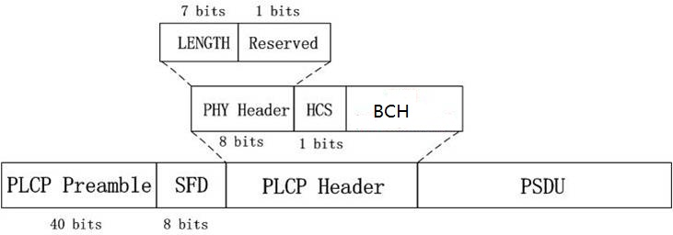
Physical layer frame structure
IEEE 802.15-12-0585-00-004N
--Preamble: length-31 binary m-sequence followed by 010101010
sequence. There two preambles for even and odd number channels
(Preamble 1# and 2# ) .
-- SFD:

Slide 11
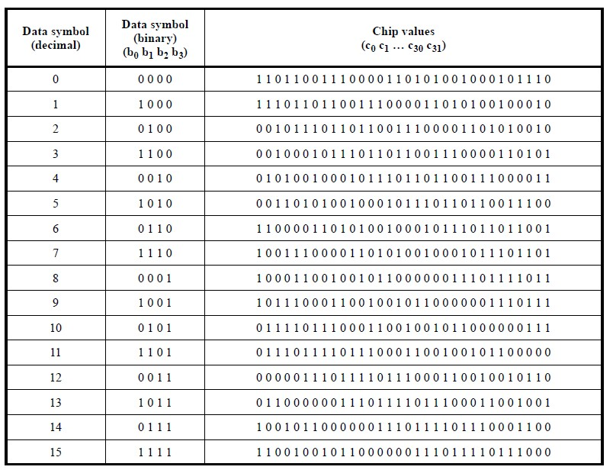
Coding and Spreading
IEEE 802.15-12-0585-00-004N
-- coding : BCH code (39/63)
-- spreading : reference to IEEE 802.15.4-2006 2.4GHz physical layer definitions.

Slide 12
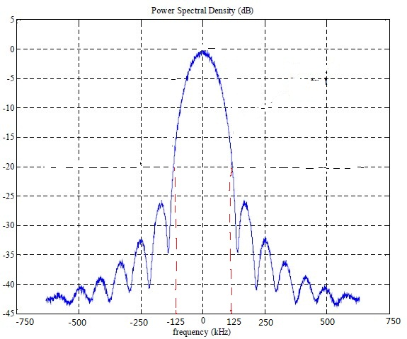
Modulation : GMSK
advantage：
-- constant enveloped modulation
-- high power efficiency
-- high spectrum efficiency
-- Strong anti-interference capability
-- low ACI
-- a wide and mature of applications
for example GSM.
PSD of GMSK
disadvantage：
-- more complexity due to Gaussian
low-pass filter
-- ISI is more serious

Slide 13
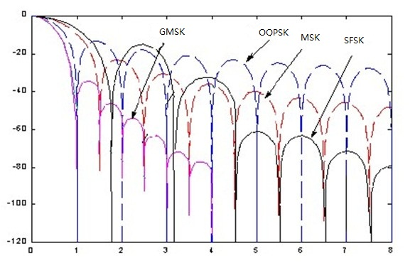
Comparison of the spectrum for GMSK and others

Slide 14
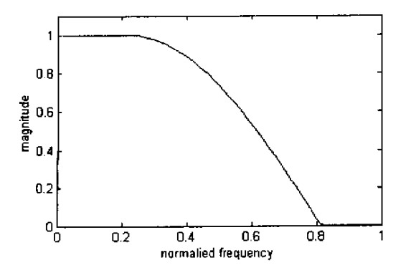
Pulse-Shape Filter
Square Root Raised Cosine filter :
-- Filter order : 13
-- The following Figure shows the frequency response characteristic
The frequency response curve of designed SRRC

Slide 15
Receiver Sensitivity
Assumption : distance=3m, AWGN and 0dBi Gain in Tx and Rx antennas
● 400MHz:
fc=408MHz, Pt= -10dBm, PL=20log(4*pi*d*fc/c)=34.19dB
∴Pr=Pt-PL= -44.19dBm
Noise Power Pn= -174+10log(BW)= -120dBm
Rx Noise Figure NF=10 dB
Implementation loss Ｉ= 10dB
Minimum SNR for PER-10% S=5dB (assumption)
Link Margin : M= Pr – Pn-S-I= 54.81dBm
Receiver Sensitivity : Ps= Pr-M=-99.02dBm
● 600MHz;
fc=609MHz, …,
Link Margin : M= Pr – Pn-S-I= 50.83dBm
Receiver Sensitivity : Ps= Pr-M=-98.5dBm

Slide 16
Future works
(1)、Interference modeling :
digital TV signal / wireless microphone / interphone et al.( on the way )
(2)、BER、PER performance , link budget, receiver sensitivity, ACI rejection in:
-- AWGN channel ( on the way )
-- Fading channel ( not start )
-- Fading + interference channel ( not start)

