Slide 1
Project: IEEE P802.15 Working Group for Wireless Personal Area Networks (WPANs)
Submission Title: DSSS PHY Proposal for IEEE802.15.4N
Date Submitted: May 13, 2013
Source: Wei-Xia Zou, BUPT; Liang Li, Vinno; Dietmar Eggert, Atmel ; Chia-lung Tsai, ITRI; Guang-long Du, Feng-yuan Kang, BUPT
Suite 202, Building D, No.2 Xinxi Lu, Beijing, China,
Voice: 1-949-813-7909, FAX: 1-949-813-7909,
E-Mail: liangli@vinnotech.com
Abstract: Tech Proposal for TG4n(MBAN) Task Group
Purpose: Outline accomplishments from the March 2012 meeting and planned tasks for this meeting.
Notice: This document has been prepared to assist the IEEE P802.15. It is offered as a basis for discussion and is not binding on the contributing individual(s) or organization(s). The material in this document is subject to change in form and content after further study. The contributor(s) reserve(s) the right to add, amend or withdraw material contained herein.
Release: The contributor acknowledges and accepts that this contribution becomes the property of IEEE and may be made publicly available by P802.15.

Slide 2
General View
One PHY layer solution adopts O-QPSK modulation and is similar to ones applied on sub-GHz in IEEE802.15.4C/4G.
This PHY layer solution is special on
  The designed Tx/Rx is mainly applied for wireless short-distance communication in-door hospital/clinic/senior house environment.
  The designed TX/RX is capable to operate well under interference environment (such as wireless microphone on 200Mhz band, interphone on 400Mhz band and remote control on 600Mhz)
  The designed Tx/Rx is capable to detect strong interferences (such as CMBB TV signals) and switch to interference-free channels adaptively

Slide 3
Proposal Definition
Data Rate: 250Kb/s and 500 Kb/s
Band Width: 2MHz
Operation Frequency Bands: 608-630MHz, 407-425MHz, 174-216MHz
  -- F_{c}= 175+ 2k, k= 0, ….., 20
  F_{c}=408 + 2k, k= 0, ….., 8
  F_{c}=609 + 2k, k= 0, ….., 10

Slide 4
Bandwidth, Data Rate and Chip Rate
Chip rate is 1Mchip/s for 2MHz bandwidth.
Two DSSS table(16,4) and (8,4) for 250kbps and 500kbps.
The 16-ary symbol consists of 16 continues chips for (16,4) DSSS table and 8 continues chips for (8,4) DSSS table (Which are same to DSSS tables used in 15.4C and 15.4g).
The 16-ary symbol rate is 62.5ksym/s and 125ksym/s. Hence the data rate is log₂16×62.5=250kb/s and log₂16×125=500kb/s.

Slide 5
Coefficient Summary
Frequency Band (MHz) | Bandwidth | Chip Rate (kchip/s) | Modulation | Symbols | DSSS table | Bit Rate (kb/s) | Symbol Rate (ksymbol/s)
174-216 | 2MHz | 1000 | QPSK | 16-ary | (16,4) | 250 | 62.5
 |  |  |  |  | (8,4) | 500 | 125
407-425 | 2MHz | 1000 | QPSK | 16-ary | (16,4) | 250 | 62.5
 |  |  |  |  | (8,4) | 500 | 125
608-630 | 2MHz | 1000 | QPSK | 16-ary | (16,4) | 250 | 62.5
 |  |  |  |  | (8,4) | 500 | 125

Slide 6
Modulation and Spreading Functions
Modulation and Spreading Functions
O-QPSK chip offsets

Slide 7
Symbol-to-chip mapping for O-QPSK
Data Symbol (decimal) | Data Symbol (binary) (b₀ b₁ b₂ b₃) | Chip Values for (16,4) DSSS (c₀ c_{1 …} c₁₄ c₁₅) | Chip Values for (8,4) DSSS (c₀ c_{1 …} c₆ c₇)
0 | 0 0 0 0 | 0 0 1 1 1 1 1 0 0 0 1 0 0 1 0 1 | 0 0 0 0 0 0 0 1
1 | 1 0 0 0 | 0 1 0 0 1 1 1 1 1 0 0 0 1 0 0 1 | 1 1 0 1 0 0 0 0
2 | 0 1 0 0 | 0 1 0 1 0 0 1 1 1 1 1 0 0 0 1 0 | 0 1 1 0 1 0 0 0
3 | 1 1 0 0 | 1 0 0 1 0 1 0 0 1 1 1 1 1 0 0 0 | 1 0 1 1 1 0 0 1
4 | 0 0 1 0 | 0 0 1 0 0 1 0 1 0 0 1 1 1 1 1 0 | 1 1 1 0 0 1 0 1
5 | 1 0 1 0 | 1 0 0 0 1 0 0 1 0 1 0 0 1 1 1 1 | 0 0 1 1 0 1 0 0
6 | 0 1 1 0 | 1 1 1 0 0 0 1 0 0 1 0 1 0 0 1 1 | 1 0 0 0 1 1 0 0
7 | 1 1 1 0 | 1 1 1 1 1 0 0 0 1 0 0 1 0 1 0 0 | 0 1 0 1 1 1 0 1
8 | 0 0 0 1 | 0 1 1 0 1 0 1 1 0 1 1 1 0 0 0 0 | 1 0 1 0 0 0 1 0
9 | 1 0 0 1 | 0 0 0 1 1 0 1 0 1 1 0 1 1 1 0 0 | 0 1 1 1 0 0 1 1
10 | 0 1 0 1 | 0 0 0 0 0 1 1 0 1 0 1 1 0 1 1 1 | 1 1 0 0 1 0 1 1
11 | 1 1 0 1 | 1 1 0 0 0 0 0 1 1 0 1 0 1 1 0 1 | 0 0 0 1 1 0 1 0
12 | 0 0 1 1 | 0 1 1 1 0 0 0 0 0 1 1 0 1 0 1 1 | 0 1 0 0 0 1 1 0
13 | 1 0 1 1 | 1 1 0 1 1 1 0 0 0 0 0 1 1 0 1 0 | 1 0 0 1 0 1 1 1
14 | 0 1 1 1 | 1 0 1 1 0 1 1 1 0 0 0 0 0 1 1 0 | 0 0 1 0 1 1 1 1
15 | 1 1 1 1 | 1 0 1 0 1 1 0 1 1 1 0 0 0 0 0 1 | 1 1 1 1 1 1 1 0

Slide 8
PHY-frame Format
SFD value (bits 0–15)
1 1 1 0 1 0 1 1 0 1 1 0 0 0 1 0
Frame structure

Slide 9
PHY-frame Generate Diagram
Same Preamble and SFD for Dual Modes

Slide 10
PSD Limitation
PSD Limitation among Channels.
Transmit center frequency tolerance is still ±40ppm.
Bandwidth | Frequency | Relative limit | Absolute limit
2MHz | |f-f_{c}|<1MHz | -20dB | -20dBm

Slide 11
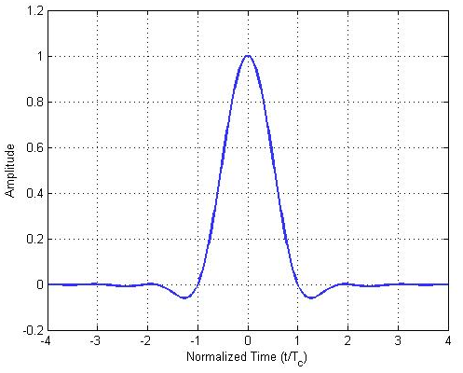
Pulse-Shape Filter
The raised cosine pulse shape with roll-off factor of r=0.8 is used to represent each baseband chip
This pulse shape filter is enough to meet the PSD and minimum receiver jamming resistance.
See the PSD figure in the next slide.

Slide 12
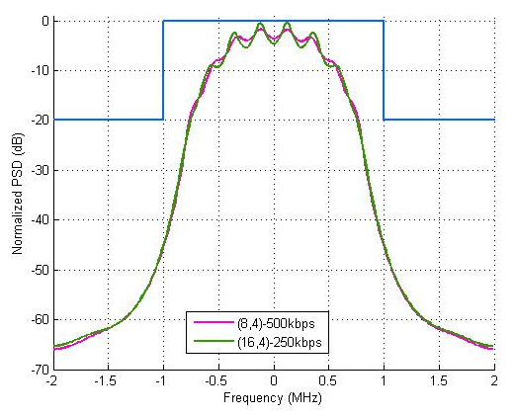
PSD of TX-signal
PSD limit
Same PSD for both (16,4)-DSSS signal and (8,4)-DSSS signal.
PSD of transmission signal (Burg's estimation method.)

Slide 13
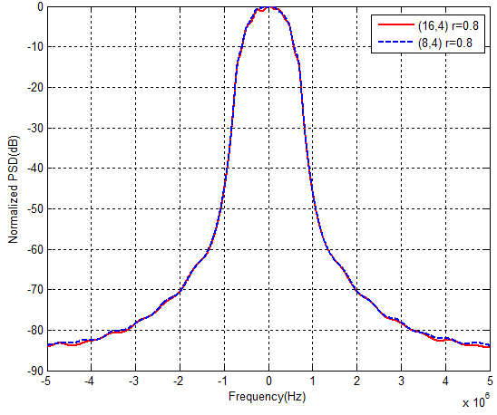
Radiation Power at the Upper/Lower Limits
Burg's estimation method, the order of an autoregressive (AR) prediction model is 10,VBW=1kHz.
Rolloff factor is 0.8.
Suppose max power: 10dBm/2MHz = -53dBm/Hz (EIRP)
After filtering, the PSD level at edge of
2Mhz bandwidth is -45dB lower than the
ones at carrier frequency point.
So the radiation power at the upper/lower
limits is:
-53dBm/Hz-45dB =-98dBm/Hz
Conclusion: The radiation power at the
upper/lower limits of the specified band
is no more than －80dBm/Hz (EIRP).
-45dB

Slide 14
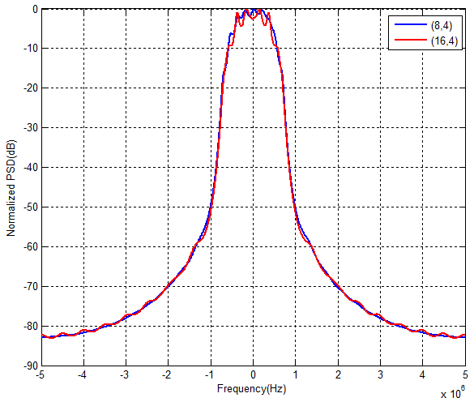
Spurious Radiation Emission Limits (1)
  Suppose The edge of spurious is ±5MHz
  (Spurious radiation emission limits (the demarcation between spurious radiation and out of band radiation is the bandwidth, which is ±2.5 multiples of operation channel band on carrier frequency))
Burg's estimation method, the order of an autoregressive (AR) prediction model is 10,VBW=1kHz.
Rolloff factor is 0.8.
  The estimated PSD at ±5MHz
  is -82dB
So, the spurious value at edge of
spurious domain is
(-53dBm/Hz -82dB) ×100kHz=-85dBm.
-82dB

Slide 15
Spurious Radiation Emission Limits (2)
  This value -85dBm is smaller than -36dBm and -54 dBm.
  Both of -36dBm and -54dBm are spurious limitation based on Chinese Radio Management doc: 15-12-0105-01-004n:
    Spurious radiation emission, in 48.5MHz-72.5MHz, 76MHz-108MHz, 167MHz-223MHz, 470MHz-566MHz or 606MHz-798MHz bands, should be less －54dBm.
    Transmitter in transmission state at the maximum power
Frequency range | Test bandwidth | Limit | Detection method
9kHz-150kHz | 200Hz (6dB) | 27dBuA/m (10 meters) (3 dB decreased per octave) | Quasi-peak
150kHz-10MHz | 9kHz (6dB) |  | Quasi-peak
10MHz-30MHz | 9kHz (6dB) | －3.5dBuA/m (10 meters) | Quasi-peak
30MHz-1GHz | 100kHz (3dB) | －36dBm | Effective value
1GHz-40GHz | 1MHz (3dB) | －30dBm | Effective value
>40GHz | 1MHz (3dB) | －20dBm | Effective value

Slide 16
Receiver Design
Receiver Sensitivity: <-85dBm for (16,4) DSSS table and <-82dBm for (8,4) DSSS table (with a noise figure of 10 dB and an implementation loss of 6 dB).
Minimum Receiver Jamming Resistance Requirement
Adjacent channel rejection | Alternate channel rejection
0dB | 36dB

Slide 17
Noise Models and Environment
Noise Model
  Flat-fading for 2MHz band channel on 200MHz, 400MHz and 600MHz band;
  Noise model is AWGN ones.
Multiple Path Model
  Reference Diffuse exponential model,
(IEEE P802.15 Working Group for WPANs, Multipath Simulation Models for Sub-GHz PHY Evaluation, 15-04-0585-00-004b, Oct. 2004.)
RMS delay spread = 10~300ns(in door).

Slide 18
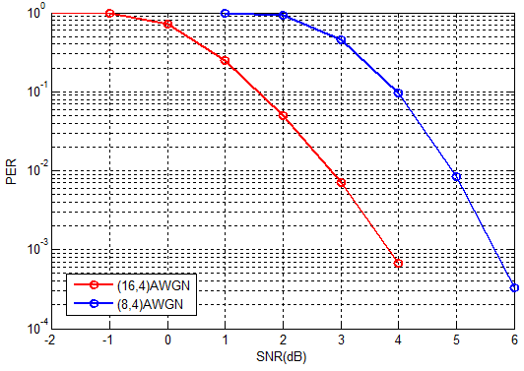
Simulation in Noise Environment
The PER vs. SNR simulation result is illustrated in the right figure.
(16,4) means when (16,4) DSSS table has been used (250kbps);
(8,4) means when (8,4) DSSS table has been used (500kbps).

Slide 19
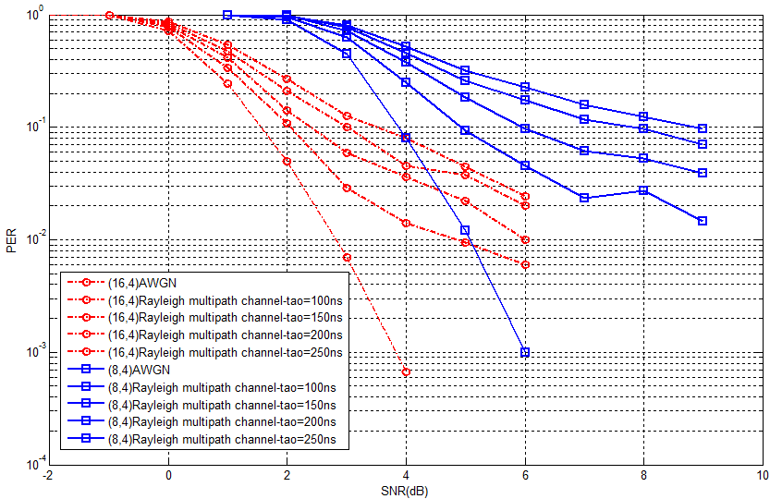
Simulation in Multiple Path Model Environment
Suppose: Single Parameter:
  - RMS delay spread ≈ τ=250ns
  - Mean excess delay ≈ τ
  - Max excess delay (20 dB) ≈ 5τ.
Simulation Result:
The PER is worsened about 4~5db
with Multipath channel as τ=250ns .
(No-coherence demodulation)
This simulation do not consider
the barrier of the direct path.

Slide 20
TV(CMBB) Interference and Models (1)
Interference Models
  CMMB (China Mobile Multimedia Broadcasting) is the mainly interference signal in the 174-216MHz, 608-630MHz band.
  On 174-216 MHz, the major interference are CMBB TV signals DS-8, DS-9, DS-10, DS-11; and on 606-630MHz, the major interference are CMBBTV Signals DS-25, DS-26, DS-27

Slide 21
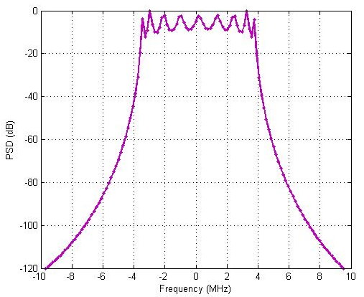
TV (CMBB) Interference and Models (2)
Interference Models
  Bandwidth for CMMB signal is 8MHz
  BPSK, QPSK and16QAM modulation, OFDM technology with 4096 sub-carrier (3076 been used)
  The math model is as the following equation:
  r(t)=x(t)+A_{m}×[h*x_{C}(t)]+n
r(t): received signal;
x(t): transmitted signal (after fading);
x_{C}(t): CMMB interference signal in unit power;
A_{m}: amplitude of CMMB interference signal;
h: low-path filter with 2MHz bandwidth;
n: the gauss noise.
*: denote convolution.
Right figure: Power Spectrum Density (PSD) of CMMB signal (in QPSK modulation scheme).

Slide 22
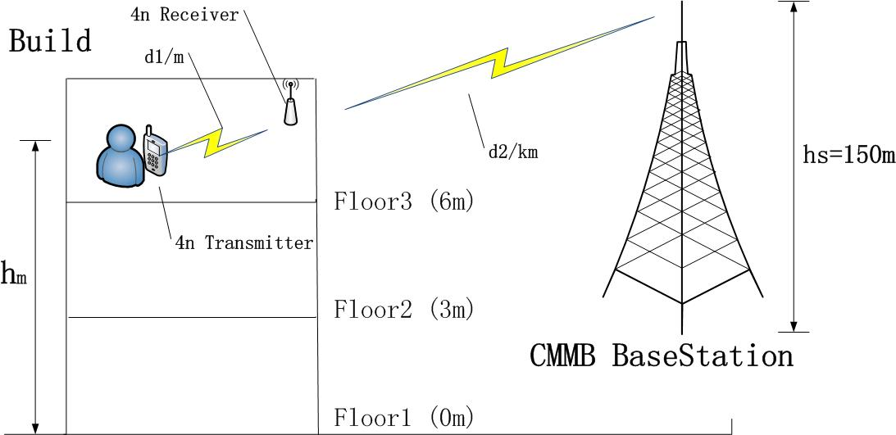
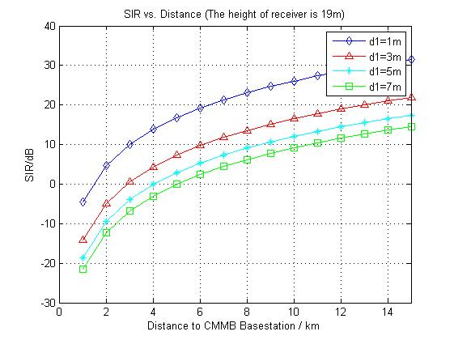
TV (CMBB) Interference and Models (3)
Interference scenario
SIR calculation result with different distance between 4n devices
the 4n device is assumed in 19m high, or floor 5 ~ floor 6.
In the figure:
signal power: CMMB – 60dBm, 4n – 0dBm;
d1: distance between 4n transmitter and 4n receiver;
d2: distance between 4n devices and the CMMB base station;
hm: the height of 4n devices for ground;
hs: the height of CMMB base station;

Slide 23
Simulation in Interference Environment (1)
Simulation system model is as the following figure.
Cross-correlation demodulator have 16 correlation where each one denotes a modulated symbol.
Other coefficients:
CMMB modulation scheme: QPSK
Frame length: 256 byte;
Carrier frequency offset: random variable between ±40ppm.
Matched filter order: 10-order fir filter;
Roll-off factor: 0.8;
Correlator length in demodulator: 16.

Slide 24
Simulation in Interference Environment (2)
The interference math model is as:
I_{C}=A_{m}×[h*x_{C}(t)]
So the interference power is estimated as
P_{icmmb}=1kW×f(d)×B_{r}≈1kW×d⁻²×0.25=54-20log₁₀(d) dBm
Where
f(d) ≈d⁻² is path loss factor, and d is the distance to CMMB base station (m);
B_{r}=2MHz/8MHz=0.25 is relatively bandwidth factor;
So the amplitude of interference signal is
A_{m}=P_{icmmb}^{1/2}

Slide 25
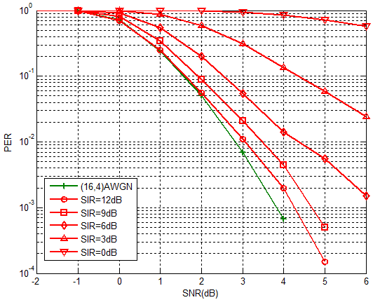
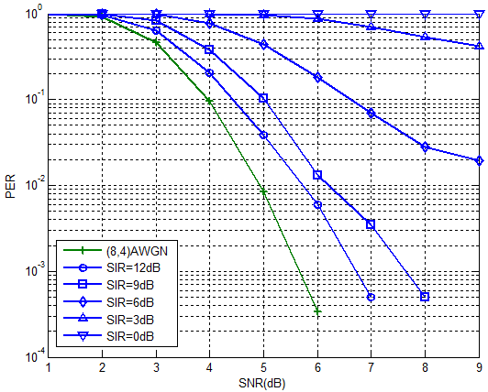
Simulation in Interference Environment
(CMMB)
The following figures illustrates PER vs SNR in constant interference signals (SIR).
(16,4) DSSS table (250kbps)
(8,4) DSSS table (500kbps)

Slide 26

Wireless Microphone Interference and Models (1)
Operation Modes
Transmission Signal
: sound signal
: amplitude (0.3 in this modulation)
: carrier frequency (200MHz in this modulation)
: frequency deviation

Slide 27
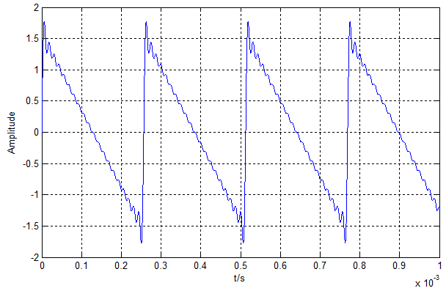
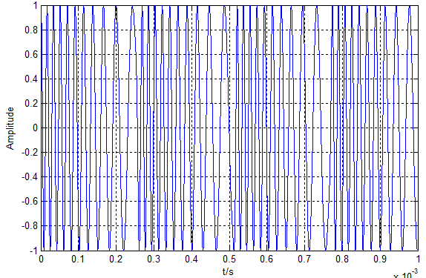
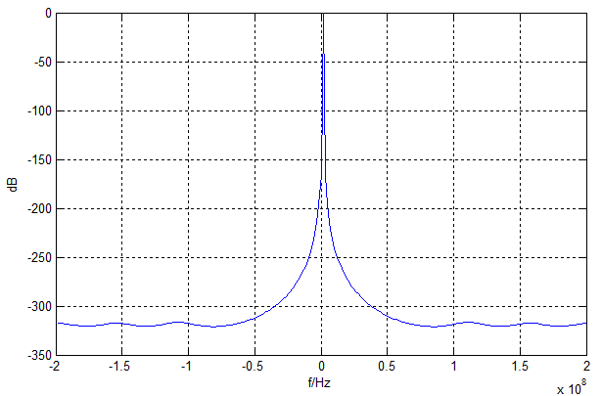
Wireless Microphone Interference and Models (2)
Soft speaker mode
The audio data sampling rate is relatively low, when Insufficient data, use Interpolation instead.
Sound signal
Transmit signal
Spectrum analysis

Slide 28
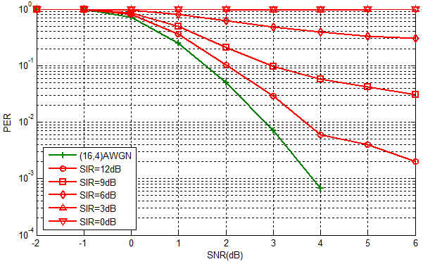
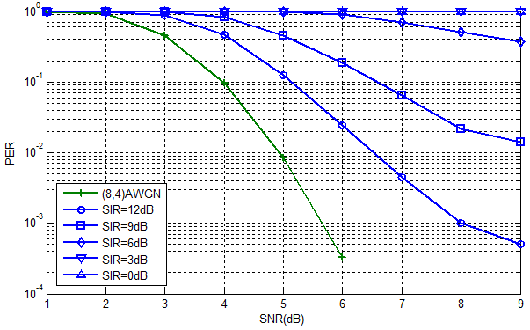
Simulation in Interference Environment
(Wireless Microphone)
The following figures illustrates PER vs SNR in constant interference signals (SIR).
(16,4) DSSS table (250kbps)
(8,4) DSSS table (500kbps)

Slide 29
Transmission Model in Hospital Environment
The path-loss model is:
L=L_{a}+L_{b}
Here, L_{a} is free space path loss
L_{a}=32.45+20logf+10γlogd , (dB)
where γ is channel fading parameter, in the equation, γ=2.0;
And, L_{b} is penetration loss
L_{b}=nL_{p}+N₁L₁+N₂L₂, (dB)
where :
L_{p} : penetration loss of human body;
L₁ : penetration loss of concrete wall;
L₂ : penetration loss of wooden door.
and n, N₁, N₂ is the number of human body, concrete wall and wooden door correspondingly.

Slide 30
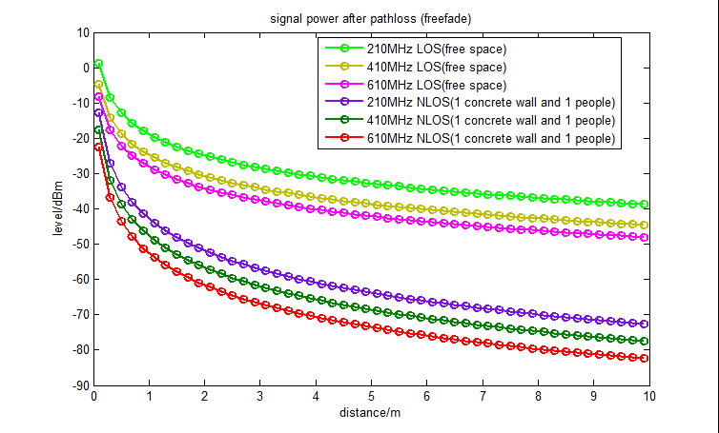
Transmission Model in Hospital Environment
The parameters L_{p}, L₁, L₂ is listed in the following table.
 | L_{p} | L₁ (with thickness of 200mm) | L₂ (with thickness of 42mm)
200MHz | 15.5db | 8db | 2db
410MHz | 13.5dB | 9dB | 2.3dB
610MHz | 14dB | 10dB | 3dB
  Right figure: Path loss in 200MHz, 400MHz and 600MHz band.
  NLOS: Path loss after penetrate 1 concrete wall and 1 people.
  The transmit power is 1dBm.
Path loss of 200MHz 400MHz and 600MHz band

Slide 31
Conclusion
This O-QPSK proposal includes one dual-data transmission
The simulation describes its performance under…
  Gaussian Noise Environment
  Multiple Path Environment
  CMBB Interference Model
The performance simulation for complex Transmission Path is TBD
Based on current simulation, this O- QPSK proposal may be acceptable as one PHY Layer solution of 15.4

