Slide 1
Project: IEEE P802.15 Working Group for Wireless Personal Area Networks (WPANs)
Submission Title: DSSS PHY Proposal for IEEE802.15.4N
Date Submitted: Jan 10, 2012
Source: Wei-Xia Zou, BUPT; Liang Li, Vinno; Guang-Long Du, BUPT ;
Suite 202, Building D, No.2 Xinxi Lu, Beijing, China,
Voice: 1-949-813-7909, FAX: 1-949-813-7909,
E-Mail: liangli@vinnotech.com
Abstract: Tech Proposal for TG4n(MBAN) Task Group
Purpose: Outline accomplishments from the March 2012 meeting and planned tasks for this meeting.
Notice: This document has been prepared to assist the IEEE P802.15. It is offered as a basis for discussion and is not binding on the contributing individual(s) or organization(s). The material in this document is subject to change in form and content after further study. The contributor(s) reserve(s) the right to add, amend or withdraw material contained herein.
Release: The contributor acknowledges and accepts that this contribution becomes the property of IEEE and may be made publicly available by P802.15.

Slide 2
General View
One PHY Definition and similar to sub-GHz ones in IEEE802.15.4C/4G
The designed Tx/Rx mainly applied for in-door hospital/clinic/senior house environment.
The Tx/Rx adopting this PHY may detect interference and switch to free band adaptively

Slide 3
Proposal Definition
Data Rate: 250Kb/s and 500 Kb/s
Band Width: 2MHz
Operation Frequency Bands: 608-630MHz, 407-425MHz
F_{c}=408 + 2k, k= 0, ….., 8
F_{c}=609 + 2k, k= 0, ….., 10

Slide 4
Bandwidth, Data Rate and Chip Rate
Chip rate is 1Mchip/s for 2MHz bandwidth.
Tow DSSS table, (16,4) and (8,4) for 250kbps and 500kbps.
The 16-ary symbol consists of 16 continues chips for (16,4) DSSS table and 8 continues chips for (8,4) DSSS table. (which are same to DSSS tables used in 15.4C and 15.4g)
The 16-ary symbol rate is 62.5ksym/s and 125ksym/s. Hence the data rate is log₂16×62.5=250kb/s and log₂16×125=500kb/s.

Slide 5
Coefficient Summary
Frequency Band (MHz) | Bandwidth | Chip Rate (kchip/s) | Modulation | Symbols | DSSS table | Bit Rate (kb/s) | Symbol Rate (ksymbol/s)
407-425 | 2MHz | 1000 | QPSK | 16-ary | (16,4) | 250 | 62.5
 |  |  |  |  | (8,4) | 500 | 125
608-630 | 2MHz | 1000 | QPSK | 16-ary | (16,4) | 250 | 62.5
 |  |  |  |  | (8,4) | 500 | 125

Slide 6
Modulation and Spreading Functions
Modulation and Spreading Functions
O-QPSK chip offsets

Slide 7
Symbol-to-chip mapping for O-QPSK
Data Symbol (decimal) | Data Symbol (binary) (b₀ b₁ b₂ b₃) | Chip Values for (16,4) DSSS (c₀ c_{1 …} c₁₄ c₁₅) | Chip Values for (8,4) DSSS (c₀ c_{1 …} c₆ c₇)
0 | 0 0 0 0 | 0 0 1 1 1 1 1 0 0 0 1 0 0 1 0 1 | 0 0 0 0 0 0 0 1
1 | 1 0 0 0 | 0 1 0 0 1 1 1 1 1 0 0 0 1 0 0 1 | 1 1 0 1 0 0 0 0
2 | 0 1 0 0 | 0 1 0 1 0 0 1 1 1 1 1 0 0 0 1 0 | 0 1 1 0 1 0 0 0
3 | 1 1 0 0 | 1 0 0 1 0 1 0 0 1 1 1 1 1 0 0 0 | 1 0 1 1 1 0 0 1
4 | 0 0 1 0 | 0 0 1 0 0 1 0 1 0 0 1 1 1 1 1 0 | 1 1 1 0 0 1 0 1
5 | 1 0 1 0 | 1 0 0 0 1 0 0 1 0 1 0 0 1 1 1 1 | 0 0 1 1 0 1 0 0
6 | 0 1 1 0 | 1 1 1 0 0 0 1 0 0 1 0 1 0 0 1 1 | 1 0 0 0 1 1 0 0
7 | 1 1 1 0 | 1 1 1 1 1 0 0 0 1 0 0 1 0 1 0 0 | 0 1 0 1 1 1 0 1
8 | 0 0 0 1 | 0 1 1 0 1 0 1 1 0 1 1 1 0 0 0 0 | 1 0 1 0 0 0 1 0
9 | 1 0 0 1 | 0 0 0 1 1 0 1 0 1 1 0 1 1 1 0 0 | 0 1 1 1 0 0 1 1
10 | 0 1 0 1 | 0 0 0 0 0 1 1 0 1 0 1 1 0 1 1 1 | 1 1 0 0 1 0 1 1
11 | 1 1 0 1 | 1 1 0 0 0 0 0 1 1 0 1 0 1 1 0 1 | 0 0 0 1 1 0 1 0
12 | 0 0 1 1 | 0 1 1 1 0 0 0 0 0 1 1 0 1 0 1 1 | 0 1 0 0 0 1 1 0
13 | 1 0 1 1 | 1 1 0 1 1 1 0 0 0 0 0 1 1 0 1 0 | 1 0 0 1 0 1 1 1
14 | 0 1 1 1 | 1 0 1 1 0 1 1 1 0 0 0 0 0 1 1 0 | 0 0 1 0 1 1 1 1
15 | 1 1 1 1 | 1 0 1 0 1 1 0 1 1 1 0 0 0 0 0 1 | 1 1 1 1 1 1 1 0

Slide 8
PHY-frame format
PHR field format
PHY frame format

Slide 9
PHY frame generate diagram

Slide 10
PSD Limitation
PSD Limitation among Channels.
Transmit center frequency tolerance is still ±40ppm.
Bandwidth | Frequency | Relative limit | Absolute limit
2MHz | |f-f_{c}|>1MHz | -20dB | -20dBm

Slide 11
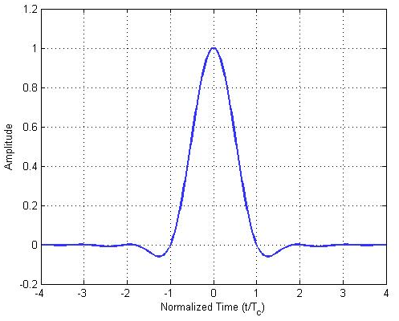
Pulse-Shape Filter
The raised cosine pulse shape with roll-off factor of r=0.8 is used to represent each baseband chip
This pulse shape filter is enough to meet the PSD and minimum receiver jamming resistance.
See the PSD figure in the next slide.
The future work is to confirm its ability to anti-TV and other inference

Slide 12
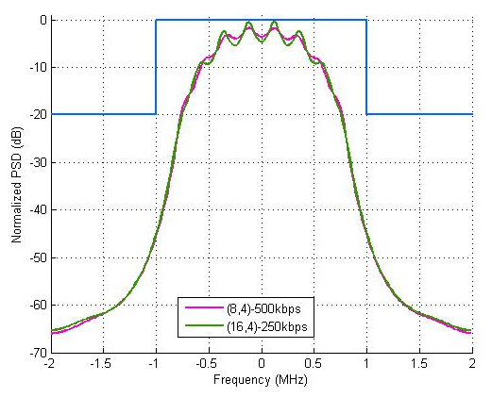
PSD of TX-signal
PSD limit
Same PSD for both (16,4)-DSSS signal and (8,4)-DSSS signal.
PSD of transmission signal (Burg's estimation method.)

Slide 13
Source Coding
FEC or other source coding may be necessary.
The further research is on the way

Slide 14
Receiver Design
Receiver Sensitivity: <-85dBm for (16,4) DSSS table and <-82dBm for (8,4) DSSS table (with a noise figure of 10 dB and an implementation loss of 6 dB).
Minimum Receiver Jamming Resistance Requirement
Rx details on the way.
Adjacent channel rejection | Alternate channel rejection
0dB | 36dB

Slide 15
Noise and Interference Models
Noise Model
Flat-fading for 2MHz band channel both in 400MHz and 600MHz band;
Noise model is AWGN channel model.
Interference Models
CMMB (China Mobile Multimedia Broadcasting) is the mainly interference signal in the 608-630MHz band.
The channel for CMMB signal is illustrated in following figure (3 channel in 606-630MHz)

Slide 16
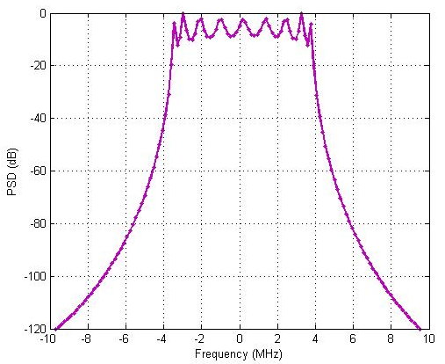
Noise and Interference Models
Interference Models
Bandwidth for CMMB signal is 8MHz
BPSK, QPSK and16QAM modulation, OFDM technology with 4096 sub-carrier (3076 been used)
The math model is as the following equation:
r(t)=x(t)+A_{m}×[h*x_{C}(t)]+n
r(t): received signal;
x(t): transmitted signal (after fading);
x_{C}(t): CMMB interference signal in unit power;
A_{m}: amplitude of CMMB interference signal;
h: low-path filter with 2MHz bandwidth;
n: the gauss noise.
*: denote convolution.
Right figure: Power Spectrum Density (PSD) of CMMB signal (in QPSK modulation scheme).

Slide 17
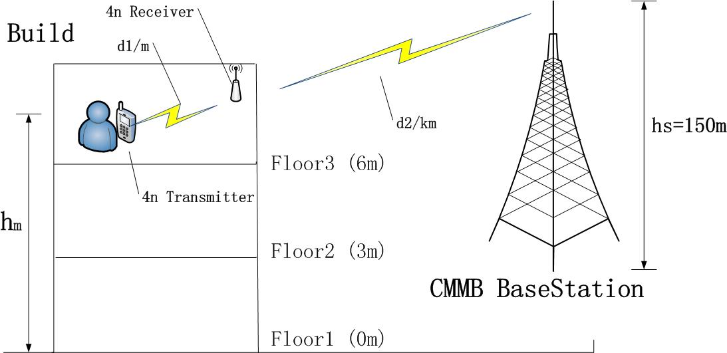
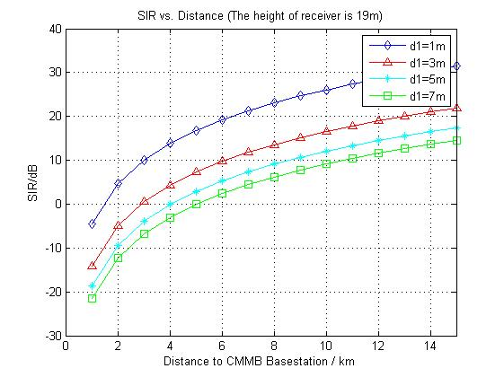
Noise and Interference Models
Interference scenario
SIR calculation result with different distance between 4n devices
the 4n device is assumed in 19m high, or floor 5 ~ floor 6.
In the figure:
signal power: CMMB – 60dBm, 4n – 0dBm;
d1: distance between 4n transmitter and 4n receiver;
d2: distance between 4n devices and the CMMB base station;
hm: the height of 4n devices for ground;
hs: the height of CMMB base station;

Slide 18
Simulation in Interference Environment
Simulation system model is as the following figure.
Cross-correlation demodulator have 16 correlator where each one denotes a modulated symbol.
Other coefficients:
CMMB modulation scheme: QPSK
Frame length: 256 byte;
Carrier frequency offset: random variable between ±40ppm.
Matched filter order: 10-order fir filter;
Roll-off factor: 0.8;
Correlator length in demodulator: 16.

Slide 19
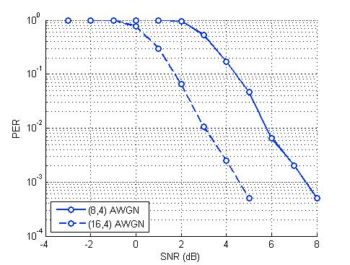
Simulation in Interference Environment
The PER vs. SNR simulation result is illustrated in the right figure.
(16,4) means when (16,4) DSSS table has been used (250kbps);
(8,4) means when (8,4) DSSS table has been used (500kbps).

Slide 20
Simulation in Interference Environment
The interference math model is as:
I_{C}=A_{m}×[h*x_{C}(t)]
So the interference power is estimated as
P_{icmmb}=1kW×f(d)×B_{r}≈1kW×d⁻²×0.25=54-20log₁₀(d) dBm
Where
f(d) ≈d⁻² is path loss factor, and d is the distance to CMMB base station (m);
B_{r}=2MHz/8MHz=0.25 is relatively bandwidth factor;
So the amplitude of interference signal is
A_{m}=P_{icmmb}^{1/2}

Slide 21
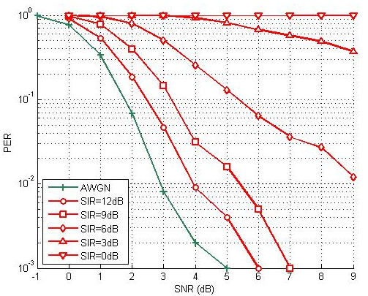
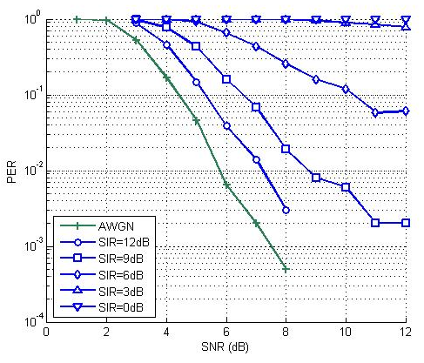
Simulation in Interference Environment
The following figures illustrates PER vs SNR in constant interference signals (SIR).
(16,4) DSSS table (250kbps)
(8,4) DSSS table (500kbps)

Slide 22
Transmission Model in Hospital Environment
The path-loss model is:
L=L_{a}+L_{b}
Here, L_{a} is free space path loss
L_{a}=32.45+20logf+10γlogd , (dB)
where γ is channel fading parameter, in the equation, γ=2.0;
And, L_{b} is penetration loss
L_{b}=nL_{p}+N₁L₁+N₂L₂, (dB)
where :
L_{p} : penetration loss of human body;
L₁ : penetration loss of concrete wall;
L₂ : penetration loss of wooden door.
and n, N₁, N₂ is the number of human body, concrete wall and wooden door correspondingly.

Slide 23
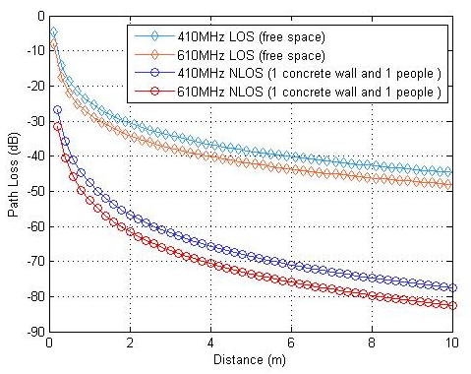
Transmission Model in Hospital Environment
The parameters L_{p}, L₁, L₂ is listed in the following table.
 | L_{p} | L₁ (with thickness of 200mm) | L₂ (with thickness of 42mm)
410MHz | 14dB | 10dB | 3dB
610MHz | 13.5dB | 9dB | 2.3dB
Right figure: Path loss in 400MHz and 600MHz band.
NLOS: Path loss after penetrate 1 concrete wall and 1 people
Path loss of 400MHz and 600MHz band

Slide 24
Simulation in Hospital Environment
The PER simulation result is illustrated in the right figure.
TBD

Slide 25
Conclusion
This proposal includes one dual-data rate PHY structure.
Introduce the major interference CMBB model
Initial Simulation of PER vs SNR + CMBB interference
Introduce the path models in hospital environment
More Simulation are on the way.

