Slide 1
Project: IEEE P802.15 Working Group for Wireless Personal Area Networks (WPANs)
Submission Title: [Elapsed Time of Device Discovery and Spatial Filtering]
Date Submitted: [2012-11-5]
Source: [Byung-Jae Kwak, Sunggeun Kim, Jinkyeong Kim, Seon-Ae Kim, Young-Hoon Kim]
Company: [ETRI, Korea]
Address: bjkwak@etri.re.kr, sgjin@etri.re.kr
Re: []
Abstract: [This document presents benefits of spatial filtering in device discovery]
Purpose: [To discuss the benefit of spatial filtering in PAC]
Notice: This document has been prepared to assist the IEEE P802.15. It is offered as a basis for discussion and is not binding on the contributing individual(s) or organization(s). The material in this document is subject to change in form and content after further study. The contributor(s) reserve(s) the right to add, amend or withdraw material contained herein.
Release: The contributor acknowledges and accepts that this contribution becomes the property of IEEE and may be made publicly available by P802.15.
Slide 1

Slide 2
Contents
Assumptions
Typical Device Discovery
Device Discovery with Spatial Filtering
Discovery Time Analysis
BF for Mobile Devices

Slide 3
Assumptions
Usage scenario: Look and Link (LnL) Communications [1]
Single hop links
Device discovery procedures: Scan-and-select with vs. without spatial filtering
WLAN style CSMA/CA random access for packet transmission
  N_{I}: # of active (trying to access the medium) devices within communication range, not necessarily related to the current device discovery
  N_{R}: # of devices that responds to scan query
  N_{R} ≪ N_{I}

Slide 4
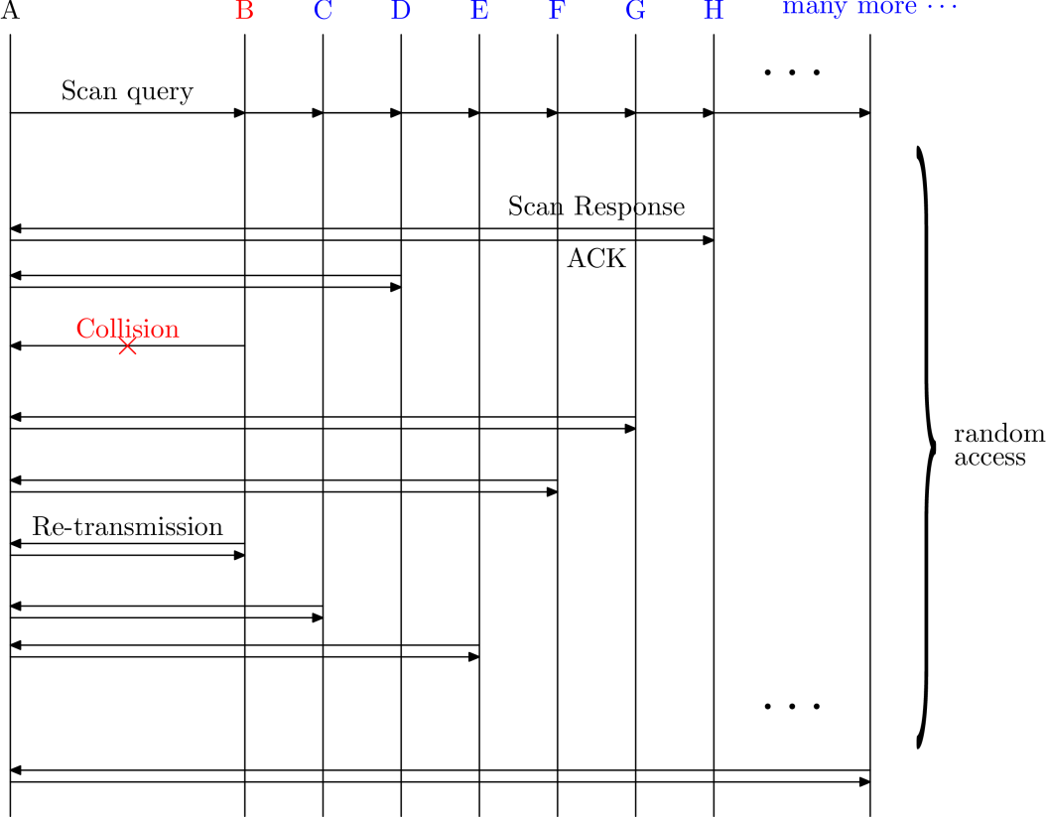
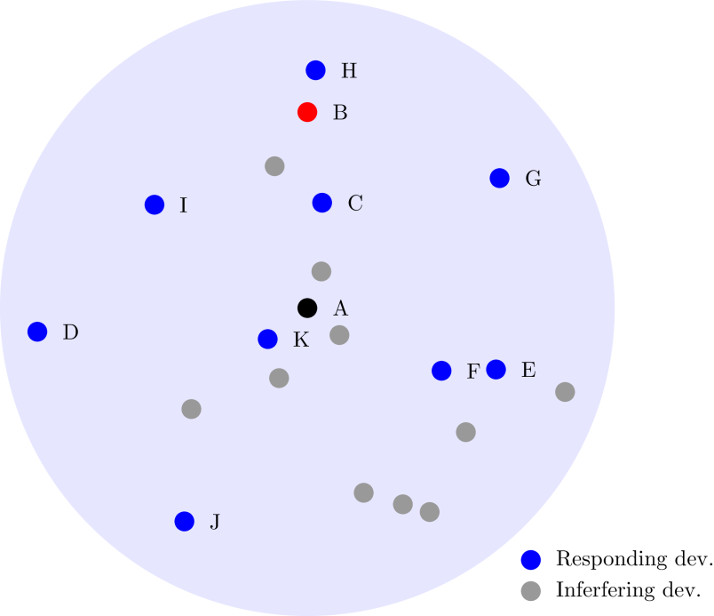
Typical Device Discovery

Slide 5
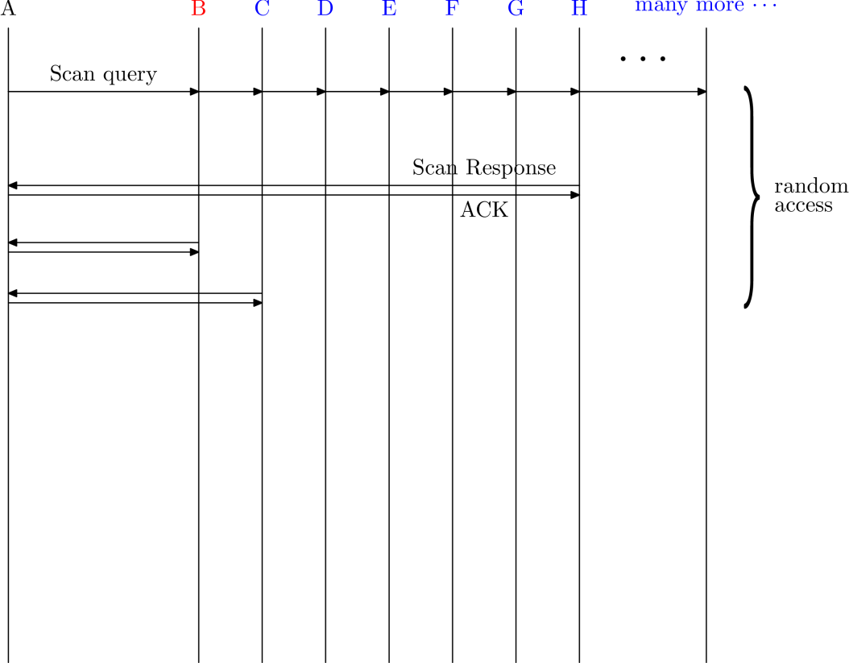
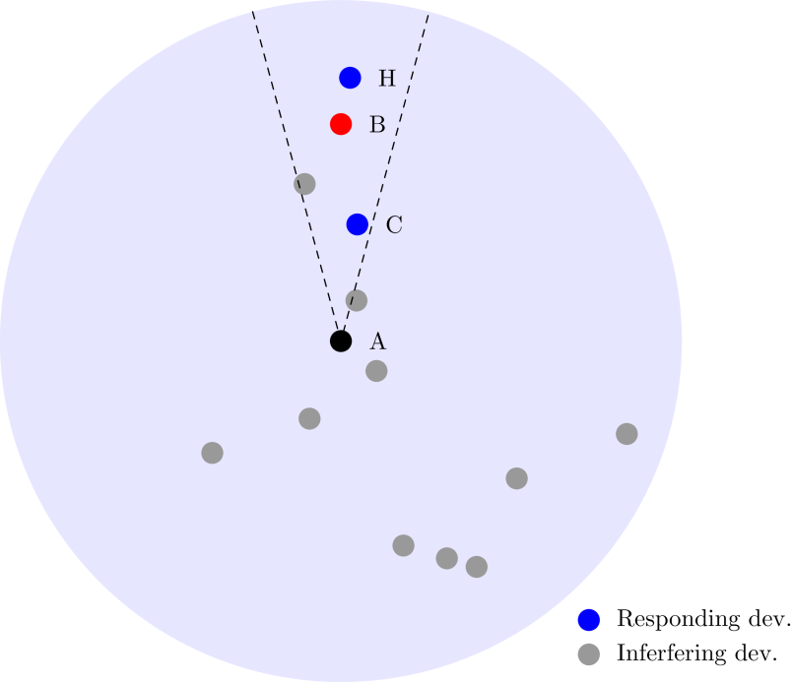
Device Discovery with Spatial Filtering

Slide 6
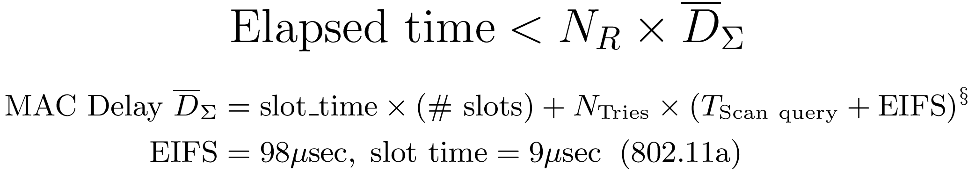
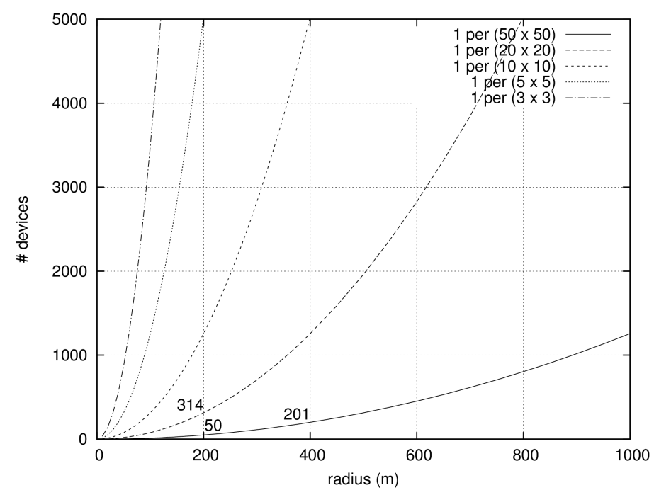
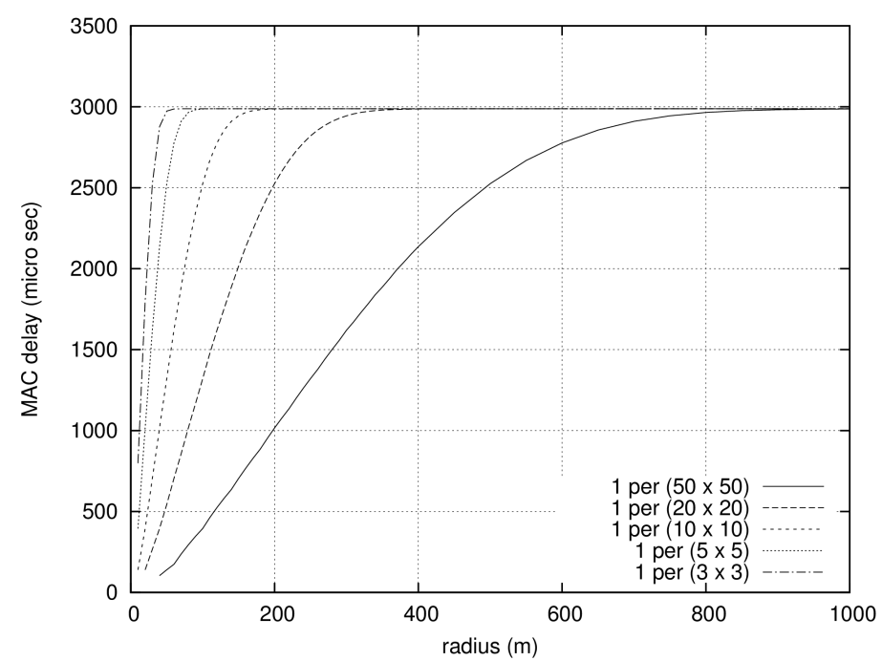
Elapsed Time of Device Discovery
§: Ref. [3]

Slide 7
Is BF Feasible for Mobile Devices? (1/4)
The Myths – Limiting factors of mobile devices to use an array antenna
  Small size:
  “Mobile devices are too small to accommodate an array antenna”
  High mobility:
  “The high mobility of mobile devices makes BF unusable”
  Limited power:
  “Power hungry BF technology is impractical solution for battery powered mobile devices”

Slide 8
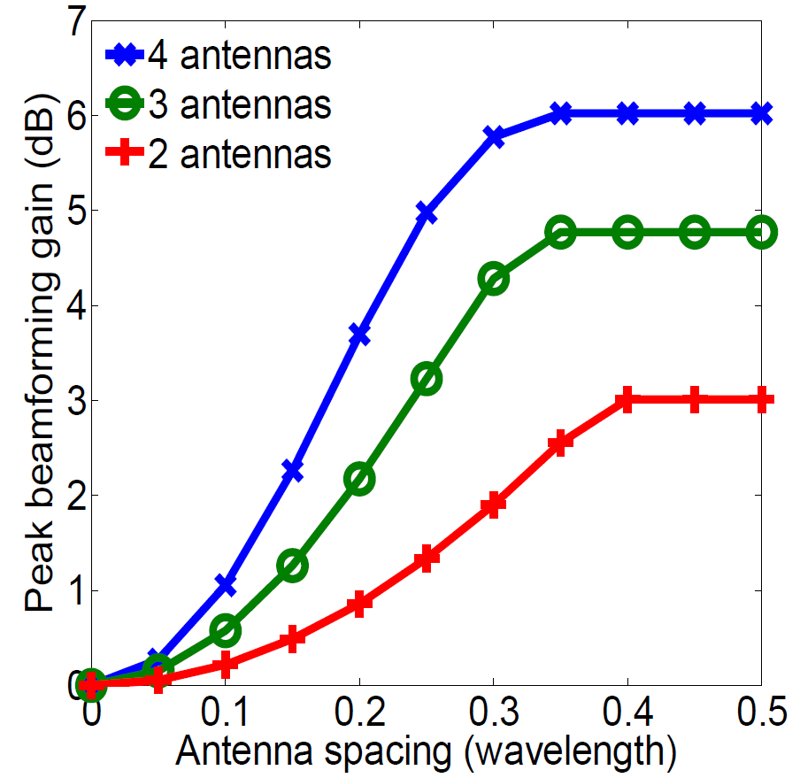
Is BF Feasible for Mobile Devices? (2/4)
Form Factor
  The minimum antenna spacing for maximum BF gain is 0.3λ ~ 0.4 λ
  Small size mobile devices (e.g., smartphones) can accommodate 2 antennas at 2 GHz, and a 4 antenna linear array at 5 GHz.
(Source: [4])

Slide 9
Is BF Feasible for Mobile Devices? (3/4)
Device Mobility
  BF with predefined beam pattern can cope with vehicular mobility very well [5, 6]
  Real-time BF (with CSI feedback) is still effective with reasonable CSI estimation interval [4]

Slide 10
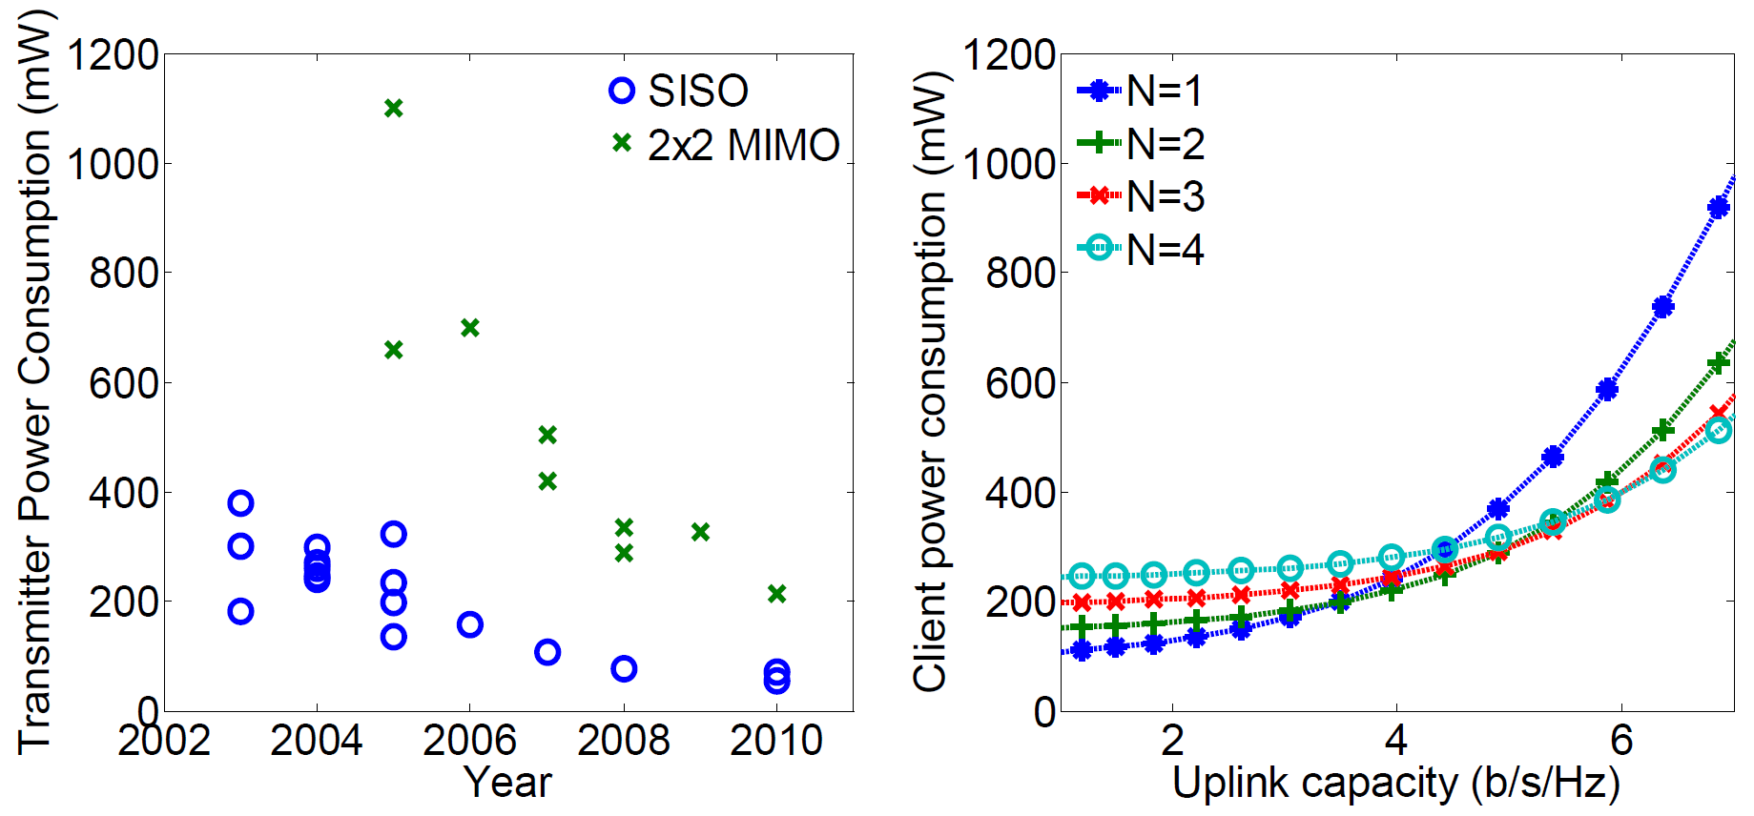
Is BF Feasible for Mobile Devices? (4/4)
Power Efficiency
  Improvement of RF integrated circuits over the years
  BF is more power efficient than a single antenna in delivering higher rate data
(Source: [4])

Slide 11
References
[1] Byung-Jae Kwak et al., “Response to the Call for Applications: Look-and-Link Communication,” IEEE 15-12-0227-01-0008, May 2012.
[2] Byung-Jae Kwak et al., “Challenges in PAC,” IEEE 15-12-0411-01-0008, July 2012.
[3] Byung-Jae Kwak, Nah-Oak Song, Leonard E. Miller, “Performance Analysis of Exponential Backoff,” IEEE/ACM Trans. Networking, vol. 13, no. 2, April 2005.
[4] Hang Yu, Lin Zhong, Ashutosh, Sabharwal, David Kao, “Beamforming on Mobile Devices: A First Study,” in Proc. MobiCom 2011, 2011.
[5] V. Navda, A. P. Subramanian, K. Dhanasekaran, A. Timm-Giel, S. Das, “MobiSteer: using steerable beam directional antenna for vehicular network access,” in Proc. MobiSys 2007, 2007.
[6] K. Ramachandran, R. Kokku, K. Sundaresan, M. Gruteser, S. Rangarajan, “R2D2: regulating beam shape and rate as directionality meets diversity,” in Proc. MobiSys 2009, 2009.
[7] Igor Dotlic, Huan-Bang Li, Marco Hernadnez, “Possibility of using antenna arrays in IEEE 802.15.8,” IEEE 802.15-12-0409-01-0008, July 2012.

Slide 12
Thank You!

