Slide 1
Project: IEEE P802.15 Working Group for Wireless Personal Area Networks (WPANs)
Submission Title: [Secure Access to WPAN using Mobile Phone ]
Date Submitted: [ Nov, 2012]
Source: [Zhao Junhui] Company [China Mobile Communication Corporation]
Address [32 Xuanwumen West Street, Beijing, China]
Voice:[+86 10 5268 6688], E-Mail:[zhaojunhui@chinamobile.com]
Re: [This is the original document]
Abstract: [This documents describes demand and possible ideas of secure access to WPAN using mobile phone.]
Purpose: [To present a potential application demand of convergence of WPAN and telecom network.]
Notice: This document has been prepared to assist the IEEE P802.15. It is offered as a basis for discussion and is not binding on the contributing individual(s) or organization(s). The material in this document is subject to change in form and content after further study. The contributor(s) reserve(s) the right to add, amend or withdraw material contained herein.
Release: The contributor acknowledges and accepts that this contribution becomes the property of IEEE and may be made publicly available by P802.15.

Slide 2
Secure Access to WPAN using Mobile Phone
Zhao Junhui
China Mobile Communication Corporation

Slide 3
Contents
Application Demand
Security Problem
Solution Proposal

Slide 4
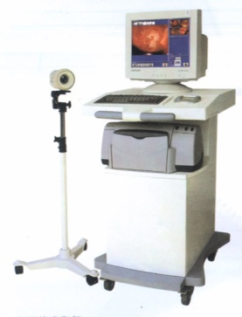
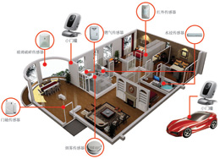
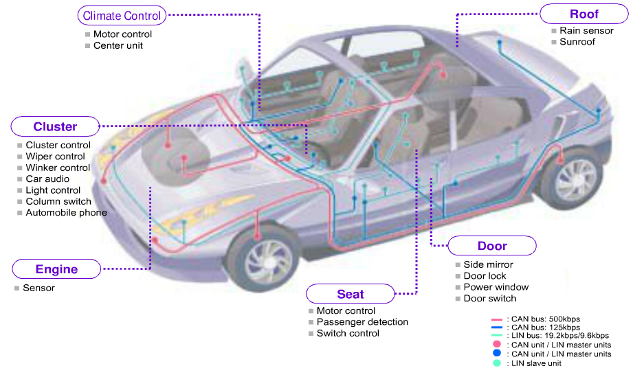
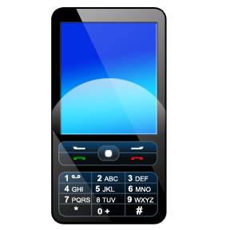
Application Demand
The convergence of telecom network and WPAN is a promising way to generate many novel and useful services to users.
Telecom network is popular and widely used by ordinary people.
WPAN provides capabilities for M2M, IOT applications.
Access to WPAN by Mobile Phone
Home Network
Healthcare Device
SNS
Gaming
Vehicle OBU
… …

Slide 5
Security Problem
Mobile phone authentication and authorization to access WPAN with high security.
Data exchange between mobile phone and WPAN with high security.

Slide 6
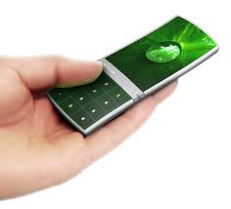
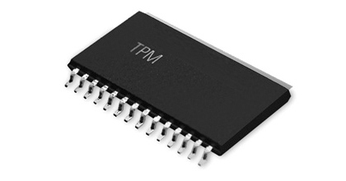
Possible Solution
Password Check
Mobile phone and WPAN share same password
User input password when accessing WPAN
Problem: Low Security, manual input
PKI (Secure Chip)
Mobile phone uses private key to generate digital signature
Private key needs to be stored in a secure chip
Problem: High cost
1%2671#!.4.@2!5

Slide 7
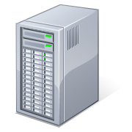
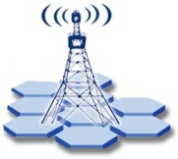
Access Control via SIM Authentication
WPAN
Coordinator
2G/3G/LTE
Authentication
Agent
Short Range Communication
Telecom Network
HLR
Mobile Phone
Coordinator in WPAN acts as gateway between mobile phone and WPAN
Coordinator adds telecom communication capability.

Slide 8
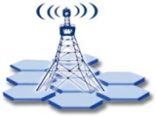
Working Flow
Mobile Phone
Agent
HLR
Coordinator
Send IMSI
Request RAND authentication (IMSI)
Authentication (RAND, Kc, SRES)
Send RAND back
Request RAND Authentication
Send SRES
Send SRES
Return Result
Return Result
(Kc)
Kc can be used for data exchange encryption between mobile phone and WPAN.

Slide 9
Summary
Convergence between telecom and WPAN can bring out many promising services to users.
A proposal of utilizing SIM authentication for secure accessing WPAN is presented.
Next Step
Clarify the new functions to be added to Coordinator
Define the communication protocol between Mobile Phone and Coordinator.

Slide 10
Thank You!

